Slide 1
Hidden Markov Models
Dave DeBarr
ddebarr@gmu.edu

Slide 2
Overview
General Characteristics
Simple Example
Speech Recognition

Slide 3

Andrei Markov
Russian statistician (1856 – 1922)
Studied temporal probability models
Markov assumption
  State_{t} depends only on a bounded subset of State_{0:t-1}
First-order Markov process
  P(State_{t} | State_{0:t-1}) = P(State_{t} | State_{t-1})
Second-order Markov process
  P(State_{t} | State_{0:t-1}) = P(State_{t} | State_{t-2:t-1})

Slide 4
Hidden Markov Model (HMM)
Evidence can be observed, but the state is hidden
Three components
  Priors (initial state probabilities)
  State transition model
  Evidence observation model
Changes are assumed to be caused by a stationary process
  The transition and observation models do not change

Slide 5
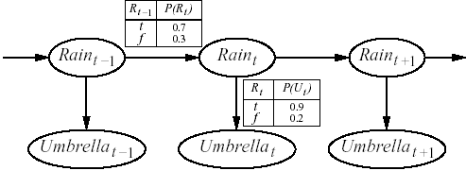
Simple HMM
Security guard resides in underground facility (with no way to see if it is raining)
Wants to determine the probability of rain given whether the director brings an umbrella
P(Rain₀ = t) = 0.50

Slide 6
What can you do with an HMM?
Filtering
  P(State_{t} | Evidence_{1:t})
Prediction
  P(State_{t+k} | Evidence_{1:t})
Smoothing
  P(State_{k} | Evidence_{1:t})
Most likely explanation
  argmax_{State1:t} P(State_{1:t} | Evidence_{1:t})

Slide 7
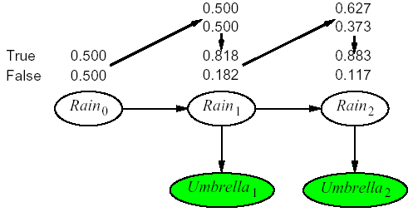
Filtering
(the forward algorithm)
P(Rain₁ = t)
= Σ_{Rain0} P(Rain₁ = t | Rain₀) P(Rain₀)
=0.70 * 0.50 + 0.30 * 0.50 = 0.50
P(Rain₁ = t | Umbrella₁ = t)
= α P(Umbrella₁ = t | Rain₁ = t) P(Rain₁ = t)
= α * 0.90 * 0.50 = α *0.45 ≈ 0.818
P(Rain₂ = t | Umbrella₁ = t)
= Σ_{Rain1} P(Rain₂ = t | Rain₁) P(Rain₁ | Umbrella₁ = t)
= 0.70 * 0.818 + 0.30 * 0.182 ≈ 0.627
P(Rain₂ = t | Umbrella₁ = t, Umbrella₂ = t)
= α P(Umbrella₂ = t | Rain₂ = t) P(Rain₂ = t | Umbrella₁ = t)
= α * 0.90 * 0.627 ≈ α * 0.564 ≈ 0.883

Slide 8
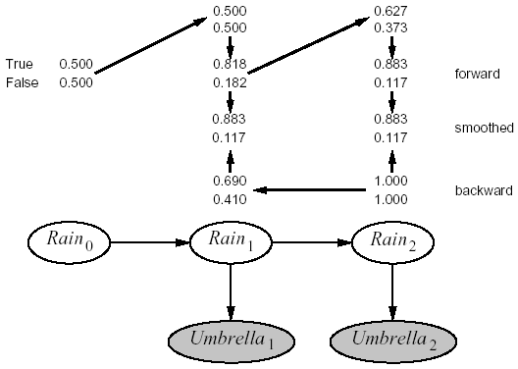
Smoothing
(the forward-backward algorithm)
P(Umbrella₂ = t | Rain₁ = t)
= Σ_{Rain2} P(Umbrella₂ = t | Rain₂) P(* | Rain₂) P(Rain₂ | Rain₁ = t)
= 0.9 * 1.0 * 0.7 + 0.2 * 1.0 * 0.3 = 0.69
P(Rain₁ = t | Umbrella₁ = t, Umbrella₂ = t)
= α * 0.818 * 0.69 ≈ α * 0.56 ≈ 0.883

Slide 9
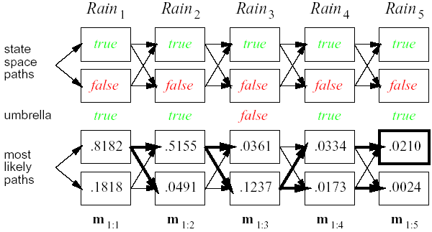
Most Likely Explanation
(the Viterbi algorithm)
P(Rain₁ = t, Rain₂ = t | Umbrella₁ = t, Umbrella₂ = t)
= P(Umbrella₁ = t | Rain₁ = t)
* P(Rain₂ = t | Rain₁ = t)
* P (Umbrella₂ = t | Rain₂ = t)
= 0.818 * 0.70 * 0.90 ≈ 0.515

Slide 10
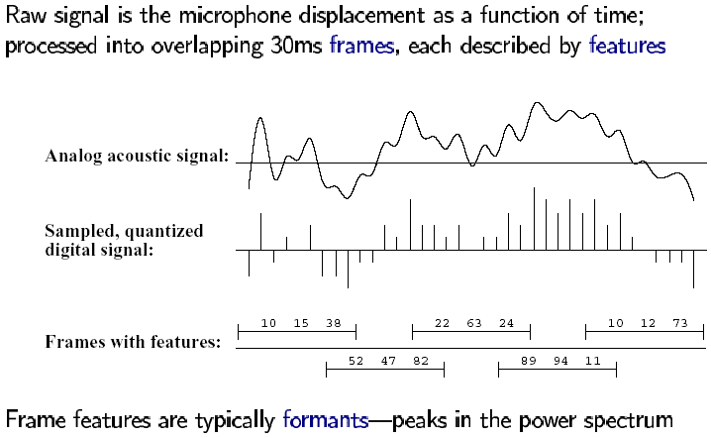
Speech Recognition
(signal preprocessing)

Slide 11
Speech Recognition
(models)
P(Words | Signal) = α P(Signal | Words) P(Words)
Decomposes into an acoustic model and a language model
  Ceiling or Sealing
  High ceiling or High sealing
A state in a continuous speech HMM may be labeled with a phone, a phone state, and a word

Slide 12
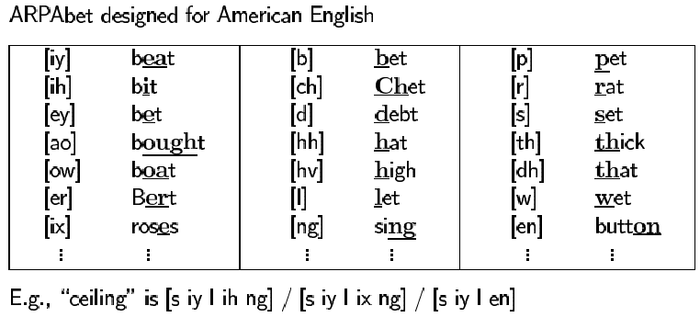
Speech Recognition
(phones)
Human languages use a limited repertoire of sounds

Slide 13
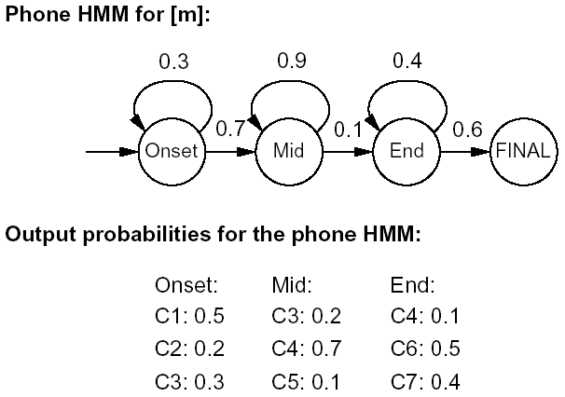
Speech Recognition
(phone model)
Acoustic signal for [t]
  Silent beginning
  Small explosion in the middle
  (Usually) Hissing at the end

Slide 14
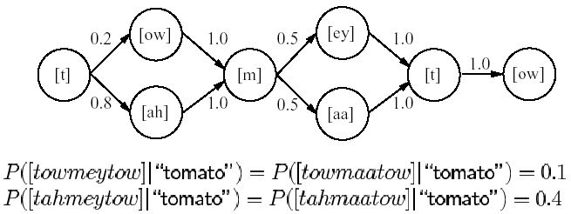
Speech Recognition
(pronounciation model)
Coarticulation and dialect variations

Slide 15
Speech Recognition
(language model)
Can be as simple as bigrams
  P(Word_{i} | Word_{1:i-1}) = P(Word_{i} | Word_{i-1})

Slide 16
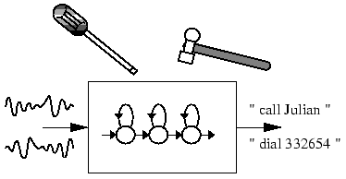
References
Artificial Intelligence: A Modern Approach
  Second Edition (2003)
  Stuart Russell & Peter Norvig
Hidden Markov Model Toolkit (HTK)
  http://htk.eng.cam.ac.uk/
  Nice tutorial (from data prep to evaluation)

