Slide 1
WELCOME TO MY PRESENTATION
1

Slide 2

Republic of Cameroon
Peace– Work – Fatherland
Republic of Cameroon
Peace– Work – Fatherland
AFRICAN INSTITUTE OF COMPUTER SCIENCE
BP 13719 Yaounde (Cameroon)
Tel :( 237) 242 72 99 57 / 242 72 99 58
Site: www.iaicameroun.com
E-mail : contact@iaicameroun.com
AFRICAN INSTITUTE OF COMPUTER SCIENCE
BP 13719 Yaounde (Cameroon)
Tel :( 237) 242 72 99 57 / 242 72 99 58
Site: www.iaicameroun.com
E-mail : contact@iaicameroun.com
PERSONAL PROJECT
THEME
DIGITALIZATION OF THE CLINICAL PRACTICES IN THE INTENSIVE CARE SERVICE:CASE OF THE YAOUNDE GENERAL HOSPITAL
Presented By:
HOUMWEIN BLAG Helene
Academic supervisor:
Mrs. TCHOUTHOUO Emmanuelle Isabelle
Lecturer at AICS-Cameroon, Paul Biya Technological Center of Excellence
Academic Year 2024/2025
2

Slide 3

PLAN
1
INTRODUCTION
CONTEXT AND CRITICISM OF THE EXISTING
2
3
PROBLEMATIC AND SOLUTIONS PROPOSED
4
METHODOLOGY AND ARCHITECTURE USED
5
TECHNOLOGY USED
6
DEMONSTRATION
7
CONCLUSION AND OUTLOOK
3

Slide 4
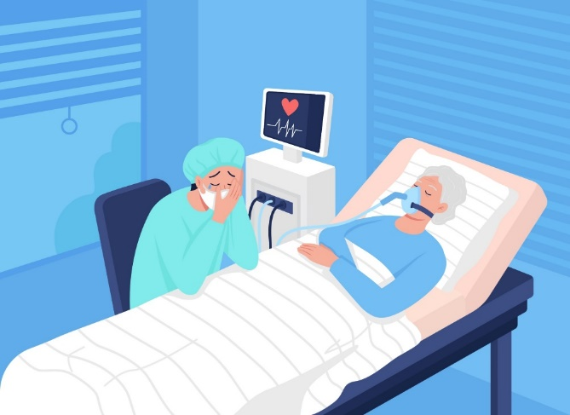
2
CONTEXT AND CRITICISM OF THE EXISTING
HANDWRITTEN PRESCRIPTION OF THE PATIENTS;
HANDWRITTEN COMPLETION OF THE PATIENT MONITORING FORM;
HANDWRITTEN COMPLETION OF THE IDENTIFICATION FORM FOR THE MEDICATIONS USED.
LACK OF DEVICES OR MATERIALS
Complications: one of the most commonly used therapy in intensive care is mechanical ventilation; its simple absence can cause numerous complications such as pneumonia. Thus, increasing the probability of death
Loss of the prescription or follow-up sheets that could cause confusion about the treatment that the patient should normally receive.
PREPARATION OF PRO FORMA INVOICES
(PHYSICAL DOCUMENT)
EVERY MORNING.
PHYSICAL MEDICAL FILE
In the event of loss of the patient's medical file, it would be impossible to have access to the patient's medical history, thus leading to a wrong diagnosis by the doctor, which could lead to the administration of the wrong treatment.
repetitive tasks leading to wasted time
• LACK OF FLUID AND DIRECT COMMUNICATION BETWEEN T
HE NURSE AND THE MEDICAL STAFF
• POOR COORDINATION OF CARE BETWEEN THE MEDICAL STAFF
DELAY DURING EMERGENCY INTERVENTIONS
BY HEALTHCARE TEAMS.
A patient requiring emergency treatment due to a complication could risk losing their life while waiting to notify the team capable of caring for them
Poor transmission of information causing errors in medical prescriptions and in the administration of care.
6

Slide 5
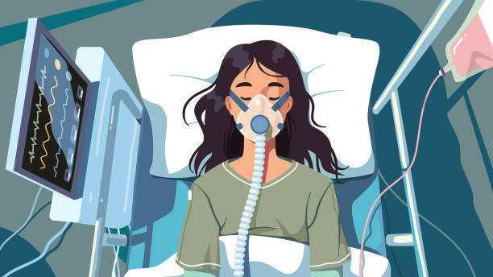
3
PROBLEMATIC AND SOLUTIONS
HOW CAN THE DIGITALIZATION OF CLINICAL PRACTICES IMPROVE THE QUALITY OF CARE IN INTENSIVE CARE WHILE GUARANTEEING THE SECURITY AND CONFIDENTIALITY OF PATIENT DATA?
8

Slide 6


SOLUTIONS PROPOSED
Poor transmission of information causing errors in medical prescriptions and in the administration of care.
repetitive tasks leading to wasted time
In the event of loss of the patient's medical file, it would be impossible to have access to the patient's medical history, thus leading to a wrong diagnosis by the doctor, which could lead to the administration of the wrong treatment.
Loss of the prescription or follow-up sheets that could cause confusion about the treatment that the patient should normally receive.
Make available to users a catalog of all the essential machines in the intensive care unit.
7

Slide 7
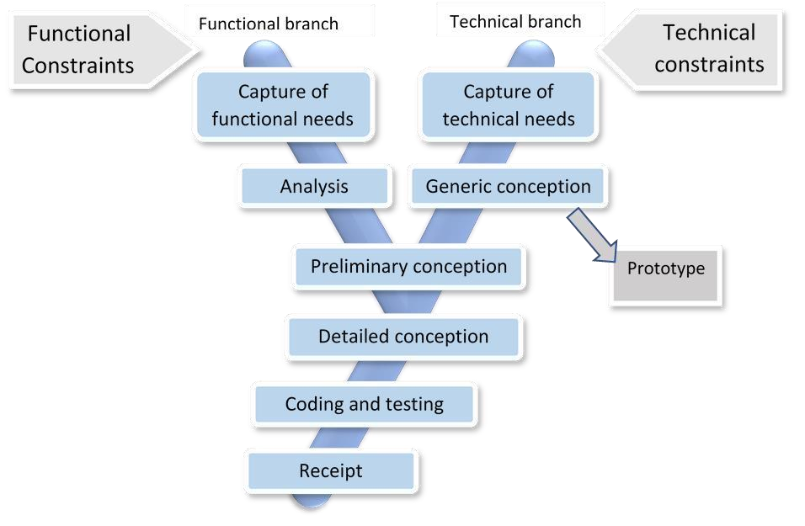
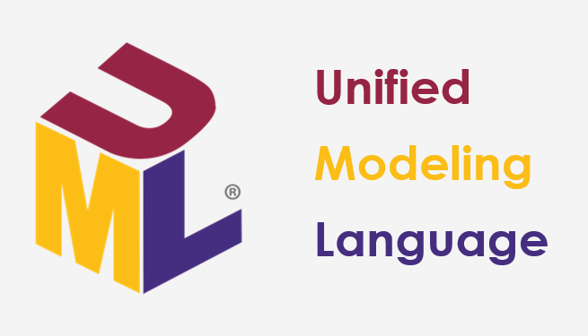
4
METHODOLOGY AND ARCHITECTURE USED
MODELING TOOLS
2TUP
9

Slide 8
PRESENTATION OF DIAGRAMS
USE CASE DIAGRAM
10

Slide 9
CONSULT MEDICAL FILE
SEQUENCE DIAGRAM
11

Slide 10
REGISTER PATIENT
ACTIVITY DIAGRAM
12

Slide 11
CLASS DIAGRAM
13

Slide 12
DEPLOYMENT DIAGRAM
14

Slide 13
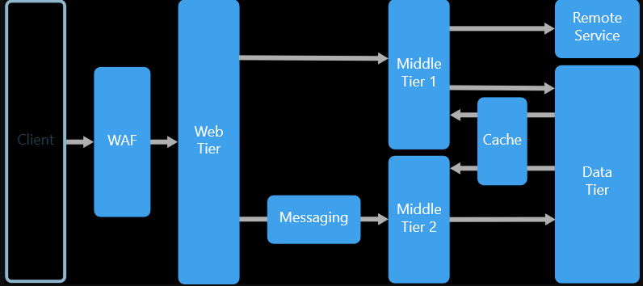
ARCHITCTURE
PHYSICAL ARCHITECHTURE
15

Slide 14
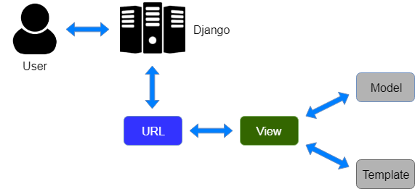
ARCHITCTURE
WE WILL BASE OUR APPLICATION LOGIC ON THE VIEW TEMPLATE (MVT) PATTERN, A VARIATION OF THE MVC (MODEL-VIEW-CONTROLLER) DESIGN PATTERN THAT IS COMMONLY USED IN WEB APPLICATION DEVELOPMENT, PARTICULARLY WITH FRAMEWORKS SUCH AS DJANGO (FOR PYTHON) OR RUBY ON RAILS (FOR RUBY). THIS APPROACH IS PRIMARILY ASSOCIATED WITH DJANGO.
ARCHITECHTURE LOGIC
0
16

Slide 15





5
TECHNOLOGY USES
Software environment
Visual Studio Code:
Gantt Project:
PowerAMC:
Google chrome:
Git:
Lightweight integrated development environment (IDE) for coding, debugging, and managing projects in various languages.
Version control system to manage code changes and facilitate collaboration between developers.
Project management tool to create Gantt charts, plan tasks and track progress.
Web browser for testing and deploying web applications
Modeling tool for designing databases and information systems (UML, MCD, MLD models).
17

Slide 16
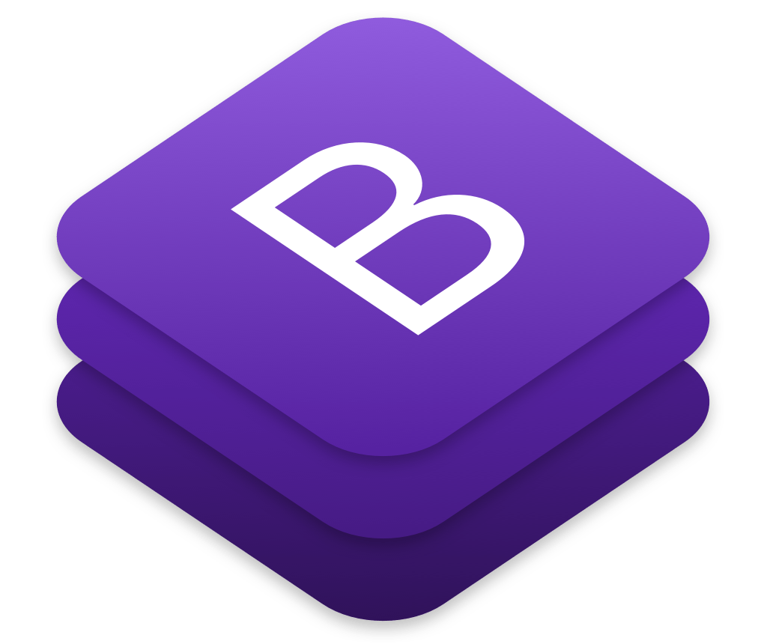



Web technologies used
FRONT-END TECHNOLOGIES
Bootstrap:
JavaScript:
HTML:
CSS:
CSS framework for designing responsive and attractive web interfaces quickly with pre-built components.
Programming language for adding dynamic interactions and functionality to web pages.
Standard markup language for structuring the content of web pages.
Cascading Style Sheets to visually style and arrange web pages.
10
18

Slide 17



BACK-END TECHNOLOGIES
Twilio:
Django:
Python :
API communication platform to integrate messaging, calling, and video features into applications..
Django: Python web framework for developing secure and scalable web applications quickly.
Versatile programming language used for web development,automation,data science and artificial intelligence
10
18

Slide 18

6
DEMONSTRATION
19

Slide 19

OUTLOOK
Automation of monitoring sheet and identification sheet so that they can be generated and used in Word format and be consult by doctor
Integration of the call API to enable direct voice communication between medical staff members
Improvement of the chat module to make it fully operational and provide a better user experience
21

Slide 20


THANK YOU FOR YOUR KIND ATTENTION
22

