Slide 1
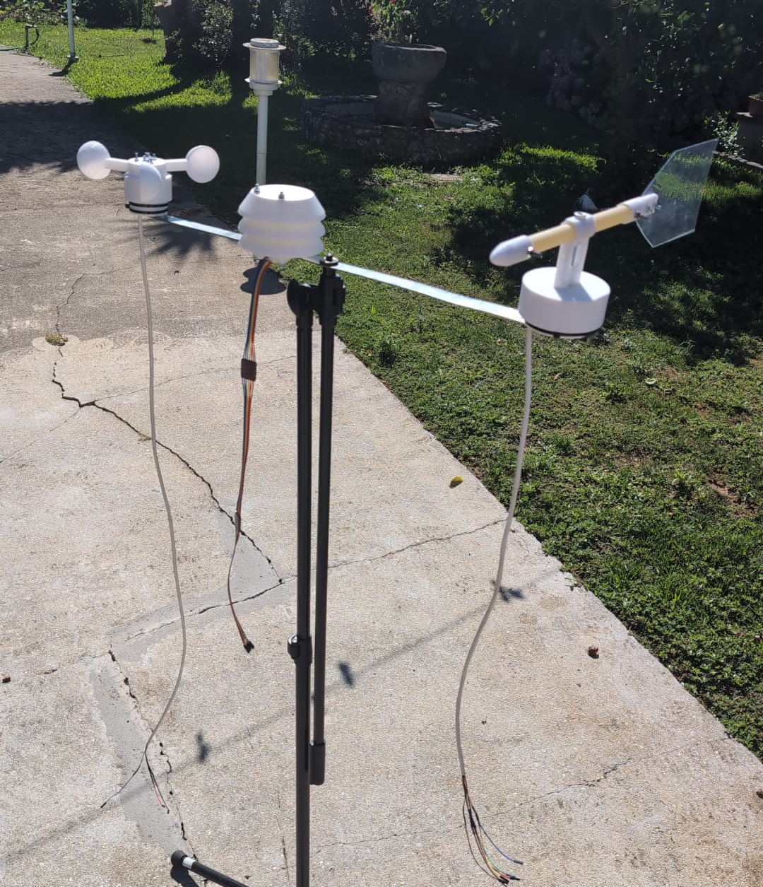

Weather Station
Francisco Ribeiro - 107993
Miguel Vila - 107276
Embedded Systems Architectures
Notes:
Vila

Slide 2
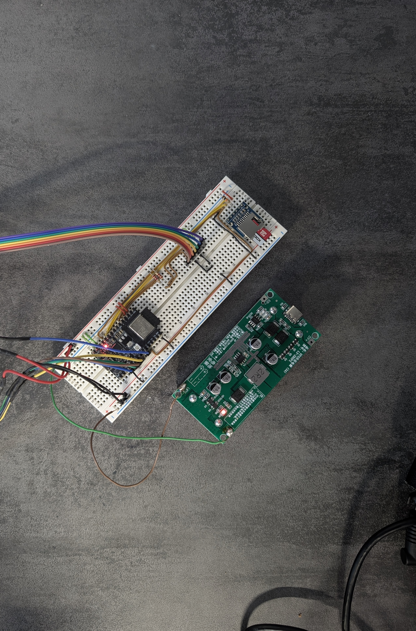
Introduction
What is this project?
Real-time data collection for temperature, humidity, pressure, wind speed & direction with autonomous operation with local storage and cloud connectivity.
Real-life Applications
Climate Awareness: Growing need for localized weather data in climate change era;
Precision Agriculture: Need for micro-climate data for optimal crop management;
Research & Education: Accessible platform for meteorological studies.
Technical Highlights
Multi-sensor Integration: BME280 + Custom made wind sensors in unified system;
Dual Data Strategy: Local SD card backup + Cloud MQTT publishing;
Configurable Connectivity: WiFi and MQTT settings via SD card;
Power Failure Resilient: Can be powered by batteries, solar panels and USB-C;
Notes:
Vila

Slide 3
Introduction
Problem Statement
Commercial weather stations are expensive ($500+), need for affordable alternatives;
Many areas lack adequate weather monitoring coverage
Our Propositions
Cost-Effective: Fraction of commercial station cost
Open Source: Fully customizable and extensible
Scalable: Easy to deploy multiple units for coverage networks
Target Applications
Agricultural monitoring systems
Weather enthusiast networks
IoT development learning platform
Notes:
Vila

Slide 4
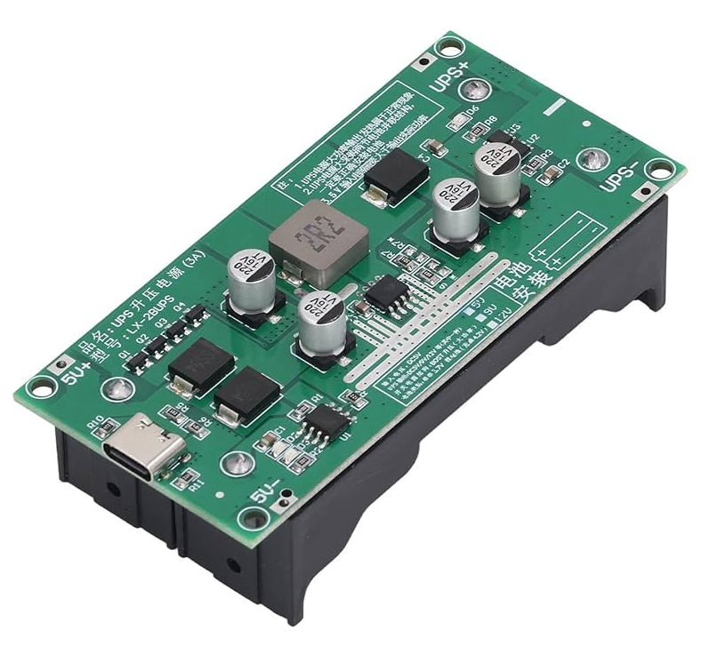
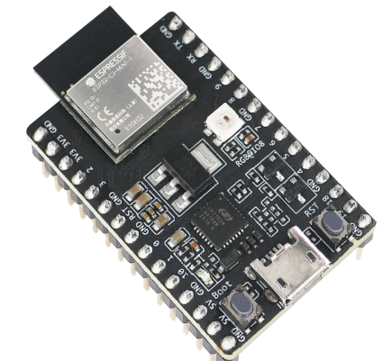
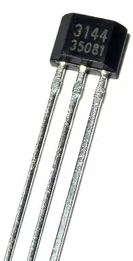
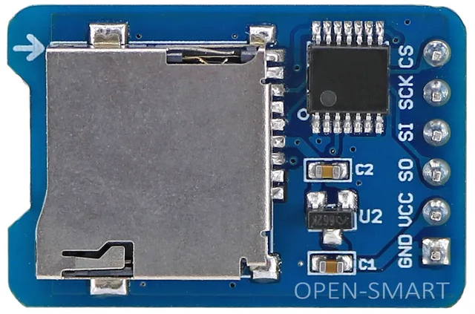
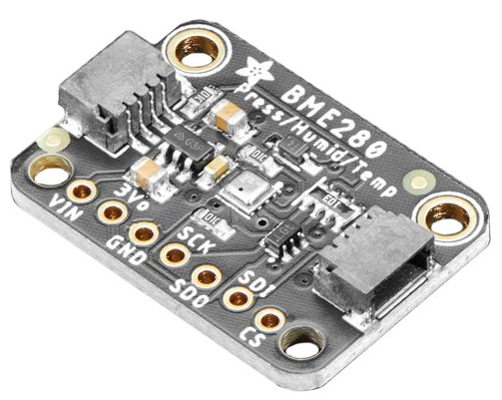
SW & HW Stack
Hardware
ESP32-C3 SoC
SPI SD Card Reader
A3144 Hall Effect Sensor (latch & non latch variant)
18650 Lithium Battery UPS module
BME280
Software
ESP-IDF
FreeRTOS
MQTT
WiFi
Grafana
Notes:
Francisco

Slide 5
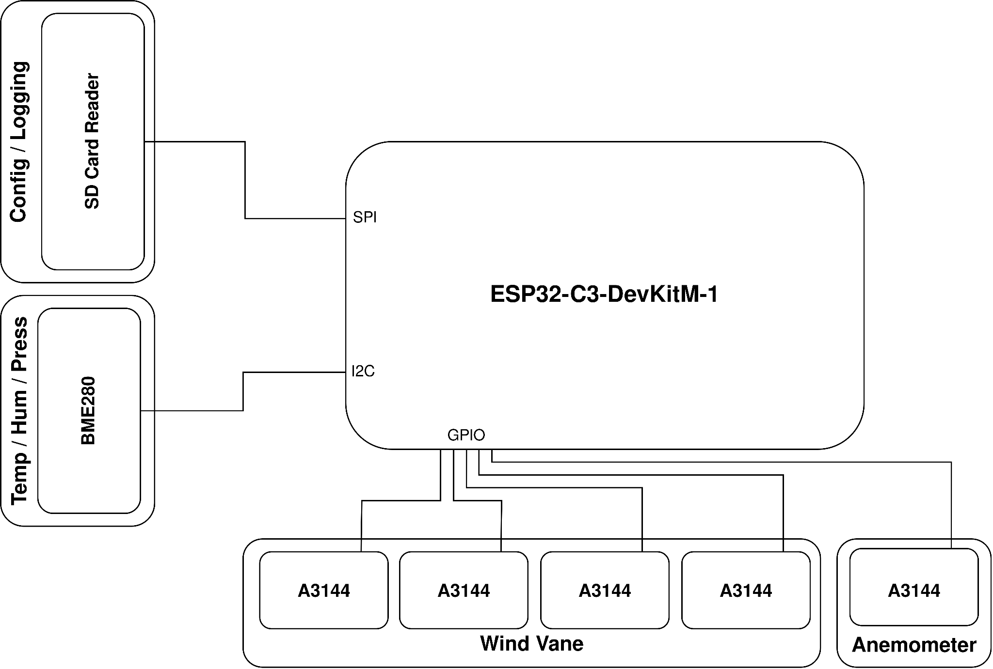
Hardware Architecture
Notes:
Francisco

Slide 6
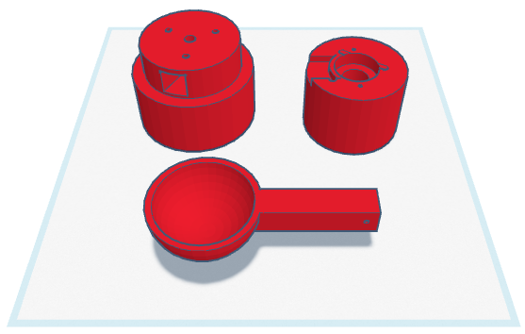
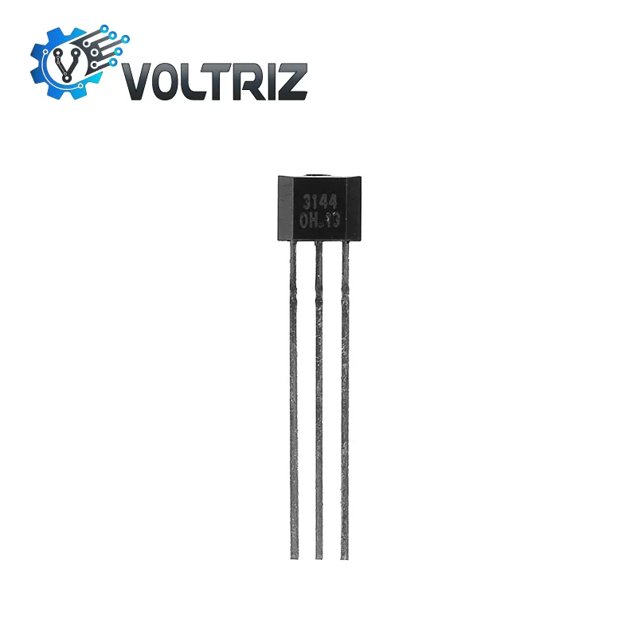
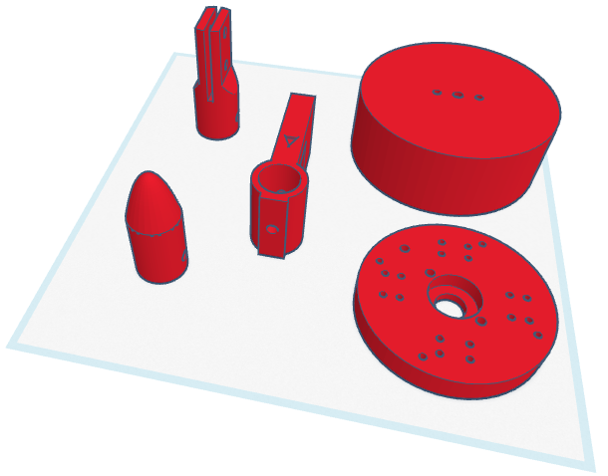
Custom-Made
Sensors
N
NW
NE
W
E
SW
SE
S
Notes:
Vila

Slide 7
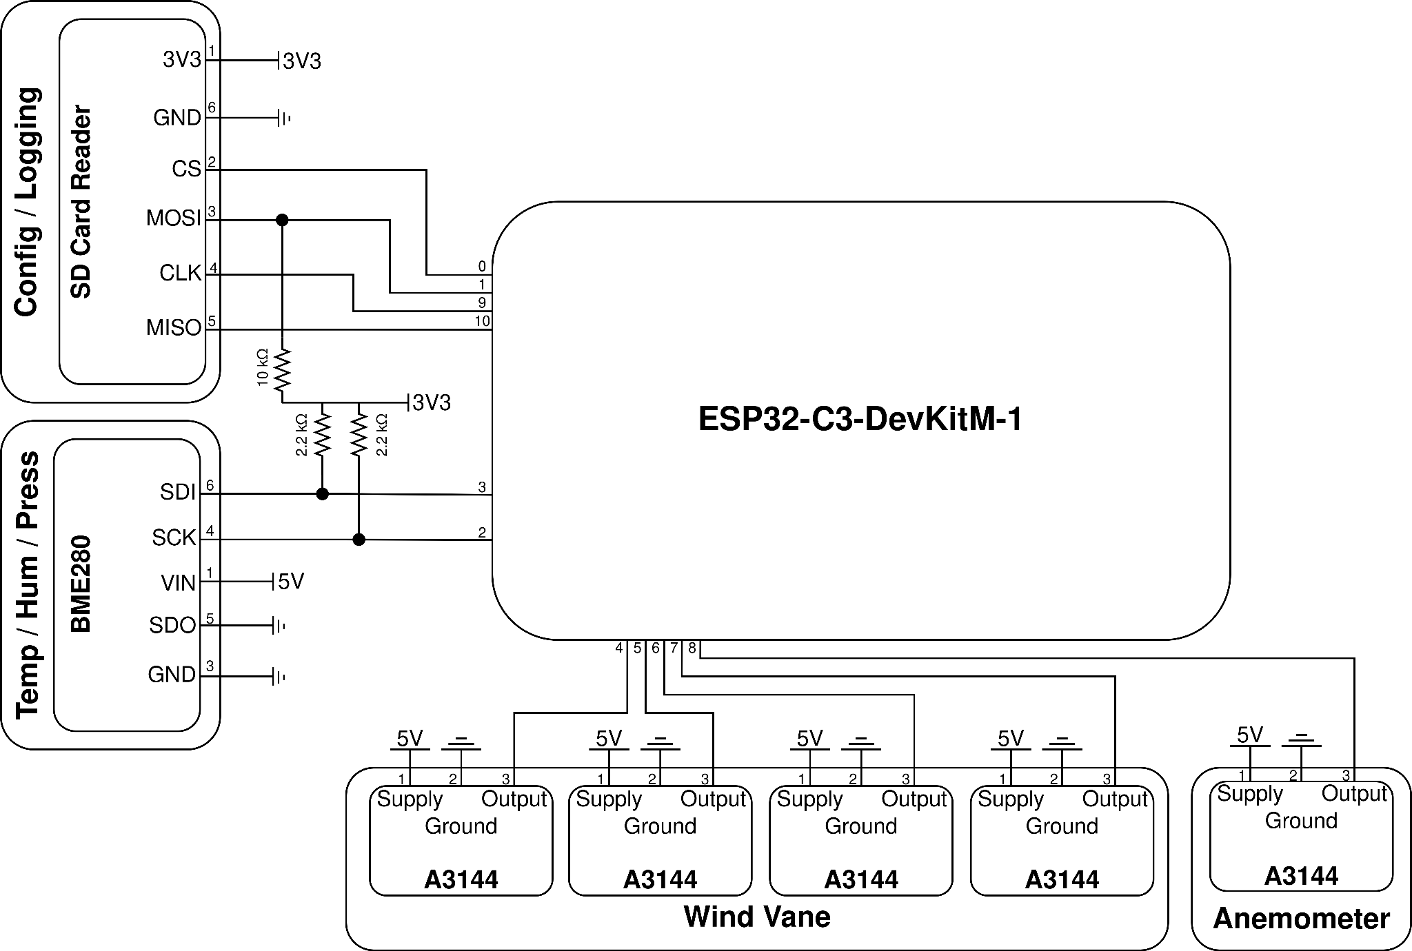
Electrical Schematic
Notes:
Francisco

Slide 8
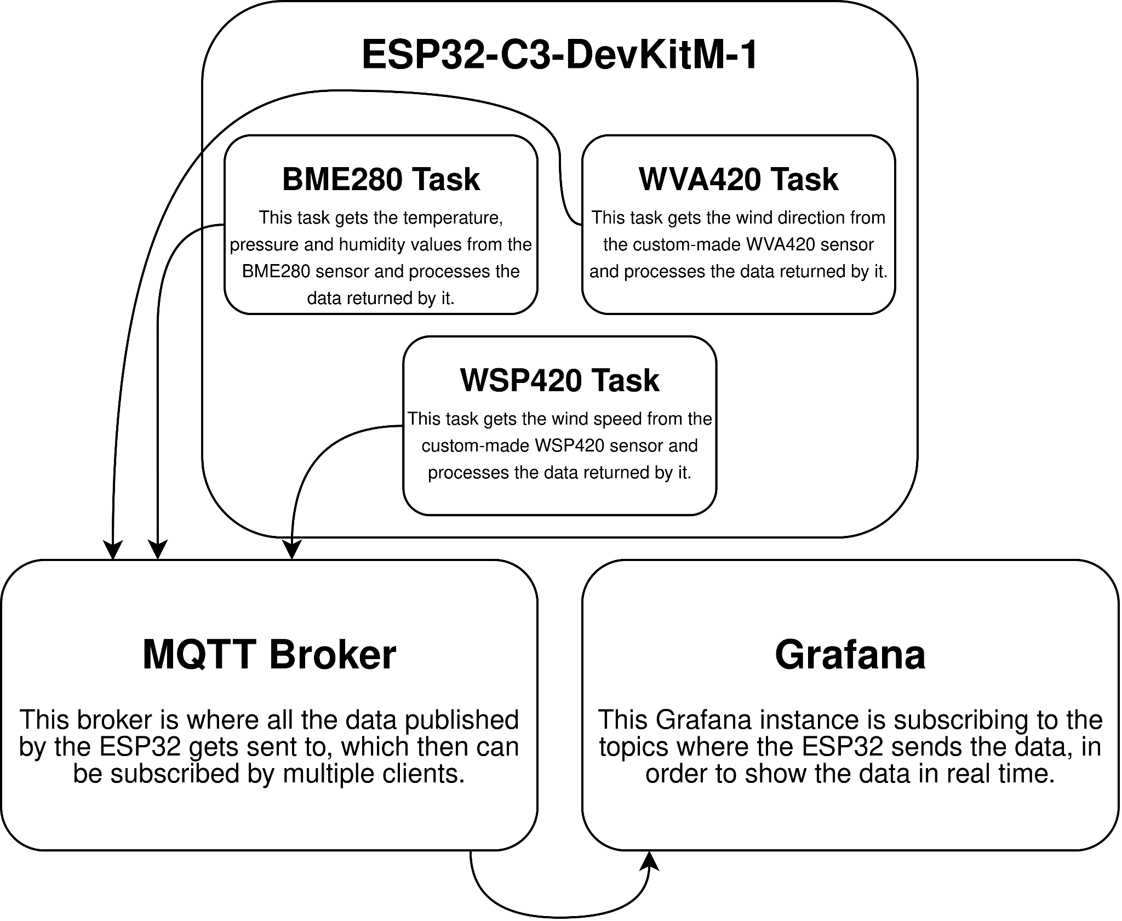
Software Architecture
Notes:
Francisco

Slide 9
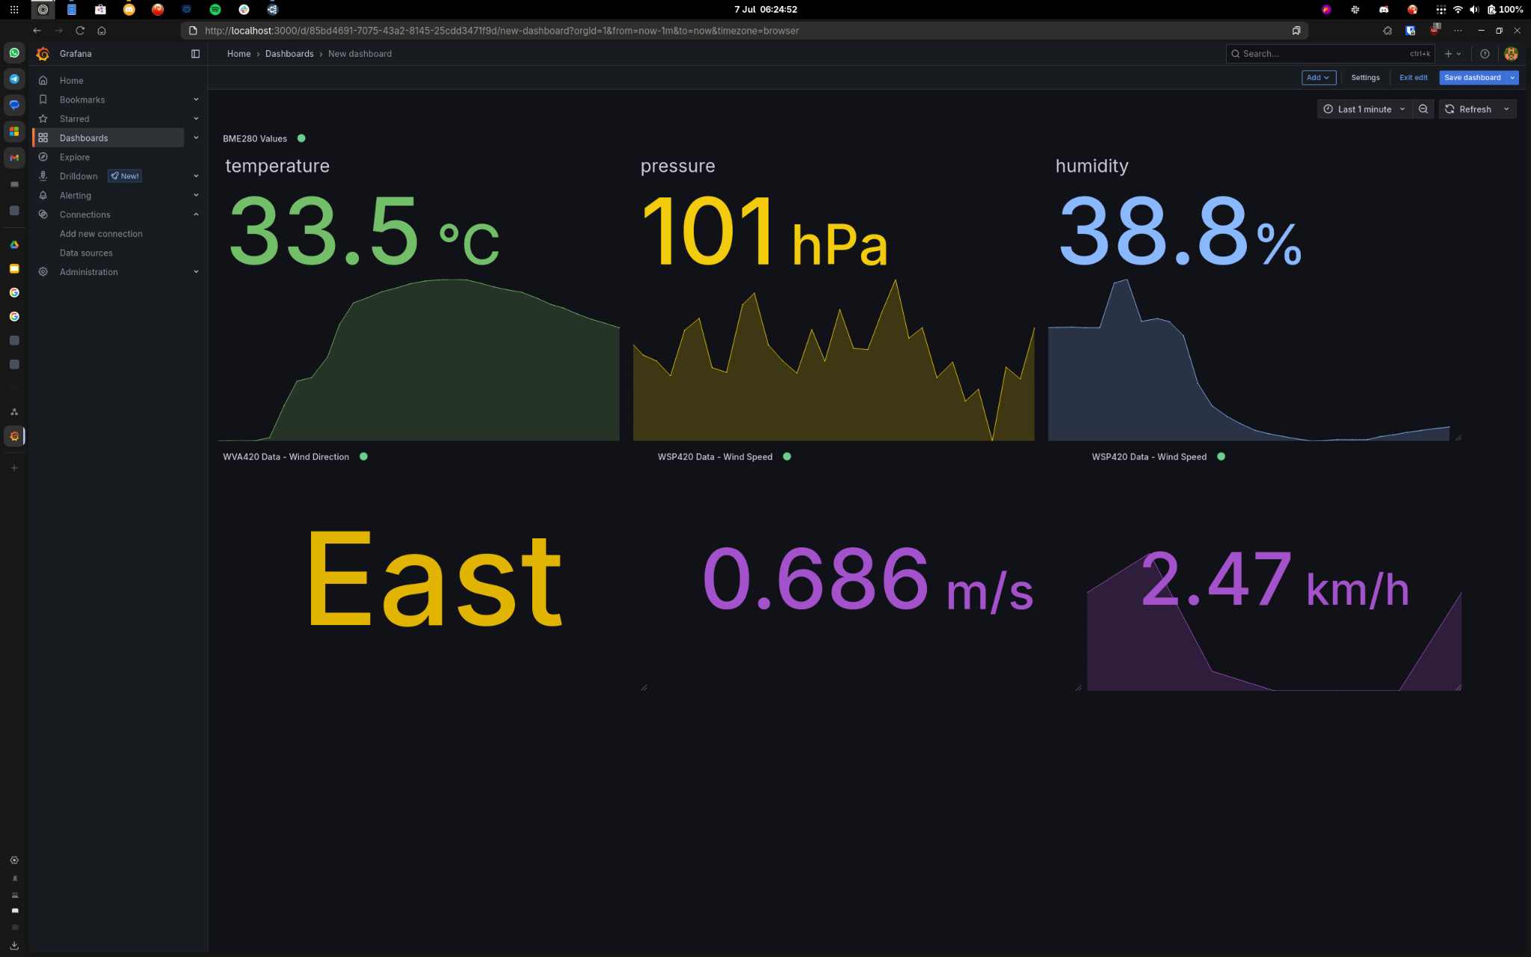
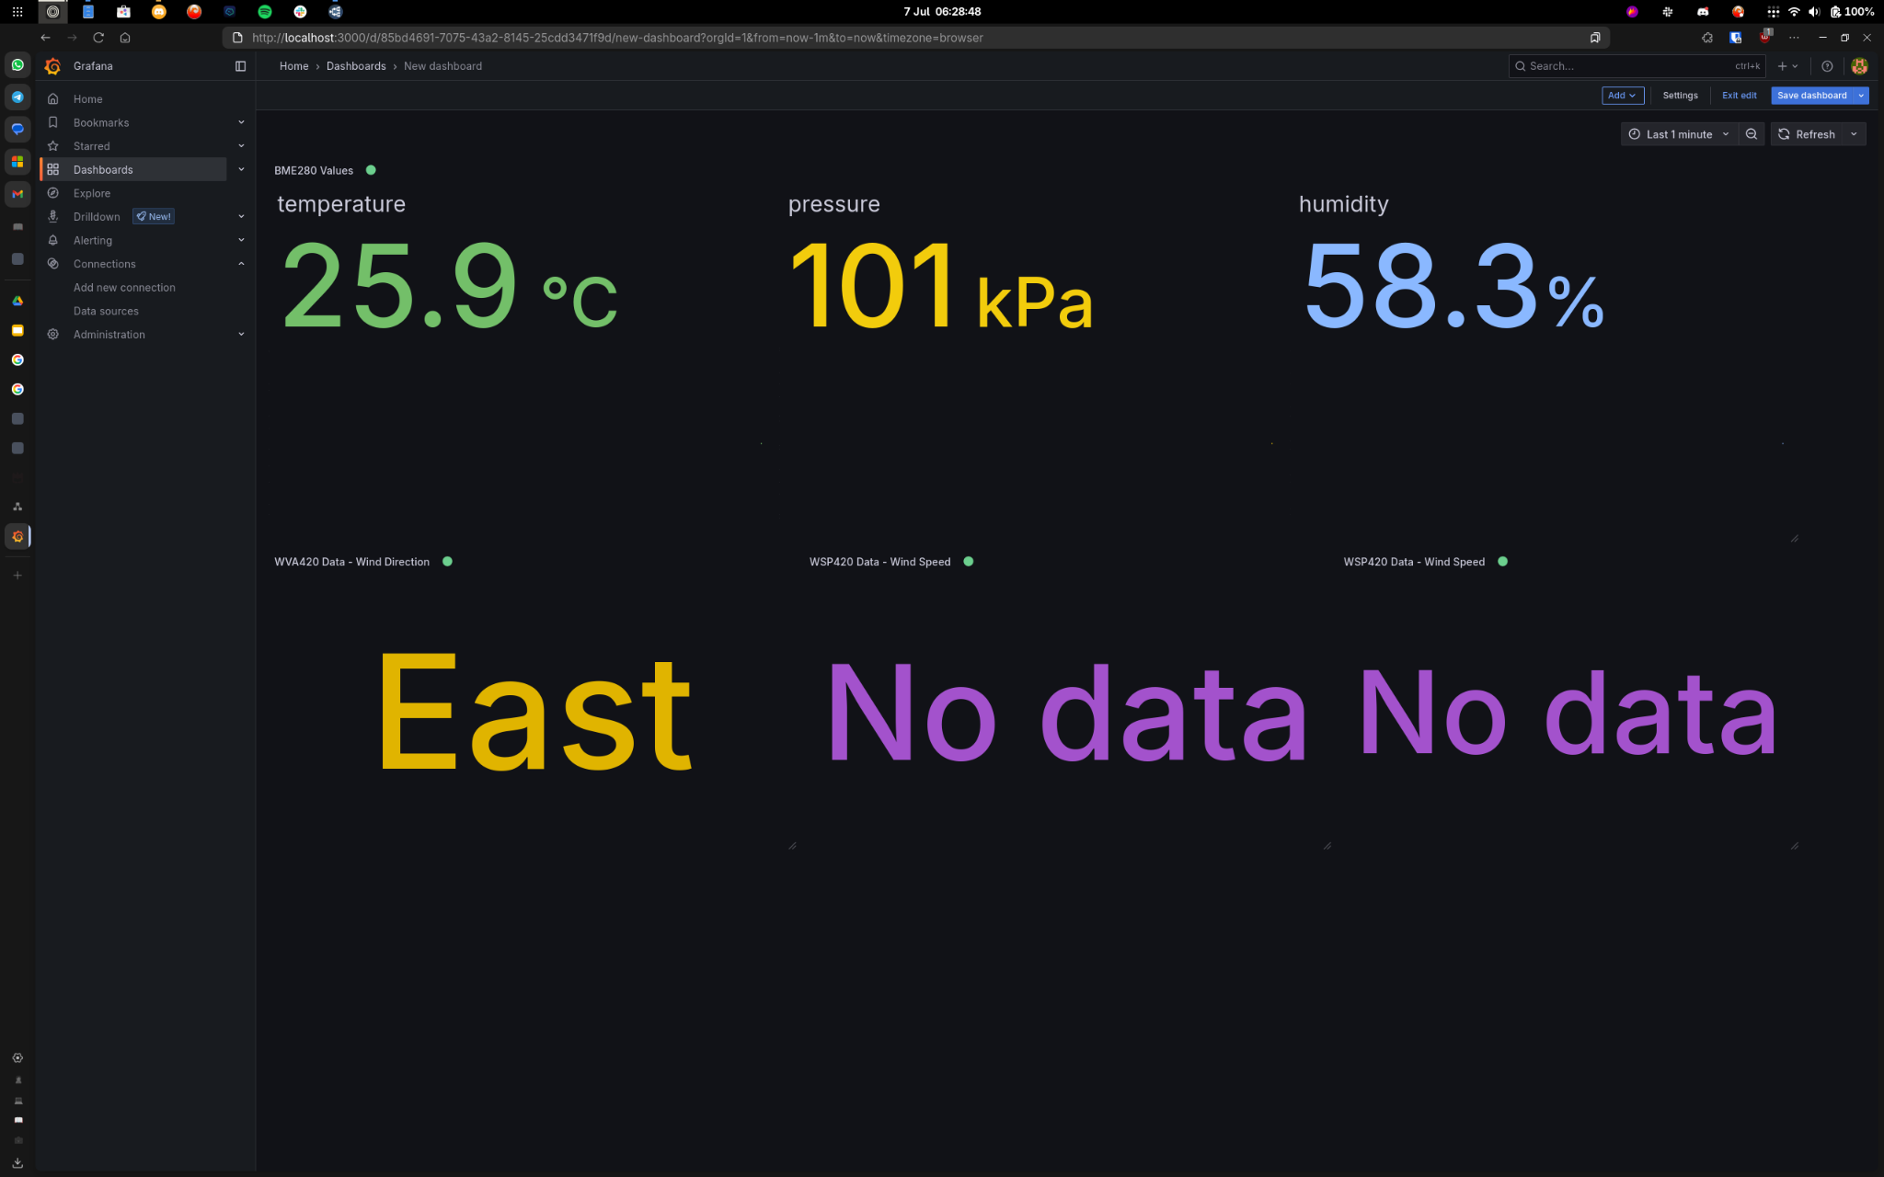
Demo

Slide 10
Battery Consumption
Power Draw: 0.35W
Current Draw: 0.35W / 5V = 0.07A
Using two cells with 2200 mAh each, in parallel, we get 4400 mAh.
Battery life: 4400 mAh / 70 mA = 62.86 hours
Notes:
Francisco

Slide 11
Future Work
Hardware
Get the battery level reading from the UPS module
Modularize the sensors (ATtiny)
Improve the building quality of the custom-made sensors (weight, friction)
Software
Energy management
Wind direction sensor self-calibration
Troubleshoot WiFi issues
Notes:
Vila

Slide 12
Sources
ESP-IDF Documentation
Lab classes exercices
Components datasheet
Notes:
Vila

Slide 13
Weather Station
Francisco Ribeiro - 107993
Miguel Vila - 107276
Embedded Systems Architectures

Slide 14
Custom-made sensor: WSP420
Notes:
Vila

