Slide 1
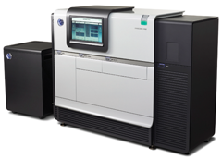



NGS data analysis: An introduction
Miguel Pérez-Enciso
miguel.perez@uab.es

Slide 2

Warninggg: this is a rapidly evolving field!

Slide 3


NGS:
One technology fits all
De novo sequencing
Re sequencing: variant discovery
mRNA resequencing
microRNA characterization
Epigenomics (CHip technology)
Metagenomics
Medical applications (cancer genomes …)
...

Slide 4
No prior targeted amplification.
Paired - end sequences.
Sequences are ~ 100-150 bp.
Based on parallel sequencing.
Massive output: 10 Gb – 1Tb
The technology: Illumina HiSeq

Slide 5
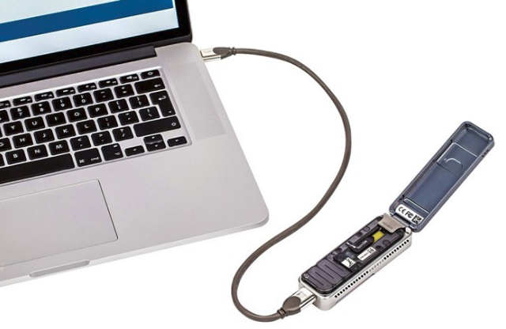
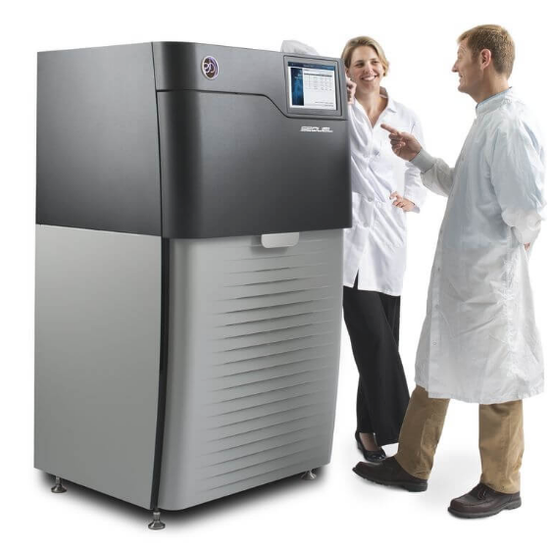
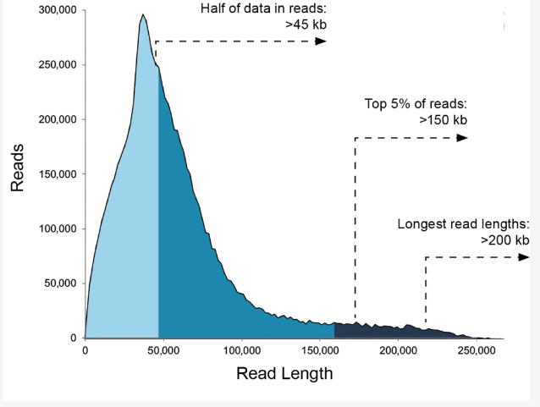
The 3rd generation:
single molecule long reads
Oxford nanopore minion:
Each consumable flow cell can now generate 10–20 Gb of DNA sequence data. Ultra-long read lengths are possible (hundreds of kb) as you can choose your fragment length. The MinION streams data in real time so that analysis can be performed during the experiment and workflows are fully versatile.

Slide 6
reads
Reference genome
Quality control
Indexing reference genome (once)
Alignment*
Generic pipeline
Realignment around indels
recommended
Visualization
PCR duplicate removal
Variant calling
* Includes sorting
and indexing

Slide 7
reads
Reference genome
fastqc
bwa
Quality control
Indexing reference genome (once)
bwa
alignment
GATK
Generic pipeline: software
realignment around indels
picard
IGV
Visualization
PCR duplicate removal
samtools / GATK
Variant calling

Slide 8
reads
Reference genome
fastq
Quality control
Indexing reference genome (once)
alignment
bam
Generic pipeline: formats
realignment around indels
bam
gtf,
html
Visualization
PCR duplicate removal
bam
Variant calling
vcf / gvcf

Slide 9
Basic tools
Fastqc: http://www.bioinformatics.babraham.ac.uk/projects/fastqc/
BWA: http://bio-bwa.sourceforge.net/
Samtools: http://www.htslib.org/
GATK: http://www.broadinstitute.org/gatk/
Vcftools: https://vcftools.github.io/
Picard: http://picard.sourceforge.net/
IGV : http://www.broadinstitute.org/igv/

Slide 10

Basic format: fastq
All NGS data come in fastq format
Quality representation using ascii code
perl -e ‘print ord(‘!’);’
perl -e ‘print chr(33);’
http://nar.oxfordjournals.org/content/38/6/1767.full

Slide 11
Quality is expressed as PHRED score (Q), which measures the probability P of a sequencing error:
Q = -10 log₁₀ P
P = 10^{-Q/10}
perl -e 'print 10**(-(ord("A")-33)/10)'
Phred Quality Score | Probability of incorrect base call | Base call accuracy
10 | 1 in 10 | 90 %
20 | 1 in 100 | 99 %
30 | 1 in 1000 | 99.9 %
40 | 1 in 10000 | 99.99 %
50 | 1 in 100000 | 99.999 %

Slide 12
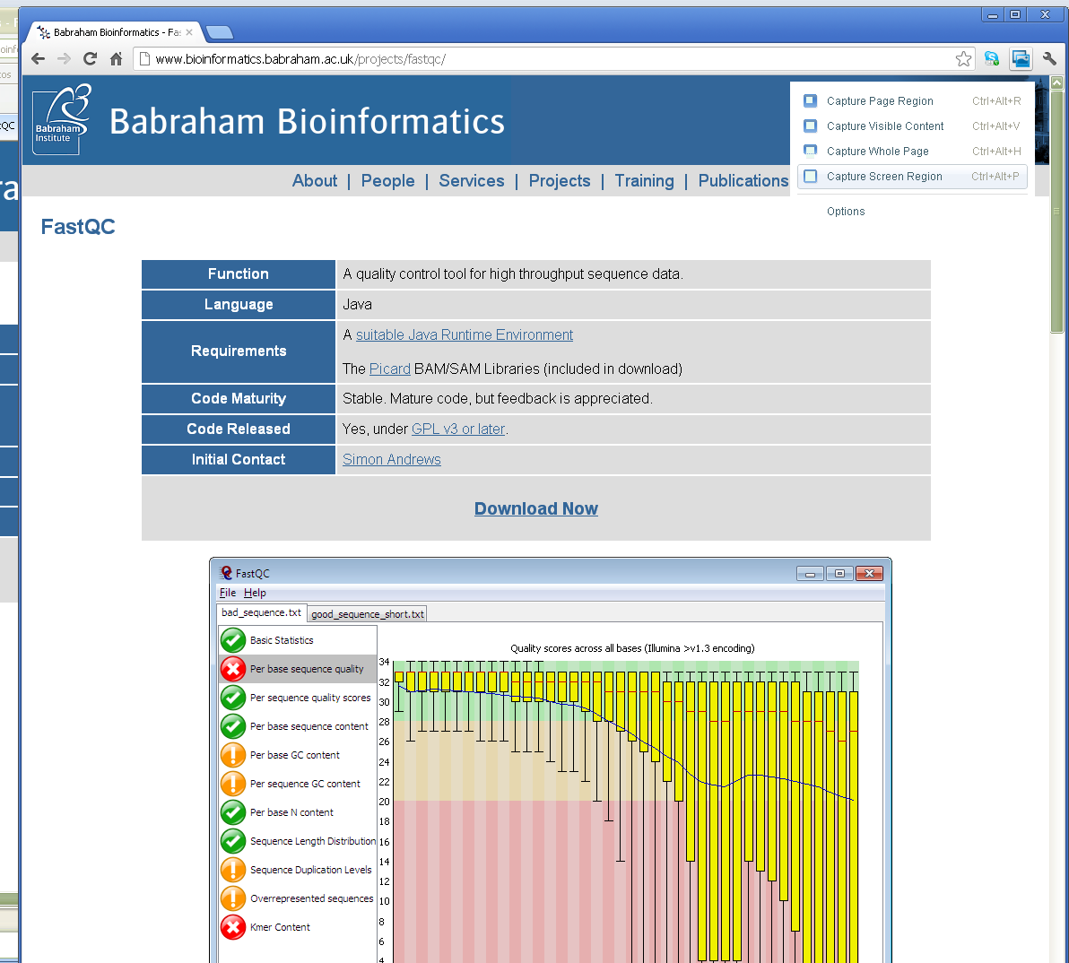
The first step is to check quality: fastqc
http://www.bioinformatics.babraham.ac.uk/projects/fastqc/

Slide 13
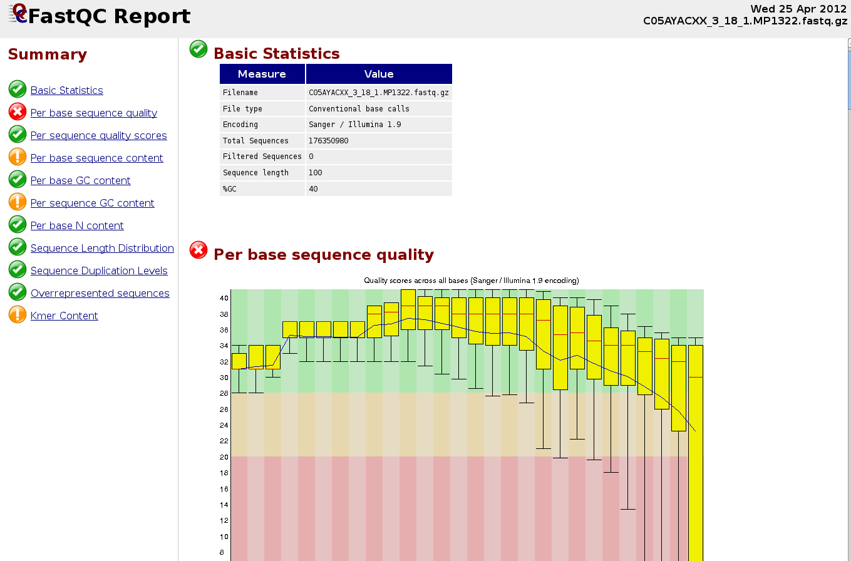
Creole pig, Argentina
100 bp PE
CNAG

Slide 14
Indexing reference genome
Consists of generating a rapidly accessible reference genome
It needs to be done only one
Currently, Burrows-Wheeler algorithm is the most used

Slide 15
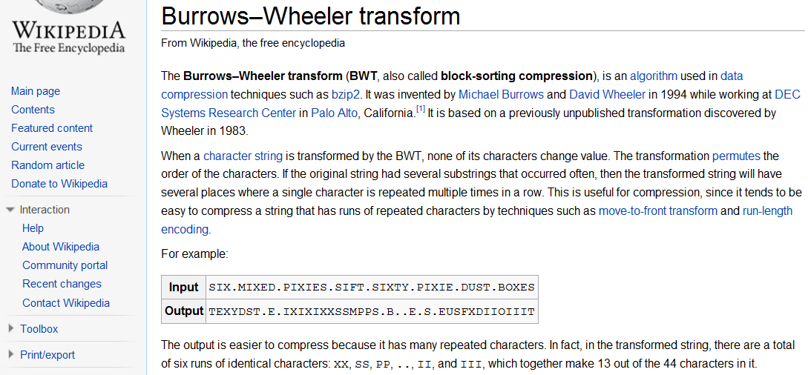

Slide 16
Alignment
Consists of determining the most likely origin of a short read sequences within a larger reference genome.
BLAST is a classical tool, but you will never finish …
New challenges: number of sequences (speed) and close similarity (large impact of sequence errors).
Main Softwares:
bwa (genome data)
Hisat2 (RNAseq)
Superseded by Hisat2

Slide 17
Alignment: sources of errors
Incomplete / Wrong reference genomes
Repeats, segmental duplications
Incomplete search.
Short indels.

Slide 18
Alignment: sources of errors
Aligners give very low quality for multiple mapping reads or those with many mismatches.
It is very important to filter for LOW quality alignments before further processing.

Slide 19
Alignement: BAM format
It is the standard format. It contains, for every read, most likely mapping position and differences to the reference genome.
Managed by SAMtools: merging alignments , variant calling, selecting regions, …
Can be visualized with IGV or samtools view command

Slide 20
Variant calling
It is the main goal of many studies.
Fraught with dangers and subtleties, among them:
Base and mapping qualities
Low or too high coverage
Multiple alignments
Structural variants are much more difficult to identify than SNPs
Sex chromosomes
SNP filtering is essential to improve reliability.
The standard format to contain SNPs is the vcf format: https://github.com/samtools/hts-specs

Slide 21
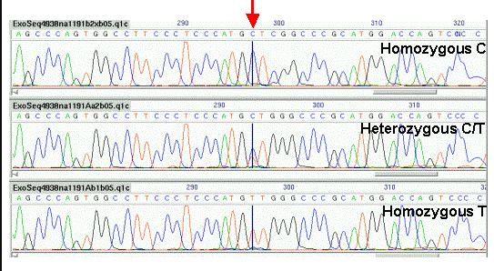
SNP Visualizing: Sanger sequencing

Slide 22
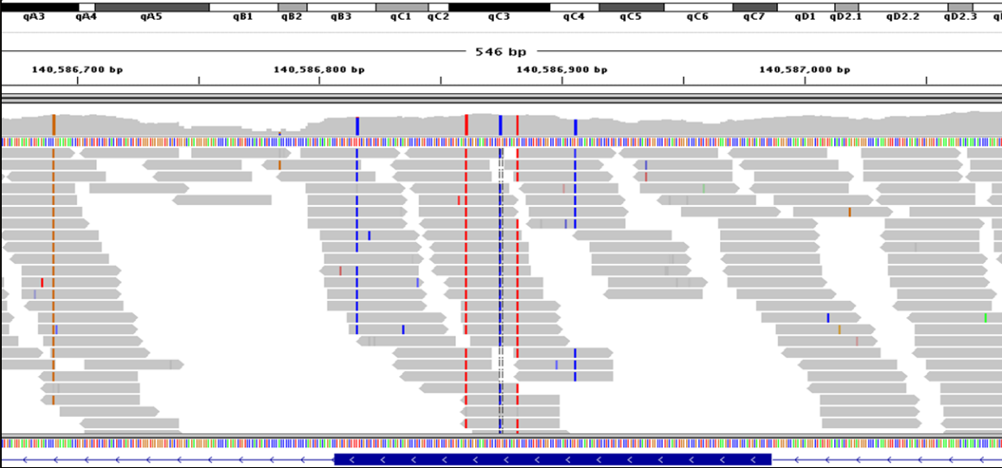
SNP Visualizing: NGS alignment with IGV
http://phylonetworks.blogspot.com.es/

Slide 23
NOTES ON SNP CALLING
Using several individuals simultaneously improves reliability, specially for middle frequency alleles.
However, calling SNPs in individuals separately is better for singleton detection.
Distrust indels, especially long or complex ones.
It is absolutely necessary to filter SNPs with bcftools filter or similar.
Inspect with IGV if necessary.
Beware of duplicated regions, filter by MAQ quality.
Pools require specific algorithms.

Slide 24
Variant calling pipelines
samtools / bcftools
GATK
A combination (see attached pipeline)

Slide 25
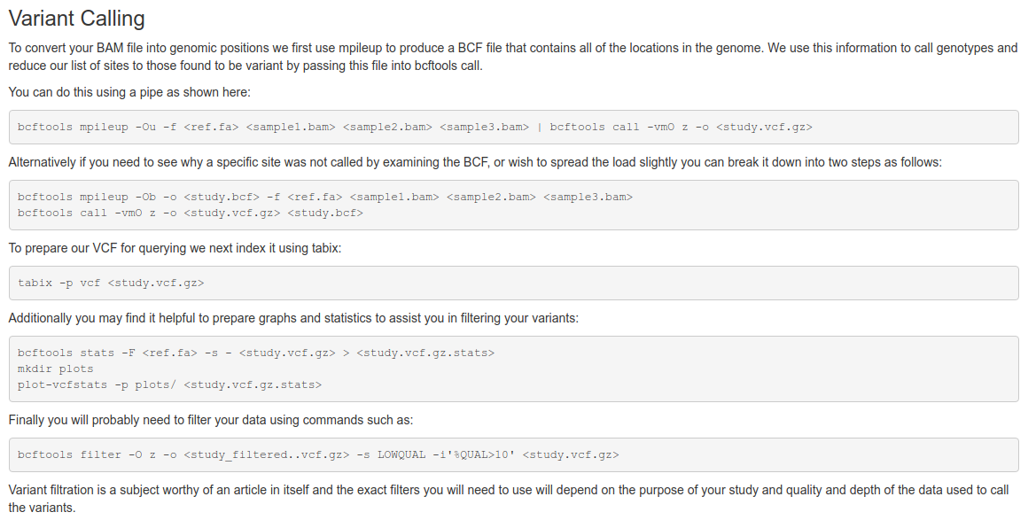
SAM / BCF tools
http://www.htslib.org/workflow/#mapping_to_variant

Slide 26
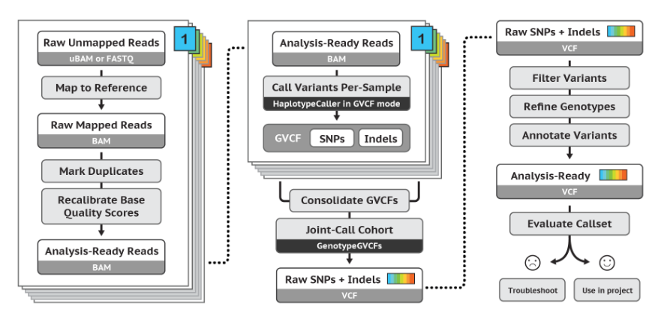
GATK
https://software.broadinstitute.org/gatk/best-practices/

Slide 27
NGS pipeline main steps (Alignment)
# sample name
OUT=sample
# reads
$OUT.2.fq.gz
$OUT.2.fq.gz
# reference genome
ASSEMBLY=human.v23.2
# index genome
bwa index -a bwtsw $ASSEMBLY.fa
# align read pairs
bwa mem $ASSEMBLY.fa $OUT.1.fq.gz $OUT.2.fq.gz | samtools view -b - > $OUT.tmp.bam
# sorts
samtools sort -O bam -T tmp $OUT.tmp.bam > $OUT.sort.bam
# remove duplicates with picard
java -jar $picard MarkDuplicates REMOVE_DUPLICATES=true INPUT=$OUT.rl.bam OUTPUT=$OUT.realigned.bam \ METRICS_FILE=metrics.out
# index
samtools index $OUT.realigned.bam

Slide 28
NGS pipeline main steps (Variant Calling)
# minimum map quality
MAPQ=20
# minimum base quality
BASEQ=20
# minimum depth
MINCOV=10
# maximum depth (recommended twice average depth)
MAXCOV=30
# minimum SNP quality
SNPQ=10
# variant calling
samtools mpileup -q $MAPQ -Q $BASEQ -go $OUT.bcf -t DP -f $ASSEMBLY.fa $OUT.realigned.bam
bcftools call -vmO v -o $OUT.vcf $OUT.bcf
# filtering (see https://github.com/samtools/bcftools/wiki/HOWTOs#variant-filtering)
bcftools filter -O v -g3 -s LOWQUAL -e"%QUAL<$SNPQ || %MAX(DP)<$MINCOV || %MAX(DP)>$MAXCOV" $OUT.vcf | \
grep ‘PASS’ > $OUT.flt.vcf
You need a linux computer with ~16 Gb RAM and 100 Gb disk per mammalian genome

Slide 29
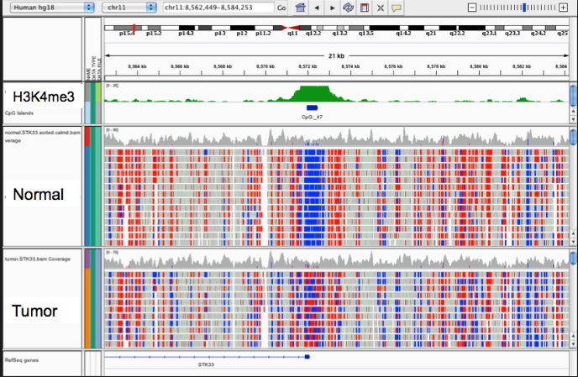
Visualizing data: IGV http://www.broadinstitute.org/igv/
Load reference genome
Load annotation files
Load bam files

Slide 30
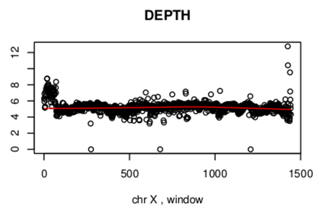
This is X chromosome of a mammal: is it a male or a female?

Slide 31
Annotating SNPs
Variant Effect Predictor:
https://www.ensembl.org/info/docs/tools/vep/index.html

Slide 32
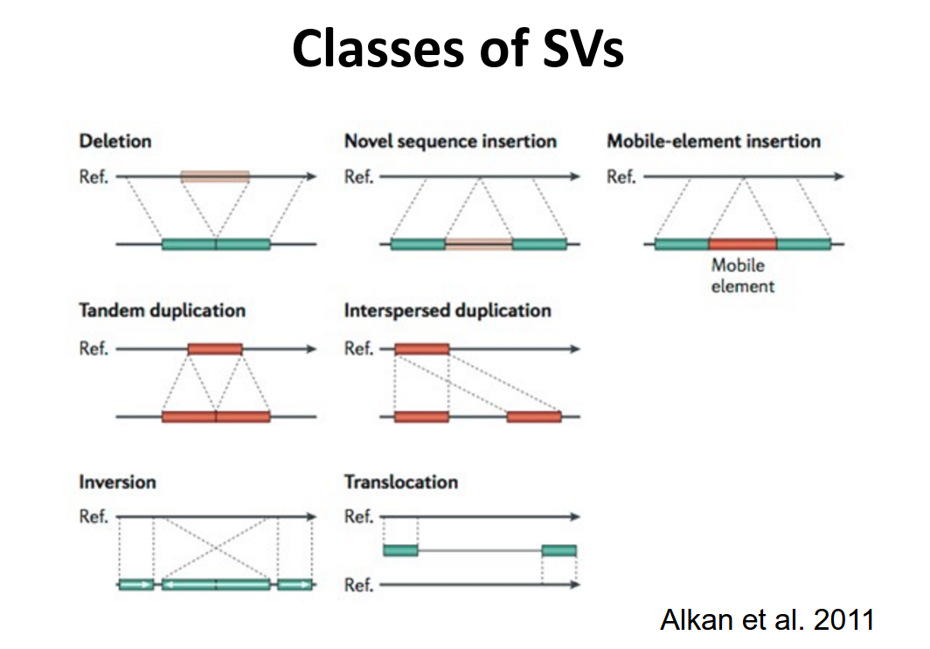
Identifying structural variants

Slide 33
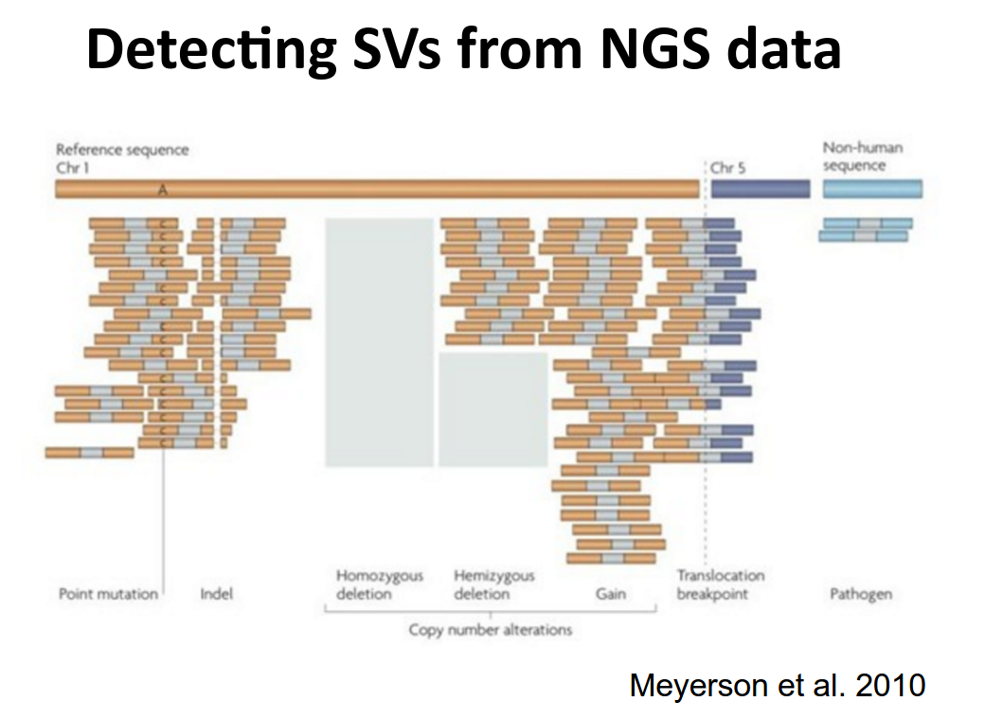

Slide 34
Identifying structural variants: https://genomebiology.biomedcentral.com/articles/10.1186/s13059-019-1720-5
CNVer : http://compbio.cs.toronto.edu/CNVer/
CNVnator: http://sv.gersteinlab.org/
ReadDepth: https://github.com/chrisamiller/readdepth
Control-Free: http://bioinfo-out.curie.fr/projects/freec/
cn.MOPS: http://www.bioinf.jku.at/software/cnmops/
…
No method is best for all SVs
Short reads are not suited to detect complex rearrangements, mainly copy number variants and short indels .

Slide 35
RNAseq
Multiple applications: discovery of new transcripts, isoforms, and non coding RNAs, quantification of (differential) expression, allele specific expression, improve anotation.
Best if annotation file available.
Paired end needed if you wish to discover isoforms
Mapping is normally done allowing ambiguity to study expression in paralogs.
Popular pipeline: Bowtie + Tophat + Cufflinks.

Slide 36
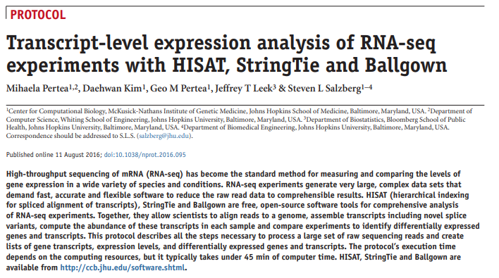
https://www.nature.com/articles/nprot.2016.095

Slide 37
RNAseq Pipelines (J Hopkins): Hisat2 + StringTie + BallGown
HISAT2 is a new, rapid and accurate system for aligning NGS reads (both DNA and RNA) against a population of genomes. HISAT2 is a successor to both HISAT and TopHat2. In this program, we extended the Burrows-Wheeler transform (BWT) and the Ferragina-Manzini (FM) index to incorporate genomic differences among individuals into the reference genome.
StringTie: A new and fast transcript assembler and abundance estimator for RNA-seq data. Similar to Cufflinks, StringTie assembles transcripts from the alignments produced by TopHat, including novel isoforms, and quantitates those transcripts.
Ballgown: A program for computing differentially expressed genes in two or more RNA-seq experiments, using the output of StringTie or Cufflinks. The Ballgown package provides functions to organize, visualize, and analyze expression measurements. Ballgown is written in R and is part of Bioconductor.

Slide 38
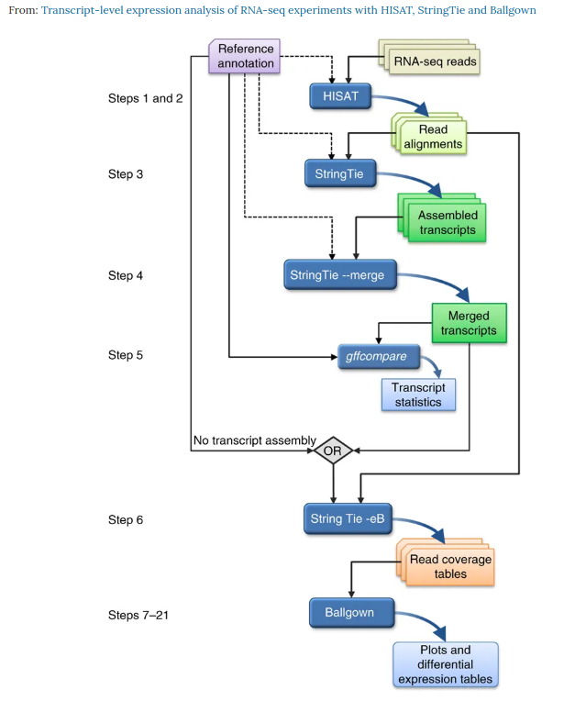
In an experiment involving multiple RNA-seq data sets, reads are first mapped to the genome using HISAT (Steps 1 and 2). Annotation of reference genes and transcripts is optional-
The alignments are then passed to StringTie (Step 3), which assembles and quantifies the transcripts in each sample.
After initial assembly, the assembled transcripts are merged together (Step 4) by a special StringTie module, which creates a uniform set of transcripts for all samples.
The gffcompare program then compares the genes and transcripts with the annotation and reports statistics on this comparison (Step 5).
In Step 6, StringTie processes the read alignments and either the merged transcripts or the reference annotation (through the diamond labeled 'OR'). Using this input, StringTie re-estimates abundances where necessary and creates new transcript tables for input to Ballgown.
Ballgown then compares all transcripts across conditions and produces tables and plots of differentially expressed genes and transcripts (Steps 7–21).

Slide 39
Experimental Design and Population Genetics
Traditional approach involved sequencing one or very few genes in many individuals.
New studies consider full sequence but a low number of individuals.
Since sequencing is far more expensive than array genotyping, experimental design issues arise:
Is it better to increase number of samples sequenced or depth?
Is pooling effective?

Slide 40
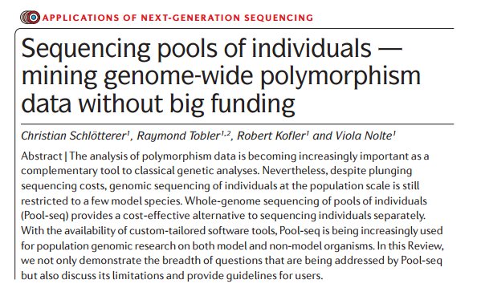
Pools
Nat Rev Genet 2015

Slide 41
Pools
DNA Pooling is proposed as a cost effective approach for genetic analyses of populations at ‘low cost’.
It allows to analyze many individuals at a fraction of the cost.
Same principles apply to auto-polyploids as well.
Difficult to separate errors from low frequency variants.
Requires specific methods / software.
Biased towards frequent variants.
No. of SNPs identified is independent of individuals in the pool.

Slide 42
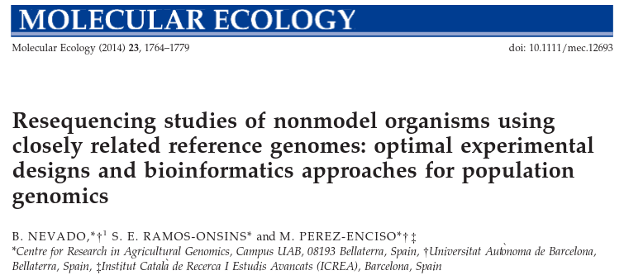
Experimental Design (≡ if money is limiting, ie, almost always)

Slide 43
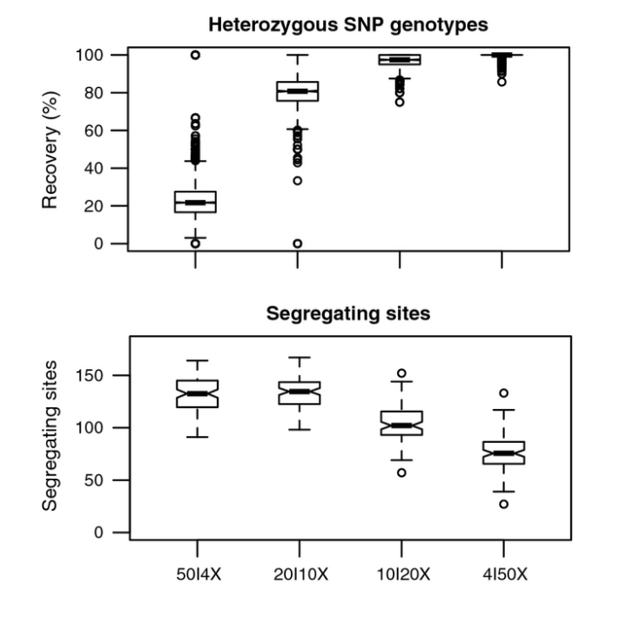
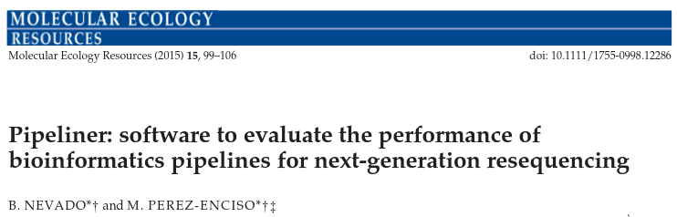
% of original heterozygous SNP genotypes that are correctly identified
# segregating sites identified with each experimental design.

Slide 44
To summarize
NGS data are massive yet noisy.
Caution and quality control are a must in every step.
Experimental design is highly relevant, is NGS what you need?
Numerous pipelines and software, specific to each application (Variant detection, RNAseq, metagenomics, …).
Allow for enough computing power (cloud services?).

