Slide 1
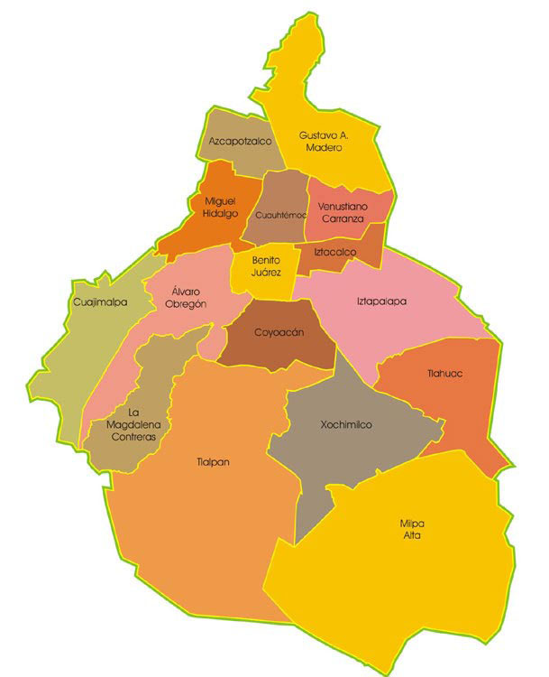
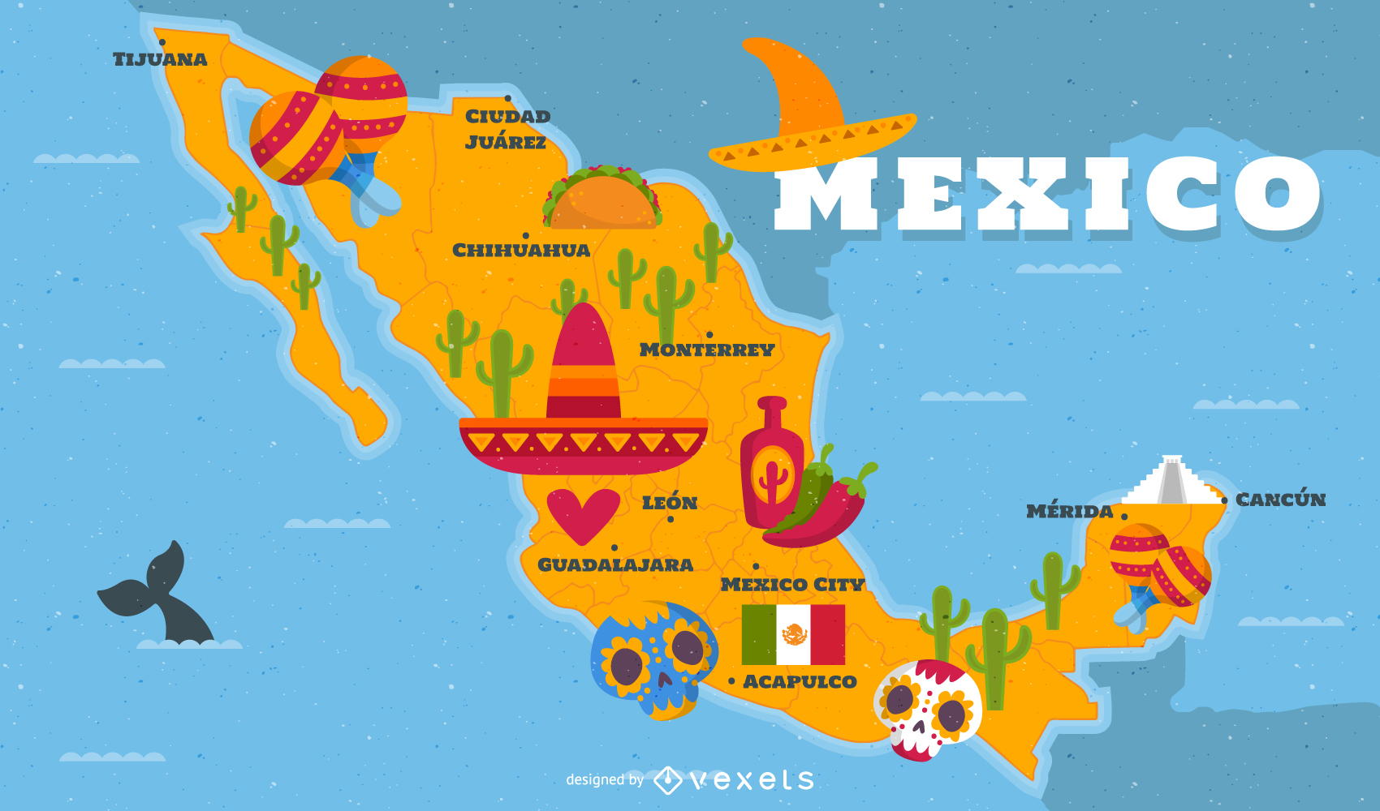
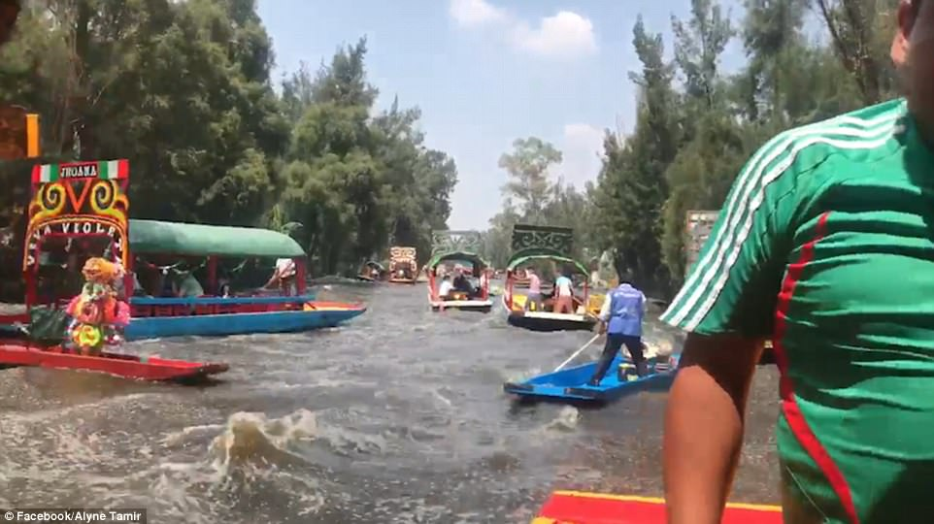
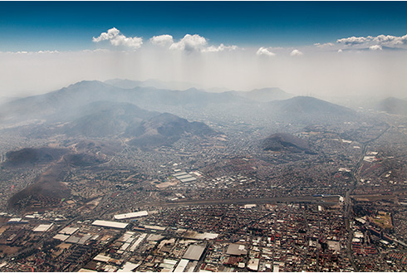
Incorporating Water-Borne Disease in Decision Making in Mexico City
Miguel Pessanha Pais
Aniruddha Belsare
Rocio Marilyn Caja Rivera

Slide 2
MODEL DESCRIPTION
RAINFALL
Occurs in the whole landscape
influence
Patch
Infrastructure of the patch
(Humans living)
Determines the prob of outbreak
Altitude
Age
Hazard
contribute
Calculates when weather flooding will occurs.
Risk of water supply disruption
Water agent decision
Protest
Vulnerability
scarcity/flood

