Slide 1
Decision algorithm
IDEAL
Drain
Supply
Protests
Protests
Age
Benefit more neighbors
Age
Benefit more neighbors
No drainage
No supply
7%
Decision every 10 steps
Repair / new

Slide 2
Decision algorithm
IDEAL
Drain
Supply
Disease incidence in the last year (10 steps)
Repair / new

Slide 3

Population 21,505,108
“Parallel Universe” experiment
1 Km² neighborhoods with an average of 3000 people
Old infrastructure (supply and drainage)
Run for 50 years (500 steps)
Fixed random seed, changing policy scenario

Slide 4
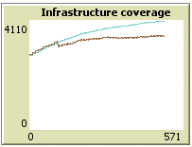
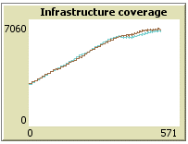
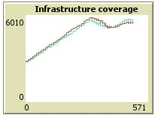
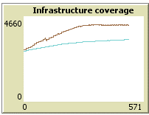
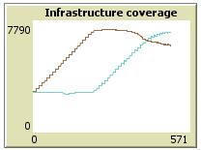
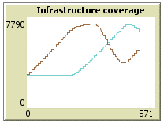
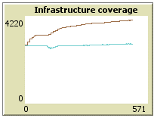
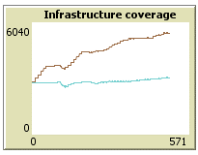
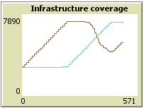
Squeaky wheel
Expand Access
Repair first
Infrastructure coverage
Water supply
Drainage
Baseline
Disease 10%
Disease 50%

Slide 5
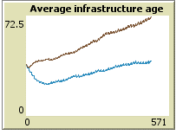
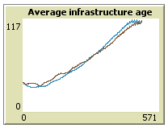
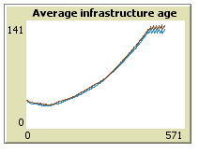
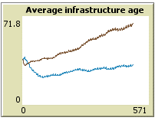
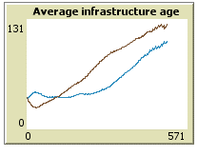
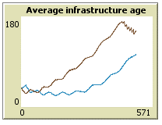
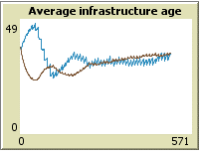
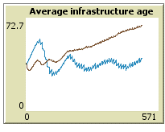
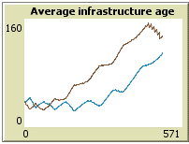
Squeaky wheel
Expand Access
Repair first
Infrastructure age
Water supply
Drainage
Baseline
Disease 10%
Disease 50%

Slide 6

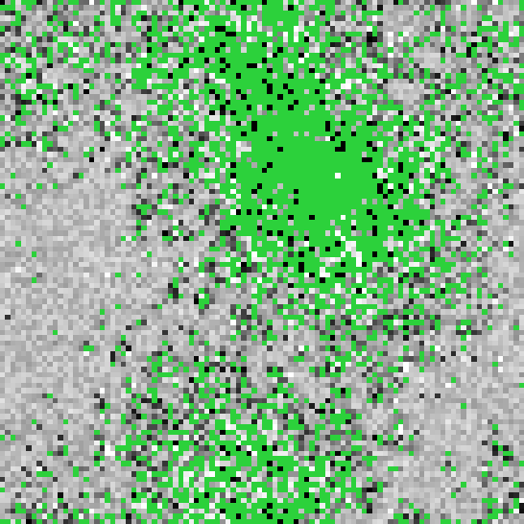





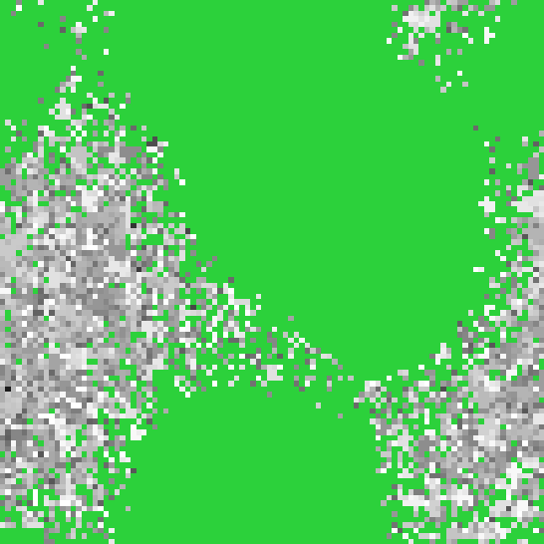

Squeaky wheel
Expand Access
Repair first
Drainage coverage and age
White is newer
Baseline
Disease 10%
Disease 50%

Slide 7
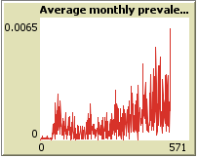
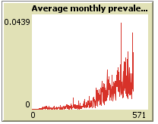
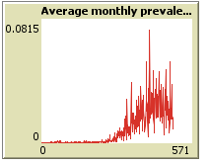
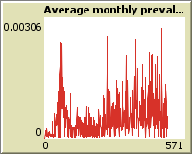
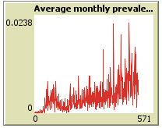
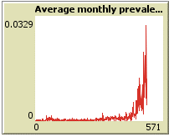
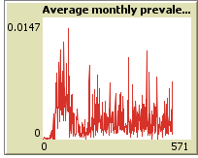
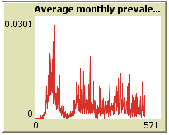
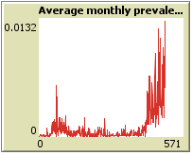
Squeaky wheel
Expand Access
Repair first
Disease incidence
Average “monthly” proportion of infected
Baseline
Disease 10%
Disease 50%

Slide 8

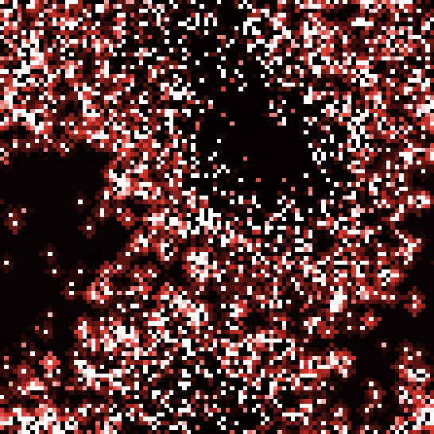


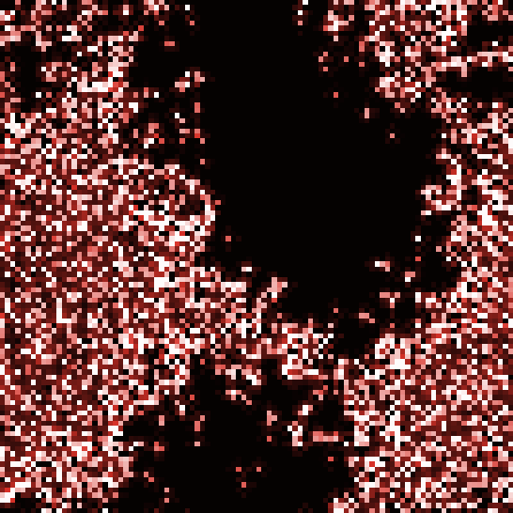


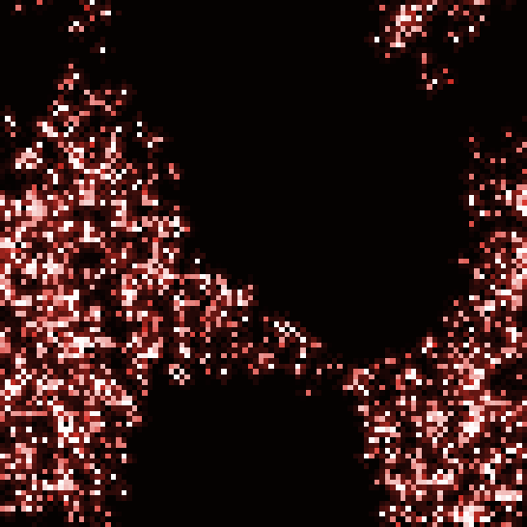

Squeaky wheel
Expand Access
Repair first
Disease incidence
Last 10 years
White is higher
Black is absence
Baseline
Disease 10%
Disease 50%

Slide 9









Squeaky wheel
Expand Access
Repair first
Floods
Last 10 years
White is more
Black is absence
Baseline
Disease 10%
Disease 50%

Slide 10
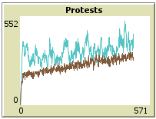
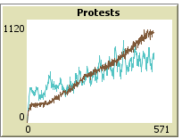
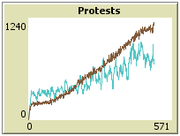
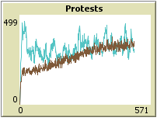
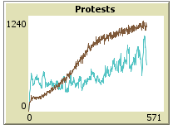
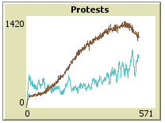
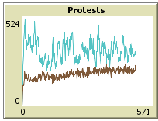
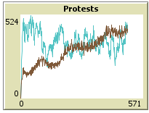
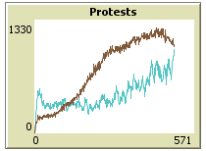
Squeaky wheel
Expand Access
Repair first
Protests
Want supply
Want drainage
Baseline
Disease 10%
Disease 50%

Slide 11
Main conclusions :
Supply infrastructure state was affected
Effect on reducing flooding:
When policy focuses on something else, disease draws attention to flooding hazards
When policy responds directly to hazards, disease becomes a distraction

Slide 12
Improving the model:
More realistic parameters and more detailed disease dynamics (survey data, moving agents, agent heterogeneity)
How policy scenarios fit other types of disease dynamics
Optimization of the decision algorithm for different goals

