Slide 1
Numerical computing in Julia
GPU programming
Tim Besard (UGent, Belgium)
Valentin Churavy (OIST, Japan)

Slide 2
What are GPUs?

Slide 3
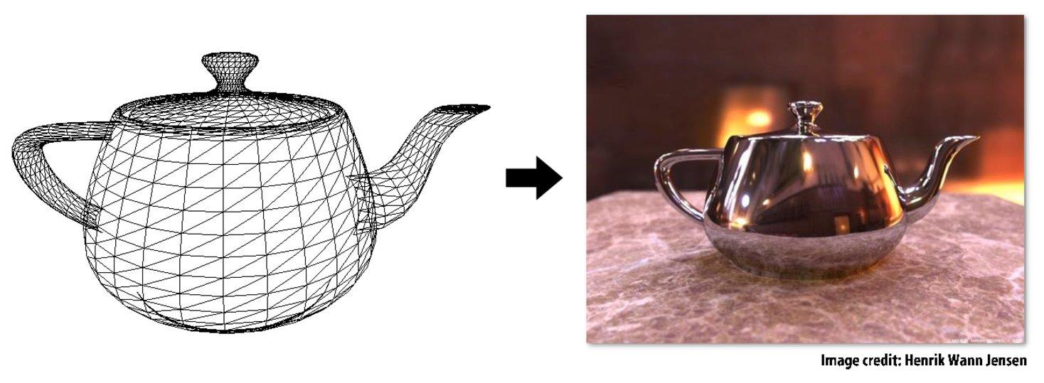
What GPUs were meant to do
Input: description of a scene:
Surface geometry + surface materials, lights, camera, etc
GPU → specialised co-processor for graphics
Why?

Slide 4
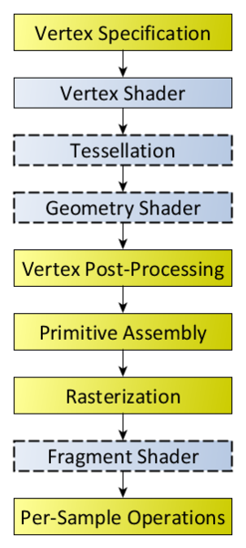
Graphics shader pipeline
Programmable
Programmable
Programmable
Programmable
opengl.org

Slide 5
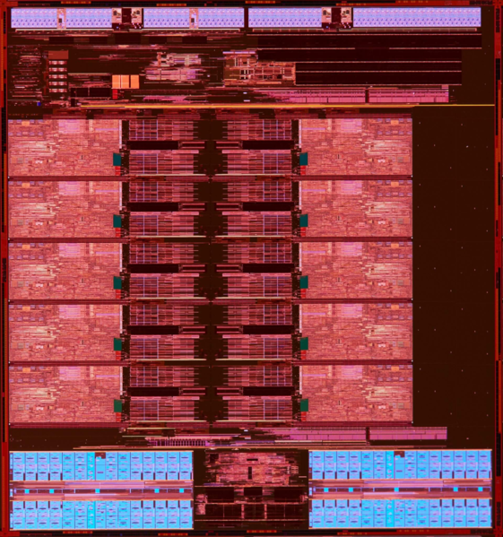
Heavyweight core architecture
https://en.wikichip.org/wiki/intel/microarchitectures/broadwell

Slide 6
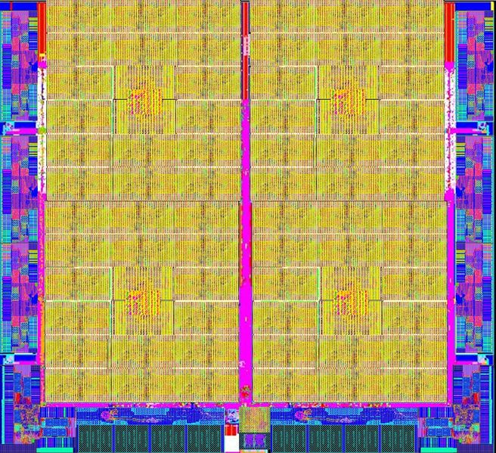
Lightweight cores architecture
https://en.wikichip.org/wiki/pezy/pezy-sc

Slide 7
Why use GPUs?

Slide 8
A small supercomputer in your desktop/laptop/phone
HPC:
NVIDIA Tesla P100 | 21 TFLOPS FP16 | 10 TFLOPS FP32 | 5 TFLOPS FP64
NVIDIA Tesla K80 | 8.93 TFLOPS FP32 | 2.91 TFLOPS FP64
AMD FirePro S9100 | 4.22 TFLOPS FP32 | 2.11 TFLOPS FP64
Desktop
NVIDIA Geforce 1080 | 8.9 TFLOPS FP32
NVIDIA Titan X | 11 TFLOPS FP32
AMD Radeon R9 Fury X | 8.6 TFLOPS FP32
Phone
NVIDIA Tegra X1 | 512 GFLOPS FP32
PowerVR GT7XT | 115 GFLOPS FP32
In comparison Xeon E5-2600v3 | 500 GFLOPS FP64
Energy efficiency: https://www.top500.org/green500/lists/2016/06/

Slide 9
Why use GPUs
Problems that map well onto the GPU:
Dense Linear Algebra
Computer Vision
Physics simulations
Fluids
Weather
Deep Learning (and other Machine Learning paradigms)
Problems that do not map as well (but you will still see performance gains):
Graph processing
Sparse Linear Algebra

Slide 10
A short history of GPGPU
2002/2003: Using shaders for scientific computation on a GPU.
Render 2 triangles that exactly cover the screen
One shader operation per pixel = one shader computation per output element
GPUs can be used for data-parallel programming on arbitrary data.
Examples:
[Harris2002] (http://dl.acm.org/citation.cfm?id=569061)
[Bolz2003] (http://dl.acm.org/citation.cfm?id=882364)
2004: Brook stream programming language out of Stanford [Buck2004]
Brook compiler converted generic stream program into OpenGL commands and shader programs
C-like language
2007 NVIDIA Tesla architecture offered the first non-graphics-specific interface.
Introduction of CUDA (C-like language) with the design goal of maintaining a low abstraction distance.
2009 OpenCL was introduced as an open standard.

Slide 11
How do GPUs work?

Slide 12
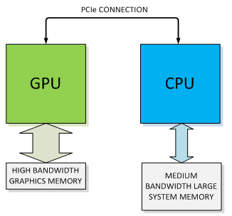
How do GPUs work?
Slow!
Fast
Fast
Device
Host
Source: NVIDIA
Notes:
How it fits in a system:
Coprocessor: not independent, driven by CPU Hence device & host
Dedicated memory: non-transparent
Connected over bus: transfer cost
NVIDIA TITAN X
Memory bandwidth: 336 GB/s
PCIe 3.0 x16: 32 GB/s

Slide 13
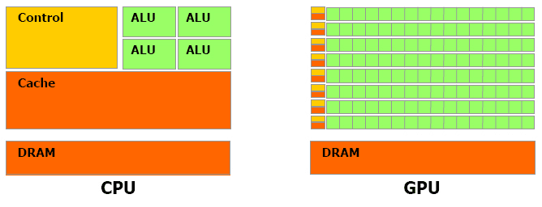
How do GPUs work?
Heavyweight cores Limited parallelism
Advanced control circuitry
Out-of-order execution
Branch prediction
Lightweight cores → higher latency Massive parallelism
Source: AllegroViva

Slide 14
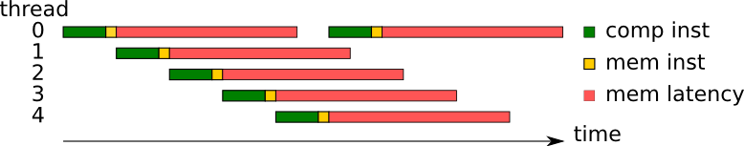
How do GPUs work: latency hiding
Requirement: enough work to schedule (occupancy)
Source: TU/e

Slide 15
How do GPUs work?
Heavyweight cores Limited parallelism
Advanced control circuitry
Out-of-order execution
Branch prediction
Lightweight cores Massive parallelism
Simple, shared control circuitry
Lockstep execution
Source: AllegroViva
Notes:
Lockstep execution:
Every thread should execute the same instructions

Slide 16
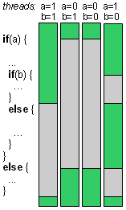
How do GPUs work: lockstep execution
Source: Y. Kreinin

Slide 17
How do GPUs work?
Massive parallelism
Lightweight cores
High latency
Latency hiding, given sufficient occupancy
Lockstep execution
Avoid branch divergence
Memory transfer cost

Slide 18
How to program GPUs?

Slide 19
How to program GPUs: libraries
Mostly array-based abstractions:
cuBLAS → CUBLAS.jl
Thrust
ArrayFire → ArrayFire.jl
GPUArrays.jl
…
using ArrayFire a = rand(AFArray{Float64}, 100) b = …
product = a * b c = a .> b fast_fourier = fft(a)

Slide 20
How to program GPUs: low-level toolkits
Shallow wrappers around the hardware:
OpenCL
CUDA → CUDAnative.jl

Slide 21
How to program GPUs: vector addition
function cpu_vadd(a, b, c)
for i = 1:length(a)
c[i] = a[i] + b[i]
end
end
len = 16
a = rand(len)
b = rand(len)
c = similar(a)
cpu_vadd(a, b, c)
function gpu_vadd(a, b, c)
i = get_my_index()
c[i] = a[i] + b[i]
end
len = 16
a = rand(len)
b = rand(len)
gpu_a = CuArray(a)
gpu_b = CuArray(b)
gpu_c = CuArray(Float64, len)
@cuda (...) gpu_vadd(gpu_a, gpu_b, gpu_c)
c = Array(d_c)
Executed by each thread

Slide 22
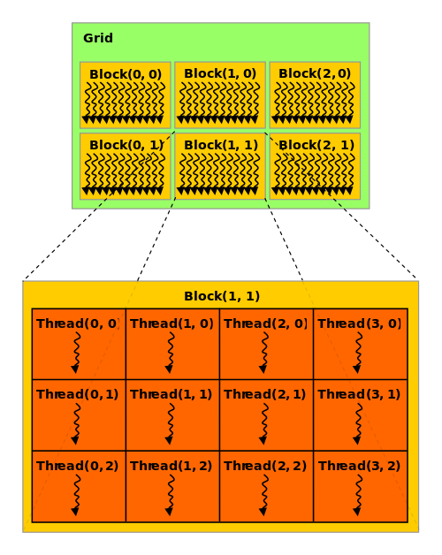
How to program GPUs: CUDA indexing
get_my_index() ?
threadIdx() & blockDim()
@cuda (1, threads) kernel(...)
function gpu_vadd(a, b, c)
i, j = threadIdx().x, threadIdx().y
c[i,j] = a[i,j] + b[i,j]
end
threads = (size(a,1), size(a,2))
@cuda (1,threads) gpu_vadd(...)
Source: NVIDIA

Slide 23
How to program GPUs: CUDA indexing
threadIdx(), blockDim()
blockIdx(), gridDim()
@cuda (blocks, threads) kernel(...)
Threads are executed together!
Cheaper communication
Lockstep execution
Source: NVIDIA, AllegroViva

Slide 24
How to program GPUs: prefix sum
function cpu_scan{T}(data)
cols = size(data,2)
for col in 1:cols
accum = zero(T)
rows = size(data,1)
for row in 1:rows
accum += data[row,col]
data[row,col] = accum
end
end
end
4×4 Array{Int64,2}: 1 5 9 13 2 6 10 14 3 7 11 15 4 8 12 16
↓
4×4 Array{Int64,2}: 1 5 9 13 3 11 19 27 6 18 30 42 10 26 42 58

Slide 25
How to program GPUs: prefix sum
function cpu_scan{T}(data)
cols = size(data,2)
for col in 1:cols
accum = zero(T)
rows = size(data,1)
for row in 1:rows
accum += data[row,col]
data[row,col] = accum
end
end
end
@target ptx function gpu_scan{T}(data)
cols = gridDim().x
col = blockIdx().x
rows = blockDim().x
row = threadIdx().x
accum = zero(T)
for i in 1:row
accum += data[i,col]
end
data[row,col] = accum
end
@cuda (size(data,2), size(data,1)) gpu_scan(...)
Notes:
All threads within a block executed in lockstep → not true!
Only $warp amount
Need for synchronization in a thread

Slide 26
How to program GPUs: prefix sum
@target ptx function gpu_scan{T}(data)
cols = gridDim().x
col = blockIdx().x
rows = blockDim().x
row = threadIdx().x
accum = zero(T)
for i in 1:row
accum += data[i,col]
end
data[row,col] = accum
end
@cuda (size(data,2), size(data,1)) gpu_scan(...)
4×4 Array{Int64,2}: 1 5 9 13 2 6 10 14 3 7 11 15 4 8 12 16
↓
4×4 Array{Int64,2}: 1 5 9 13 2 6 10 14 3 7 30 15 4 8 12 16
Branch divergence
sync_threads()
Notes:
All threads within a block executed in lockstep → not true!
Only $warp amount
Need for synchronization in a thread

Slide 27
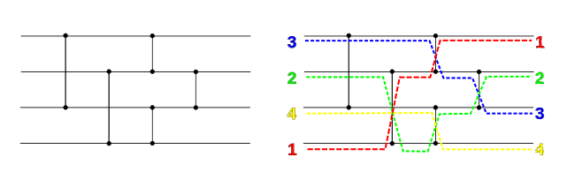
How to program GPUs: sorting
Source: Wikipedia

Slide 28
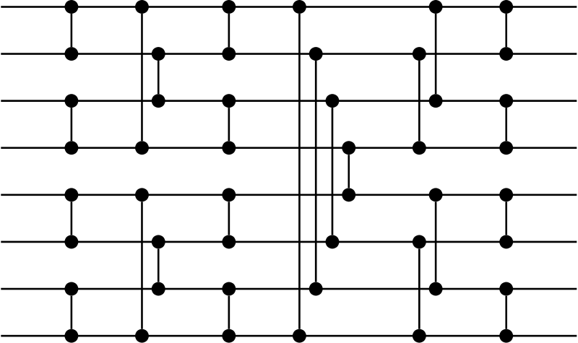
How to program GPUs: sorting
t₁
t₂
t₃
t₄
t₅
t₆
Source: Wikipedia

