Slide 1
Module E: Distributed Scientific Computing
Lecture E-2: Introduction to the Practice of Distributed Computing -II
Dr Shantenu Jha

Slide 2
Overview of Module E Distributed Scientific Computing
E1: Introduction to the Practice of DC
WLCG + Application Examples [30mins]
Summarize and compare with HPC [10mins]
Distributed Computing is Hard. So Why?
Introduction to SAGA and installing it [20mins]
Mod E Project [10mins]
E2: Introduction to the Practice of DC - II
Examples of “Production” Grid Infrastructure [20min]
HPC vs HTC, Research vs Production, Commercial
More on SAGA [40 mins]
Your first (?) Distributed Application [15mins]

Slide 3
Production Distributed Infrastructure(DI)
HPC Grids
TeraGrid [DEISA]
HTC Grids
OSG, EGI
Research Grid Infrastructure
FutureGrid, [Grid5000, DAS]
Commercial Infrastructure
AWS (EC2, S3), Azure

Slide 4
Why are we examining DI?
Sapir-Whorf Hypothesis:
Language Influences the Habitual Thought
Scientific Computing Analog:
Infrastructure shapes the practice and formulation of research
Think historically how CI has shaped research
“I have a research Q. Which CI should I use?”
Go to TG? Go to OSG? Or should I pay for resource?
Might the policies of these DI influence your decision?
This lecture (part) aims to provide a quick overview and understanding of the infrastructures available
For each, (i) Description, (ii) Management, (iii) Typical Usage Modes and applications supported, (iv) Policies

Slide 5
TeraGrid US National Cyberinfrasctructure for Scientific Research

Slide 6
11 Resource Providers
Grid Infrastructure Group (UChicago)
UW
UC/ANL
PSC
NCAR
PU
NCSA
Caltech
IU
UNC/RENCI
ORNL
USC/ISI
NICS
SDSC
LONI
TACC
Resource Provider (RP)
Software Integration Partner

Slide 7
TeraGrid Resources and Services
Computing
-More than one petaflop of computing power today and
growing
500 Tflop Ranger system at Texas Advanced Computing Center (TACC)
466 TFlop Kraken (Cray Xt4) at National Institute for Computational Sciences (NICS), University of Tennessee
Remote visualization servers and software
60 TFlop condor-based viz resource at Purdue University
Data
Allocation of data storage facilities
Over 100 Scientific Data Collections
Central allocations process
Technical Support
Central point of contact for support of all systems
Advanced Support for TeraGrid Applications (ASTA)
Education and training events and resources
Over 30 Science Gateways

Slide 8
TeraGrid Usage Modes in CY2008
Use of TeraGrid Resources | # of projects
Batch Computing on Individual Resources | 850
Exploratory and Application Porting | 650
Workflow, Ensemble, and Parameter Sweep | 160
Science Gateway Access | 100
Remote Interactive Steering and Visualization | 35
Tightly-Coupled Distributed Computation | 10
Notes:
Needs updating to 2008. This might be revised to focus on the wide range of types of TG uses. I removed pie charts because they confused the message for me. I also think that the numbers may be unnecessary – the kinds of use could just as easily be bulleted.

Slide 9
Policies and Operational Details
Management: GIG – central point of coordination
Top-down process of determining who the resource providers (RP) are
Eg LSU/LONI is an RP via a NSF HPCOPS award
User needs allocation to access resource
Eg TRAC, PRAC, Educational
Allocation typically bound to a resource
We talked about co-scheduling
Is not provided for all intents and purposes
Users typically use a single resource at a time
See Usage Mode table
Notes:
While addressing challenges in nanotechnology, NCN researchers produce new algorithms, approaches, and software with capabilities not yet available commercially. As part of the NSF's infrastructure for the National Nanotechnology Initiative (NNI), the NCN engages the community through workshops, seminars and novel educational resources. The nanoHUB is a source of on-line resources including a unique web-based computational user facility that puts research-grade software in the hands of users across the globe.
was created in 2000 and relies on middleware developed at Purdue called PUNCH (Purdue University Network Computing Hub). In the year 2003, the nanoHUB has served 1000 users and ran 86,000 jobs
The applications already available on the nanoHUB range from single cpu jobs to parallel jobs. Some are well suited to run on a Condor pool, whereas more compute intensive application will run on the TeraGrid.

Slide 10

TeraGrid Usage
Notes:
Update to include additional communities added since 2006.

Slide 11
Open Science Grid http://www.openscience.org
Bottom-Up Organization: OSG brings together computing and storage resources from campuses and research communities into a common, shared grid infrastructure over research networks via a common set of middleware
Philosophy: OSG offers participating research communities low-threshold access to more resources than they could afford individually, via a combination of dedicated, scheduled and opportunistic alternatives
Management: OSG is a consortium of software, service and resource providers and researchers, who together build and operate the OSG project

Slide 12
Open Science Grid http://www.openscience.org
OSG Consortium members' independently owned and managed resources make up the distributed facility, agreements between them provide the glue for it
Organized around Virtual Organizations
Software: Virtual Data Toolkit provides packaged, tested and supported collections of software for installation on participating compute and storage nodes and a client package for end-user researchers.

Slide 13
OSG Middleware
User Science Codes and Interfaces
VO Middleware
Applications
Biology
Portals, databases etc
HEP
Data and workflow management etc
Astrophysics
Data replication etc
OSG Release Cache:
OSG specific configurations, utilities etc.
Virtual Data Toolkit (VDT) core technologies + software needed by stakeholders:many components shared with EGEE
Infrastructure
Core grid technology distributions:
Condor, Globus, Myproxy: shared with TeraGrid and others
Existing Operating, Batch systems and Utilities.

Slide 14
It takes VOs to make OSG work!
cdf Collider Detector at Fermilab
cms Compact Muon Solenoid
compbiogrid CompBioGrid
des Dark Energy Survey
dosar Distributed Organization for Scientific and Academic Research
dzero D0 Experiment at Fermilab
engage Engagement
fermilab Fermi National Accelerator Center
fmri Functional Magnetic Resonance Imaging
gadu Genome Analysis and Database Update
glow Grid Laboratory of Wisconsin
gpn Great Plains Network
grase Group Researching Advances in Software Engineering
gridex Grid Exerciser (GEx)
grow Grid Research and Education Group at Iowa
gugrid Georgetown University Grid
i2u2 Interactions in Understanding the Universe Initiative
ligo Laser Interferometer Gravitational-Wave Observatory
mariachi Mixed Apparatus for Radar Investigation . . .
nanohub nanoHUB Network for Computational Nanotechnology (NCN)
nwicg Northwest Indiana Computational Grid
osg Open Science Grid
osgedu OSG Education Activity
sbgrid Structural Biology Grid
sdss Sloan Digital Sky Survey
star Solenoidal Tracker at RHIC
usatlas United States ATLAS Collaboration

Slide 15
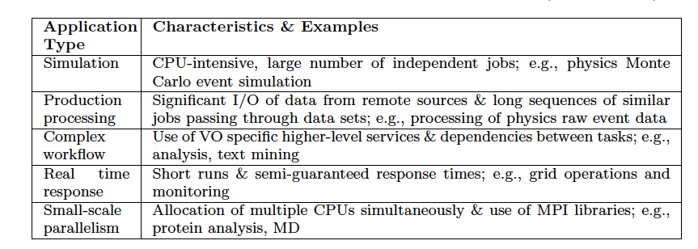
OSG Usage Modes

Slide 16

European Grid Initiative http://www.egi.eu/
The objective of EGI.eu (a foundation established under Dutch law) is to create and maintain a pan-European Grid Infrastructure in collaboration with National Grid Initiatives (NGIs) in order to guarantee the long-term availability of a generic e-infrastructure for all European research communities and their international collaborators
Coordinating activities between European NGIs EGI.eu will
Operate a secure integrated production grid infrastructure that federates resources from providers around Europe
Work with software providers within Europe and worldwide to provide high-quality innovative software solutions that deliver the capability required by our user communities

Slide 17
European Grid Initiative http://www.egi.eu/
Management Model: EGI Council with representatives from all National Grid Projects
EGI: Follow-on project to EGEE, EGEE-II and EGEE-III
Usage Modes:
Mostly HTC but not confined to HTC
All of OSG Usage Modes and more
Many diverse research areas and not just particle-physics

Slide 18
FutureGrid Goals
Support the research on the future of distributed, grid, and cloud computing.
Build a robustly managed simulation environment or testbed to support the development and early use in science of new technologies at all levels of the software stack: from networking to middleware to scientific applications.
Mimic TeraGrid and/or general parallel and distributed systems – FutureGrid is part of TeraGrid and one of two experimental TeraGrid systems (the other is based on GPU)
Enable major advances in science and engineering through collaborative development of science applications and related software using FG
FutureGrid is a (small 5600 core) Science Cloud but it is more accurately a virtual machine based simulation environment

Slide 19
FutureGrid Hardware
FutureGrid has dedicated network (except to TACC) and a network fault and delay generator
Can isolate experiments on request; IU runs Network for NLR/Internet2
(Many) additional partner machines will run FutureGrid software and be supported (but allocated in specialized ways)

Slide 20
Amazon AWS http://aws.amazon.com
Story goes: Build capacity for X-mas. What do with spare capacity year around?
“Utility Computing”
Around long before Amazon EC2
$0.10 per CPU-hour, plus bandwidth cost
*aaS Model:
* = Infrastructure, Software, almost anything
AWS: A set of APIs which give users access to Amazon technology and content
IaaS, but also “people as a service” – Mechanical Turk

Slide 21
Amazon Simple Storage Service (S3)
Data Storage in Amazon Data Center
Web Service interface
No set-up fee, No monthly minimum
Storage: $0.15 per GB/Month
Data Transfer: $0.20/GB to transfer data
Private and public storage
Each object up to 5GB in size

Slide 22
Amazon Elastic Compute Cloud
A Web service that provides resizable compute capacity in the cloud. Designed to make Web-scale computing easier
A simple Web service interface that provides complete control of your computing resources
Quickly scales capacity, both up and down, as your computing requirements change
Changes the economics of computing:
Pay only for capacity that used; no cost of ownership
a + bc becomes just bc

Slide 23
Amazon Elastic Compute Cloud
No start-up, monthly, or fixed costs
$0.10 per CPU hour
$0.20 per GB transferred across Net
No cost to transfer data between Amazon S3 and Amazon EC2
More when we do Cloud Computing next week

Slide 24
Azure
Description: Microsoft’s “Platform as a Service” (Paas) offering
Platform that is “Available” and “Scalable”
Cloud Based around virtualization
Explicit Cost to Use
No cost to transfer data, only to use/store
“Democratization of Infrastructure”
Rich Data Abstractions
Large user data items: blobs
Service state: tables
Service workflow: queues
Simple and Familiar Programming Interfaces
REST: HTTP and HTTPS

Slide 25
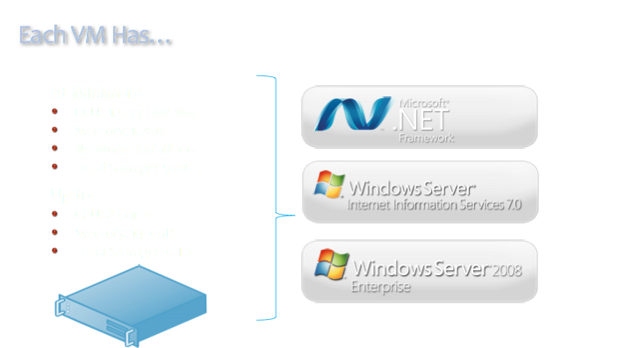

Slide 26
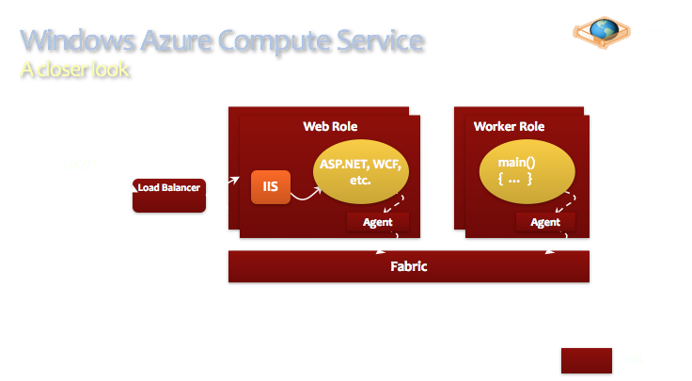

Slide 27
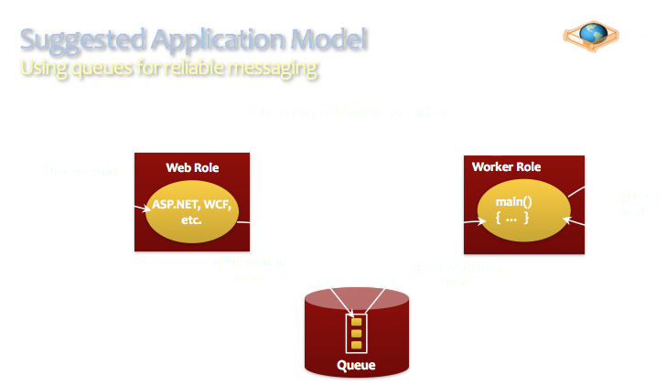

Slide 28
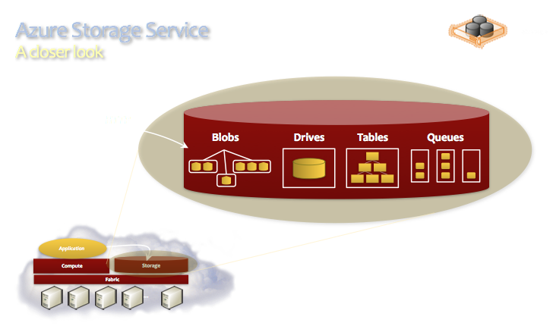

Slide 29
DI - Summary
A rich space of infrastructure & capabilities
Not all DI have delivered on “their Grid” role
Why is difficult to answer, as many co-dependent factors, e.g. policy, social/technical/software ecosystem, external pressures..
But in general, “Narrow grid” (e.g OSG) have done better versus “Broad grids” (eg Teragrid)
Interesting developments in the commercial sector: Google, Microsoft and Amazon
First time ever, Academic Research being done on commerical infrastructure!
Due to rise of data-intensive computing but also well designed infrastructure (Azure) and effective abstractions for applications (MapReduce)

Slide 30
ENSEMBLE-BASED REPLICA-EXCHANGE

Slide 31
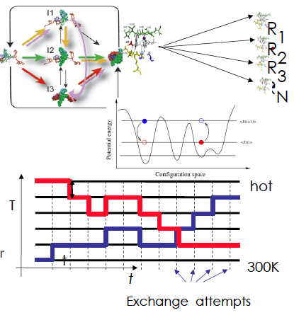
Ensemble-based & Replica-Exchange Simulations
Ensemble-based:
Many uncoupled simulations
But not necessarily uncoupled in analysis!
Replica-Exchange (RE) methods:
Represent a class of algorithms that involve a large number of loosely coupled ensembles.
RE simulations are used to understand a range of physical phenomena
Protein folding, unfolding etc
MC simulations
Many successful implementations
Eg folding@home [replica based]

Slide 32
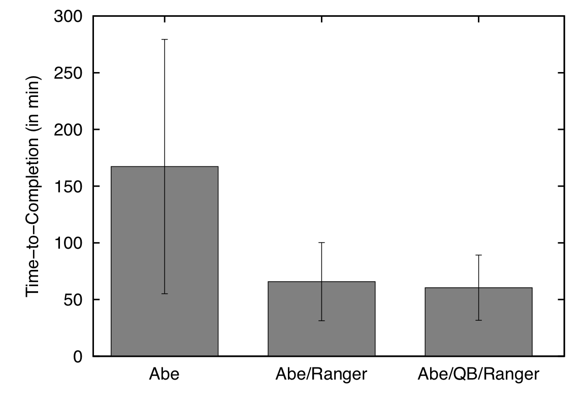
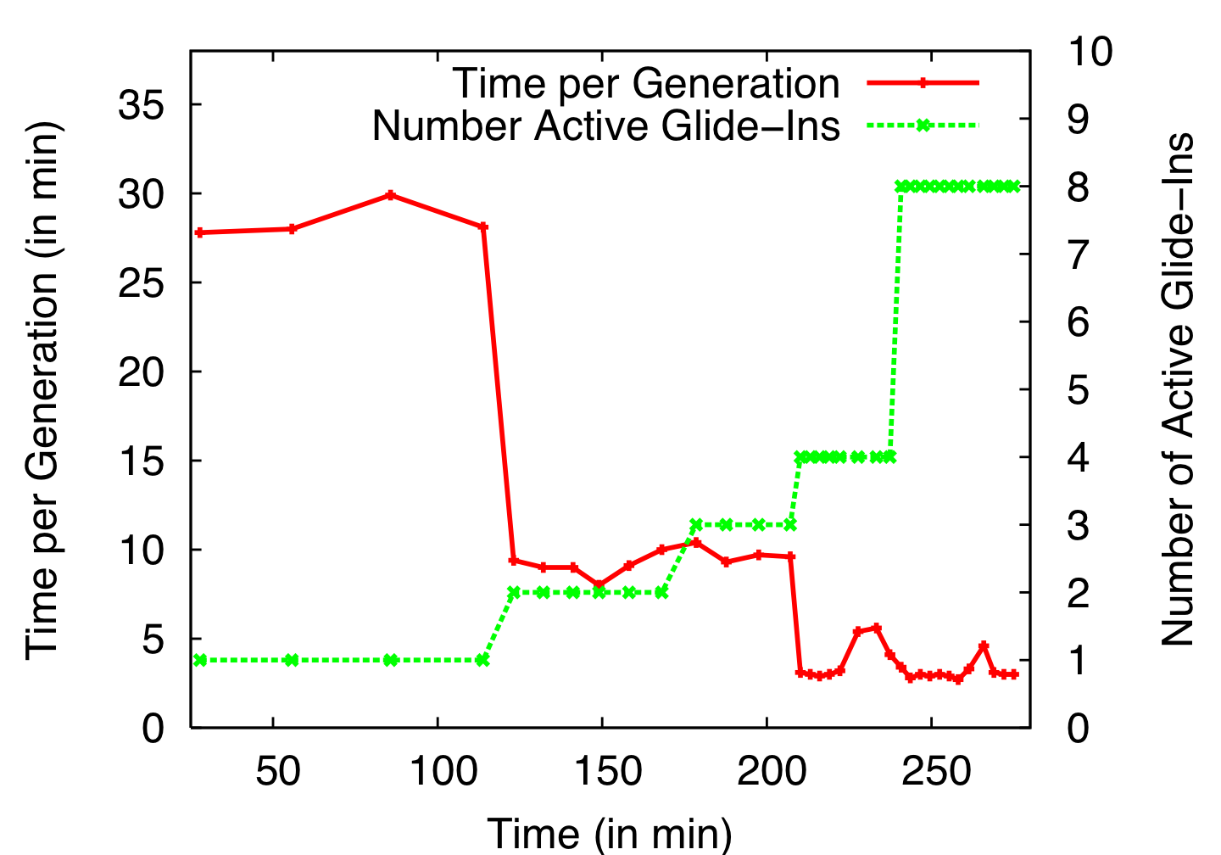
Distributed Adaptive Replica Exchange (DARE) Multiple Pilot-Jobs on the “Distributed” TeraGrid
Ability to dynamically add HPC resources. On TG:
Each Pilot-Job 64px
Each NAMD 16px
Time-to-completion improves
No loss of efficiency

Slide 33
Understanding Replica-Exchange
Why Distributed?
Many un-coupled units (ensembles/replica)
More resources, the merrier!!
How Distributed?
Many implementations exist (eg folding@home)
SAGA-based “Pilot-Jobs” to use many distributed TG resources
Limitations and Success?
Getting SAGA working on all machines!
Finding the best set of resources
Coordinating work across all the resources

Slide 34
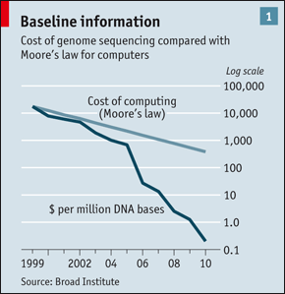
An Interesting Observation….
HW Assignment: Think about the implications of this graph
HW Assignment: Energy Cost (in Joules) of moving 1 byte of data 1meter?

Slide 35
Distributed Applications How do they differ from traditional HPC applications?
Performance Models:
Not just “peak utilization”; e.g., HPC & HTC (# of jobs)
Skillful Decomposition vs Aggregation
Primacy of Coordination across distributed resources
Usage Modes:
The same application has multiple usage modes
How applications are developed, deployed and executed is often determined by the infrastructure
Execution Environment
Typically not as well controlled or defined
Varying resource conditions, application requirements
HW Assignment: Think about applications we’ve studied and see if the above is true?

