Slide 1
Module E: Distributed Scientific Computing
Lecture E-4: To Distribute or not to Distribute?
Dr Shantenu Jha

Slide 2
Overview of Module E Distributed Scientific Computing
E3: Introduction to Cloud Computing
Introduction to Commercial / Enterprise DC aka Cloud Computing (EC2, Azure, Google) [30mins]
Using FutureGrid [30mins]
Using the Master-Worker Pattern [15mins]
E4: To Distribute or not to Distribute?
Distributed Applications Redux [30mins]
Observations on Distributed Applications [15mins]
Project Discussion/Presentation [30mins]

Slide 3
Distributed Applications Redux
For each representative distributed application we will understand:
A Brief Overview of the Application
Why it is (was) distributed?
How is the Application Distributed?
What are the challenges (or successes) ?

Slide 4
MOntage

Slide 5
Understanding Montage
Why distributed?
Scale Processing (over come size limits) above local limits
How distributed?
DAG is created
DAG is executed via a DAG-Enactor [DAGMAN]
Other approaches exist
Challenges/Issues/Success?
Mapping to right resources – to effectively use different resources, network (as now data transfer can become bottleneck)

Slide 6
NeKTAR

Slide 7
Understanding NeKTAR
Why distributed?
Full model Required 7 TB of RAM!! Factor of 10 greater
Scaled down resolution and tried to get as much as possible
Fundamental limitation on scalability of full 3D problem
Reformulated
How distributed?
MPI Based Application, use “distributed” library version of MPI
Resources selected in advance
Challenges/Issues/Success?
Co-scheduling
Single point of failure
Exponentially increasing with # of systems/resources used!

Slide 8
ENSEMBLE-BASED REPLICA-EXCHANGE

Slide 9
Understanding Replica-Exchange
Why Distributed?
Many un-coupled units (ensembles/replica)
More resources, the merrier!!
How Distributed?
Many implementations exist (eg folding@home)
SAGA-based “Pilot-Jobs” to use many distributed TG resources
Limitations and Success?
Getting SAGA working on all machines!
Finding the best set of resources
Coordinating work across all the resources

Slide 10
CLIMATEPREDICTION.NET

Slide 11
Understanding ClimatePrediction.net
Why Distributed?
Many small indep. Comp. tasks – naturally decomposable
Access many more resources without owning
Petaflop computing years before Petaflop Computing era!?
How Distributed?
BOINC -- basis for @HOME projects [Volunteer Computing]
“Trickles” – job reporting to the Master (project server)
Data too large to aggregate and analyze centrally
Hence must operate on data in-situ
Limitations and Success?
Coordinating work across all the resources
Managing changing number of resources and failures

Slide 12
SCOOP..

Slide 13
Understanding SCOOP
Why Distributed?
Naturally Distributed: Geographically distributed producers and end-users
High Peak Demand and quick response time
But with very low duty cycle --- Economic Argument !!
How Distributed?
Customized workflows
Limitations and Success?
Not Robust – Many components that need to come together
Coordinating work across all the resources
Co-scheduling / Advanced Scheduling / Prediciton a challenge

Slide 14
Distributed Applications How do they differ from traditional HPC applications?
[1] Performance Models:
Not just “peak utilization”; e.g., HPC & HTC (# of jobs)
[2] Skillful Decomposition vs Aggregation
Primacy of Coordination across distributed resources
[3] Usage Modes:
The same application has multiple usage modes
How applications are developed, deployed and executed is often determined by the infrastructure
[4] Execution Environment
Typically not as well controlled or defined
Varying resource conditions, application requirements

Slide 15
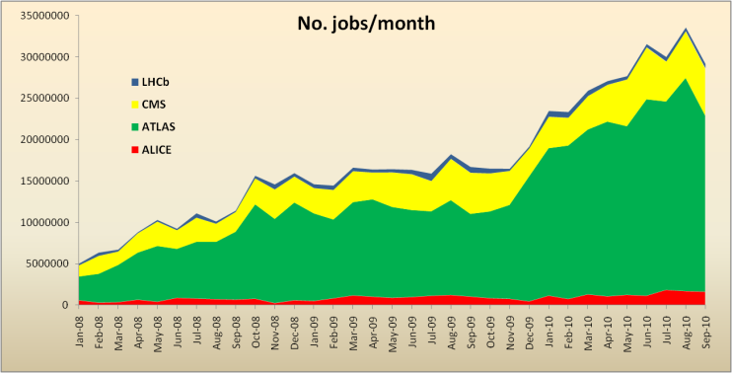
WLCG Usage
Tier 0 storage:
Accepts data at average of 2.6 GB/s; peaks > 7 GB/s
Serves data at average of 7 GB/s; peaks > 18 GB/s
CERN Tier 0 moves ~ 1 PB data per day
Use remains consistently high
1 M jobs/day; >>100k CPU-days/day
Actually much more inside pilot jobs
1 M jobs/day
~50% utilisation
Today >140 sites
~250k CPU cores
~100 PB disk

Slide 16
Distributed Applications Summary
 | Why Distributed? | How Distributed? | Challenges & Issues | How different from || ?
Montage | Processing > local limits | Workflow enactor | Coordination | [1, 2]
NeKTAR | Processing > local limits (memory) | MPIg | Advanced/Co- reservation | [1?, 4]
Ensemble-based/RE | Many compute-intensive task | SAGA, “Advert” | Coordination | [2,3]
ClimatePrediction.net | Many small tasks | BOINC, Trickles | Failures, variable # workers | [1, 4]
SCOOP | Peak req., naturally, Economic | Customized workflows | Not robust, adv. reservations | [1, 3, 4]

Slide 17
“Observations” on Distributed Applications
Is large (and rich), but the number of effective and extensible DA small
More than just submitting jobs here and there!
Developing DA is a hard undertaking
Intrinsic and Extrinsic Factors
Unique role of the Execution Environment (Infrastructure)
Embrace “distributedness”
Understanding distributedness, heterogeneity & dynamic execution is fundamental (e.g., Exascale logically distributed prog. Models)
Data-centric application will be the drivers!
Role for Pattern-oriented and Abstractions-based Development

Slide 18
Assertion #1: The space of possible DA is large, but number of effective DA small
Distributed Application: That need multiple resources, or can benefit from the use of multiple resources;
.. can benefit from increased peak performance, throughput, reduced time-to-solution
More than just HPC or HTC Applications
e.g., DDDAS scenarios
Ability to develop simple or effective distributed applications is limited
Applications that utilize multiple resources sequentially, concurrently or asynchronously is low
Developing DA > just submitting jobs to remote sites!
What the pieces of distribution are? How these pieces interact? Flow of information? What is needed to actually deploy and execute the application?

Slide 19
Assertion #2: Developing DA is a hard undertaking
Intrinsic reasons why developing DA is fundamentally hard:
Control & Coordination over Multiple & Distributed sites
Effective coordination in order for whole > sum of the parts
Complex design points; wide-range of models of DA
Many reasons for using DA, more than (just) peak performance
Extrinsic:
Execution environments will be dynamic, heterogeneous and varying degrees-of-control
Fundamental different variation in role of Execution Environment- distinguishing feature of DA from “regular environment” HPC
Application types strongly coupled to the infrastructure capabilities, abstractions/tools, & policy:
Often development tools assume “specific” deployment and execution environments, or don’t where needed!
Policies and tools, e.g production DCI has been missing for DDDAS

Slide 20
Assertion #2: Developing DA is a hard undertaking
Large number programming systems, tools and environments
Lack of extensible functionality, interfaces & abstractions
Interoperability and extensibility become difficult
Art of tool building needs to be more of science!
Applications have been brittle and not extensible:
Tied to specific tools and/or programming system
Large number of Incomplete Solutions!
Unique Role for abstractions for DA and CI
Application formulation, development and execution must be less dependent on infrastructure & provisioning details
Abstractions for Development, Deployment & Execution
A Pattern-Oriented, Abstractions-Based Approach
“Abstractions allows innovation at more interesting layers”

Slide 21
Assertion #3: Embrace Distribution
“History of computing like pendulum, swings from centralized to distributed”
Indications this time there is a fundamental paradigm shift due to DATA
Too much to move around; learn how to do analytics/compute in situ
Decoupling and delocalization of the producers-consumers of computation
Localized special services; people and collaborations are distributed
(Ironically) Most applications have been developed to hide from heterogeneity and dynamism; not embrace them
Programming models that provide dynamic execution (opposed to static), address heterogeneity etc
Logically vs Physically Distributed: NG programming models will need to support dynamic execution, heterogeneity at a logically-distributed level

Slide 22
Assertion #3: Embrace Distributedness Corollary: Clouds are not Panacea
Clouds: Novel or more of the same?
Better control over software environment via virtualization
Illusion of unlimited and immediate available resource can lead to better capacity planning and scheduling
Partly due to underlying economic model and SLAs
Clouds do not remove many/all of the challenges inherent in DA
Clouds are about provisioning, grids are about federation
Fundamental challenges in distribution remain
Makes some thing worse as impose a model of strong localization
“The reason why we are so well prepared to handle the multi-core era, is because we took the trouble to understand and learn parallel programming” – Ken Kennedy
Clouds part of a larger distributed CI
Certain tasks better suited for Grids, others on Clouds
Notes:
“Clouds are about provisioning, grids are about federation”
“IF you can keep your head when all about you, Are losing theirs and blaming it on you..”
“The reason why we are so well prepared to handle the multi-core era, is because we took the trouble to understand parallel programming

Slide 23
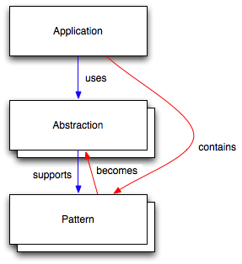
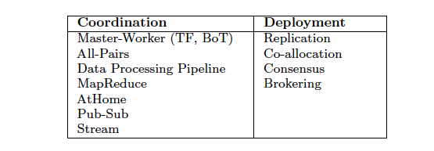
Assertion #4: Role for a Pattern-Oriented and Abstraction-Based Development Cycle
Relation between Application, Abstractions and Patterns:
Application: Need or can use >1 R
Patterns: Formalizations of commonly occurring modes of computation, composition, and/or resource usage
Devel, Deploy & Exec Phase
Abstractions: Process, mechanism or infrastructure to support a commonly occurring usage

Slide 24
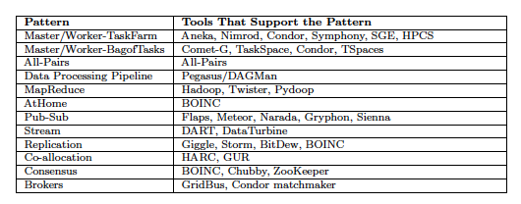
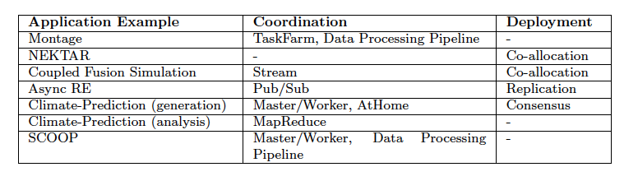
Assertion #4: Role for a Pattern-Oriented and Abstraction-Based Development Cycle
Analysis of Distributed Applications leads to three types of patterns
Patterns that appear in the Parallel Programming
Patterns driven by distributed concerns (eg @HOME, consensus)
Patterns addressing distributed environment concerns exclusively (eg co-allocation)
There exists tools that support patterns, i.e., provide abstractions

Slide 25
IDEAS: DA Development Objectives
Interoperable: Ability to work across multiple resources concurrently
Includes jobs submission, coordination mechanism,
Dynamic: Beyond legacy static execution & resource allocation models
Decisions at both deployment and run-time
Dynamical execution is almost fundamental at scale
Extensible: Support new functionality & infrastructure without wholesale refactoring, i.e., lower coupling to tools & infrastructure
Adaptive/Autonomic: Flexible response to fluctuations in dynamic resources, availability of dynamic data
Scalable: Along many dimensions and design points
Challenge: To develop DA effectively and efficiently with IDEAS as first class objectives with simplicity an over-aching concern
Notes:
“User knows where to run”:
“Information Service is only required to determine decisions at the deployment stage not run time”
“Tool X provides Dynamic Decision Capabilties”

Slide 26
FutureGrid: Eucalyptus
Eucalypus has similar API to EC2
EMI similar to Amazon Machine Image (AMI)
VM = Bind a (machine) Image to an Instance
Multiple Hardware Instance type
‘root’ access to VM’s
Starting point:
http://saga.cct.lsu.edu/software/cpp/documentation/tutorials/sagaeuca

