Slide 1



Introduction to the SAGA API

Slide 2
SAGA Design Principles
SAGA: Simple API for Grid Applications
OGF approach to a uniform API layer (facade)
governing principle: 80:20 rule
simplicity versus control!
top-down approach
defines application level abstractions
extensible
stable look & feel
API packages
API Specification is language independent (IDL)
Renderings exist in C++, Python, Java
Examples here are in C++

Slide 3
Grid APIs and Frameworks
Middleware often targets legacy applications (Unicore, Globus, Condor, ...)
some are distribution aware (MPICH-G, Ninf-G, . . . )
few APIs exist for Grid aware applications
GridFTP/GRAM, DRMAA, gLite, CoG, GAT, Cloud APIs
diversity of Grid Middleware implies diversity of APIs
some APIs try to generalize Grid programming concepts
difficult to keep up with MW development, and to stay simple

Slide 4
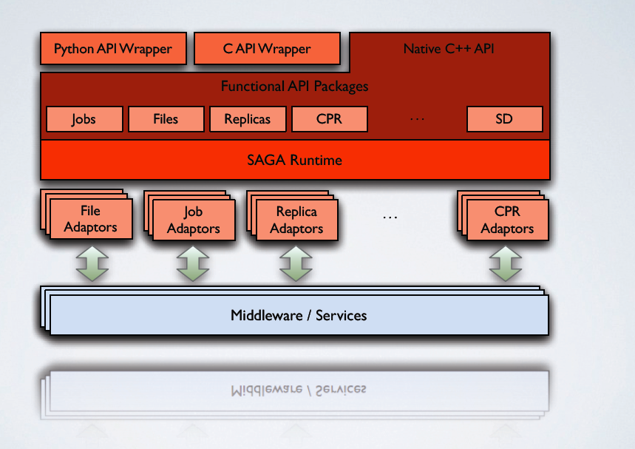
SAGA: In a thousand words..

Slide 5
SAGA Intro: Example
// SAGA: Job Submission example
saga::job::description jd;
// details left out
saga::job::service js ("any://remote.host.net/");
saga::job::job j = js.create_job (jd);
j.run ();
cout << "Job State: " << j.get_state () << endl;
j.wait ();
cout << "Retval " << j.get_attribute ("ExitCode") << endl;

Slide 6
SAGA Intro: Example
// SAGA: Job Submission example
saga::job::service js ("any://remote.host.net");
saga::job::job j = js.run_job ("touch /tmp/touch.me");
cout << "Job State: " << j.get_state () << endl;
j.wait ();
cout << "Retval " << j.get_attribute ("ExitCode") << endl;

Slide 7
SAGA Intro: Example
stateful objects!
yet another job description language? :-(
many hidden/default parameters
keeps call signatures small
’any://’ again!
TIMTOWTDI (there is more than one way to do it)

Slide 8
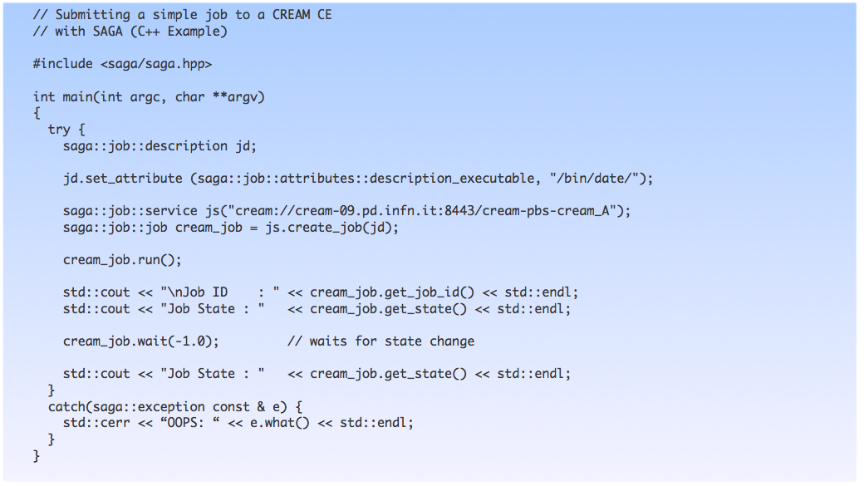
SAGA/CREAM C++ Example

Slide 9
Programmers Guide
Set of very small and easy examples, one for each package/paradigm
file_copy, file_copy (async)
Error handling
Attributes
Stream (server/client)
https://svn.cct.lsu.edu/repos/saga/core/trunk/docs/manuals/programming_guide/tex/saga-programming-guide.pdf

Slide 10
SAGA Intro: 10.000 feet
object oriented: inheritance, interfaces very moderate use of templates though!
functional and non-functional elements strictly separated
non-functional API:
look & feel: orthogonal to functional API
typically not mappable to remote operations
functional API:
API ’Packages’ extensible
typically mappable to remote operations
few inter-package dependencies - allows for partial implementations

Slide 11
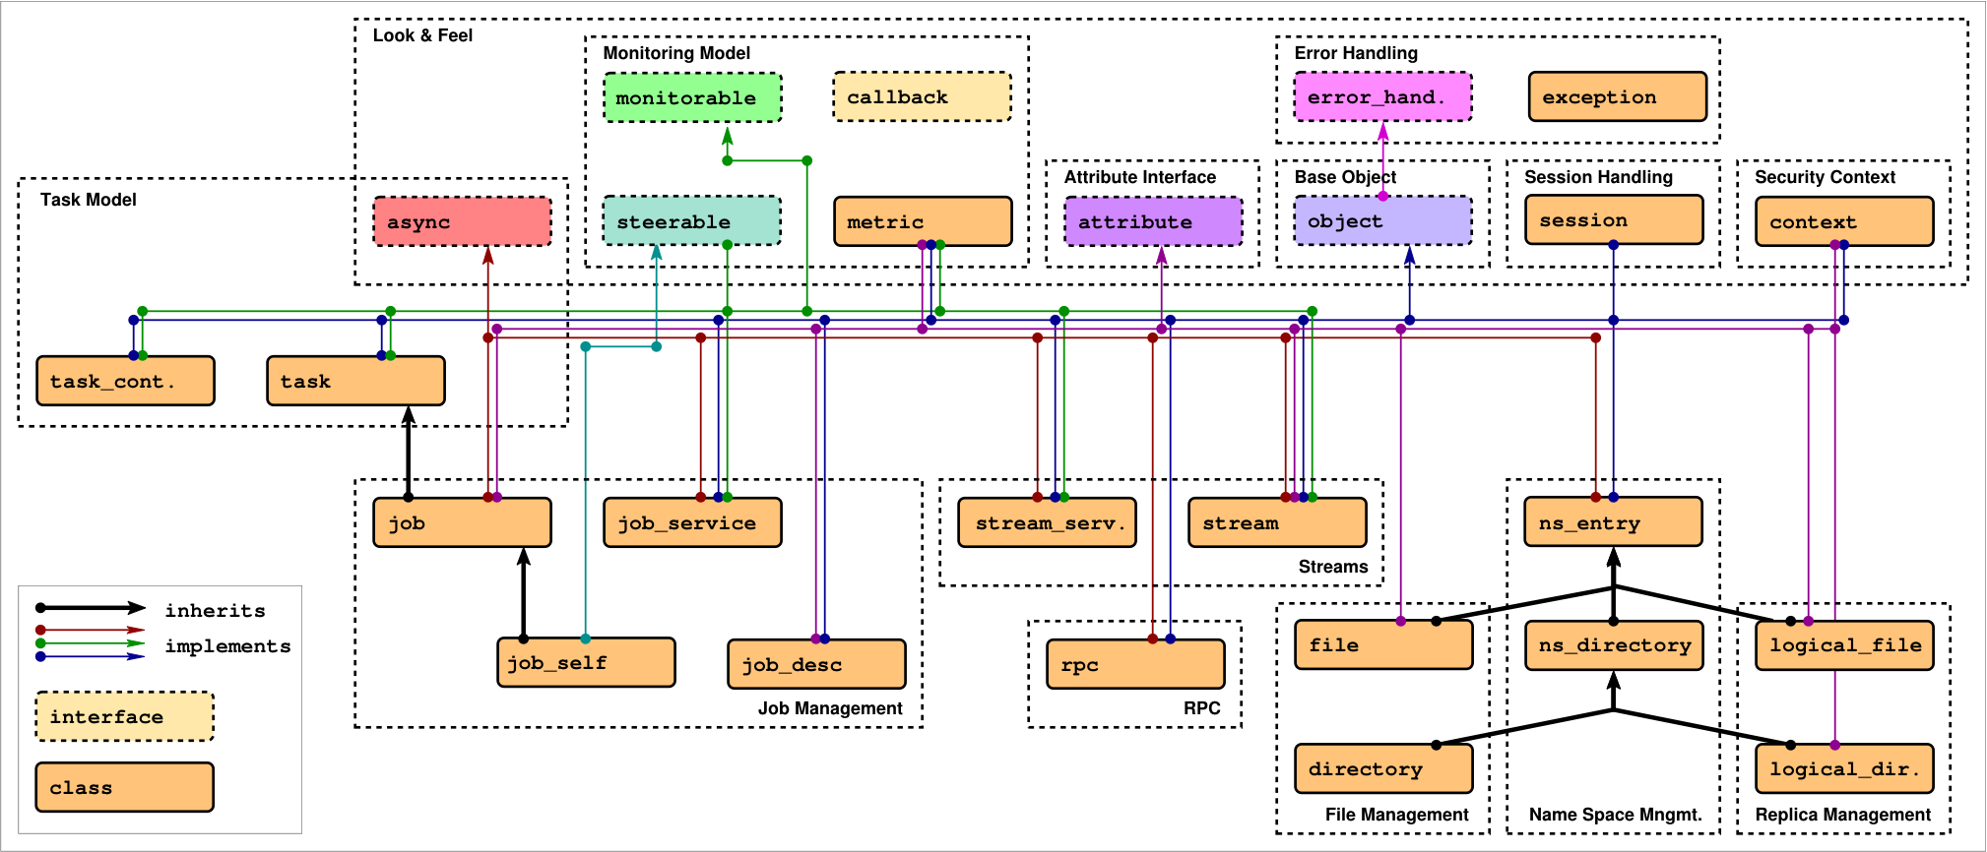
SAGA: Class hierarchy

Slide 12
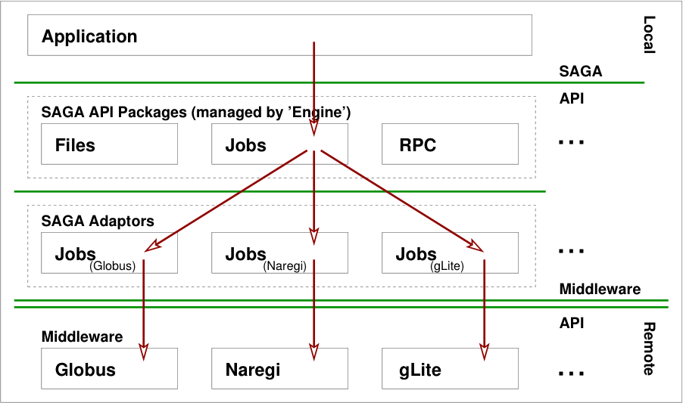
Implementation

Slide 13

SAGA: In a nutshell
There exists a lack of Programmatic approaches that:
Provide general-purpose, basic &common grid functionality for applications and thus hide underlying complexity, varying semantics..
The building blocks upon which to construct “consistent” higher-levels of functionality and abstractions
Meets the need for a Broad Spectrum of Application:
Simple scripts, Gateways, Smart Applications and Production Grade Tooling, Workflow…
Simple, integrated, stable, uniform and high-level interface
Simple and Stable: 80:20 restricted scope and Standard
Integrated: Similar semantics & style across
Uniform: Same interface for different distributed systems
SAGA: Provides Application* developers with units required to compose high-level functionality across (distinct) distributed systems
(*) One Person’s Application is another Person’s Tool

Slide 14
Installation and Configuration For any problem, send mail to saga-users@cct.lsu.edu For more info see: http://saga.cct.lsu.edu/software/cpp/mailing-lists
Building and Installing

Slide 15
Installation
SAGA is written in C++ and a little bit of Python. To build and install it, you’ll need at least:
C++ compiler and library
make tools
Python (optional)
All SAGA components require the Boost C++ libraries (>= 1.33.1). They are available as binary packages on many (Linux) systems. The source installer can be downloaded at http://www.boost.org
Adaptors require additional libraries / tools to be installed (e.g. Globus libs, PostgreSQL client libs, etc…)

Slide 16
Installation (Core Components)
Prerequisites: Boost C++ libraries and the PostgreSQL client libraries if you want to use the default advert and replica adaptors
Download and unpack the Core Components. Decide where you want to install SAGA (local/global). Run configure and make:
$> export SAGA_LOCATION=/install/location/dir/
$> ./configure --prefix=SAGA_LOCATION --with-boost= --with-postgresql=
$> make
$> make install

Slide 17
Installation Recap
SAGA_LOCATION must point to your Core Components installation
Different Adaptors may have different configure options. ./configure --help might help ;-)
Each adaptor comes with a file called: INSTALL Read it!

Slide 18
Configure Environment
SAGA_LOCATION is the only required environment variable. It makes sense to put it e.g. in your .bashrc
You will also have to add SAGA to your loader and Python paths if it is not installed in /usr or /usr/local
export SAGA_LOCATION=/install/location/dir/
export LD_LIBRARY_PATH=${SAGA_LOCATION}/lib:$LD_LIBRARY_PATH
export DYLD_LIBRARY_PATH=${SAGA_LOCATION}/lib:$DYLD_LIBRARY_PATH # On MacOS
export PYTHONPATH=${SAGA_LOCATION/lib/pythonX.Y/site-packages/:${PYTHONPATH}

Slide 19
Quick Start: Mepisto [This will install version 1.5.2]
To simplify installation we have Mephisto:
http://faust.cct.lsu.edu/trac/mephisto
But read warning at (bottom of):
http://saga.cct.lsu.edu/software/cpp/download
svn co https://svn.cct.lsu.edu/repos/saga-projects/applications/mephisto/
cd trunk
perl mephisto.pl install –target-dir=/usr/local
On Futuregrid might use $HOME/saga-meph-1.5.2 [just a suggestion]

Slide 20
SAGA from Basics: This will install svn trunk version
Instructions at:
http://saga.cct.lsu.edu/software/cpp/documentation/building-and-deploying-saga/build-everything-from-scratch
If you have wget, see also:
https://svn.cct.lsu.edu/repos/sci-comp/public/Module-E/saga-from-scratch.txt

Slide 21
SAGA On FutureGrid [Quick]
1. svn export https://svn.cct.lsu.edu/repos/sci-comp/public/Module-E/sagatrunk-fg.tgz
2 tar –zxvf sagatrunk-fg.tgz
3 create a file $HOME/.sagarc [also at https://svn.cct.lsu.edu/repos/sci-comp/public/Module-E/.sagarc ]
4 Add following: DON’T FORGET TO SET SAGA_LOCATION
export SAGA_LOCATION=$HOME/saga-test/sagameph
export LD_LIBRARY_PATH=${SAGA_LOCATION}/lib:${SAGA_LOCATION}/MapReduce.terasort/source/mapreduce/:$LD_LIBRARY_PATH
export PYTHONPATH=${SAGA_LOCATION}/lib/python2.6/site-packages/:${PYTHONPATH}
export BOOST_LOCATION=$SAGA_LOCATION/
export PATH=$SAGA_LOCATION/bin:$PATH

Slide 22
Test The Installation!
Use the SAGA file tool to print the contents of a file
Import the SAGA module into Python
$ SAGA_LOCATION/bin/saga-file cat file://localhost/etc/passwd
..
..
..
$ python
Python 2.6.1 (r261:67515, Feb 11 2010, 00:51:29)
[GCC 4.2.1 (Apple Inc. build 5646)] on darwin
Type "help", "copyright", "credits" or "license" for more information.
>>> import saga
>>> saga
<module 'saga' from '/opt/saga-svn/lib/python2.6.1/site-packages/saga/__init__.pyc'>

Slide 23
Example 1: hello_world
Hello world
Launch 3 jobs on different machines
Execute “/bin/echo”
No job dependency
Each job returns its passed input argument
"Hello"
"distributed"
"world!"
Jobs are launched in parallel (in separate threads)
As soon as result is collected it's printed on local console

Slide 24
Example 1: hello_world
Hello world
Arbitrary sequence of results
Optimally: "Hello distributed world!"
Demonstrates
How to launch a remote job using SAGA job_service
Pass arguments using the command line
Collect result by output redirection
The source code can be found here (see ‘Example1’):
https://svn.cct.lsu.edu/repos/saga/core/trunk/examples/tutorial/hello_world.cpp
The example uses localhost to spawn childs
HW: Compile and run hello world 10 times. What do you notice?

Slide 25
Command line tools
SAGA comes with simple command line tools that allow to access basic package functionality.
The source code is very simple and a great starting point to explore the SAGA package APIs:
saga-file $SAGA_LOCATION/saga/tools/clutils/file/
saga-job $SAGA_LOCATION/saga/tools/clutils/job/
saga-advert $SAGA_LOCATION/saga/tools/clutils/advert/
saga-shell $SAGA_LOCATION/saga/tools/shell/

Slide 26
Command line tools
‘Shell bindings’
Package specific (file, job, advert, replica)
SAGA shell
All in one solution
Filesystem navigation (filesystem, advert, replica)
Job launching
Scripting

Slide 27
Command line tool: saga-file
Supported protocols
Depends on SAGA adaptors
Also available: Globus GridFTP, Curl (subset), KFS, Amazon EC2, Opencloud (Sector/Sphere), Hadoop (HDFS)
Supported commands:
Command | Arguments
copy | <url from> <url to>
move | <url from> <url to>
remove | <url>
cat | <url>
list_dir | <url>

Slide 28
Command line tool: saga-job
Supported protocols
Depends on SAGA adaptors
Also available: Globus Gram, Condor, OMII-GridSAM, LSF, Amazon EC2, Opencloud (Sector/Sphere)
Supported commands:
Command | Arguments
run | <rm url> <command> <arguments>
submit | <rm url> <command> <arguments>
state | <rm url> <jobid>
suspend | <rm url> <jobid>
resume | <rm url> <jobid>
cancel | <rm url> <jobid>

Slide 29
Command line tool: saga-advert
What is it?
Central data store with
Hierachical keys
Attributes
Filesystem like structure
Supported protocols
Depends on SAGA adaptors
Local adaptor:
Local backend: SQLite3
Remote backend: PostgreSQL
Also available: Hadoop H-Base, Hypertable

Slide 30
Command line tool: saga-advert
Supported commands:
Command | Arguments
list_directory | <advert-url> <pattern>
add_directory remove_directory | <advert-url>
add_entry remove_entry | <advert-url>
store_string | <advert-url> <string>
retrieve_string | <advert-url>
list_attributes | <advert-url>
set_attribute | <advert-url> <key> <value>
remove_attribute | <advert-url> <key>

Slide 31
Command line tool: saga-shell
All in one of all command line tools as mentioned earlier
Keeps context in between commands
Navigate (remote) filesystems (advert, replica too!)
Launch (remote) jobs, uses io redirection to access in/out
All commands are implemented using SAGA

Slide 32
Command line tool: saga-shell
Some of the supported commands
Type | Commands
File system navigation | pwd, ls, mv, cp, cd, mkdir, rmdir, touch, cat
Job package | run, suspend, resume, kill, status, ps
replica | rep_find, rep_list, rep_add, rep_remove, rep_update, rep_replicate
environment | setenv, getenv, env
permissions | add_proxy, remove_proxy

Slide 33
Installation (Python Bindings)
Prerequisites: SAGA Core Components and Python (>= 2.3 with shared libraries installed)
Download and unpack the Python Bindings Run configure and make:
$> export SAGA_LOCATION=/install/location/dir/
$> ./configure --with-python=
$> make
$> make install

Slide 34
Installation (Globus Adaptors)
Prerequisites: SAGA Core Components and the Globus Toolkit (available at http://www.globus.org)
Download and unpack the Globus Adaptors Run configure and make:
This works similar for all other SAGA Adaptors
$> export SAGA_LOCATION=/install/location/dir/
$> export GLOBUS_LOCATION=/path/to/your/globus/installation
$> ./configure --with-globus-location= --with-globus-flavor=
$> make
$> make install

