Slide 1

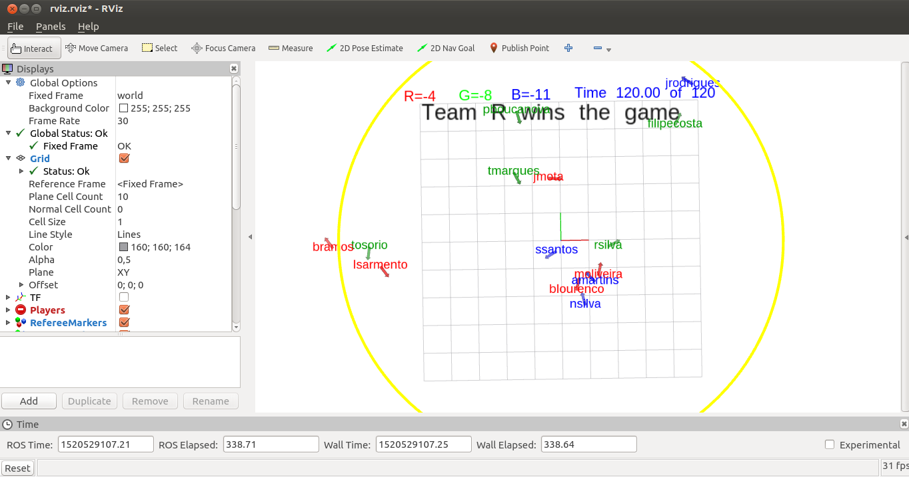

Workshop 2019 Certificate
https://github.com/miguelriemoliveira/rws2019_moliveira
I, Miguel Armando Riem de Oliveira, Assistant Professor at University of Aveiro, declare that ______________________________________ participated in a hands on workshop of ROS (Robot Operating System) which took place during February 2019, and consisted in a total of 25 hours
University of Aveiro, March, 2019
Prof. Miguel Riem Oliveira
University of Aveiro, March, 2019

