Slide 1
Data Models
Miguel Romero Karam

Slide 2
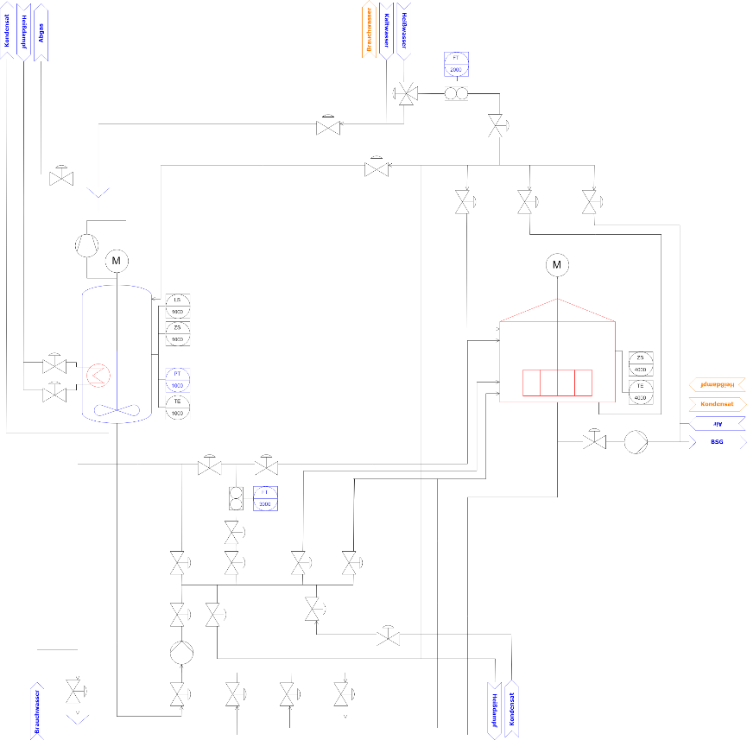
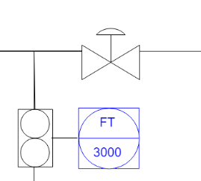
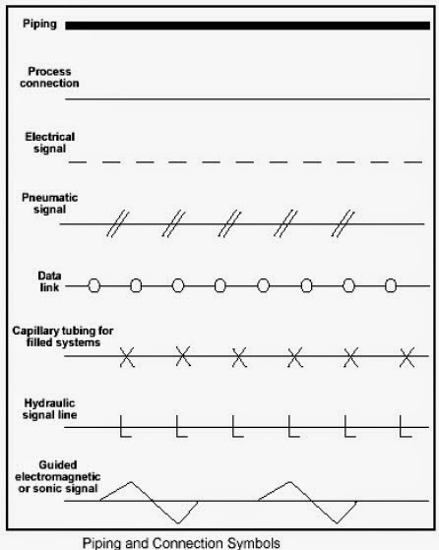

Required attributes for P&ID Tag Identifiers
Verteci (modelled in l_nodes)
KEY
 | Runtime-generated
 | Shapes Library
 | Database
B
D
A
Equipment
 | id : String
 | shapeName : String
 | pidLabel : String = null *
 | instrumentIds : Array of Strings
Instrument
 | id : String
 | shapeName : String
 | pidLabel : String = null
 | pidFunction : String ***
 | pidNumber : String
 | instrumentParentId : String
C
Group
 | id : String
 | shapeName : String = group
 | pidLabel : String = unit *
Arrow
 | id : String
 | shapeName : String = group
 | pidLabel : String = unit *
0..*
1
P&ID of Aida Brewery:
D
Pump_station
Edges (modelled in pro_flows)
shapeName defines line type:
E
Line
 | id : String
 | shapeName : String
 | pidLabel : String = Stereotype
 | instrumentIds : Array of Strings
 | source : String
 | target : String
 | 1 | pipe_line
 | 2 | connection_line
 | 3 | signal_line
 | 4 | data_line
1
1
E
A
E
[blank]
[blank]
1
HV3051
2
A
B
3
FT
3
[blank]
3000
4
3
[blank]
3
C
3
Wasser
*Manually entered in model -> recorded in database table. Default value is an empty string, which results in no label.

Slide 3
Data Sources: P&ID Visualization Instances
Verteci
Edges
Fetched from Database
A | Equipment
 | _id
 | …
 | pidClass
 | shapeDomain
 | shapeClass
 | shapeCategory
 | shapeType
 | shapeSubtype
 | shapePath
 | shapeThumbnail
 | _vertex
 | _style
 |  | shape
 |  | overflow
 |  | actuator
 |  | direction
 |  | fanType
 |  | columnType
 |  | valveType
 |  | defState
 |  | actuator
 |  | html
 |  | align
 |  | verticalLabelPosition
 |  | verticalAlign
 |  | dashed
 |  | strokeColor
 |  | fontSize
 |  | fontColor
 |  | rotation
 | _value
 | _parent
 | mxGeometry
 |  | _x
 |  | _y
 |  | _width
 |  | _height
 |  | _as
B | Instruments
 | _id
 | …
 | pidClass
 | shapeDomain
 | shapeClass
 | shapeCategory
 | shapeType
 | shapeSubtype
 | shapePath
 | shapeThumbnail
 | _vertex
 | _style
 |  | shape
 |  | overflow
 |  | mounting
 |  | indType
 | _value
 | _parent
 | mxGeometry
 |  | _x
 |  | _y
 |  | _width
 |  | _height
 |  | _as
C | Arrow
 | _id
 | …
 | pidClass
 | shapeDomain
 | shapeClass
 | shapeCategory
 | shapeType
 | shapeSubtype
 | shapePath
 | shapeThumbnail
 | _vertex
 | _style
 |  | shape
 |  | dy
 |  | dx
 |  | notch
 |  | html
 |  | verticalAlign
 |  | dashed
 |  | strokeColor
 |  | strokeWidth
 |  | fillColor
 |  | fontSize
 |  | fontColor
 |  | rotation
 | _value
 | _parent
 | mxGeometry
 |  | _x
 |  | _y
 |  | _width
 |  | _height
 |  | _as
 | mxPoint
 |  | _x
 |  | _y
 |  | _as
D | Group
 | _id
 | …
 | pidClass
 | shapeThumbnail
 | _vertex
 | _style
 |  | shape
 |  | group
 |  | container
 |  | html
 |  | dashed
 |  | strokeColor
 | _value
 | _connectable
 | _parent
 | mxGeometry
 |  | _x
 |  | _y
 |  | _width
 |  | _height
 |  | _as
 | mxPoint
E | Line
 | _id
 | …
 | pidClass
 | shapeThumbnail
 | _edge
 | _style
 |  | edgeStyle
 |  | exitX
 |  | exitY
 |  | entryX
 |  | entry
 |  | startArrow
 |  | startFill
 |  | startSize
 |  | endArrow
 |  | endFill
 |  | endSize
 |  | jettySize
 |  | orthogonalLoop
 |  | html
 |  | align
 |  | dashed
 |  | dashPattern
 |  | strokeColor
 |  | strokeWidth
 |  | fontSize
 |  | fontColor
 | _value
 | _source
 | _target
 | _parent
 | mxGeometry
 |  | _relative
 |  | _as
 | mxPoint
 |  | _x
 |  | _y
 |  | _as
Verteci (all)
 | _id
 | shapeName
 | pidLabel
 | pidFunction
 | pidNumber
 | instrumentIds
 | site
 | area
 | cell
 | unit
 | eModule
 | variable
Edges
 | _id
 | shapeName
 | pidLabel
 | instrumentIds
 | source
 | target
 | eModule
 | variable
KEY
 | Excel (Model) Brewery
 | Runtime-generated
 | Shapes Library
 | Database

Slide 4
Data Model of P&ID Project
KEY
 | Blank (null)
 | Runtime-generated ???
 | Shapes Library
 | Database
Database
A | B | D | C | E | Shape *
 |  |  |  |  | _id
 |  |  |  |  | pidClass
 |  |  |  |  | shapeName
 |  |  |  |  | shapeDomain
 |  |  |  |  | shapeClass
 |  |  |  |  | shapeCategory
 |  |  |  |  | shapeType
 |  |  |  |  | shapeSubtype
 |  |  |  |  | shapePath
 |  |  |  |  | shapeThumbnail
 |  |  |  |  | _vertex
 |  |  |  |  | _edge
 |  |  |  |  | _style
 |  |  |  |  |  | shape
 |  |  |  |  |  | overflow
 |  |  |  |  |  | actuator
 |  |  |  |  |  | mounting
 |  |  |  |  |  | indType
 |  |  |  |  |  | direction
 |  |  |  |  |  | fanType
 |  |  |  |  |  | columnType
 |  |  |  |  |  | valveType
 |  |  |  |  |  | defState
 |  |  |  |  |  | actuator
 |  |  |  |  |  | dy
 |  |  |  |  |  | dx
 |  |  |  |  |  | notch
 |  |  |  |  |  | edgeStyle
 |  |  |  |  |  | exitX
 |  |  |  |  |  | exitY
 |  |  |  |  |  | entryX
 |  |  |  |  |  | entry
 |  |  |  |  |  | startArrow
 |  |  |  |  |  | startFill
 |  |  |  |  |  | startSize
 |  |  |  |  |  | endArrow
 |  |  |  |  |  | endFill
 |  |  |  |  |  | endSize
 |  |  |  |  |  | jettySize
 |  |  |  |  |  | orthogonalLoop
 |  |  |  |  |  | group
 |  |  |  |  |  | container
 |  |  |  |  |  | html
 |  |  |  |  |  | align
 |  |  |  |  |  | verticalLabelPosition
 |  |  |  |  |  | verticalAlign
 |  |  |  |  |  | labelPosition
 |  |  |  |  |  | dashed
 |  |  |  |  |  | dashPattern
 |  |  |  |  |  | strokeColor
 |  |  |  |  |  | strokeWidth
 |  |  |  |  |  | fillColor
 |  |  |  |  |  | fontSize
 |  |  |  |  |  | fontColor
 |  |  |  |  |  | rotation
 |  |  |  |  | _value
 |  |  |  |  | _connectable
 |  |  |  |  | _visible
 |  |  |  |  | _collapsed
 |  |  |  |  | _source
 |  |  |  |  | _target
 |  |  |  |  | _parent
 |  |  |  |  | _children
 |  |  |  |  | _edges
 |  |  |  |  | mxTransient
 |  |  |  |  | mxGeometry
 |  |  |  |  |  |  | relative
 |  |  |  |  |  |  | x
 |  |  |  |  |  |  | y
 |  |  |  |  |  |  | width
 |  |  |  |  |  |  | height
 |  |  |  |  |  |  | as
 |  |  |  |  | mxPoint
 |  |  |  |  |  |  | x
 |  |  |  |  |  |  | y
 |  |  |  |  |  |  | as
Shapes library
Equipment
 | id : String
 | shapeName : String
 | pidLabel : String = null *
 | instrumentIds : Array of Strings
1
Instrument
 | id : String
 | shapeName : String
 | pidLabel : String = null
 | pidFunction : String ***
 | pidNumber : String
 | instrumentIds : Array of Strings
0..*
Arrow
 | id : String
 | shapeName : String = group
 | pidLabel : String = unit *
Group
 | id : String
 | shapeName : String = group
 | pidLabel : String = unit *
Line
 | id : String
 | shapeName : String
 | pidLabel : String = null *
 | instrumentIds : Array of Strings
 | source : String
 | target : String
** Manually inserted (either according to standard or to previously existing labels. Leads to flexible labeling system)
*Statically defined, instantiated at runtime

Slide 5
Data Map to Database Tables
Required in database:
Nodes (all)
_id
parent
shapeName : String
isInstrument : Bool
pidLabel : String = null
pidFunction : String = null
pidNumber : String = null
current_value
unit
l_nodes
p_values_config
p_value_relations
id
id
id
parent
connection
node
short_name
value_symbol
value
name_0
name_0
display
description_0
description_0
allow_modify
name_1
name_1
shift_protocoll
description_1
description_1
availability
gen_dsp_options
parent
auto_calc
spatial_infos
from_import
sort_id
node_level
plcoperand
kpi_type
model_pattern
value_format
kpi_delta
node_type
value_type
current_value
factor
unit
last_update
offset_sec
numval_format
svg_view
output
rpt_path
allow_update_output
prj_prc_pro_flows
prj_prc_pro_ports
Edges
_id
shapeName : FROM STEREOTYPE
pidLabel : String = null
source
target
current_value ????????
unit ????????
is_hidden
color_class_id
sort_id
archive
id : Int32z
id : Int32
attr_jsonb
delta
node_0 : Int32 ?
modelId
current_value
node_1 : Int32 ?
node : Int32
standing data
last_update
port_0 : Int32 ?
type : String?Int32
shapeName
port_1 : Int32 ?
name : String
isInstrument
product : Int32
pidLabel
continuous : Bool
product : Int32
pidFunction
rate : Int32
rate : Int32
pidNumber
pidLabel : String
rate : Int32

