Slide 1

Dynamic Generation of Modular Industrial Plant Visualizations
Bachelor Thesis
Miguel Romero Karam

Slide 2
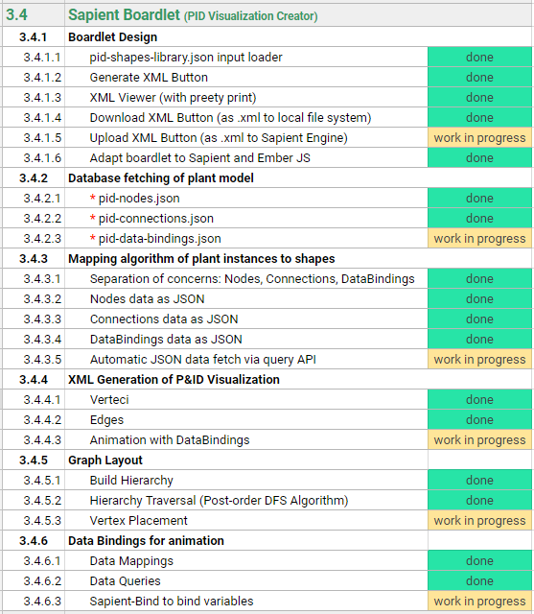
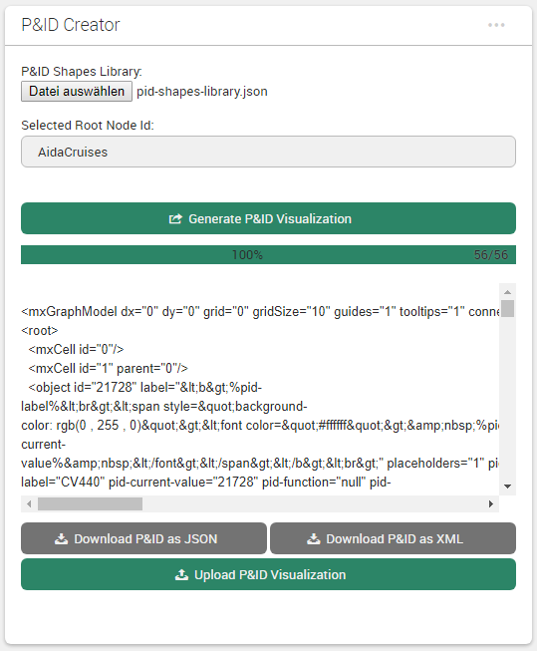
Sapient Boardlet Weekly Sprint 15

