Slide 1

Dynamic Generation of Modular Industrial Plant Visualizations
Weekly Meeting 10
Miguel Romero Karam

Slide 2
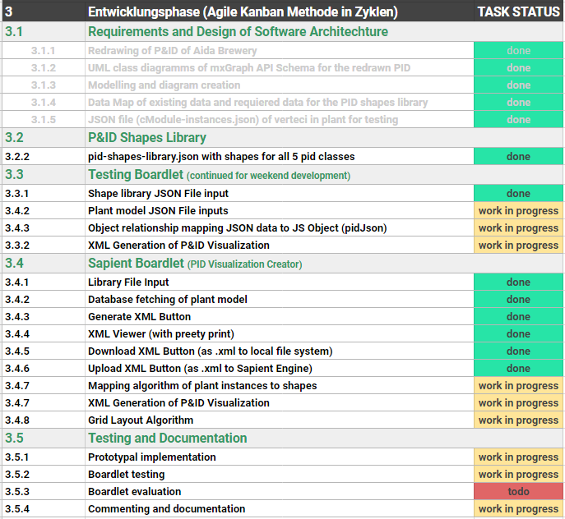
Task Backlog – Overview Overview of tasks: Week 10

Slide 3
Task Backlog – Overview Overview of tasks: Week 10

Slide 4
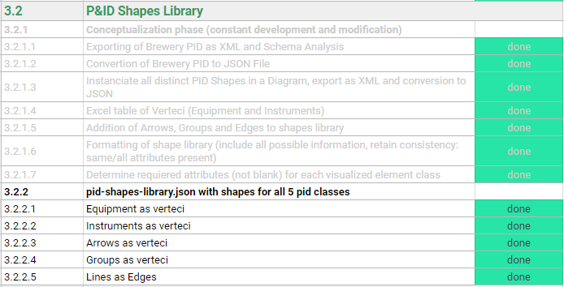
P&ID Shapes Library Weekly Sprint 10
Changes to equipment
Size modifications to be made (defaults left for now)
Arrows and groups defined in library but won’t be implemented for now
Groups are defined in l_nodes, they will serve for inclusion graphing algorithm
4 shape types defined. shapeName defines line type:
 | 1 | pipe_line
 | 2 | connection_line
 | 3 | signal_line
 | 4 | data_line

Slide 5
Task Backlog – Overview Overview of tasks: Week 10

Slide 6
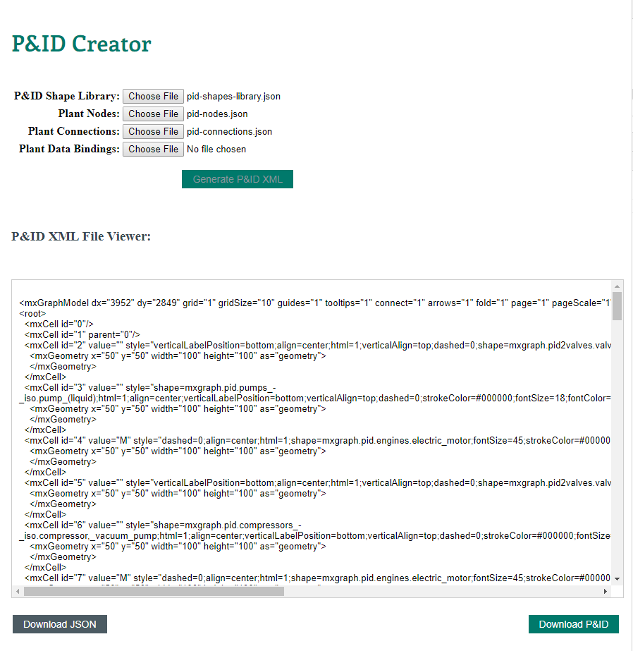
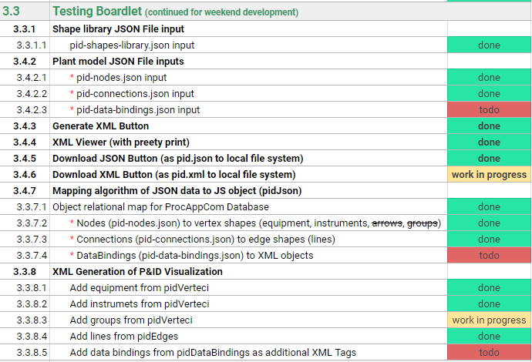
Testing Boardlet Weekly Sprint 10
In client- background
Allows work during weekend
Allows testing with json data * (instead of database fetches)
Separation of concerns. 3 DB fetches → 3 separate json file inputs for model

Slide 7


Task Backlog – Overview Overview of tasks: Week 10

Slide 8
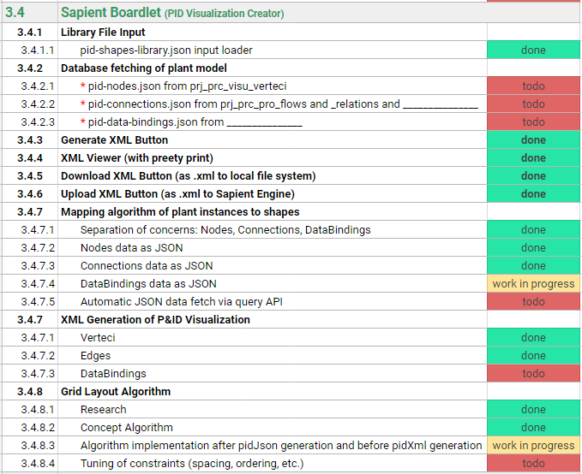
Sapient Boardlet Weekly Sprint 10
Insert screenshot here of boardlet and show demo (add link to title)

Slide 9
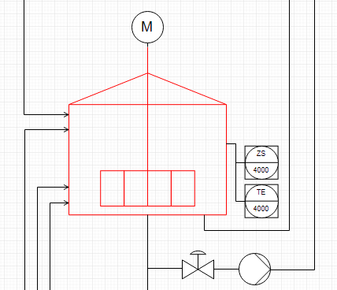
3.4.8 – Grid Layout Algorithm Concept
Oder ist Instance hierarchy als levels 0-7 im Modell implementiert?
Depth-first approach to loop through instance hierarchy (IH).
Count units to construct general grid layout.
Implement Units and CModules as groups (containers) with mxGraph API.
Vertex placement inside group: square grid algorithm places nodes inside
Rules for example: if (valve to instrument) : instrument above valve
Enterprise : AIDA Cruises
1
Site : AIDA
2
Area : Brewery
3
Brewhouse : Process Cell
4
Constructs grid layout as 2D-array
Units layed out inside each grid cell separately, units placed in grid at the end.
Unit : U_L2
5
U_M5
1
U_P3
5
U_W3
1
EModule : Water_injection
6
Stem_ heating
11
16
…
…
…
…
…
…
…
…
…
…
…
…
…
CModule :
6
7
8
9
10
12
13
14
15
…
…
…
…
…
…
…
Control_valve_440
Pump_P40
Motor
Kettle_sensor_Z
Kettle_sensor_T

Slide 10
Issues and challenges Weekly Sprint 10
Default sizes not to scale → Size modifications to be made (defaults left for now)
Time complexity of grid layout algorithm → Optimize!
Instance hierarchy (parent-child relationships defined in l_nodes) will serve for inclusion graphing algorithm to group
shapeName defines line type, but line type is implemented as a stereotype, or under which table?
Use node_level (0-4: site, area, cell, unit, emodule) for groups or set shapeName also for these instances in l_nodes (for example: shapeName = site_group)
Instrumet is CModule. But is its node_level the same as his parent’s (for example tank), or one less?

Slide 11
Next Sprint Weekly Sprint 10

