Slide 1
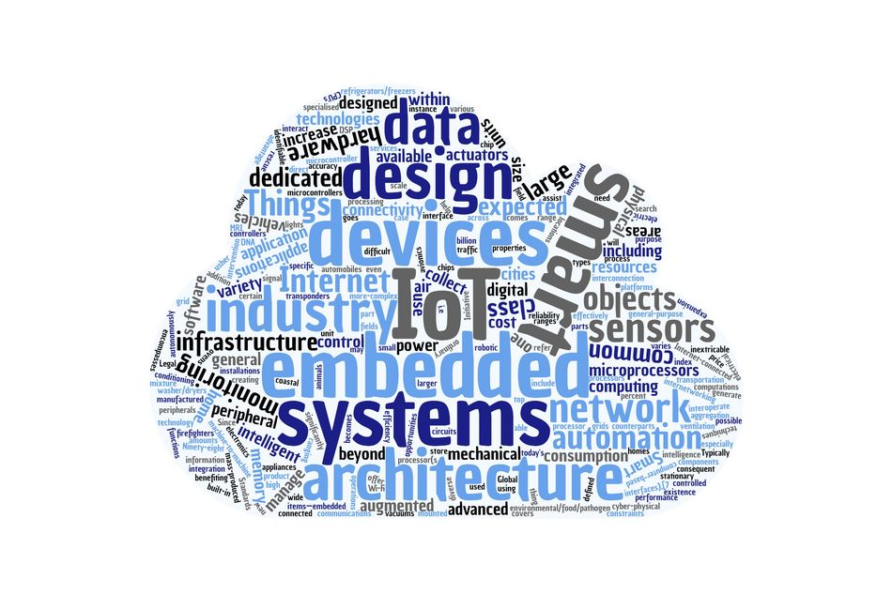
Runtime Deployment, Management and Monitoring of Web of Things Systems
Miguel Romero Karam miguel.romero@tum.de Embedded Systems and Internet of Things Department of Electrical and Computer Engineering
Munich | December 14, 2020

Slide 2
Introduction
Approach
Evaluation
Conclusion

Slide 3
Introduction
Motivation
WoT Thing Description
WoT System Description
Problem Statement
Approach
Evaluation
Conclusion

Slide 4
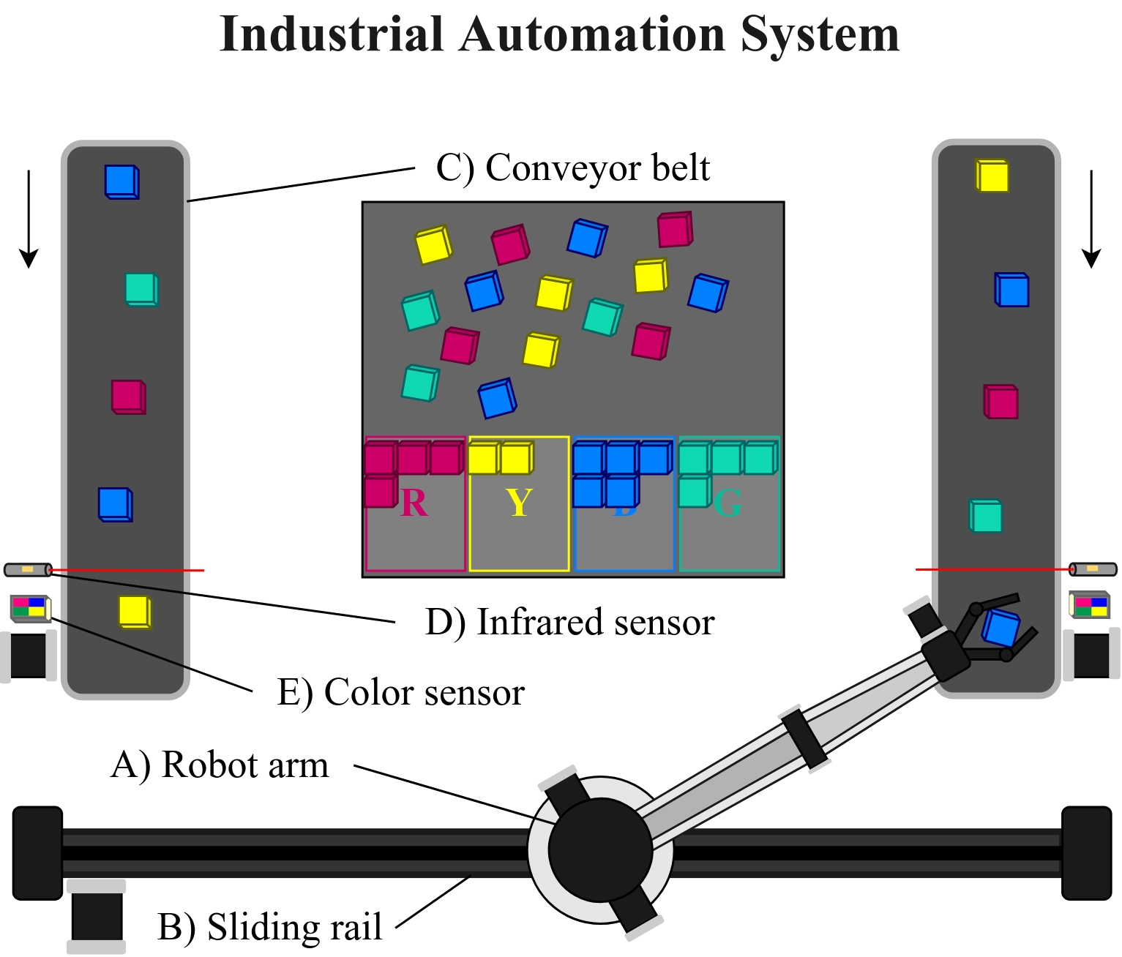

Introduction Motivation

Slide 5
Introduction
Motivation
WoT Thing Description
WoT System Description
Problem Statement
Approach
Evaluation
Conclusion

Slide 6


Introduction WoT Thing Description
TD of Conveyor Belt
"name": "LeftConveyorBelt",
"@type": "conveyor-belt",
"properties": [
"speed": {
"type": "number", "minimum": -100.0,
"maximum": 100.0
},
"status": {{
"type": "string", "enum": [ "on", "off" ],
}
],
"actions: [
"start": {...},
"stop": {...},
],
"events: [
"emergencystop": {...},
],
"security": [...]

Slide 7
Introduction
Motivation
WoT Thing Description
WoT System Description
Problem Statement
Approach
Evaluation
Conclusion

Slide 8
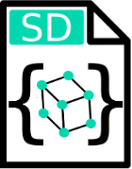
Introduction WoT System Description

Slide 9
Introduction
Motivation
WoT Thing Description
WoT System Description
Problem Statement
Approach
Evaluation
Conclusion

Slide 10


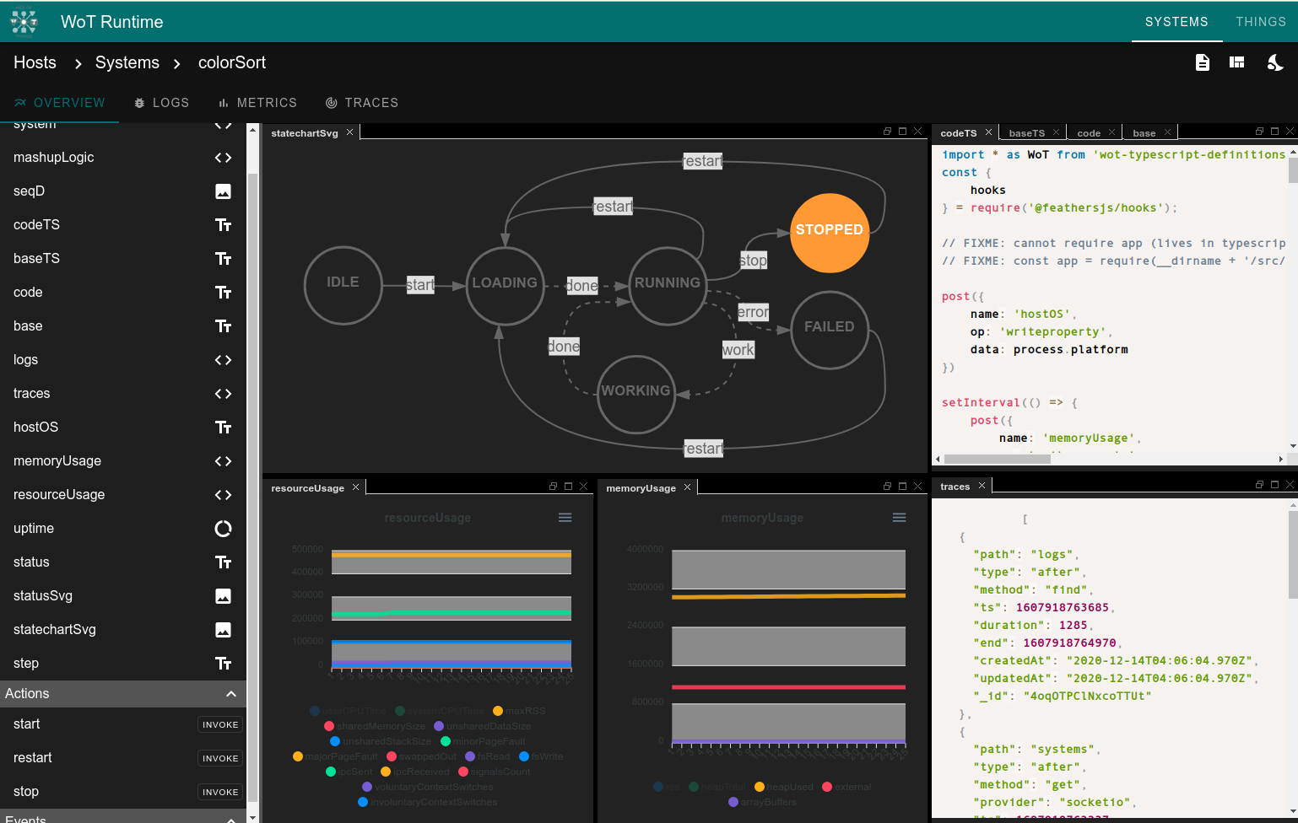


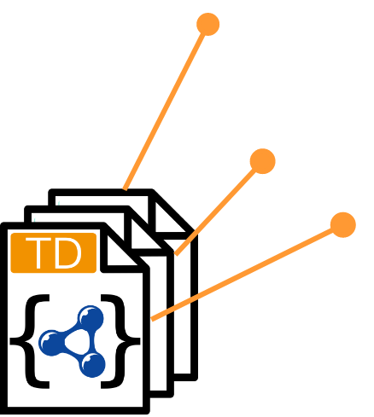
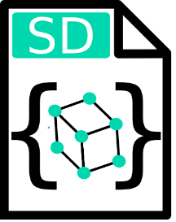
Introduction Problem Statement
Development Tools
System Description
Thing Description
For deployment, management, and monitoring of WoT Systems
Allows describing interaction logic between Things, in order to create WoT Systems
Allows modelling simple and complex standalone Things

Slide 11
Introduction
Approach
Overview
Methodology
Execution Environment and Control
WoT Runtime UI
Evaluation
Conclusion

Slide 12
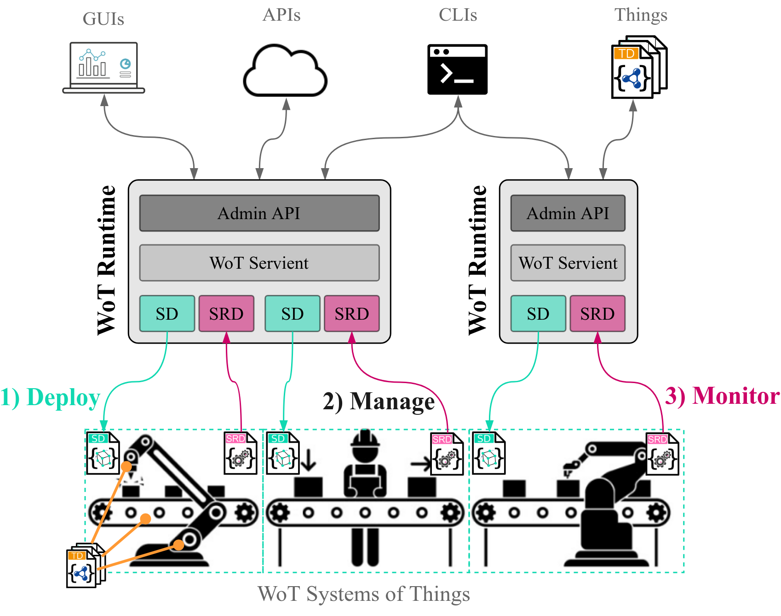
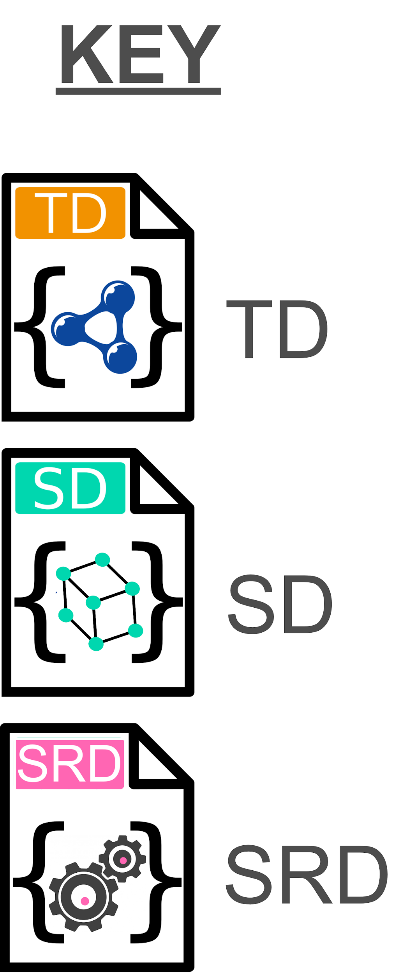
Approach Overview

Slide 13
Introduction
Approach
Overview
Methodology
Execution Environment and Control
WoT Runtime UI
Evaluation
Conclusion

Slide 14
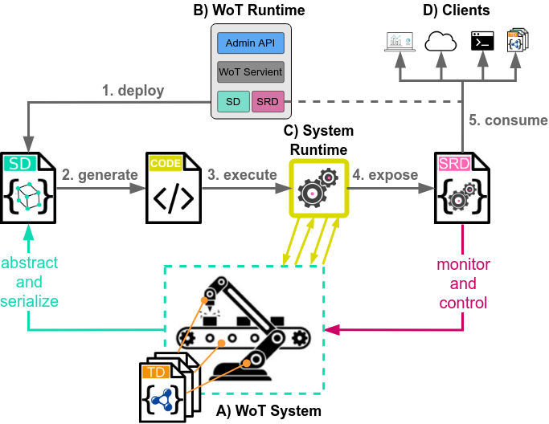
Approach Methodology

Slide 15
Introduction
Approach
Overview
Methodology
Execution Environment and Control
Execution Control
Evaluation
Conclusion

Slide 16
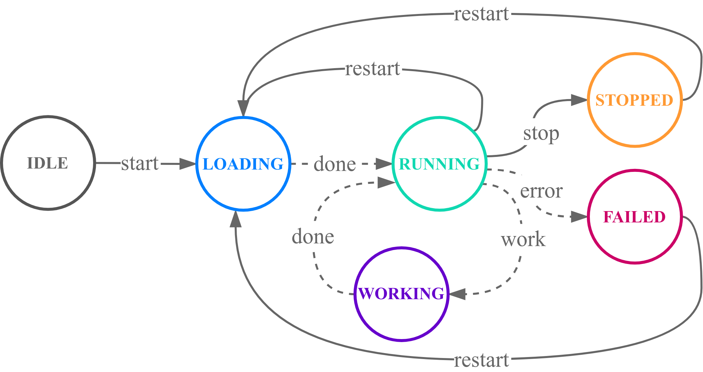
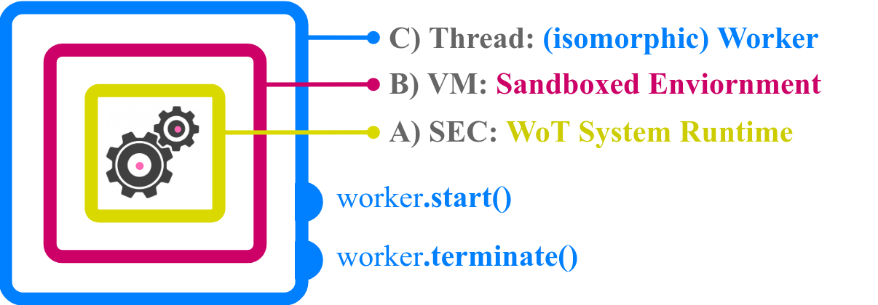
Approach Execution Environment and Control

Slide 17
Introduction
Approach
Overview
Methodology
Execution Environment and Control
WoT Runtime UI
Evaluation
Conclusion

Slide 18
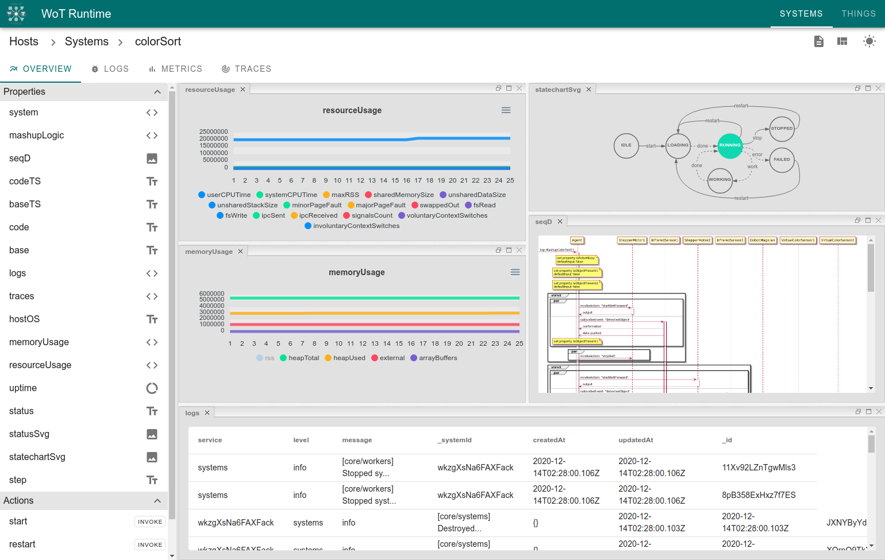
Approach WoT Runtime UI - System Dashboard

Slide 19
Approach WoT Runtime UI - System Dashboard (dark)

Slide 20
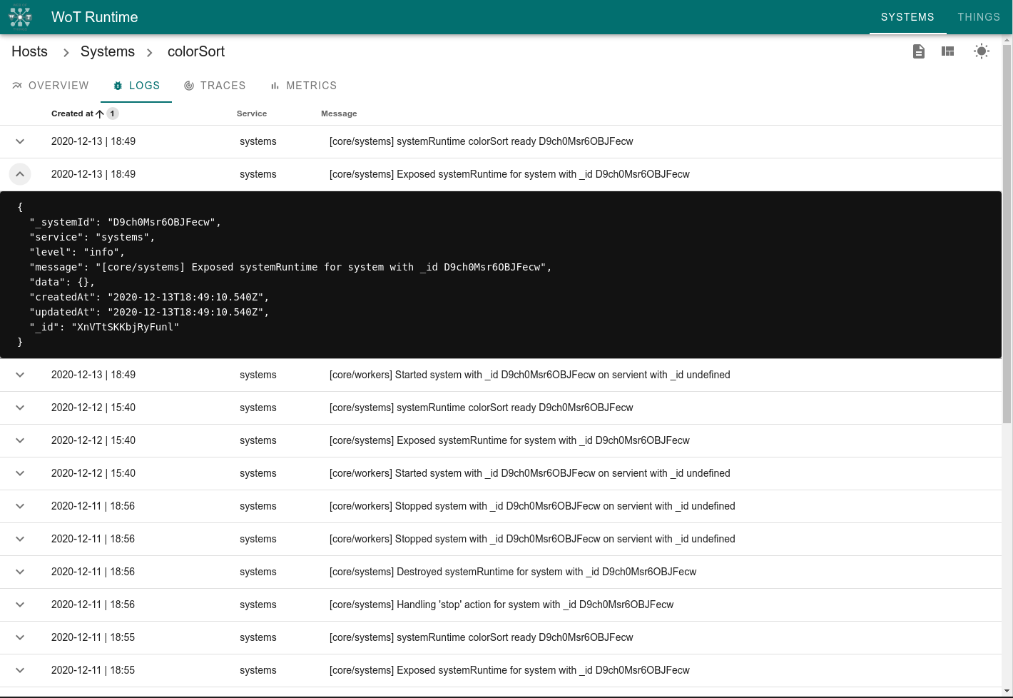
Approach WoT Runtime UI - Logs

Slide 21
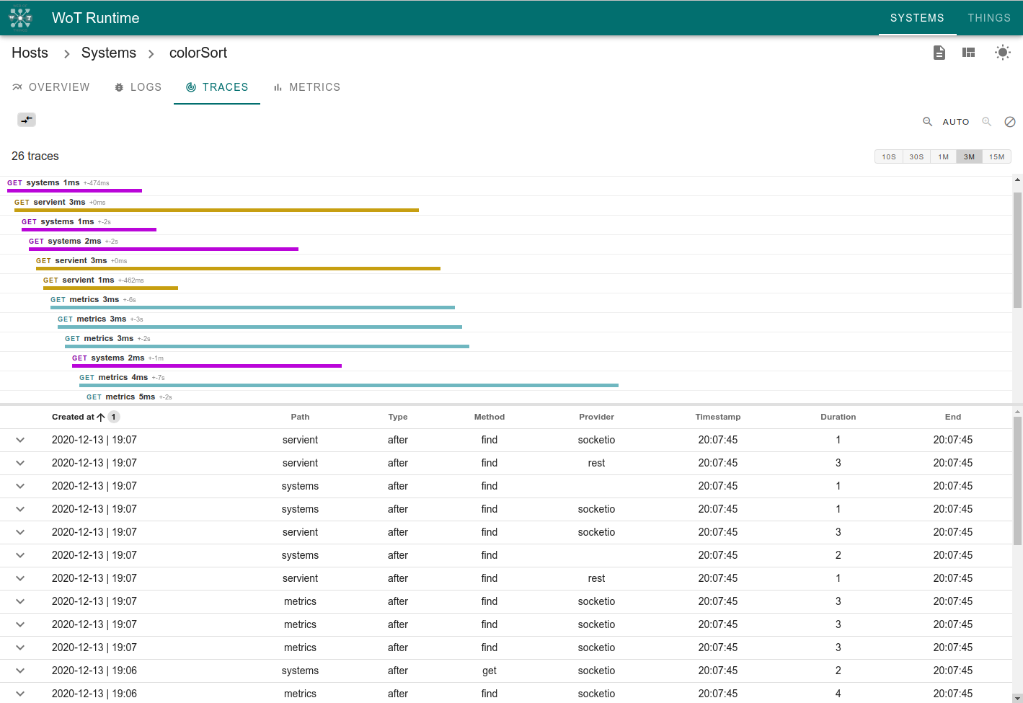
Approach WoT Runtime UI - Traces

Slide 22
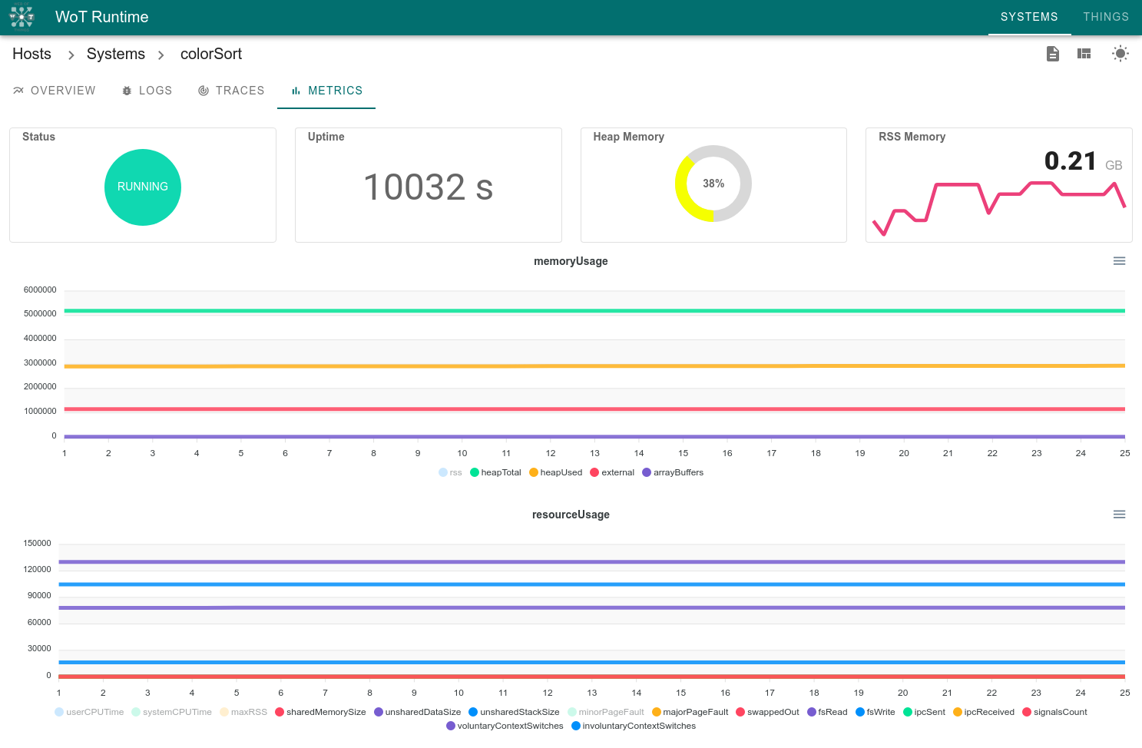
Approach WoT Runtime UI - Metrics

Slide 23
Introduction
Motivation
WoT Thing Description
WoT System Description
Problem Statement
Approach
Overview
Methodology
Execution Environment
Execution Control
Evaluation
Results
Conclusion

Slide 24

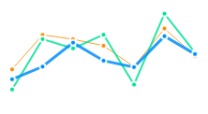


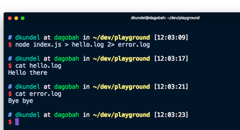


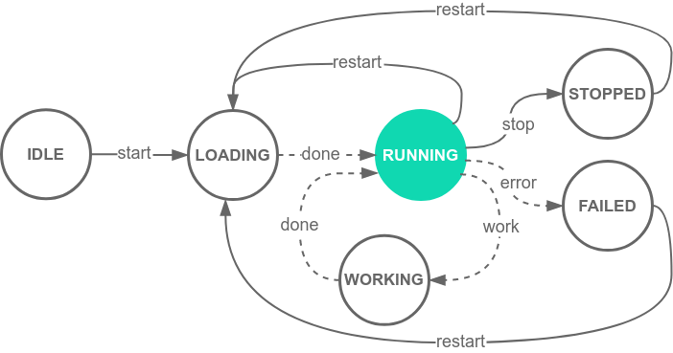

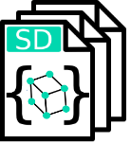
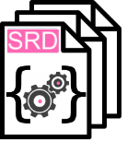

Evaluation Results
Smart Farm Simulation Use Case
C) Mashup monitoring and control via auto-generated GUI
B) Runtime monitoring via logs, metrics and traces
D) Safe and secure execution environment
[warn] DeprecationWarning
[error] ReferenceError
[info] Started system 239...
[info] Created SRD for sy...
[error] NetworkError
A) Management of multiple SDs and TDs via API
E) SRD for composing multi-layered architectures
consume
expose-
System Runtime

Slide 25
Introduction
Motivation
WoT Thing Description
WoT System Description
Problem Statement
Approach
Overview
Methodology
Execution Environment
Execution Control
Evaluation
Results
Conclusion

Slide 26
Conclusion
In conclusion:
The WoT Runtime Framework introduces an additional WoT building block for:
remote deployment of SDs into safe execution Environments,
management of WoT System Runtimes,
and monitoring and control through the auto-generated SRD
The SRD allows composing multi-layered WoT architecutes
The approach is evaluated in two use cases
An industrial automation scenario
and a smart farm simulation
demonstrating how the proposed solution works in practice
The WoT Runtime framework lays the basis for future in distributed WoT architectures

Slide 27
Thank you for your attention

