Slide 2
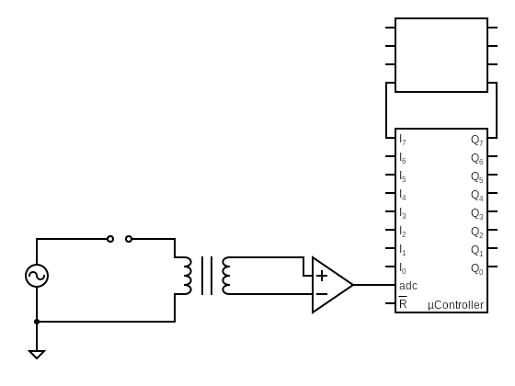
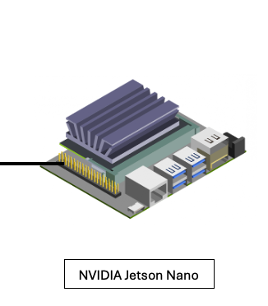
PLC
Welding
Electrodes
Filter/Amp.
Circuit
Current Sensor

