Slide 1
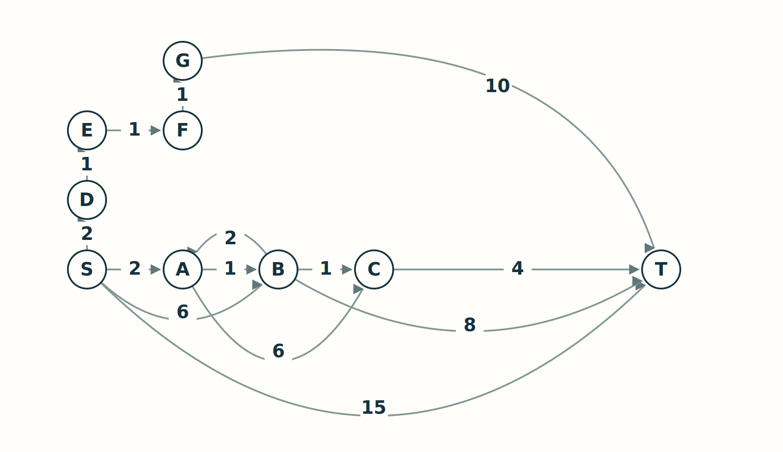
A 90-MINUTE PhD LECTURE
Dijkstra
and A*
When can a route
be finalized?
Conjecture → counterexample → repair
Find a route. Then justify stopping.
Notes:
SLIDE 1 | 00-01 min | CORE
Open with the question of certification, not the names of data structures. Ask: finding a route is one task; how would we know no cheaper route remains? Explain that the lecture reconstructs decisions through counterexamples rather than retelling historical discovery. Prerequisites: graphs, elementary Python, asymptotic notation. Do not show the solution path yet. Pedagogical inspiration: P1, P2.

Slide 2
01 / WHY SEARCH?
01-03 min
Finding a route is only half the problem.
Navigation
Networks
Agents
A current position is
not a route.
What path minimizes
the chosen cost?
Which next hop and
outgoing interface?
OSPF builds
shortest-path trees.
Which sequence of
valid moves?
The state must
encode what matters.
Can you certify that no cheaper route exists?
MODEL
ENUMERATE
FINALIZE
INFORM
TEST
R6
02
Notes:
SLIDE 2 | 01-03 min | CORE
Use Google Maps only as a familiar application, not a claim about its current implementation. Distinguish satellite positioning from road routing. For networks say next-hop router and outgoing interface, not application port. OSPF RFC 2328 section 16.1 is the documented Dijkstra example. Ask what objective each model optimizes; distance and travel time need not agree.
SOURCES
[R6] https://www.rfc-editor.org/rfc/rfc2328.html#section-16.1

Slide 3
MODEL / OBJECTIVE / OUTPUT
03-05 min
First, agree on the problem.
minimize C(P) = sum of edge costs on P
Given
Return
A finite directed graph G=(V,E).
Start s, target t.
Fixed, nonnegative edge costs.
The minimum cost.
A route attaining it.
Or: all distances from s.
What should happen if t is unreachable? What if s = t?
MODEL
ENUMERATE
FINALIZE
INFORM
TEST
R1 · R4
03
Notes:
SLIDE 3 | 03-05 min | CORE
Establish fixed additive nonnegative costs. We will later test why the sign assumption is needed. Distinguish cost, path, and all single-source distances. Expected boundary answers: unreachable gives infinity / no route; s=t gives cost zero and [s]. A target-limited run does not necessarily finalize all other labels.
SOURCES
[R1] https://ir.cwi.nl/pub/9256/9256D.pdf
[R4] https://stanford-cs221.github.io/spring2023-extra/modules/search/search2.pdf

Slide 4
FROM THE WORLD TO MEMORY
05-09 min
A graph model is not a storage format.
Model
Store
Generate
Intersections, grid
cells, or regions?
Choose states and
valid transitions.
Adjacency list:
O(n+m).
Matrix: O(n²) entries.
For an implicit grid,
compute
neighbors when
needed.
For the live code: a dictionary of outgoing (neighbor, cost) pairs.
MODEL
ENUMERATE
FINALIZE
INFORM
TEST
R4
04
Notes:
SLIDE 4 | 05-09 min | CORE
Show graphs/main_graph.py with heuristic values hidden. Separate navigation meshes and geographic modeling from matrix/list storage. Mention a turn-dependent cost may require the incoming direction in the state. Avoid a survey of mesh formats. Exit at minute 9 with the objective and adjacency representation agreed.
SOURCES
[R4] https://stanford-cs221.github.io/spring2023-extra/modules/search/search2.pdf

Slide 5
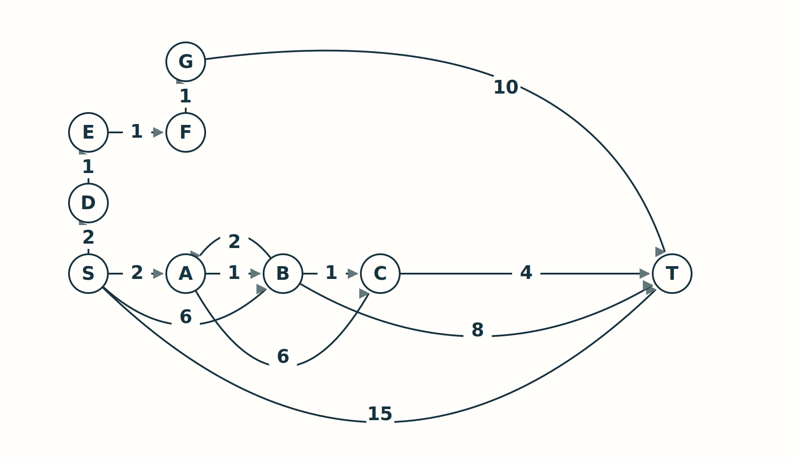
02 / ENUMERATION
09-12 min
Could we simply try every route?
First conjecture
Enumerate candidate
routes.
Add their edge costs.
Keep the cheapest.
What does the cycle A → B → A do to this plan?
MODEL
ENUMERATE
FINALIZE
INFORM
TEST
05
Notes:
SLIDE 5 | 09-12 min | CORE
Draw the main graph once on the board. Ask for the cost of S->T and any cheaper candidate. Then expose the A-B cycle. Refine unrestricted walks to simple paths. With nonnegative edge costs removing a cycle cannot worsen the route, so an optimal simple path exists whenever the goal is reachable.

Slide 6
LIVE CODE / CHECKPOINT 01
12-16 min
Simple does not mean few.
for v, weight in graph[u]:
if v not in on_path:
explore(v, cost + weight)
# on_path belongs to this route.
# It is not a global visited set.
Predict before
running
How many complete
routes?
When would this
approach
become infeasible?
Many different routes reach the same intermediate state.
MODEL
ENUMERATE
FINALIZE
INFORM
TEST
R5
06
Notes:
SLIDE 6 | 12-16 min | CORE
Complete checkpoint 01 or its notebook cell. The slide is an excerpt; the checkpoint includes adding/removing nodes from on_path. Reference result: 8 simple S-to-T paths, optimum 8. Show prepared complete-graph scaling; factorial path count is not the complexity of one DFS traversal. Do not wait for unbounded enumeration. Transition: which expensive prefixes can we discard?
SOURCES
[R5] https://networkx.org/documentation/stable/reference/algorithms/generated/networkx.algorithms.simple_paths.all_simple_paths.html

Slide 7
03 / KEEP ONLY WHAT CAN MATTER
16-18 min
Which prefixes are already dominated?
Same state B: cost 6 versus cost 3
Discard
Remember
The more expensive prefix
has no advantage for the
remaining state-based journey.
g(v): best discovered cost.
parent(v): predecessor for
that improving route.
Best discovered is not yet proved optimal.
MODEL
ENUMERATE
FINALIZE
INFORM
TEST
R1 · R4
07
Notes:
SLIDE 7 | 16-18 min | CORE
Ask whether the expensive prefix can lead to a cheaper total using the same continuation. Under this state model it cannot. Clarify that a state must contain sufficient history; otherwise dominance can fail. Define tentative g and predecessors before naming relaxation. Do not call g the true shortest distance yet.
SOURCES
[R1] https://ir.cwi.nl/pub/9256/9256D.pdf
[R4] https://stanford-cs221.github.io/spring2023-extra/modules/search/search2.pdf

Slide 8
RELAXATION + FRONTIER ORDER
18-22 min
What should we process next?
After expanding S
A: 2
B: 6
D: 2
T: 15
Choose the smallest g.
candidate = g(u) + c(u,v) · accept only a strict improvement
MODEL
ENUMERATE
FINALIZE
INFORM
TEST
R1
08
Notes:
SLIDE 8 | 18-22 min | CORE
Trace changed labels at the board. Correct non-stale order: S, A, D, B, E, C, F, G, T. B improves 6->3; C 8->4; T 15->11->8. Use neighbor order and FIFO tickets for ties. Ask whether discovering T at 15 permits stopping. Distinguish a priority based on accumulated cost from choosing the cheapest next edge.
SOURCES
[R1] https://ir.cwi.nl/pub/9256/9256D.pdf

Slide 9
PROOF OBLIGATION
22-26 min
Why is the smallest label final?
1
Assume
There is a cheaper route to the selected u.
2
Find
Take its first unfinalized node y and predecessor x.
3
Compare
Relaxation exposed y; a nonnegative suffix cannot lower
cost.
Minimum extraction forces g(u) ≤ g(y) ≤ optimal cost to u.
MODEL
ENUMERATE
FINALIZE
INFORM
TEST
R1 · R4
09
Notes:
SLIDE 9 | 22-26 min | CORE
Collaborative proof. Let S be finalized. By induction dist(x)=delta(x); optimal-prefix relaxation gives dist(y)=delta(y). Nonnegative suffix yields delta(y)<=delta(u), while minimum extraction yields dist(u)<=dist(y). Contradiction if dist(u)>delta(u). Ask which inequality needs nonnegativity. The heap does not prove the theorem; it implements the selection rule. Full proof in appendix and technical notes.
SOURCES
[R1] https://ir.cwi.nl/pub/9256/9256D.pdf
[R4] https://stanford-cs221.github.io/spring2023-extra/modules/search/search2.pdf

Slide 10
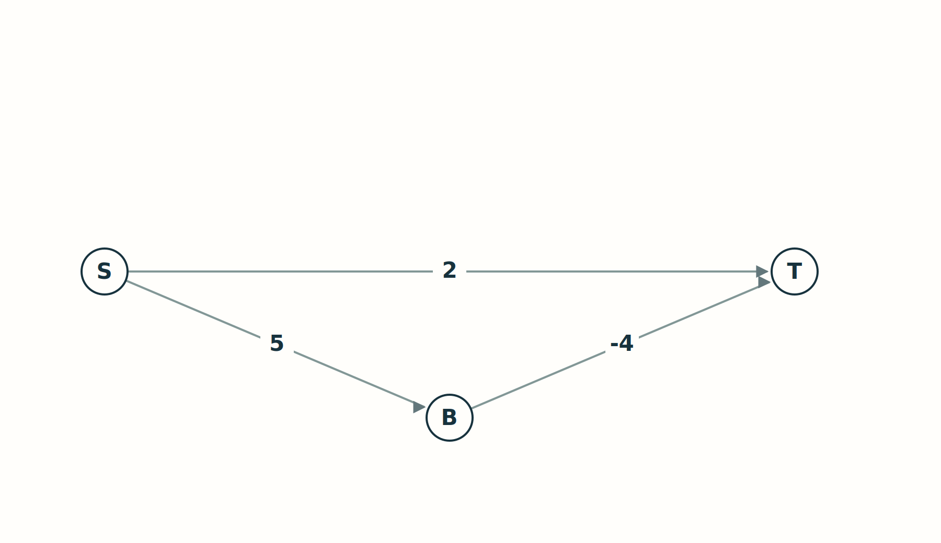
COUNTEREXAMPLE / NEGATIVE EDGE
26-28 min
Attack the assumption, not the conclusion.
Predict the failure
Which goal cost is
extracted first?
Can a later suffix
make a route cheaper?
Which exact line of the finalization argument breaks?
MODEL
ENUMERATE
FINALIZE
INFORM
TEST
R1 · R4
10
Notes:
SLIDE 10 | 26-28 min | CORE
S->T=2, S->B=5, B->T=-4. First target extraction costs 2; optimum via B is 1. The nonnegative-suffix inequality fails. The normal reference code rejects this input. Keep Bellman-Ford as a named alternative only. Move to implementation at minute 28.
SOURCES
[R1] https://ir.cwi.nl/pub/9256/9256D.pdf
[R4] https://stanford-cs221.github.io/spring2023-extra/modules/search/search2.pdf

Slide 11
LIVE CODE / CHECKPOINT 02
28-34 min
Make the proof executable.
candidate = popped_g + weight
if candidate < dist[v]:
dist[v] = candidate
parent[v] = u
heappush(queue,
(candidate, ticket, v))
Three decisions
Accumulate route cost.
Keep only strict
improvements.
Schedule the improved
route.
A queue entry is a proposal about a route, not a certificate.
MODEL
ENUMERATE
FINALIZE
INFORM
TEST
R2
11
Notes:
SLIDE 11 | 28-34 min | CORE
Use checkpoint 02; imports and initialization are prepared. The displayed ticket is shorthand for next(ticket) in the full implementation. Fill candidate and comparison, ask for a prediction, and run. Do not live-implement heapq. Keep proof meanings aligned with variables.
SOURCES
[R2] https://docs.python.org/3/library/heapq.html

Slide 12
LAZY QUEUE / CHECKPOINT 03
34-38 min
What happens to the old B = 6 entry?
popped_g, _, u = heappop(queue)
if popped_g != dist[u]:
continue
# B=3 superseded B=6.
# C=4 superseded C=8.
Two separate records
Keep the new route.
Leave the old record in
the heap.
Discard it when it
reaches the top.
Update parent(v) on every improvement, not just first discovery.
MODEL
ENUMERATE
FINALIZE
INFORM
TEST
R2
12
Notes:
SLIDE 12 | 34-38 min | CORE
Use visualizer lazy/main, next meaningful events until the first stale skip. Show the sorted queue and actual heap-array views. Main target run skips B6 and C8; later old T records remain in the queue at termination. Emphasize that an obsolete path need not be nonexistent; it has just been superseded. Finish checkpoint 03.
SOURCES
[R2] https://docs.python.org/3/library/heapq.html

Slide 13
TERMINATION / CHECKPOINT 04
38-41 min
Stop at discovery—or at certification?
Discovery
Extraction
Continue
A route to T exists.
Its cost is only an
upper bound.
After the stale guard,
minimum-g T is
certified.
With no target stop,
finalize every
reachable distance.
Do not label every tentative distance “shortest” after an early stop.
MODEL
ENUMERATE
FINALIZE
INFORM
TEST
R1
13
Notes:
SLIDE 13 | 38-41 min | CORE
Demonstrate experiments.stop_on_generation_bug returning 15. The correct main graph returns 8. Place target check after rejecting stale records. Use target=None or --all to compute all reachable distances. Explain Result.finalized. In some graphs early target extraction leaves other finite labels improvable.
SOURCES
[R1] https://ir.cwi.nl/pub/9256/9256D.pdf

Slide 14
EAGER QUEUE / CHECKPOINT 05
41-46 min
Can each frontier node have one entry?
if v in queue:
queue.decrease_key(v, candidate)
else:
queue.insert(v, candidate)
# heap array + node→position map
What changes?
The search rule does
not.
The queue bookkeeping
does.
Every swap repairs the
map.
Use the prepared indexed heap; inspect one decrease-key operation.
MODEL
ENUMERATE
FINALIZE
INFORM
TEST
R2 · R7
14
Notes:
SLIDE 14 | 41-46 min | CORE
Use the already written IndexedMinPQ and complete checkpoint 05. Do not build the heap live. Demonstrate one decrease-key event. Main graph eager uses 9 insertions, 4 decreases and peak queue 4, versus lazy 13 insertions and peak queue 6. The FIFO ticket is refreshed on improvement so variants use aligned tie policies.
SOURCES
[R2] https://docs.python.org/3/library/heapq.html
[R7] https://www3.cs.stonybrook.edu/~rezaul/papers/TR-07-54.pdf

Slide 15
COMPLEXITY / EXPLICIT GRAPH
46-48 min
Smaller queues do not prove faster runs.
Variant
Time
Extra memory
Lazy / binary heap
O(n + m log(m+1))
O(n+m)
Eager / indexed heap
O((n+m) log(n+1))
O(n)
Same search rule. Different update costs, queue size and implementation
constants.
n = |V|, m = |E|. For simple graphs, log m = O(log n).
MODEL
ENUMERATE
FINALIZE
INFORM
TEST
R2 · R7
15
Notes:
SLIDE 15 | 46-48 min | CORE
Lazy: O(n+m log(m+1)) time and O(n+m) auxiliary memory. Eager: O((n+m)log(n+1)) time and O(n) auxiliary memory. Both exclude graph storage. Eager is not guaranteed faster; the pure-Python indexed heap and standard heapq differ in constants. Mention d-ary/Fibonacci only as an appendix extension. Protect the 54-minute A* start.
SOURCES
[R2] https://docs.python.org/3/library/heapq.html
[R7] https://www3.cs.stonybrook.edu/~rezaul/papers/TR-07-54.pdf

Slide 16
04 / USE THE TARGET
48-51 min
Which term in the priority mentions T?
Priority = g(v)
The detour is cheap so
far.
Dijkstra processes it
before certifying T=8.
Dijkstra respects edge direction. It does not use target information to prioritize.
MODEL
ENUMERATE
FINALIZE
INFORM
TEST
R4
16
Notes:
SLIDE 16 | 48-51 min | CORE
Point to D-E-F-G as the tempting low-cost branch. Ask students how they might avoid it without risking optimality. Use saved grid results or the notebook for the wavefront intuition; the closing application is deferred. Always compare target-stopped Dijkstra with target-stopped A*.
SOURCES
[R4] https://stanford-cs221.github.io/spring2023-extra/modules/search/search2.pdf

Slide 17
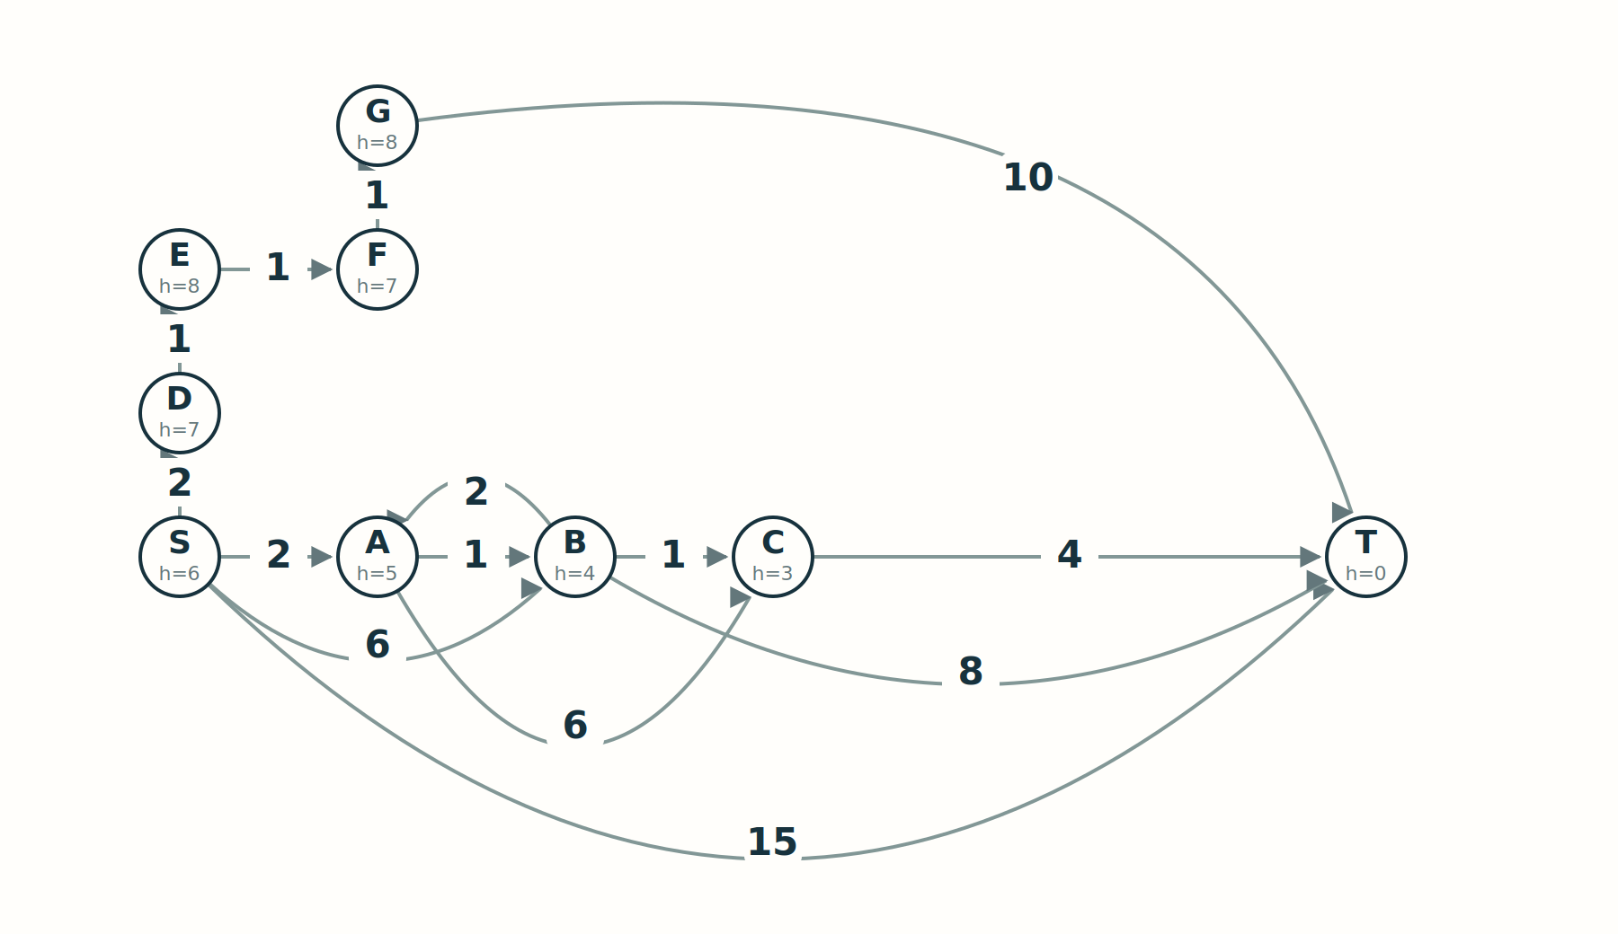
A PLAUSIBLE REPAIR THAT FAILS
51-54 min
What if we use only the estimated distance?
Priority = h(v)
The goal has h(T)=0.
Its first discovered route
costs 15.
What did we forget?
Estimated remaining cost cannot replace accumulated route cost.
MODEL
ENUMERATE
FINALIZE
INFORM
TEST
R3
17
Notes:
SLIDE 17 | 51-54 min | CORE
Introduce greedy best-first search briefly as the natural suggestion, not an extra implementation project. On this graph direct T is available at h=0 and would be selected, giving cost15. Reveal the main graph coordinate-based Manhattan heuristic. Ask how to retain the useful information from Dijkstra.
SOURCES
[R3] https://inst.eecs.berkeley.edu/~cs188/textbook/search/informed.html

Slide 18
A* / f = g + h
54-58 min
Keep the past. Estimate the future.
Selected (g, f)
S: (0, 6)
A: (2, 7)
B: (3, 7)
C: (4, 7)
T: (8, 8)
D remains at f = 2 + 7 = 9. Setting h = 0 recovers Dijkstra.
MODEL
ENUMERATE
FINALIZE
INFORM
TEST
R3
18
Notes:
SLIDE 18 | 54-58 min | CORE
Derive f=g+h before showing the trace. Four expansions exclude the goal pop. h is the exact cost of a relaxed Manhattan problem; every main-graph arc costs at least its Manhattan displacement. Coordinates are in graphs/main_graph.py. Now ask why adding any arbitrary estimate should preserve correctness.
SOURCES
[R3] https://inst.eecs.berkeley.edu/~cs188/textbook/search/informed.html

Slide 19
REFUTE OVERCONFIDENCE
58-61 min
What promise must the estimate make?
0 ≤ h(v) ≤ h*(v) and h(T) = 0
Break it first
Admissibility
Change h(A) to 20.
Can an inflated estimate
hide the optimal route?
Never overestimate
the true remaining
optimal cost.
The proof needs an appropriate optimal-prefix representative on the frontier.
MODEL
ENUMERATE
FINALIZE
INFORM
TEST
R3
19
Notes:
SLIDE 19 | 58-61 min | CORE
Before displaying the formal definition, run visualizer overestimate/A*. It returns11 via S-B-C-T instead of8. h*(A)=6 so20 overestimates. Give the optimal-prefix frontier argument f<=C*; a suboptimal goal has f=g>C*. Do not say every f-value is a lower bound on the global optimum. Leave duplicate handling as the next proof obligation.
SOURCES
[R3] https://inst.eecs.berkeley.edu/~cs188/textbook/search/informed.html

Slide 20
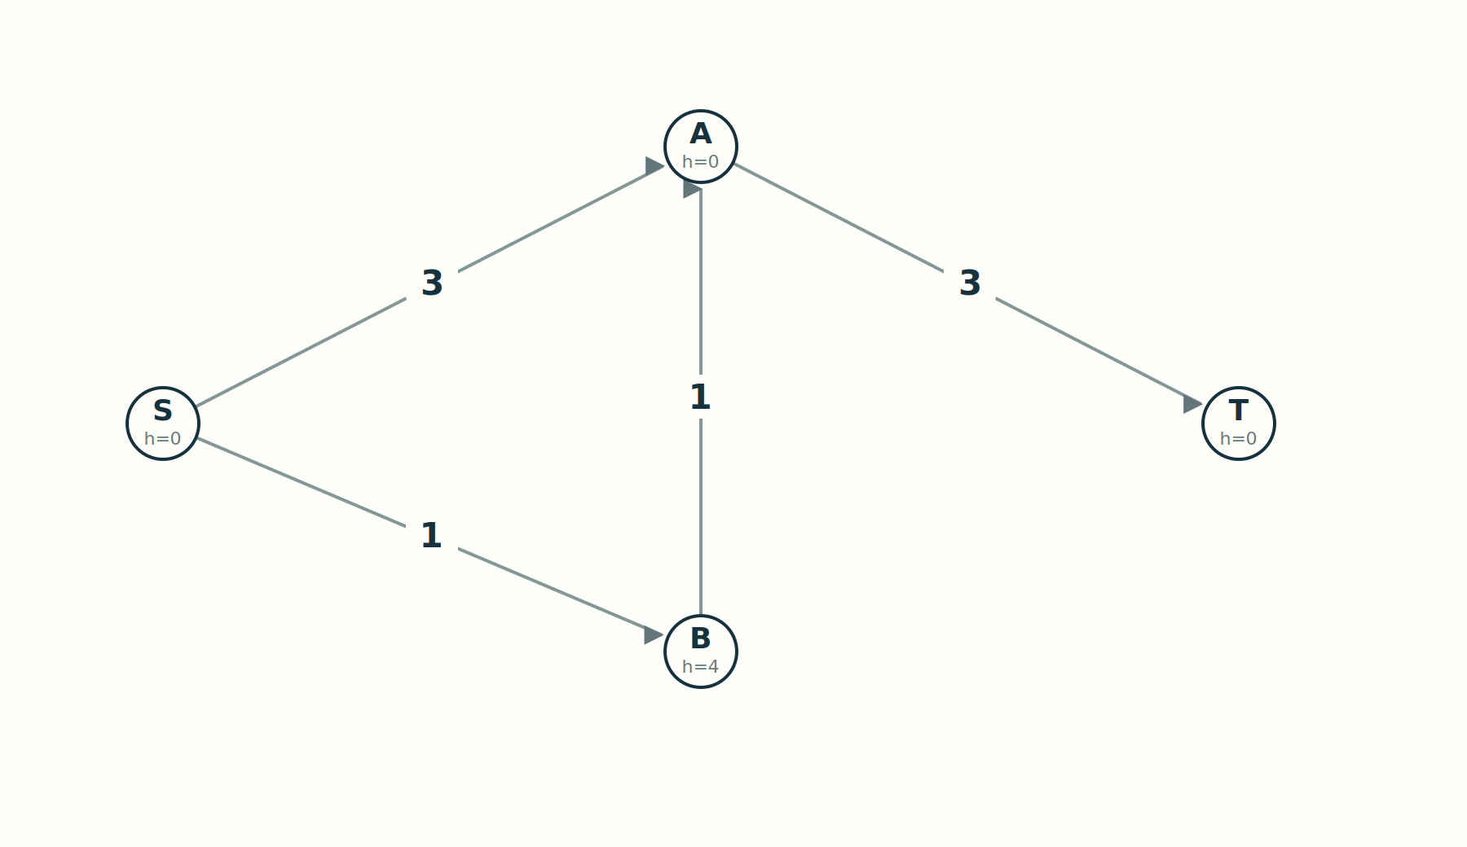
COUNTEREXAMPLE / REOPENING
61-66 min
Does admissibility let us close forever?
Predict, then trace
A is expanded at g=3.
B later proposes A at
g=2.
Should we ignore
that improvement?
All h values are admissible. Inspect the edge B → A.
MODEL
ENUMERATE
FINALIZE
INFORM
TEST
R3 · R4
20
Notes:
SLIDE 20 | 61-66 min | CORE
Ask for the true remaining cost from B (4). A expanded at g3 discovers T6; B at f5 improves A to2. Permanently closed A yields6; reopening yields5 with one re-expansion. Use the Broken: never reopen toggle, clearly labeled. Distinguish stale records from genuinely improved states. Keep students accountable for the queue prediction.
SOURCES
[R3] https://inst.eecs.berkeley.edu/~cs188/textbook/search/informed.html
[R4] https://stanford-cs221.github.io/spring2023-extra/modules/search/search2.pdf

Slide 21
CONSISTENCY AS NONNEGATIVE REWEIGHTING
66-68 min
Recover the finalization argument.
h(u) ≤ c(u,v) + h(v)
Local condition
Reweighted cost
The estimate cannot drop
by more than the cost
of taking an edge.
c_h(u,v) = c(u,v)
+ h(v) - h(u)
Consistency means c_h ≥ 0.
Along a route: g_h(v) = f(v) - h(S). The ordering is Dijkstra again.
MODEL
ENUMERATE
FINALIZE
INFORM
TEST
R4
21
Notes:
SLIDE 21 | 66-68 min | CORE
At B->A the inequality fails4>1+0; reweighted cost becomes-3. Explain the telescope and constant shift. Consistency gives the Dijkstra-like no-reopening guarantee. Under admissibility alone retain reopening. Full proof and reweighted diagram in the appendix. Do not exceed minute68.
SOURCES
[R4] https://stanford-cs221.github.io/spring2023-extra/modules/search/search2.pdf

Slide 22
LIVE CODE / CHECKPOINT 06
68-73 min
A small code change. A new proof obligation.
priority = candidate + h(v)
heappush(queue,
(priority, ticket, candidate, v))
f, _, queued_g, u = heappop(queue)
if queued_g != dist[u]:
continue
Keep the distinctions
f chooses what comes
next.
g records the route cost.
A better g may reopen a
state.
Do not compare f against g in the stale-entry guard.
MODEL
ENUMERATE
FINALIZE
INFORM
TEST
R2 · R3
22
Notes:
SLIDE 22 | 68-73 min | CORE
Complete checkpoint06, which uses the same ideas as this excerpt. Ticket is next(ticket) in the full code. Reference expanded set records statistics and never blocks improved routes. Run main, reopening, and h=0. With aligned ties, h=0 reproduces lazy Dijkstra behavior.
SOURCES
[R2] https://docs.python.org/3/library/heapq.html
[R3] https://inst.eecs.berkeley.edu/~cs188/textbook/search/informed.html

Slide 23
COMPARE CORRECT OUTPUTS FIRST
73-77 min
Which improvements did we actually obtain?
Main graph
Cost
Expansions
Stale skips
Peak queue
Dijkstra / lazy
8
8
2
6
Dijkstra / eager
8
8
0
4
A*
8
4
0
6
Fewer expansions, smaller queues, and lower runtime are different claims.
Goal extraction is not an expansion. These counts describe this fixture, not every graph.
MODEL
ENUMERATE
FINALIZE
INFORM
TEST
23
Notes:
SLIDE 23 | 73-77 min | CORE
The displayed counts are generated from the reference main graph. All correct algorithms return8. A* expands4 vs8 but peak queue6 equals lazy Dijkstra here. Eager reduces peak queue to4. Brute force examines8 complete paths with a different prefix-work unit. With consistent constant-time h the explicit-graph worst-case order remains the lazy Dijkstra bound; inconsistency can require repeated expansions. Avoid claiming universal speedup.

Slide 24
05 / EXPERIMENTS
77-86 min
Compare before concluding.
Scaling
Bookkeeping
Heuristics
Complete graphs:
when does
enumeration
exhaust the budget?
Lazy versus eager:
did fewer queue
records
produce a faster run?
Same grid, different h:
what changes when
walls
or movement rules
change?
Use the worked notebook and saved results. Measure search separately from rendering.
MODEL
ENUMERATE
FINALIZE
INFORM
TEST
R7
24
Notes:
SLIDE 24 | 77-86 min | CORE
This block is currently delivered using notebooks/lecture_solutions.ipynb and results/comparison.md. No separate closing-demo application is in this release. 77-79 scaling;79-83 grid zero/Euclidean/Manhattan;83-85 diagonal unit move refutes Manhattan with (0,0)->(1,1);85-86 distinguish expansions, memory and runtime. A future closing app can replace the visual form without changing these questions.
SOURCES
[R7] https://www3.cs.stonybrook.edu/~rezaul/papers/TR-07-54.pdf

Slide 25
EXIT / EXPLAIN WITHOUT THE PSEUDOCODE
86-90 min
What justifies an irreversible decision?
01
Why is discovering the goal not enough?
02
When may an expanded state be closed permanently?
03
Why can we skip stale entries and still reopen states?
Enumerate → discard dominated prefixes → prove finalization → inform → test.
MODEL
ENUMERATE
FINALIZE
INFORM
TEST
25
Notes:
SLIDE 25 | 86-90 min | CORE
Give students one minute to answer before summarizing. Discovery only supplies an upper bound. Nonnegative costs certify minimum-g extraction; A* needs a justified heuristic and correct duplicate handling. Consistency supports permanent closure; admissibility alone requires improvements to propagate, potentially through reopening. Stale rejection removes superseded records; reopening propagates a new better route. Return to the central question.

Slide 26
OPTIONAL / DIJKSTRA
Appendix
Appendix: the complete finalization proof
1
Induction
Every node in S has dist(x)=delta(x). Choose minimum
current u outside S.
2
Crossing
On an optimal route to u, let y be the first node outside S and
x its predecessor. Relaxation from x gives dist(y)=delta(y).
3
Contradiction
Nonnegative suffix: delta(y)≤delta(u). Minimum selection: dist(u)≤dist(y).
Thus dist(u)≤delta(u), while every label is a real route cost.
The heap supplies the minimum candidate; the invariant supplies correctness.
MODEL
ENUMERATE
FINALIZE
INFORM
TEST
R1 · R4
26
Notes:
SLIDE 26 | Appendix min | OPTIONAL APPENDIX
Not in the timed core. The base case is s with cost0. The equality of an optimal prefix uses the shortest-path optimal substructure. Explain unreachable states remain at infinity and are never extracted.
SOURCES
[R1] https://ir.cwi.nl/pub/9256/9256D.pdf
[R4] https://stanford-cs221.github.io/spring2023-extra/modules/search/search2.pdf

Slide 27
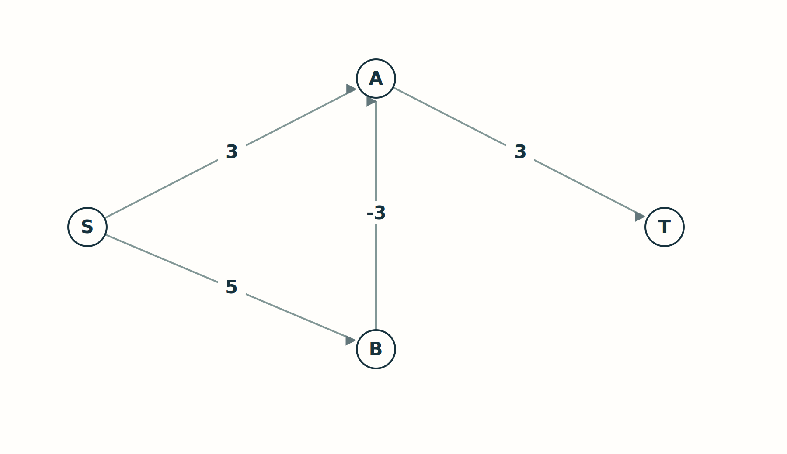
OPTIONAL / POTENTIAL REWEIGHTING
Appendix
Appendix: the same failure in another graph
c_h = c + h(v) - h(u)
S → B becomes 5.
B → A becomes -3.
All fixed-endpoint routes
shift by one constant.
An inconsistent heuristic can create negative reweighted edges.
MODEL
ENUMERATE
FINALIZE
INFORM
TEST
R4
27
Notes:
SLIDE 27 | Appendix min | OPTIONAL APPENDIX
This is the four-node reopening example with reweighted costs. Original edges remain nonnegative. The sum telescopes to original path cost plus h(t)-h(s). The f ordering agrees with reweighted Dijkstra up to h(s).
SOURCES
[R4] https://stanford-cs221.github.io/spring2023-extra/modules/search/search2.pdf

Slide 28
OPTIONAL / ENUMERATION
Appendix
Appendix: count paths, not just vertices.
Vertices n
Complete simple s-to-t paths
5
16
7
326
9
13,700
11
986,410
For complete directed graphs: sum over k=0,...,n-2 of (n-2)! / (n-2-k)! .
MODEL
ENUMERATE
FINALIZE
INFORM
TEST
R5
28
Notes:
SLIDE 28 | Appendix min | OPTIONAL APPENDIX
Fixed distinct source and target. Choose an ordered subset of the other n-2 nodes. The complete counts grow16,326,13700,986410 for n5,7,9,11. A classroom budget may stop before reaching the complete count; do not confuse measured partial counts with this exact combinatorial count.
SOURCES
[R5] https://networkx.org/documentation/stable/reference/algorithms/generated/networkx.algorithms.simple_paths.all_simple_paths.html

Slide 29
OPTIONAL / PRIORITY QUEUES
Appendix
Appendix: a heap is a design choice.
Binary
d-ary
Fibonacci
O(log n) inserts,
decreases and
extracts
with an indexed
heap.
Lower height, but
more children to
compare
on extraction.
Amortized O(1)
decrease.
O(log n) extraction.
Classical SSSP:
O(m+n log n).
There is no universal graph-size threshold at which the most intricate heap wins.
MODEL
ENUMERATE
FINALIZE
INFORM
TEST
R7 · R8
29
Notes:
SLIDE 29 | Appendix min | OPTIONAL APPENDIX
Not a live implementation block. For d-ary heap height log_d n; decrease costs O(log_d n), extraction O(d log_d n). Discuss operation mix and constants. Do not equate theoretical asymptotic improvement with measured runtime superiority.
SOURCES
[R7] https://www3.cs.stonybrook.edu/~rezaul/papers/TR-07-54.pdf
[R8] https://arxiv.org/abs/2504.17033v2

Slide 30
OPTIONAL / RELAXATION
Appendix
Appendix: the movement model is part of h.
Four neighbors
Eight neighbors
Weighted moves
Unit cardinal moves.
Without walls:
|dx| + |dy|.
All moves cost 1.
Without walls:
max(|dx|, |dy|).
Use a proven lower
bound
with the correct units
and movement costs.
A diagonally adjacent goal refutes Manhattan distance when a diagonal costs 1.
MODEL
ENUMERATE
FINALIZE
INFORM
TEST
R3 · R4
30
Notes:
SLIDE 30 | Appendix min | OPTIONAL APPENDIX
Derive Chebyshev by using diagonals for min(|dx|,|dy|) steps, then cardinal steps for the remaining difference. If diagonal costs sqrt(2), use the corresponding relaxed metric instead. For time costs, a geometric distance must be converted with a valid speed bound.
SOURCES
[R3] https://inst.eecs.berkeley.edu/~cs188/textbook/search/informed.html
[R4] https://stanford-cs221.github.io/spring2023-extra/modules/search/search2.pdf

Slide 31
OPTIONAL / RESEARCH CONTEXT
Appendix
Appendix: beyond the classical bound
O(m log^(2/3) n)
Duan, Mao, Mao, Shu and Yin (2025)
Directed SSSP · real nonnegative edge weights
Deterministic · comparison-addition model
A model-specific research result, not an implementation or runtime claim for this lecture.
MODEL
ENUMERATE
FINALIZE
INFORM
TEST
R8
31
Notes:
SLIDE 31 | Appendix min | OPTIONAL APPENDIX
Optional PhD-level context. Source arXiv2504.17033v2, Breaking the Sorting Barrier for Directed Single-Source Shortest Paths. It breaks the O(m+nlogn) bound on sparse graphs in the stated model. Do not label Fibonacci Dijkstra as the unqualified current state of the art. No claim is made about every computational model or current best bound.
SOURCES
[R8] https://arxiv.org/abs/2504.17033v2

Slide 32
READ FURTHER
Appendix
References / algorithmic foundations
R1
Dijkstra (1959). A Note on Two Problems in Connexion with Graphs.
ir.cwi.nl/pub/9256/9256D.pdf
R2
Python documentation. heapq: priority queue implementation notes.
docs.python.org/3/library/heapq.html
R3
UC Berkeley CS188. Informed Search.
inst.eecs.berkeley.edu/~cs188/textbook/search/informed.html
R4
Stanford CS221. Search II (2023), proofs and reweighting.
stanford-cs221.github.io/spring2023-extra/modules/search/search2.pdf
MODEL
ENUMERATE
FINALIZE
INFORM
TEST
32
Notes:
SLIDE 32 | Appendix min | OPTIONAL APPENDIX
Full clickable URLs and additional provenance are in docs/references.md. All figures, graph examples, code and exercises in this package are newly created; cited lecture figures are not redistributed.

Slide 33
READ FURTHER
Appendix
References / applications and perspective
R5
NetworkX documentation. all_simple_paths and factorial growth.
networkx.org/documentation/stable/reference/algorithms/
R6
Moy (1998). OSPF Version 2. RFC 2328, section 16.1.
rfc-editor.org/rfc/rfc2328.html#section-16.1
R7
Chen et al. (2007). Priority Queues and Dijkstra’s Algorithm.
www3.cs.stonybrook.edu/~rezaul/papers/TR-07-54.pdf
R8
Duan et al. (2025). Breaking the Sorting Barrier for Directed SSSP.
arxiv.org/abs/2504.17033v2
MODEL
ENUMERATE
FINALIZE
INFORM
TEST
33
Notes:
SLIDE 33 | Appendix min | OPTIONAL APPENDIX
Pedagogical inspiration: Toeplitz, The Calculus: A Genetic Approach (University of Chicago Press); Lakatos, Proofs and Refutations (Cambridge,1976). P1 and P2, including links, are in docs/references.md. This lecture reconstructs motivations and proof obligations; it does not purport to reenact the algorithms’ history.

