Slide 1
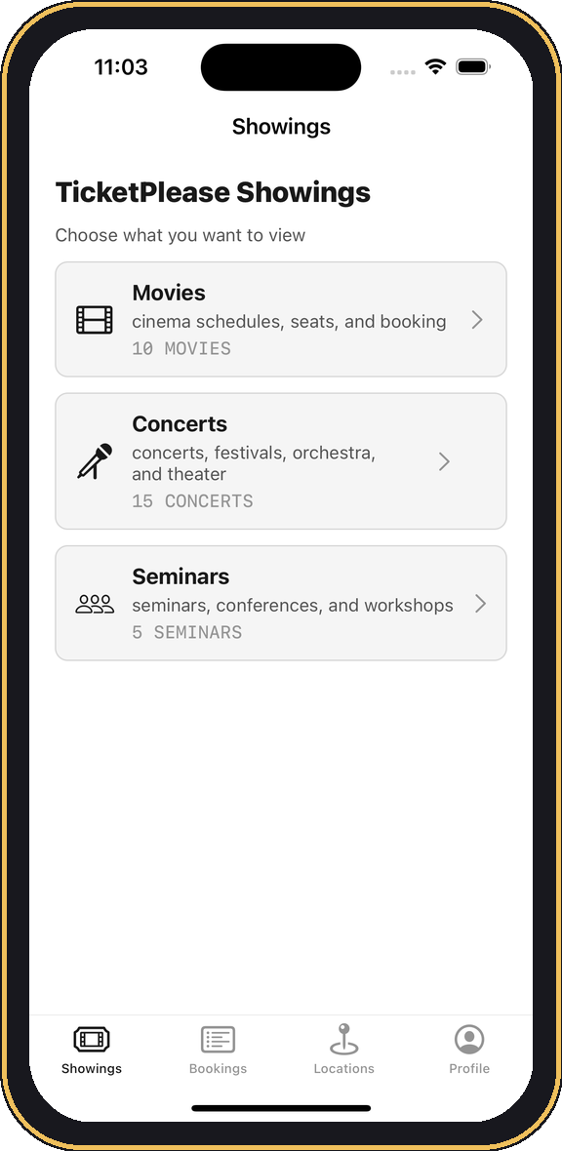

TicketPlease
iOS Ticket-Booking App · Engineering & Product Showcase
Formerly “CineSeat” · Swift 5 · UIKit · MVVM + Clean Architecture · iOS 17.5
Prepared by Miguel Joaquin A. Sanson · miguelsanson21@gmail.com · July 2026

Slide 2
AGENDA
What we’ll cover
01 Executive overview — what TicketPlease is, by the numbers, tech stack
02 Feature journey — every feature in build order (Jun 15 → Jul 3, 2026), with live screens
03 Feature deep-dives — booking, seat maps, reviews, maps, notifications
04 Engineering & learning — architecture, DI, and the 6 iOS modules practiced
05 Business translation — reuse & AI for Seven Seven Global Soft clients
06 Roadmap & future work — production blockers and next steps

Slide 3
01
Executive Overview
What TicketPlease is, at a glance
TICKETPLEASE

Slide 4
EXECUTIVE OVERVIEW
What is TicketPlease?
One app, three uses. Book movies, concerts, and seminars from a single Showings hub.
Complete journey. Browse → detail → schedule → seats / quantity → summary → confirmation.
Fully self-contained. Local accounts, bookings, reviews and reminders — works offline.
Real content. Curated movies, cinemas, venues, posters and schedules.
Purpose-built practice. A production-shaped iOS build to de-risk real client work.

Slide 5
EXECUTIVE OVERVIEW
By the numbers
30
8
137
bookable items
cinemas
Swift source files
10 movies · 15 concerts · 5 seminars
6 standard ₱350 · 2 VIP ₱550
MVVM · Domain · Persistence layers
11
6
0
dated milestones
iOS learning modules
third-party pods
Jun 15 → Jul 3, 2026 (≈ 3-4 weeks)
covered end-to-end
100% native Apple frameworks

Slide 6
EXECUTIVE OVERVIEW
Technology snapshot
Language & UI
Architecture
Data & platform
Swift 5
MVVM + Clean Architecture
JSON (FileManager + Codable)
UIKit — storyboard + programmatic
Protocol-based dependency injection
plist · UserDefaults · Keychain
Auto Layout, UIScrollView, UIStackView
AppFactory composition root or the builder for each screen of the app
MapKit · UserNotifications · URLSession
Custom seat-map & card views
Constants = Shared formatters & design tokens
No Core Data · No CocoaPods

Slide 7
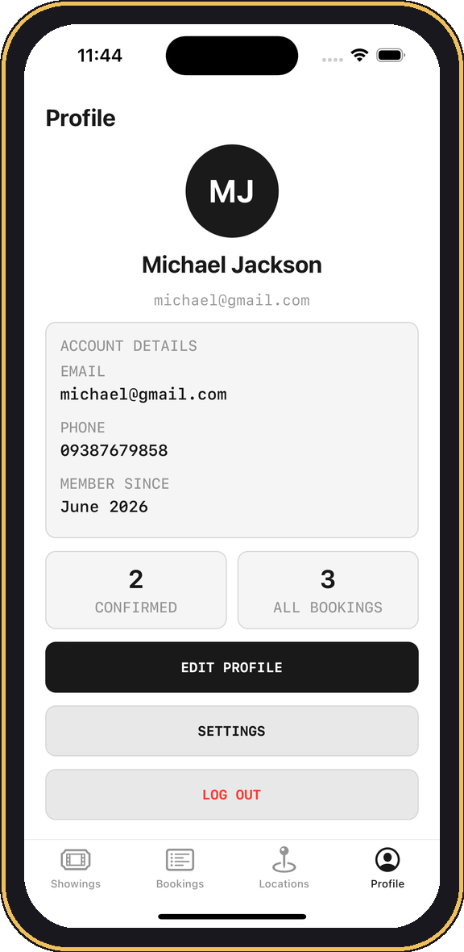
EXECUTIVE OVERVIEW
The four tabs
Showings
Category landing → Movies / Concerts / Seminars, each with search, status, rating sort & location filters.
Bookings
Local booking history with detail, seat map, cancellation, and per-ticket email sharing.
Locations
MapKit pins & callouts, Cinema Details, and assigned showtimes with Apple Maps hand-off.
Profile
Account creation, login, editing, restored sessions, Settings, and a gated Developer Mode.

Slide 8
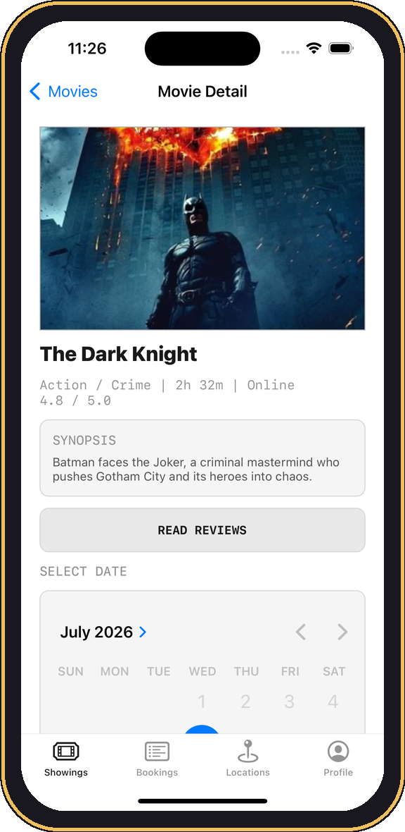
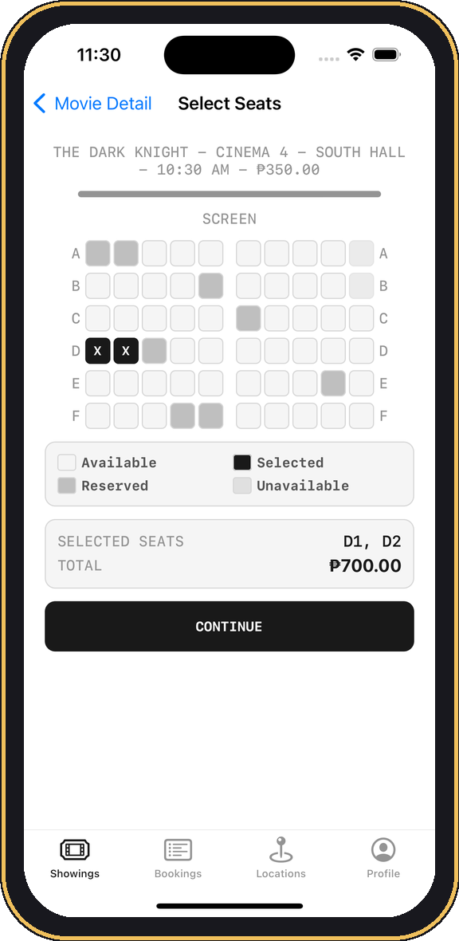
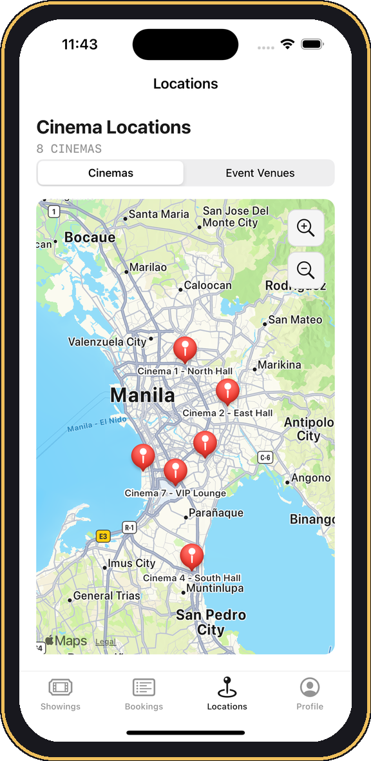
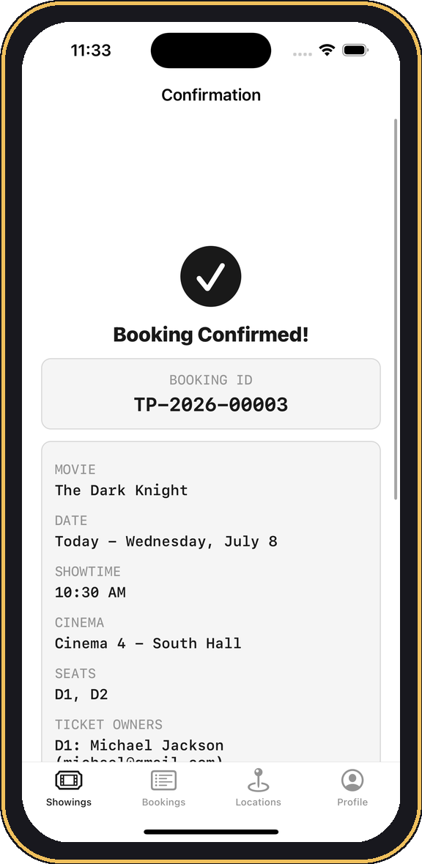
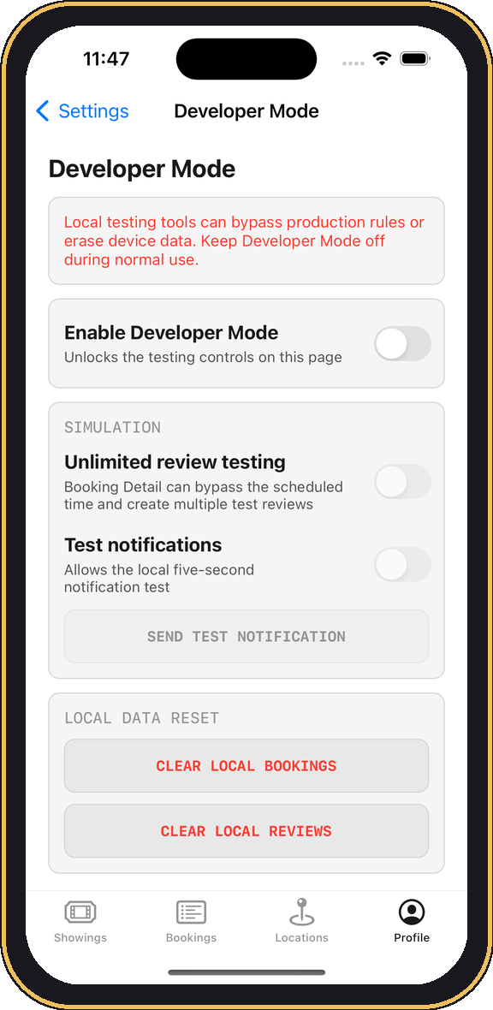
EXECUTIVE OVERVIEW
Product tour — a look at the real app
Showings hub
Movie detail
Seat selection
Locations map
Confirmation
Developer Mode

Slide 9
02
Feature Journey
Every feature, in the order it was built
TICKETPLEASE

Slide 10
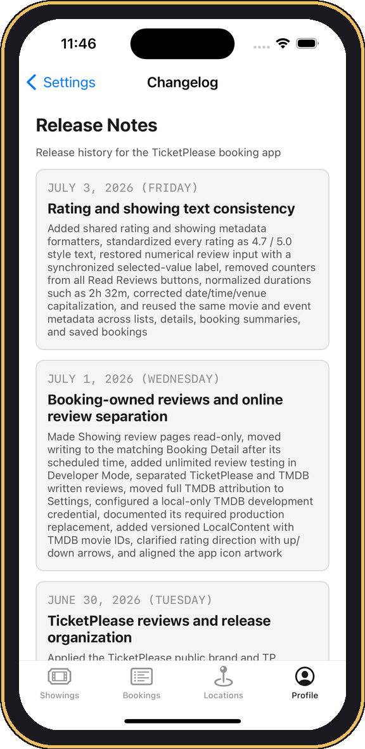
FEATURE JOURNEY
The build timeline — 11 milestones in ≈ 3 weeks
Jun 15
1
UIKit + MVVM foundation
Jun 17
2
Booking, profile & persistence
Jun 19
3
Movie data, posters & seating
Jun 22
4
Schedules, notifications & DI (Dependency Injection)
Jun 23
5
Plist settings & UI polish
Jun 24
6
Showings, maps & sharing
Jun 25
7
Interactive cinema pins
Jun 29
8
Concert / seminar booking
Jun 30
9
TicketPlease rebrand & reviews
Jul 1
10
Booking-owned & online reviews
Jul 3
11
Rating & text consistency
Release notes, shipped in-app

Slide 11
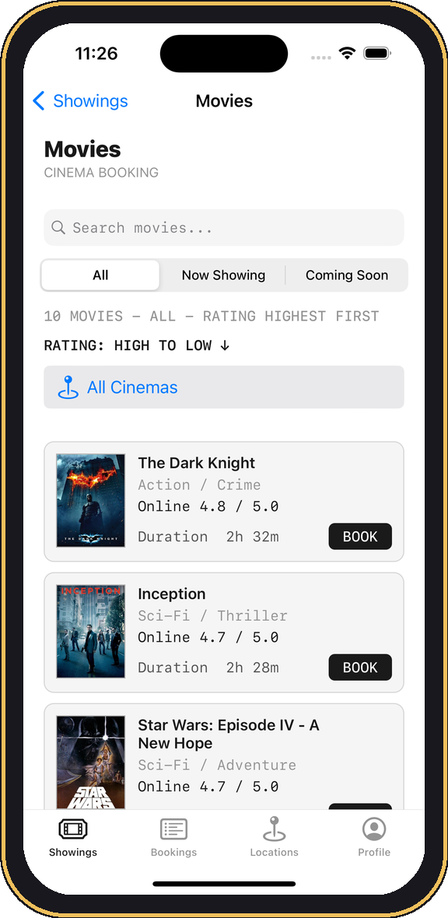
MILESTONE 01 · JUN 15, 2026
Initial UIKit / MVVM setup
What shipped
Project scaffold + storyboard tabs
Models / View / ViewModel structure
Outlets, actions, table views & reusable cells
First Movies, Bookings and Profile flows
LEARNING FOCUS
UIKit + MVVM foundations

Slide 12
MILESTONE 02 · JUN 17, 2026
Booking, profile & persistence
What shipped
Movie detail + assigned showings
₱ pricing, seat selection, confirmation
Account create / login / edit / logout + session restore
Keychain passwords + FileManager JSON persistence
LEARNING FOCUS
Persistence & security

Slide 13
MILESTONE 03 · JUN 19, 2026
Movie data, posters, cinema rules & seating
What shipped
Expanded movie data, ratings & schedules
Offline posters with URLSession / cache fallback
Rating sort + predetermined showings
8 cinemas — standard ₱350 / VIP ₱550
Varied seat layouts + booking-detail seat maps
LEARNING FOCUS
Networking + custom views

Slide 14
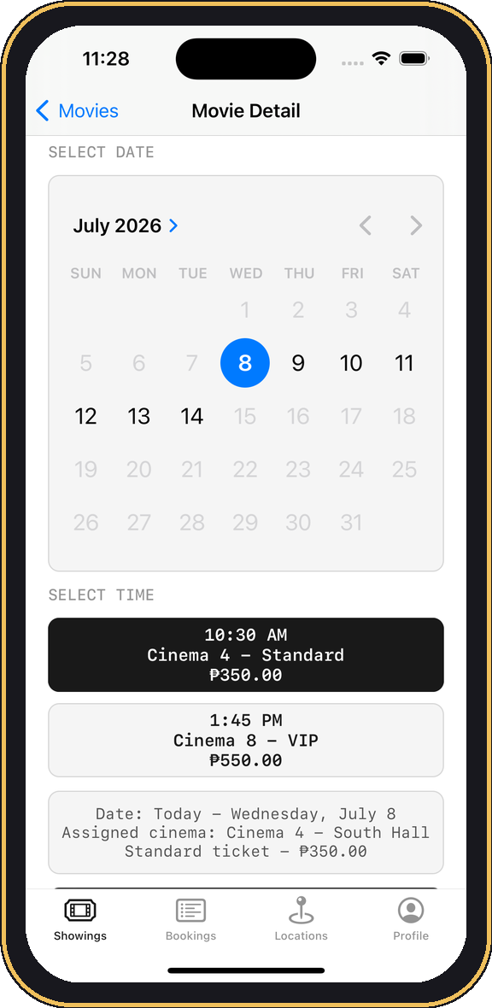
MILESTONE 04 · JUN 22, 2026
Schedules, notifications & architecture cleanup
What shipped
Nested one-week schedules + multiple showtimes
Live current-date labels
Local reminders via UserNotifications (no APNs or Apple Push Notifications)
Clean Architecture, protocol DI, use cases, AppFactory, DTOs (Data Transfer Object) & mappers
DTO: movieID: 3 · cinemaID: 4 · time: 10:30
Mapping: cinemaID: 4 → "Cinema 4 – South Hall, ₱350, South Hall address"
LEARNING FOCUS
Clean Architecture + DI by AppFactory

Slide 15
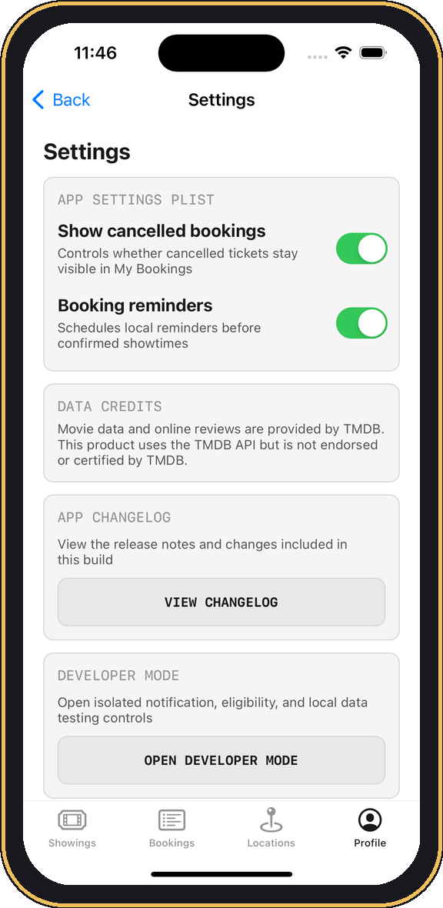
MILESTONE 05 · JUN 23, 2026
Plist settings, seat database & UI polish
What shipped
Plist settings + Settings menu ; essentially like an XML for storing structured data as simple key pairs (key: booking -> value: true)
Plist-backed seat layouts
Shared UI constants + font / warning polish
Persisted reserved seats + local reset controls
First unit tests
LEARNING FOCUS
Plist persistence + design tokens

Slide 16
MILESTONE 06 · JUN 24, 2026
Showings expansion, maps, sharing & launch cleanup
What shipped
Renamed Movies → Showings landing
Concert & Seminar JSON + browsing screens
Locations MapKit pins + zoom controls
Ticket sharing by account email
Empty-launch data + separate runtime storage
LEARNING FOCUS
MapKit + content architecture

Slide 17
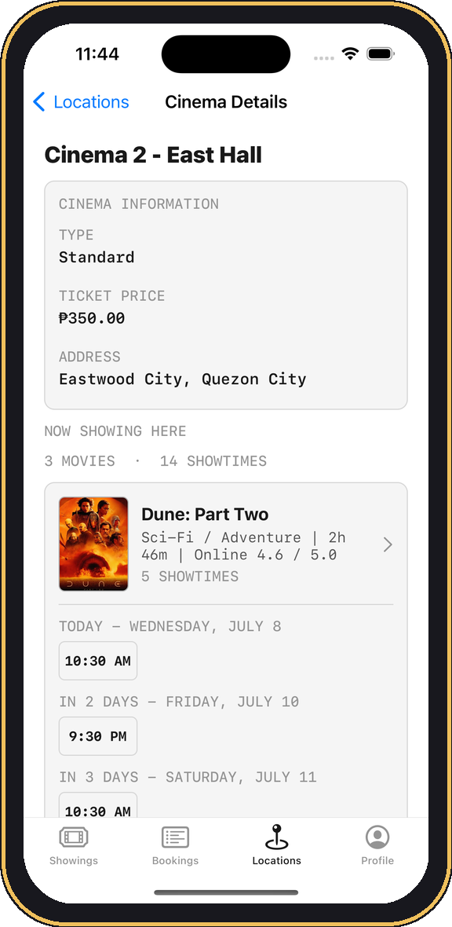
MILESTONE 07 · JUN 25, 2026
Interactive cinema pins & showtime shortcuts
What shipped
MapKit pin callouts + Cinema Details
Grouped assigned showtimes
Tappable showtime chips preselect date / time
Apple Maps pins
Assigned-cinema-only booking
LEARNING FOCUS
MapKit interaction + navigation

Slide 18
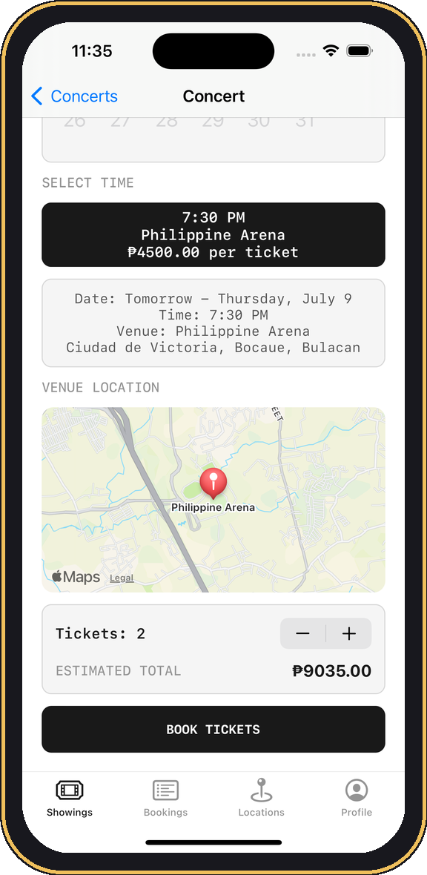
MILESTONE 08 · JUN 29, 2026
Concert / seminar booking & feature separation
What shipped
Separated Concert & Seminar models / screens
Search + venue filters
Coordinate-backed venues + live schedules
Quantity booking, reminders, sharing, cancellation, history
App icon + expanded tests
LEARNING FOCUS
Feature modularization + reuse

Slide 19
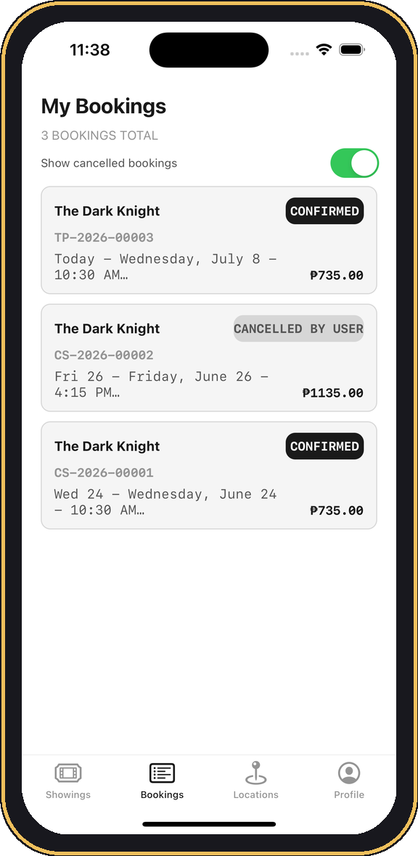
MILESTONE 09 · JUN 30, 2026
TicketPlease rebrand & review system
What shipped
Applied TicketPlease brand + TP booking IDs
Standardized list controls across categories
Account-owned JSON reviews replace bundled data
Booking-Detail review eligibility + one-review rules
Developer Mode isolation + organized LocalContent
LEARNING FOCUS
Data ownership + release prep

Slide 20
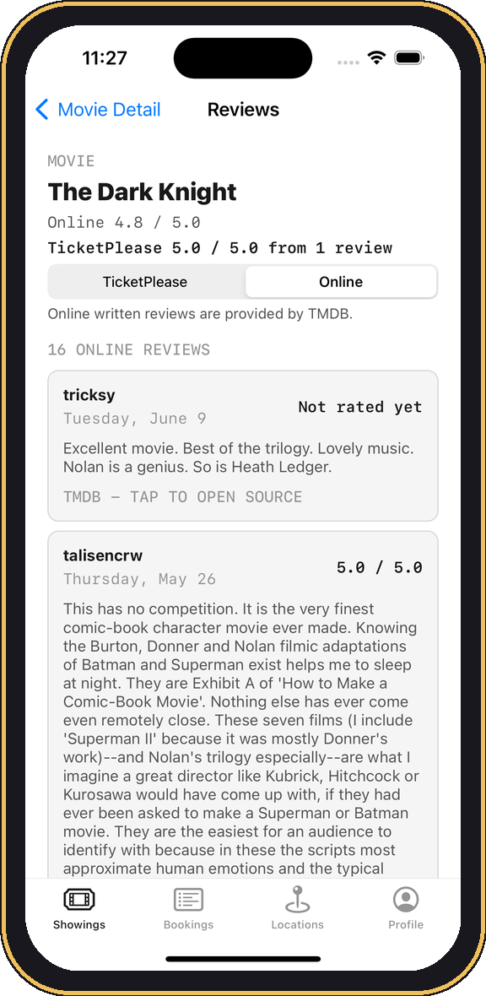
MILESTONE 10 · JUL 1, 2026
Booking-owned reviews & online separation
What shipped
Showing reviews read-only; writing moved to Booking Detail
Unlimited review testing in Developer Mode
Separated TicketPlease vs TMDB online reviews
Local-only TMDB token + documented production swap
Versioned LocalContent + sort-direction arrows
LEARNING FOCUS
API integration + credential hygiene

Slide 21
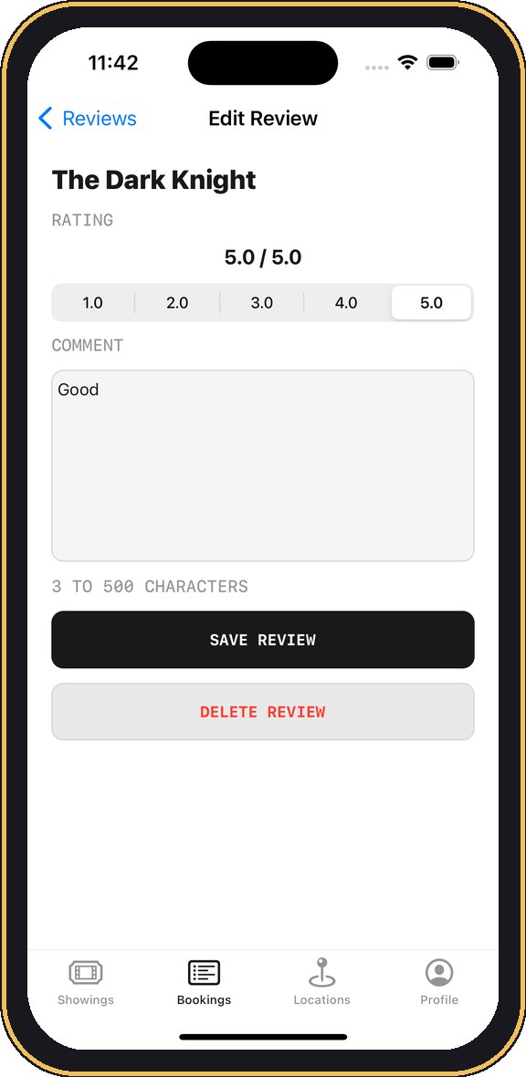
MILESTONE 11 · JUL 3, 2026
Rating & showing text consistency
What shipped
Shared Rating & Showing metadata formatters
Standardized 4.7 / 5.0 rating text everywhere
Numerical review input + synced value label
Normalized durations (2h 32m) + capitalization
Reused metadata across lists, details & bookings
LEARNING FOCUS
Consistency & polish

Slide 22
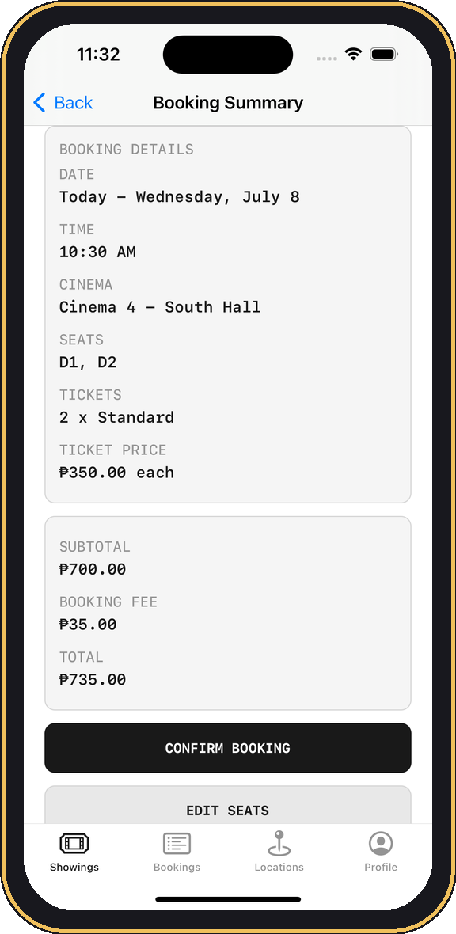
FEATURE JOURNEY
The booking flow, end to end
›
›
›
›
Detail
Schedule
Seats
Summary
Confirmed
Five taps from browsing to a confirmed, locally-persisted ticket with a TP booking ID.

Slide 23
FEATURE JOURNEY
Two booking modes, one engine
MOVIES — seat map
CONCERTS & SEMINARS — quantity
Cinema-specific seat selection vs. quantity + venue map — the same reservation core, two front-ends.

Slide 24

FEATURE JOURNEY
Real bundled content, not placeholders
10 movie posters ship inside the app bundle. A three-tier image pipeline serves them: bundled asset → FileManager cache → URLSession download.
Concerts and seminars carry their own venues, coordinates, schedules and metadata — all authored as structured JSON.

Slide 25
03
Feature Deep-Dives
How the marquee features work
TICKETPLEASE

Slide 26
DEEP-DIVE · BOOKING
Booking & cinema-specific seat maps
SeatMapView builds vertical rows of horizontal seat stacks with explicit aisle gaps.
Reserved states persist. Confirmed seats are stored and blocked from re-selection.
Events differ by design. Concerts & seminars book by ticket quantity, not seats.
Traceable orders. Every booking gets a “TP” ID, summary, confirmation & history.
Peso pricing. 6 standard cinemas at ₱350, 2 VIP cinemas at ₱550.
Why it matters: The same engine models any seat-, slot-, or quantity-based reservation.

Slide 27
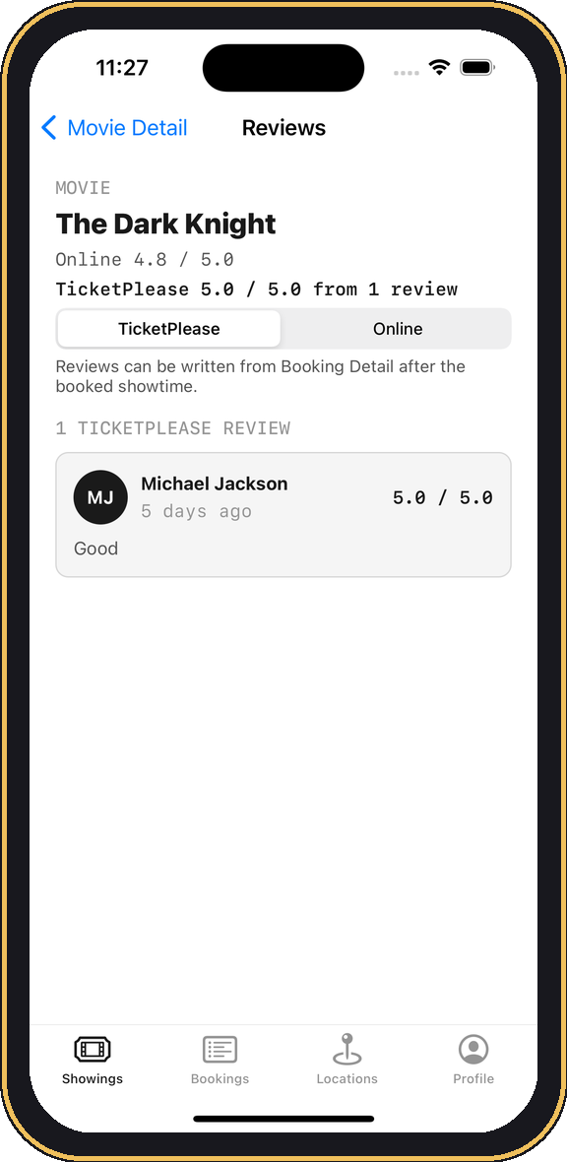
DEEP-DIVE · REVIEWS
A rules-driven review system
Read anywhere, write once. Showing pages are read-only; writing lives on Booking Detail.
Four ownership gates. Signed in + owns the ticket + confirmed + showtime passed.
One review per item. A single editable / deletable rating + comment, author-locked.
Two sources, never merged. TicketPlease reviews stay separate from TMDB “Online”.
Safe testing. Developer Mode can bypass the time rule without polluting data.
Why it matters: Server-side this becomes moderated, one-per-customer feedback — ideal for NPS modules. (Net Promoter score)

Slide 28
DEEP-DIVE · LOCATIONS
MapKit locations & showtime shortcuts
Live pins. Cinema and event-venue annotations render from real coordinates.
Rich callouts. Tapping a pin opens Cinema Details with grouped showtimes.
Tap-to-book. Showtime chips preselect the date and time, then route to booking.
Native hand-off. Apple Maps pins and zoom controls for real navigation.
Guardrails. Booking is restricted to the cinema assigned to that showing.
Why it matters: The identical pattern powers branch / ATM / store locators and field dispatch.

Slide 29
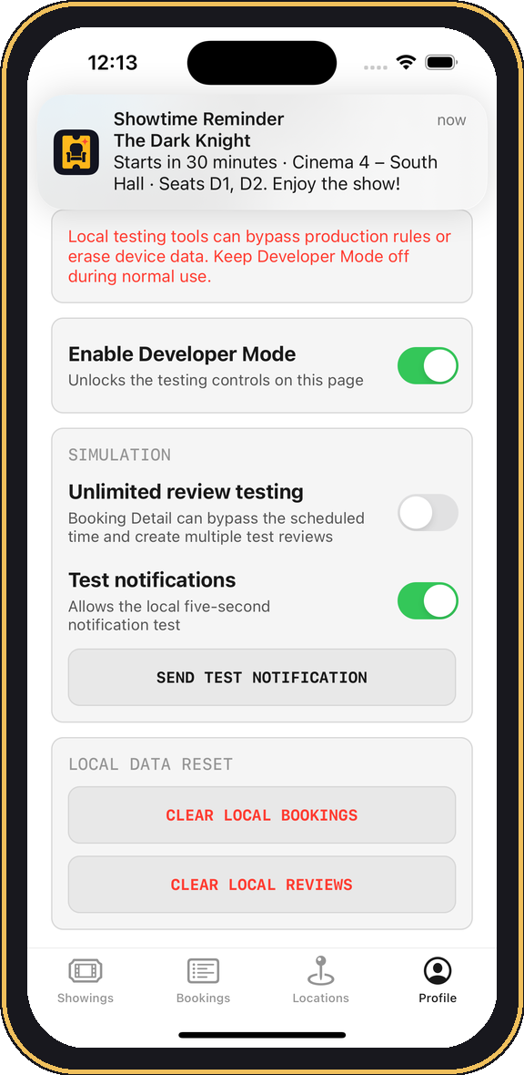
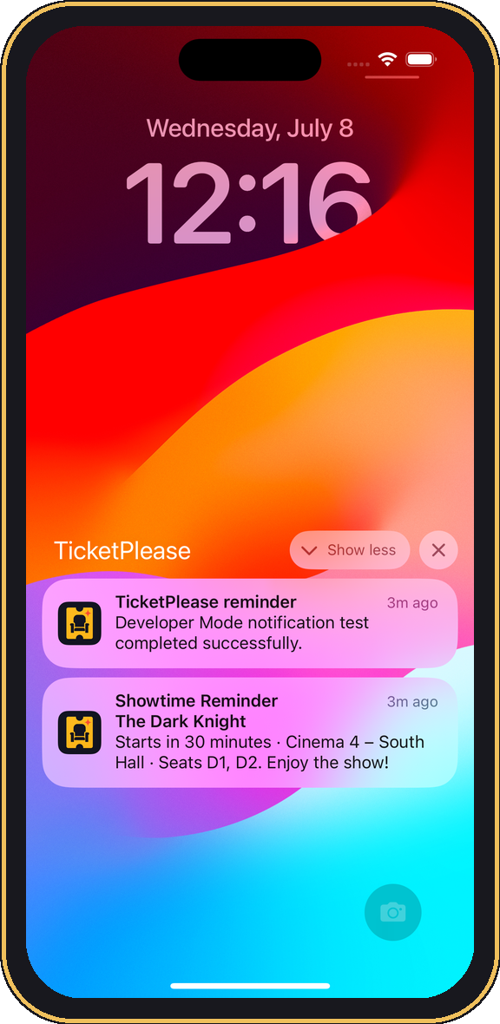
DEEP-DIVE · NOTIFICATIONS
Local notifications & reminders
On-device scheduling. Reminders fire through UserNotifications — no server, no APNs.
Booking reminders. Alert before confirmed showtimes; toggled in Settings.
Standard iOS surfaces. Delivered as a top banner and on the lock screen.
Rich content. Title, subtitle and body carry the movie / event, venue, seats & time.
Built-in test harness. Developer Mode fires a five-second test notification.
Why it matters: the same reminder pattern drives appointment & payment alerts — upgraded to server APNs in production.
Banner pop-up
Lock screen

Slide 30
DEEP-DIVE · DATA
Persistence & security model
Local reminders fire through UserNotifications (no server / APNs). Each data type has a purpose-fit store:
Data | Where it lives | Mechanism
Bookings | Documents/bookings.json | FileManager + Codable
Profiles | Documents/profiles.json | FileManager + Codable
Reviews | Documents/reviews.json | FileManager + Codable
Settings | CineSeatSettings.plist | Plist repository
Seat layouts | SeatLayouts.plist (editable copy) | Plist repository
Session & prefs | UserDefaults | Key-value
Passwords | iOS Keychain | Secure enclave-backed
Posters | Caches/PosterCache | URLSession + cache
Bundled content | 7 LocalContent JSON files | DTO → mapper → model

Slide 31
04
Engineering & Learning
Architecture and the iOS competencies practiced
TICKETPLEASE

Slide 32
ENGINEERING
Clean Architecture at a glance
PRESENTATION
AppFactory
View (UIKit controllers, storyboards, custom views) + ViewModel
Composition root — injects every client, repository, service & use case through protocols.
▲
DOMAIN
Protocol contracts · Use cases (framework-independent)
Cross-cutting / Constants
▲
Shared formatters, design tokens, reusable cells & headers keep every screen consistent.
DATA / PERSISTENCE
Model — JSON · plist · UserDefaults · Keychain · URLSession

Slide 33
LEARNING
Six iOS modules learned from the training
Module | How TicketPlease applies it
1 · Swift Fundamentals | Types, optionals, enums/structs/classes, protocols, Codable, ARC, shared formatters
2 · UIKit & MVVM | Storyboard + programmatic Auto Layout, table views, segmented controls, custom seat views
3 · Intermediate Swift | Closures, map/filter/reduce/sorted, protocol abstraction, UserNotifications, main-thread UI
4 · Networking & Deps | URLSession poster fallback, async TMDB reviews, native MapKit/UIKit, zero pods
5 · Persistence & Security | JSON repositories, plist, UserDefaults, Keychain password storage
6 · Clean Arch & DI | View/ViewModel/Domain/Persistence split, AppFactory, shared formatters

Slide 34
05
Business Translation
From practice app to Seven Seven Global Soft solutions
TICKETPLEASE

Slide 35
BUSINESS TRANSLATION
Why this matters for Seven Seven Global Soft
The company. An IT services firm delivering tailored web & app solutions to banks and international clients.
The direction. Actively moving into AI integration across its client portfolio.
The proof. TicketPlease demonstrates reusable patterns — scheduling, secure auth, maps, notifications, clean architecture.
The payoff. Every module could map to a concrete deliverable a bank or enterprise client would pay for.
One well-built booking app is really a toolkit: reservation logic, identity, geolocation, messaging and reviews are the same primitives behind bank appointment systems, corporate calendars, and portals.

Slide 36
BUSINESS TRANSLATION
Capability → client solution
TicketPlease capability | Reusable client solution
Booking & scheduling engine | Appointment / calendar systems, branch queueing, corporate room booking
Seat / resource map | Desk, room & branch resource allocation; event seating
Keychain secure auth | Bank-grade secure login & credential storage modules
Reviews & ratings | Customer feedback, NPS & survey modules with moderation
MapKit locations | Branch / ATM / store locators; field-service dispatch
Local + push notifications | Transaction alerts, appointment & payment reminders
Clean Arch + DI + tests | Maintainable, testable, hand-off-ready client codebases

Slide 37
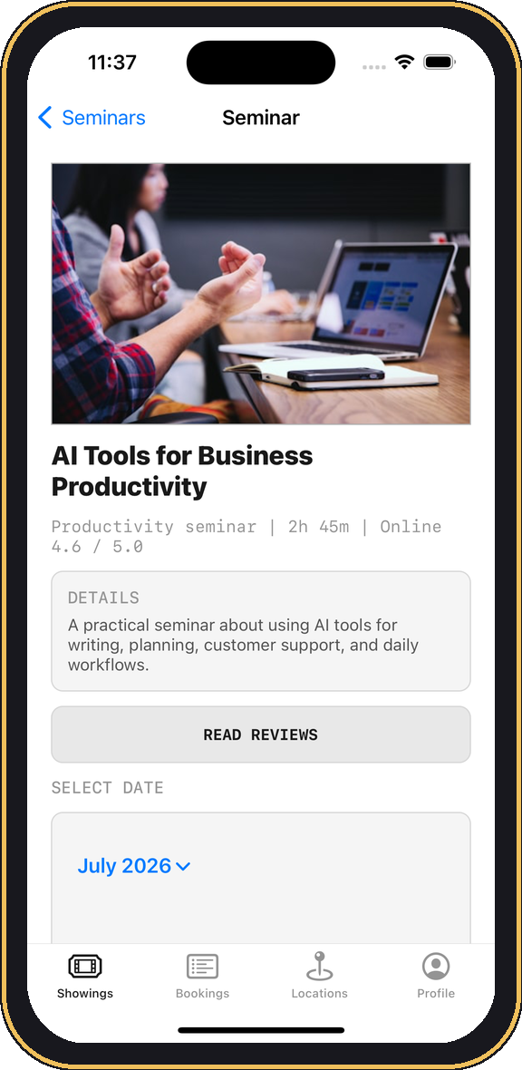
BUSINESS TRANSLATION
Three concrete client translations
Bank branch appointment app
Reuse booking + Keychain auth + MapKit + reminders. Customers reserve a branch, time & service; AI predicts wait times and staffs accordingly.
Corporate room / desk booking
Reuse the seat-map engine as a floor plan. Employees reserve desks & rooms; calendar sync and AI suggest optimal times.
Enterprise event & webinar portal
Reuse Concerts/Seminars + quantity booking + reviews. International clients run registrations; AI summarizes attendee feedback.

Slide 38
BUSINESS TRANSLATION
Where AI plugs in
Smart scheduling
Demand & revenue forecasting
Review sentiment
Demand forecasting for slots, seats & staffing across branches.
Project future demand, revenue, and transaction volumes so clients can plan capacity, cash, and staffing ahead.
AI model can summarizes customer feedback into actionable insight.
Conversational booking
Document & KYC
Risk & anomaly signals
Chat / voice assistant that books, reschedules & answers questions.
Vision + LLM extraction for onboarding and compliance at banks.
Flag unusual booking / transaction patterns for review.
Delivered with AI models — API for scale, on-device / private deployment for sensitive banking data.

Slide 39
06
Roadmap & Future
What it takes to go from practice to production
TICKETPLEASE

Slide 40
ROADMAP
What are not present in the app
Real Backend & shared DB — accounts, inventory, bookings, reviews across devices
Server authentication — hashing, token refresh, revocation, account recovery
Transactional locking — prevent two devices buying the same seat / ticket
PCI-compliant payments — never store card data on-device
Server-driven APNs — cancellations, schedule changes, transfers
Governance — review moderation, privacy policy, licensing & attribution

Slide 41
ROADMAP
Future development & improvements
Platform
Intelligence
Craft
Swap local JSON → cloud backend + sync
Recommendations & smart scheduling
Accessibility: VoiceOver + Dynamic Type
Real ticketing & payment integration
Conversational booking assistant
Further iPad & landscape support testing
CI/CD (Continuous Integration/Continuous Deployment), analytics & crash reporting
Review sentiment with AI model
Split legacy files; swap old UIKit → with new SwiftUI ; gate Dev Mode not accessible for any user

Slide 42
WRAP-UP
Key takeaways
Full-featured & well-architected. A production-shaped iOS app built in ≈ 3-4 weeks, 11 documented milestones.
Every core competency, proven. UIKit, MVVM, Clean Architecture, persistence, security, maps, notifications, networking.
Directly reusable. Its patterns map 1:1 onto Seven Seven client work — booking, auth, locations, feedback.
AI-ready. Clear insertion points for AI model use across scheduling, recommendations, support and KYC (“Know Your Customer” like from bank and financial companies term).
A credible path forward. From practice build → backend + payments → AI-enhanced client products.

Slide 43
Thank you
TicketPlease — an iOS practice build for Seven Seven Global Soft Inc.
Miguel Sanson · miguelsanson21@gmail.com · July 2026

