Slide 1
MODULE 00
Course Introduction
Eleven sessions, from no Swift to an app of your own

Slide 2
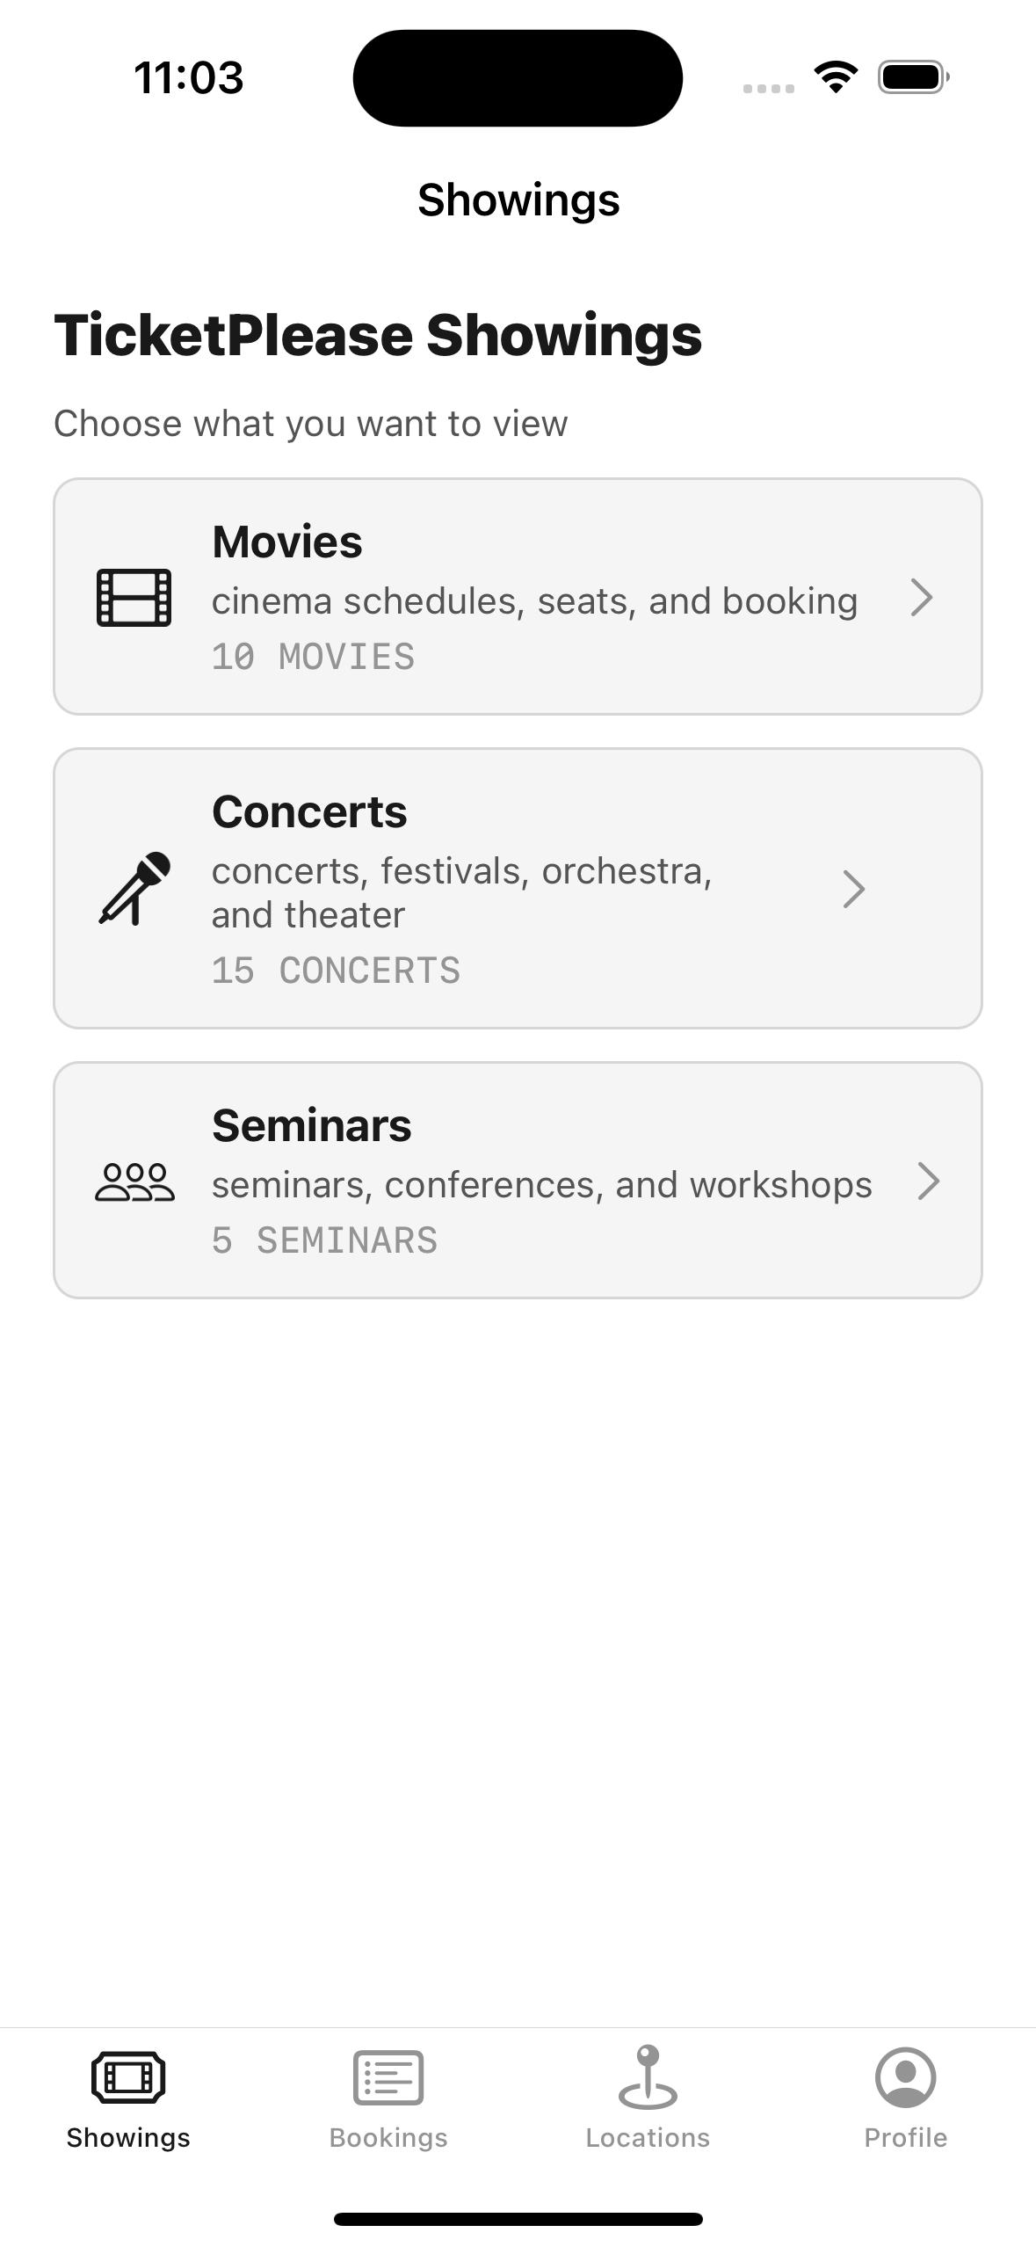
EVERY APP, THE SAME SUBSTRATE
Three foundations under every iOS app
A language. Swift
A set of tools. Xcode
A way of connecting what's on screen to code that runs

Slide 3
BY THE END OF THIS VIDEO YOU WILL KNOW
Course objectives
How the eleven modules are structured, and why in that order
What you need to follow along — and what you don't
How the example app is used, and why it isn't the point
What to do with each module's practice exercise

Slide 4
TWO HALVES
How the course is built
Modules 1–7
Chapters 8–10
The technical curriculum
The craft no single API teaches you
It climbs deliberately
Case study, testing, documentation
Each one needs the one before it

Slide 5
THE TECHNICAL CURRICULUM
It climbs
01
The language and the tools — Swift, Xcode
02
The interface layer — UIKit, MVVM, Auto Layout
03
Intermediate Swift and concurrency
04
Networking — real data
05
Data persistence and security
06
Architecture — keeping it maintainable
07
Device capabilities — maps, notifications, media

Slide 6
THREE CRAFT CHAPTERS
What no single API teaches
08
Case study — assembling it into one product
09
Testing — proving it works
10
Documentation — whether your work survives handover

Slide 7
EVERY MODULE ENDS WITH A PRACTICE EXERCISE
Why they matter
Watching someone write code
Writing it yourself
feels like learning
is where it becomes yours
Do them.

Slide 8
WHAT YOU NEED
Three things
A Mac
Xcode
Apple account
iOS needs macOS
free, Mac App Store
free

Slide 9
YOU DON'T NEED A PHYSICAL IPHONE
Simulator or device?
The simulator
A real device
covers almost everything in this course
eventually — camera and sensors
But not to learn.

Slide 10
HOW THE EXAMPLE APP IS USED
Every idea is shown twice
Once — in isolation
Again — inside a working app
let title: String
let rating: Double
struct Movie: Codable {
let title: String
let tmdbID: Int?
}
the idea, nothing in the way
what it looks like in a real product

Slide 11
NOTHING ABOUT THE EXAMPLE APP IS SPECIAL
Why it's good for teaching
137
0
0
Swift source files
third-party libraries
backend servers
MVVM · Domain · Persistence
100% native Apple frameworks
runs entirely on the device

Slide 12
Where does this idea fit in the thing I want to make?
The useful question isn't "how do I build this screen?"

Slide 13
RECAP
Course introduction
Seven technical modules, then three craft chapters
A Mac, Xcode and a free Apple account — no iPhone needed
Every idea shown twice: in isolation, then in a working app
The example app is scaffolding — build something of your own
Do the exercises; that's where it becomes yours

Slide 14
Module 1 — iOS Fundamentals and Swift Basics
Install the tools, create a first project, and the Swift foundations.

