Slide 1
MODULE 01
iOS Fundamentals and Swift Basics
The language, the tools, and connecting screen to code

Slide 2
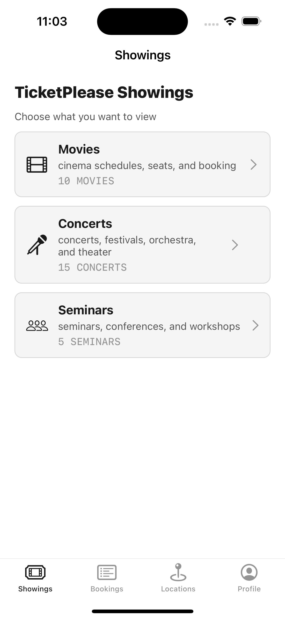
EVERY APP, THE SAME FOUNDATIONS
What every iOS app comes down to
A language. Swift — one language across every Apple platform
A set of tools. Xcode — editor, interface builder, simulator, debugger
A way of connecting. Outlets and actions, tying screen to code

Slide 3
BY THE END OF THIS VIDEO YOU WILL BE ABLE TO
Objectives
Explain what iOS development is, and why this course uses UIKit
Create a project and set its bundle identifier deliberately
Declare values with var and let — and reach for let first
Read and safely unwrap an optional
Connect a control to code with an outlet and an action

Slide 4
APPLE'S PLATFORMS
What you build for
iPhone
iPad
Apple Watch
Apple TV
iOS
iPadOS
watchOS
tvOS

Slide 5
HOW THE LANGUAGE GOT HERE
A little history
before 2014
Objective-C — still in older codebases
2 June 2014
Swift announced — the language this course uses
2019
SwiftUI — a declarative way to build interfaces

Slide 6
WHY UIKIT FIRST
UIKit, not SwiftUI
UIKit
SwiftUI
The overwhelming majority of existing production code
Newer, declarative
A great deal is done for you
You lay things out by hand
You'll understand what's being done for you — because you'll have done it yourself.

Slide 7
WHAT YOU NEED
Xcode is the whole toolkit
editor
interface builder
simulator
debugger

Slide 8
NEW PROJECT
The template asks for several things
Product Name
CineSeat
Bundle Identifier
← don't rush this
Interface
← or this
Language
Swift
Storage
None

Slide 9
1 — THE BUNDLE IDENTIFIER
Your app's unique identity on the App Store
SevenSeven.CineSeat
// your organisation, reversed · your app
// no two apps can share one
Transferable only by agreement between accounts — never simply claimed.

Slide 10
2 — INTERFACE
Choose Storyboard
Storyboard
SwiftUI
this is what selects UIKit
not this course

Slide 11
WHAT XCODE GENERATES
Don't delete any of them
AppDelegate.swift
the first thing that runs
SceneDelegate.swift
window / scene lifecycle
Main.storyboard
your screens
ViewController.swift
the code behind the first screen

Slide 12
DECLARING A VALUE
var and let
var — a variable
let — a constant
var score = 10
score = 25 // fine
let age = 25
age = 30 // error
it can change
once it's set, that's it

Slide 13
THE RULE
Reach for let by default
let age = 25
age = 30
// error: cannot assign to value — 'age' is a 'let' constant
A constant is a promise that this thing will not move.

Slide 14
THE CORE TYPES
What you'll use constantly
Int
Double
String
Bool
whole numbers
decimals
text
true / false
Array
Dictionary
ordered, by index
key / value

Slide 15
CONTROL FLOW
Conventional, with one difference
if score > 20 {
print("high")
} else {
print("low")
}
for movie in movies { ... }
Swift doesn't need parentheses around the condition.

Slide 16
FUNCTIONS
func, a name, parameters, a return type
Idiomatic Swift
Not Swift
func bookSeat(row: Int) -> Booking
isNowPlaying
posterURLString
func book_seat(row: Int)
is_now_playing
snake_case with underscores
camelCase — first word lowercase

Slide 17
Optionals
The single most important idea in this module.

Slide 18
FROM THE REAL APP
Three properties can be empty
CineSeat/Models/Movies/Movie.swift
struct Movie: Codable, Equatable {
let title: String
let tmdbID: Int?
let genre: String
let rating: Double
let posterURLString: String?
let localPosterName: String?
}
A ? means: this might hold a value, or it might be empty.

Slide 19
WHY OPTIONALS EXIST
Most crashes come from data
Without optionals
With optionals
poster = json["poster"]
imageView.load(poster)
let poster: String? = json["poster"]
if let poster { load(poster) }
the field isn't there
the compiler makes you handle it
nothing checks
caught at write time, not in production
the app dies in someone's hand

Slide 20
OPENING AN OPTIONAL SAFELY
Three ways
if let poster = movie.posterURLString {
imageView.load(poster)
}
let name = movie.localPosterName ?? "placeholder"
guard let id = movie.tmdbID else { return }
if let · ?? supplies a fallback · guard exits early

Slide 21
AND THE ONE TO USE SPARINGLY
Force-unwrap
You were right
You were wrong
nothing happens — this time
the app crashes, in someone's hand
Every force-unwrap is a small bet that you're right.

Slide 22
TWO MORE LANGUAGE PIECES
struct and class
struct — a value type
class — a reference type
it gets copied
it gets shared
two independent values
one object, two names
use for data and models
use for behaviour and services

Slide 23
A PROTOCOL IS A CONTRACT
What a type must do, not how
protocol BookingStore {
func save(_ booking: Booking)
func load() -> [Booking]
}
In Module 6 this becomes the backbone of the whole architecture.

Slide 24
How does a button on screen run your code?
The last topic, and the practical one.

Slide 25
TWO SEPARATE CONNECTIONS
You usually need both
Outlet
Action
@IBOutlet weak var confirmButton: UIButton!
@IBAction func confirmTapped(_ sender: UIButton)
the control as an object
the behaviour
enable it, restyle it, read its text
code runs when it's tapped

Slide 26
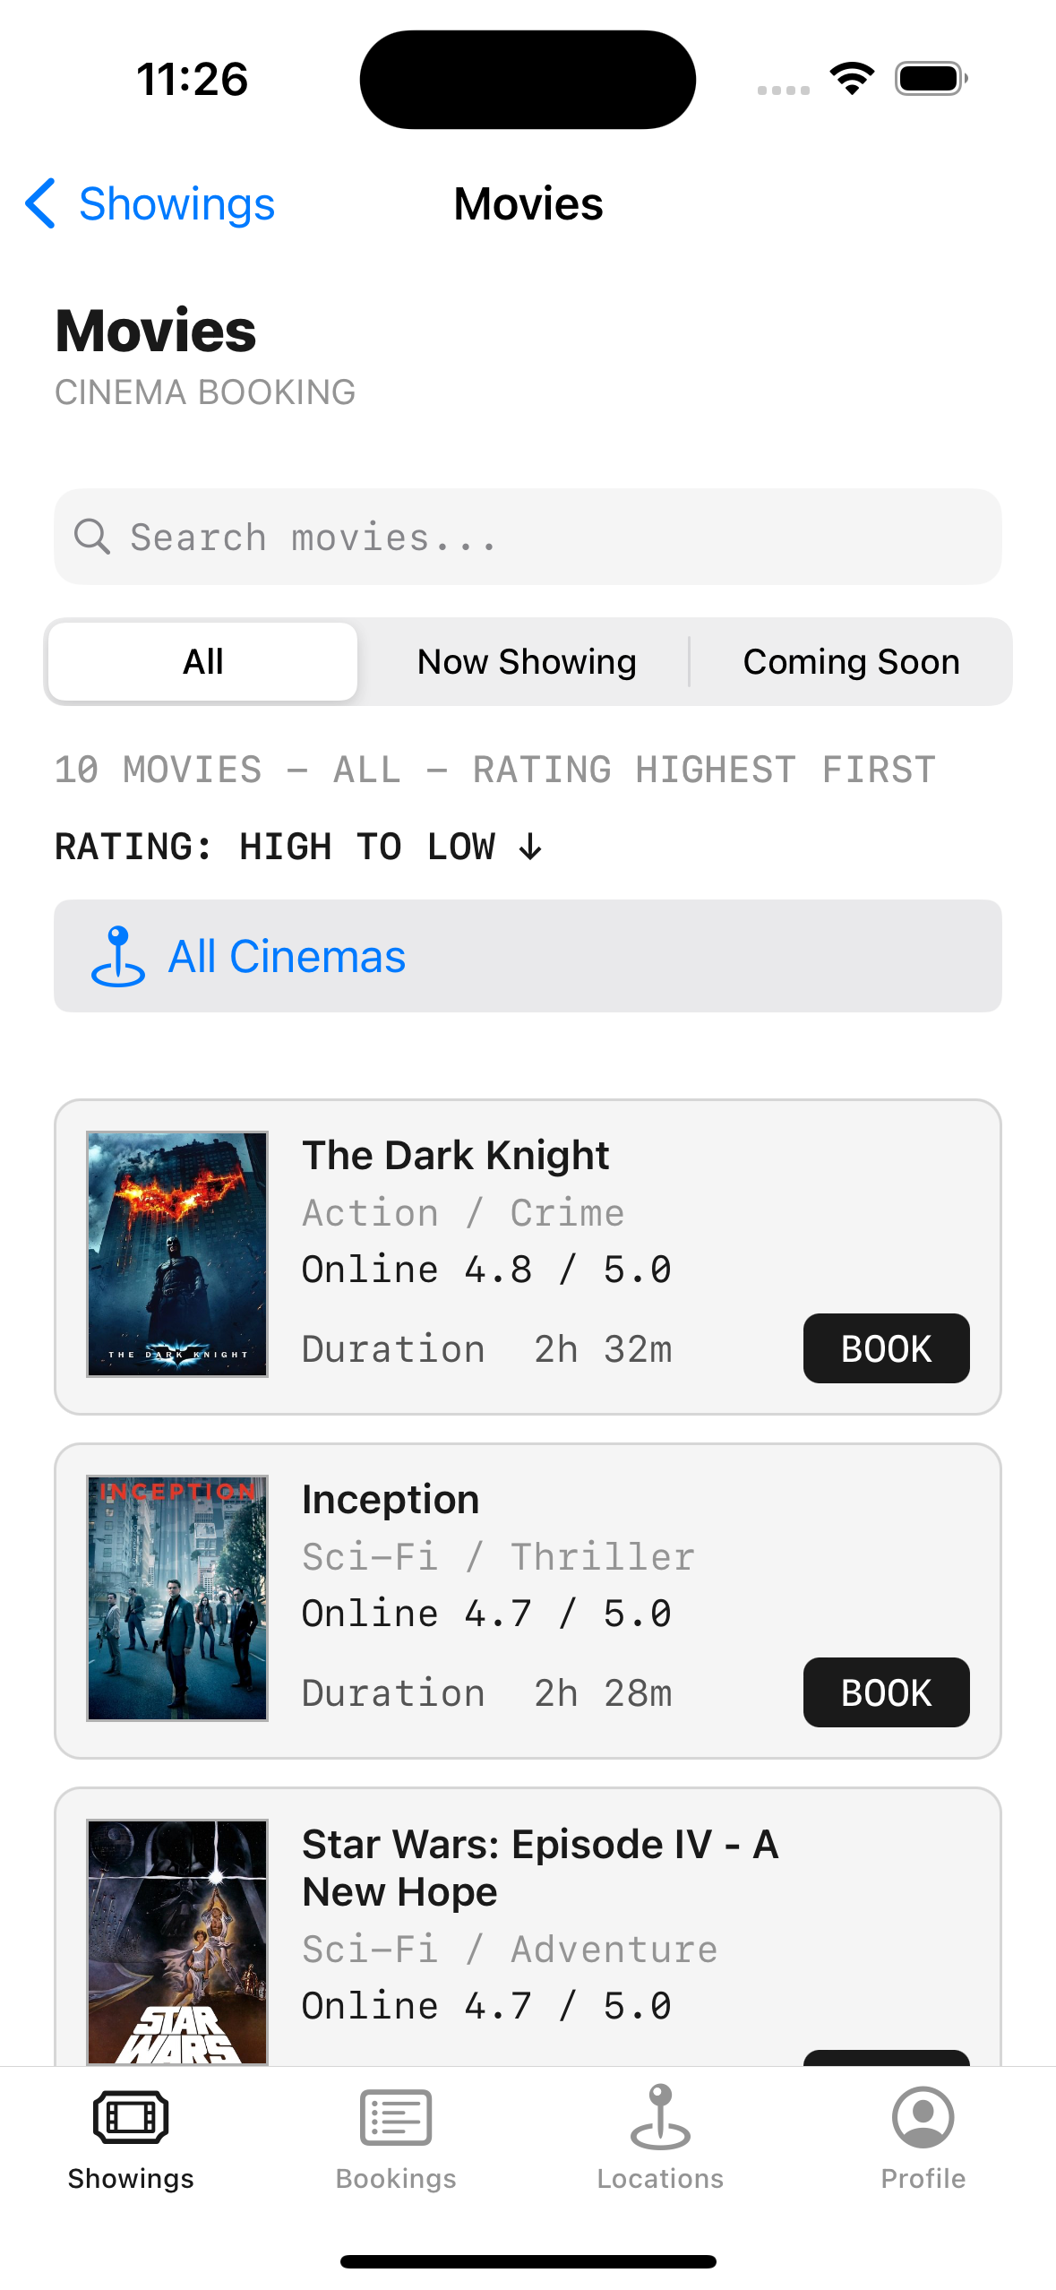
ALL OF IT, DOING REAL WORK
Every row in this list is one Movie struct
The optional properties are the poster and the online-database ID
Not every film has either
The list scrolls, nothing crashes
No value is forced open anywhere

Slide 27
RECAP
iOS Fundamentals and Swift Basics
iOS development means Swift and Xcode — this course uses UIKit
The bundle identifier is a permanent, unique identity
let by default; var only when the value must change
An optional says a value might be missing — unwrap it safely
Outlets connect the object; actions connect the behaviour

Slide 28
PRACTICE EXERCISE
Model something you actually use
01
Write a struct for it — at least six properties
02
Make two of them optional, and be able to say why
03
Print a summary using if let and ?? — no force-unwraps

Slide 29
Module 2 — UIKit, MVVM, Auto Layout and Table Views
Layout, navigation, table views, and the pattern that keeps code from becoming a mess.

