Slide 1
MODULE 02
UIKit, MVVM, Auto Layout and Table Views
Building an interface you can touch

Slide 2
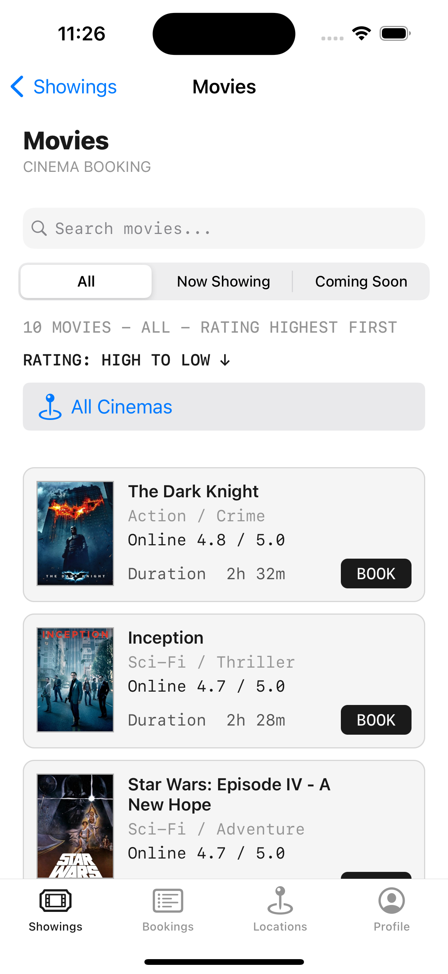
FROM A LANGUAGE TO SOMETHING YOU CAN TOUCH
This is the longest module in the course
Module 01 gave you a language. Types, optionals, functions
Module 02 builds an interface. Screens, layout, navigation, lists
This is where it starts to feel like real app development.

Slide 3
BY THE END OF THIS VIDEO YOU WILL BE ABLE TO
Objectives
Explain what UIKit is and how a view controller's life cycle works
Apply the MVVM pattern to keep logic out of your screens
Build layouts with Auto Layout constraints and stack views
Navigate between screens with push and modal presentation
Populate a table view using its delegate and data source

Slide 4
UIKIT
Apple's long-established interface framework
Views. What is actually on screen
View controllers. The code behind one screen
An event-driven model. The user acts, your code responds
Storyboards. A visual file where you drag controls onto a canvas

Slide 5
Where does your code go?
This is where most beginner projects go wrong.

Slide 6
MVVM
Three responsibilities
Model
Holds data — Movie
ViewModel
Owns logic and formatting — MoviesViewModel
View
Displays only what it is handed — MoviesViewController

Slide 7
A REAL VIEW MODEL FROM THE APP
All the logic lives here
CineSeat/ViewModel/MoviesViewModels.swift
var filteredMovies: [Movie] {
movies.filter { movie in
let matchesSearch = searchText.isEmpty ||
movie.title.localizedCaseInsensitiveContains(searchText)
let matchesCategory = selectedCategory == .all ||
movie.category == selectedCategory
return matchesSearch && matchesCategory
}
}
Search filtering, category filtering, rating sort — none of it in the view controller.

Slide 8
WHY BOTHER
Two reasons
The view controller stays small
Logic in a view model can be tested
Instead of becoming a dumping ground for everything
Logic buried inside a screen cannot
We prove exactly this in Chapter 9
Readable at a glance

Slide 9
THE RULE FOR THE REST OF THE COURSE
Nothing but display in the view
No data handling in the view
No parsing in the view
No network calls in the view
All of it goes in the view model.

Slide 10
THE VIEW CONTROLLER LIFE CYCLE
A fixed sequence, every screen
viewDidLoad
Runs once, when the screen first loads
viewWillAppear
Runs every time the screen is about to show
viewDidAppear
After it is on screen
viewWillDisappear
As it goes away

Slide 11
THE TWO YOU WILL USE CONSTANTLY
Setup versus fresh data
viewDidLoad — once
viewWillAppear — every time
override func viewDidLoad() {
super.viewDidLoad()
tableView.dataSource = self
}
override func viewWillAppear(_ a: Bool) {
super.viewWillAppear(a)
reloadBookings()
}
Setup goes here
Fresh data each time the user returns
Putting it in the wrong place is a classic source of stale-data bugs.

Slide 12
Auto Layout
The part almost everyone finds hardest. If you struggle here, you are exactly where everybody else is.

Slide 13
WHY CONSTRAINTS EXIST
One design, many screens
1
5+
1
iPhone size, originally
sizes today
system that scales
layout was trivial
SE · standard · Pro · Max · iPad
constraints

Slide 14
TWO PIECES OF VOCABULARY
Origin, leading and trailing
The origin. Zero, zero is the top-left corner
Leading and trailing, not left and right
They follow reading direction, so the same layout works right-to-left
You change nothing to support Arabic or Hebrew

Slide 15
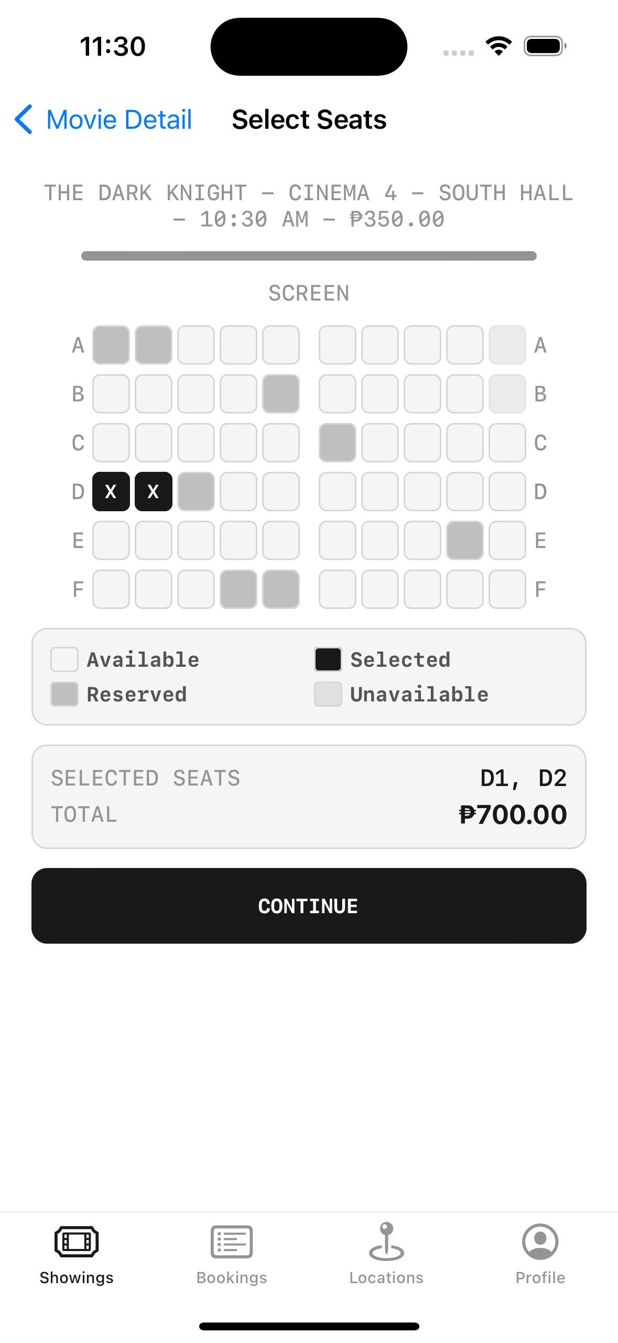
THE TECHNIQUE THAT MAKES CONSTRAINTS MANAGEABLE
Stack views
**This seat map** is rows of seats inside a vertical stack
**Constrain the stack**, not every individual seat button
**One set of constraints** instead of dozens
It handles what is inside for you

Slide 16
IF YOU GET STUCK
Do not let constraints block you
01
Build the working flow first
02
Treat layout polish as a finishing pass
03
Group things into stacks before you start constraining

Slide 17
Moving between screens
Three ways — two of them worth using.

Slide 18
THE TWO WORTH USING
Push and modal
Push navigation
Modal presentation
Slides in from the right
Slides up from the bottom, sits on top
Gives you a back button automatically
Good for an about screen or a dialog
For going deeper into a hierarchy

Slide 19
THE THIRD WAY
Segues constrain you
A segue cannot jump
Code can
Drawn in the storyboard, no code
Navigation in code goes anywhere
Forces you through the hierarchy
This is why the course does it in code
Five screens deep, it cannot jump back to screen two

Slide 20
ONE GOTCHA THAT WILL COST YOU AN AFTERNOON
Push does nothing outside a navigation controller
navigationController?.pushViewController(detail, animated: true)
// the code is correct
// the button does nothing
// there is no error message
If that happens to you — the screen is not inside a navigation controller.

Slide 21
FINALLY, TABLE VIEWS
Table or collection?
Table view
Collection view
A single scrolling column of rows
A grid of tiles
Like a social media feed
Like a photo gallery
Far more common — our focus

Slide 22
TWO PROTOCOLS MAKE A TABLE VIEW WORK
Data source and delegate
tableView.dataSource = self // how many rows, what is in each
tableView.delegate = self // what happens when a row is tapped
You assign both in viewDidLoad.

Slide 23
Miss that assignment and the table renders completely empty
No crash, no warning, no error. Probably the single most common beginner stumble in UIKit.

Slide 24
ONE MORE DETAIL IN THE CELL
prepareForReuse
override func prepareForReuse() {
super.prepareForReuse()
posterImageView.image = nil
}
Cells are recycled as you scroll — clearing on reuse prevents the previous row's image flickering in.

Slide 25
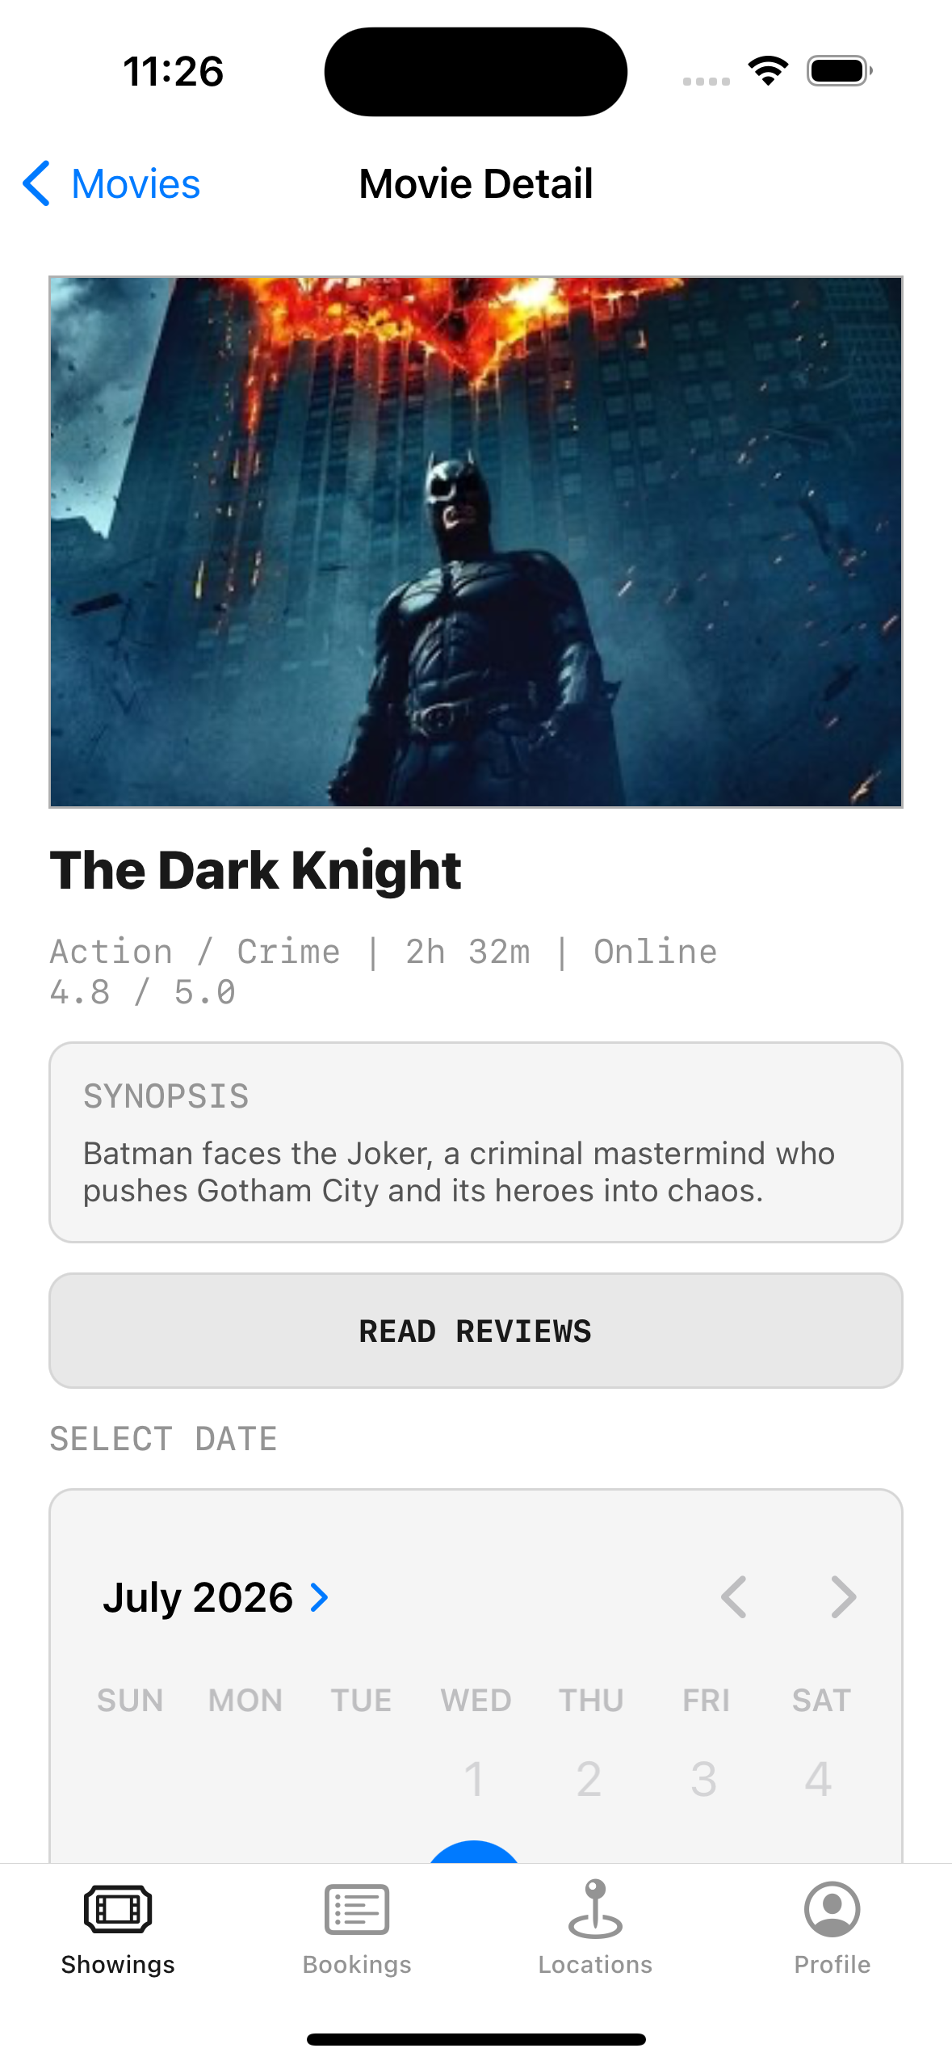
THE WHOLE MODULE, ON SCREEN AT ONCE
The screen is not doing the work
**Search and sort** ask the view model for a filtered, sorted list
**Rows are reusable cells** built from stack views
**Navigation** pushes the detail screen in code
**viewDidLoad** wired it all together

Slide 26
RECAP
UIKit, MVVM, Auto Layout and Table Views
UIKit is views, view controllers and an event-driven model
MVVM keeps logic in the view model — and testable
viewDidLoad runs once; viewWillAppear runs every time
Constraints scale one design across devices; stack views tame them
A table view needs both its data source and its delegate assigned

Slide 27
PRACTICE EXERCISE
Build a two-screen list app
01
A table view listing something you care about, driven by a view model
02
Tap a row to push a detail screen — in code, no segues
03
Lay the detail screen out with stack views, not individual constraints

Slide 28
Module 3 — Intermediate Swift and Concurrency
Closures, collections and concurrency — then how to plan an app before you write it.

