Slide 1
MODULE 04
Networking
Talking to a server safely, without blocking the interface

Slide 2
Almost every app worth using talks to a server
Safely, without freezing, and without shipping your secrets to strangers.

Slide 3
BY THE END OF THIS VIDEO YOU WILL BE ABLE TO
Objectives
Make a request with URLSession using async and await
Check the status code before trusting the data
Decode JSON into Swift types with Codable
Centralise networking behind one API client
Keep credentials out of your source code

Slide 4
NETWORKING ON IOS
HTTP, in practice always HTTPS
URLSession is Apple's built-in API for it
You do not need a third-party library for this
Everything in this module uses only what ships with the platform

Slide 5
THE METHODS YOU WILL USE
GET and POST
GET
POST
Fetches
Sends data and receives a response
You send nothing, you get data back
Logging in is the obvious example

Slide 6
Every request has the same shape
Build a URL, set any headers, make the call, check the response, decode.

Slide 7
BUILDING THE REQUEST
URL, then URLRequest for headers
guard let url = URL(string: base + "/movie/\(id)/reviews") else { return }
var request = URLRequest(url: url)
request.setValue("Bearer \(token)", forHTTPHeaderField: "Authorization")
A plain GET can skip URLRequest entirely.

Slide 8
THE CALL
async and await, from the last module
let (data, response) = try await URLSession.shared.data(for: request)
The interface stays responsive while it waits.

Slide 9
Check the status code before you touch the data
This is the step people skip, and it is the important one.

Slide 10
A REQUEST CAN SUCCEED AND STILL CONTAIN NOTHING USEFUL
What the codes mean
200
OK
401
You are not authenticated
404
There is nothing at that address
500
The server itself failed

Slide 11
NOTICE WHAT IS ABSENT
No force-unwrapping anywhere
guard let http = response as? HTTPURLResponse,
(200..<300).contains(http.statusCode) else {
throw APIError.badStatus
}
Every uncertain value is guarded. The worst case is an error you handle, not a crash.

Slide 12
TURNING DATA INTO SWIFT TYPES
Codable does it in one line
struct Review: Codable {
let author: String
let content: String
}
let reviews = try JSONDecoder().decode([Review].self, from: data)

Slide 13
WHY THIS MATTERS
Before and after Codable
The old approach
Codable
Pull values out of a dictionary key by key
One line, whatever the shape
The compiler checks it for you
The code grew forever as the payload did

Slide 14
ONE WRINKLE
CodingKeys bridges naming styles
struct Movie: Codable {
let posterPath: String?
enum CodingKeys: String, CodingKey {
case posterPath = "poster_path"
}
}
Swift uses camelCase; plenty of APIs use snake_case. You keep idiomatic Swift names.

Slide 15
RATHER THAN REPEAT THIS IN EVERY SCREEN
One generic API client
func fetch<T: Decodable>(_ path: String) async throws -> T {
let (data, response) = try await session.data(for: request(path))
try validate(response)
return try JSONDecoder().decode(T.self, from: data)
}
One function serves every endpoint in the app.

Slide 16
Keep your base URLs in one constant
Not scattered through view controllers — switching development to production becomes one edit.

Slide 17
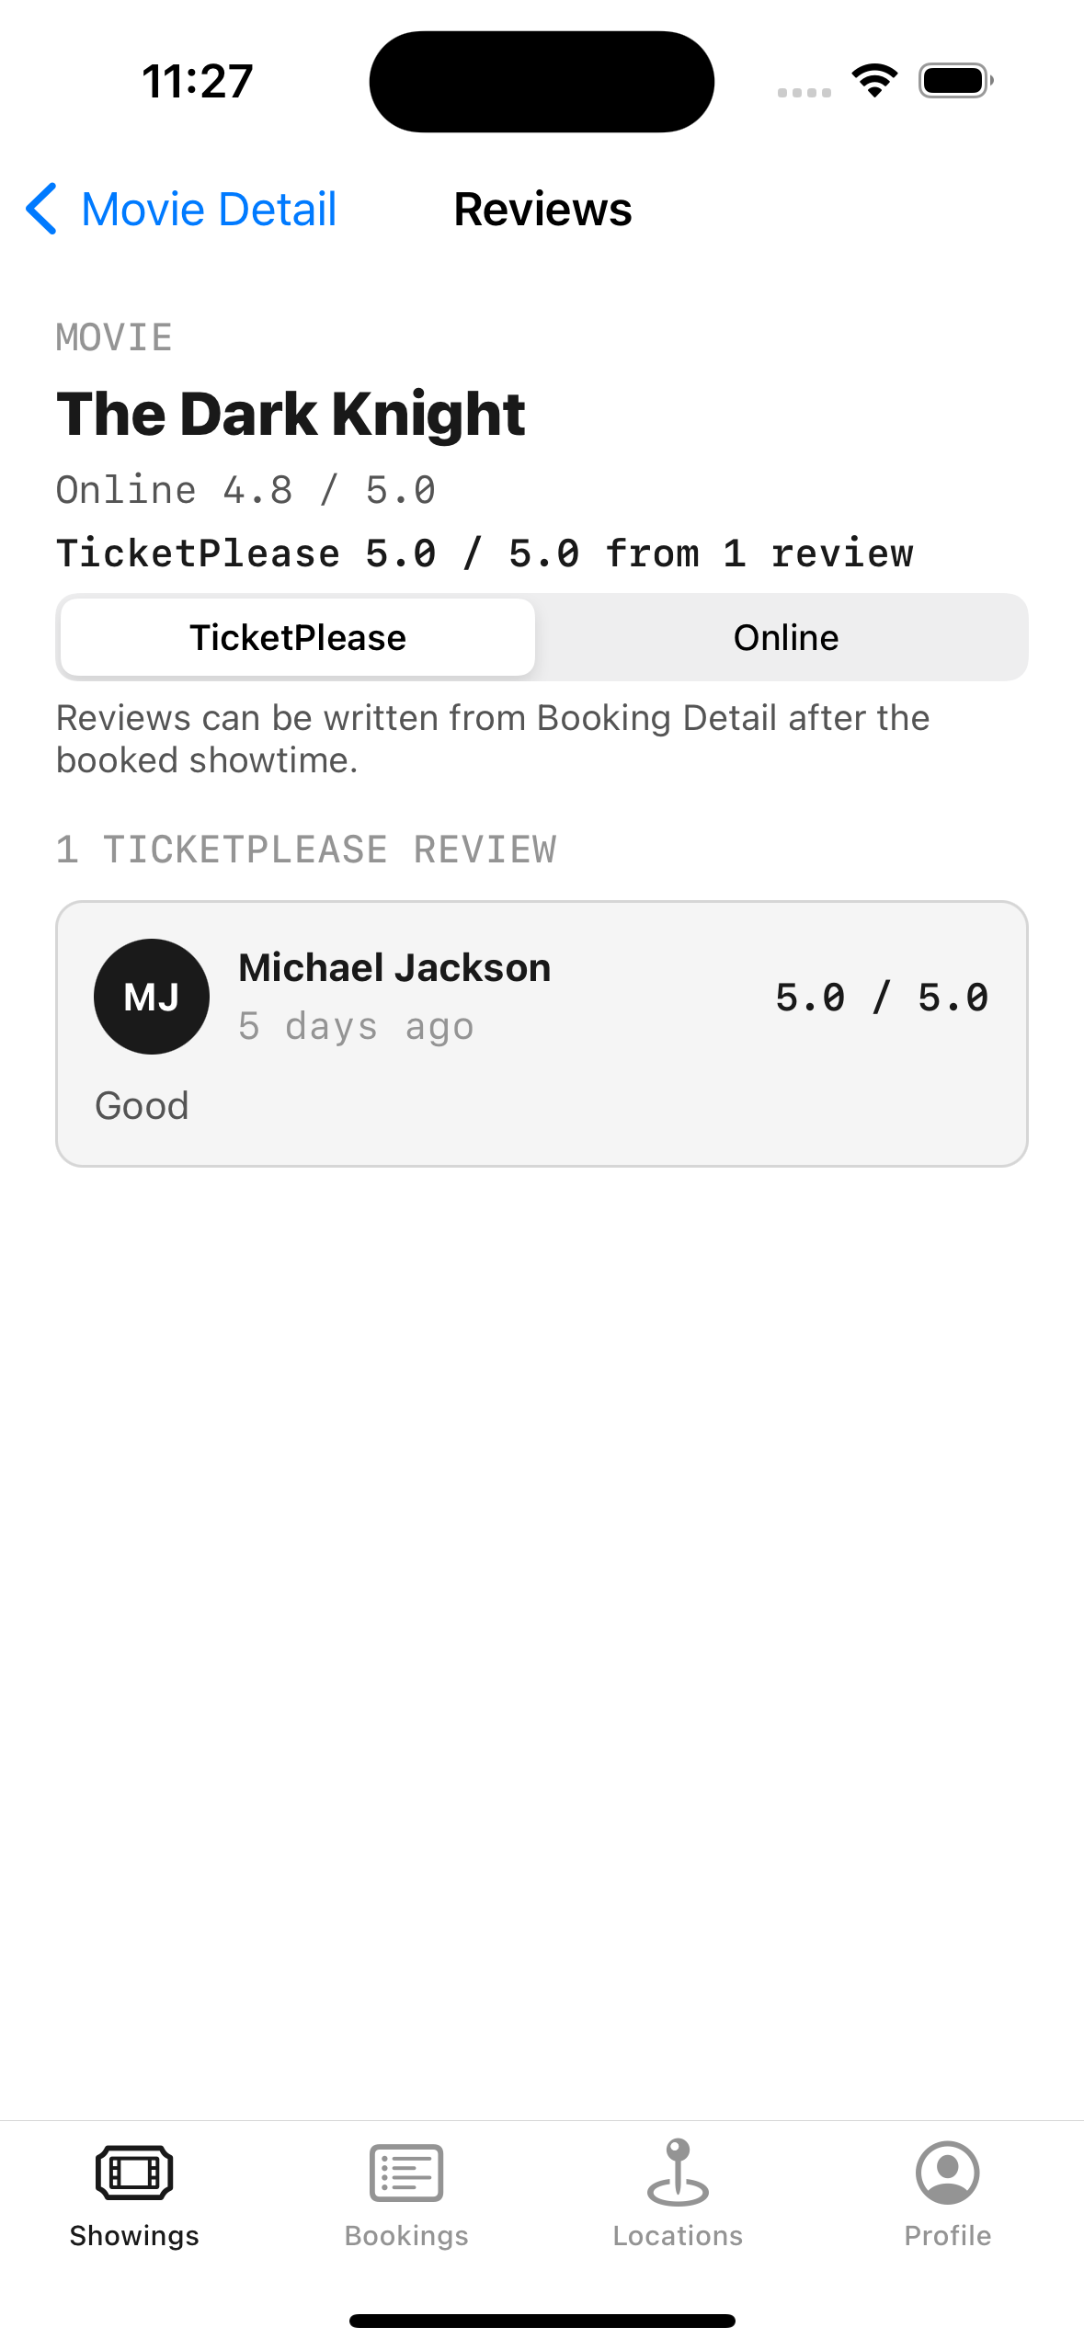
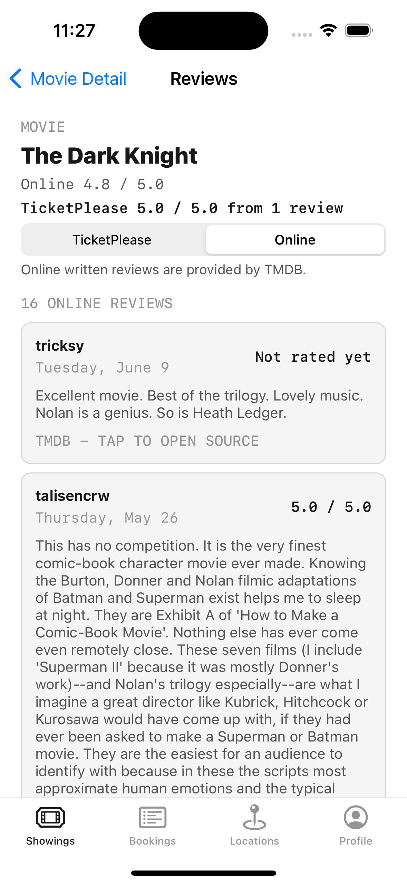
HERE IT IS RUNNING
Two sources, never mixed
**The app's own reviews** are stored on the device
**The Online tab** fetches from a real public API
**Same screen**, two very different data paths

Slide 18
External reviews are never counted into the app's own rating
Averaging someone else's numbers into yours would make both meaningless.

Slide 19
CREDENTIALS
The token is not in the source code
Not in the repository. It lives only in a local scheme setting
Not in the bundle. Anything you ship can be extracted from it
A production app keeps secrets on a server, not in the app

Slide 20
Anything you ship inside an app can be extracted from it
Getting into that habit now costs nothing and prevents a real incident later.

Slide 21
RECAP
Networking
URLSession with async and await — no third-party library needed
Always check the status code before trusting the data
Codable turns JSON into Swift types in one line
Centralise requests behind one generic API client
Secrets never live in source, the repo, or the shipped bundle

Slide 22
PRACTICE EXERCISE
Talk to a real API
01
Pick a free public API and fetch one endpoint with async / await
02
Decode it into a Codable struct — handle a non-200 status explicitly
03
Keep the base URL in one constant and the key out of source control

Slide 23
Module 5 — Data Persistence and Security
The data has arrived. Where does it live when the app closes?

