Slide 1
MODULE 05
Data Persistence and Security
Storing data on device, and storing secrets properly

Slide 2
Close the app, reopen it, and everything's gone
This module is about memory — and the one storage decision that, got wrong, is a real security problem.

Slide 3
BY THE END OF THIS VIDEO YOU WILL BE ABLE TO
Objectives
Choose between UserDefaults, files, Core Data and the Keychain
Persist models as JSON with Codable and FileManager
Explain why UserDefaults is not a safe place for secrets
Store credentials in the Keychain, correctly scoped

Slide 4
There is no single right answer
iOS gives you several mechanisms deliberately. The skill is matching each to the weight and sensitivity of the data.

Slide 5
FIRST — USERDEFAULTS
Small, lightweight key-value storage
UserDefaults.standard.set(true, forKey: "isDarkMode")
let dark = UserDefaults.standard.bool(forKey: "isDarkMode")
Which filter was last selected. Whether the user has seen the welcome screen.

Slide 6
ONE RULE
The type must match
Save a Bool, read a String and you get an error
A naming habit that prevents it: prefix boolean keys with `is`
`isDarkMode`, `isNowPlaying`, `isFirstLaunch`

Slide 7
SECOND — FILEMANAGER
Bigger, structured data as JSON
let url = FileManager.default
.urls(for: .documentDirectory, in: .userDomainMask)[0]
.appendingPathComponent("bookings.json")
try JSONEncoder().encode(bookings).write(to: url)

Slide 8
THIS IS HOW THE REFERENCE APP STORES ITS DATA
Codable in, Codable out
Bookings, profiles and reviews all live as JSON files
Codable turns the model into JSON, FileManager writes it
On next launch it reads straight back into the same Swift types

Slide 9
THIRD — CORE DATA
Apple's heavyweight option
Reach for it when
The reference app does not use it
You have a lot of data
For this volume, JSON files were simpler
Complex relationships between entities
Easier to reason about
You need querying, not just loading

Slide 10
That is a real skills gap, stated honestly
Core Data is worth learning next — the app simply did not need it.

Slide 11
The Keychain
The fourth mechanism, and the most important part of this module.

Slide 12
A BELIEF THAT CIRCULATES
UserDefaults is NOT encrypted
What people believe
What actually happens
"UserDefaults is encrypted on iOS"
A plain, unencrypted file in your app's container
"So it's fine for passwords and tokens"
That is not true
No access control
Readable with file system access or an unencrypted backup

Slide 13
MATCH THE STORE TO THE DATA
Where things belong
UserDefaults
Preferences and flags — nothing sensitive
JSON files
Models: bookings, profiles, reviews
Core Data
Large, related, queryable data sets
Keychain
Passwords, tokens, API keys, anything personal

Slide 14
Passwords, tokens, API keys — those go in the Keychain
Encrypted and protected by the operating system itself.

Slide 15
THE REAL IMPLEMENTATION
Note the accessibility setting
let query: [String: Any] = [
kSecClass as String: kSecClassGenericPassword,
kSecAttrAccount as String: email,
kSecvalueData as String: passwordData,
kSecAttrAccessible as String:
kSecAttrAccessibleWhenUnlockedThisDeviceOnly
]
'This device only' means the credential never travels in an iCloud backup.

Slide 16
Whatever encoding you save with, you must read back with
Mismatched text encodings are a confusing Keychain bug that will cost you an afternoon.

Slide 17
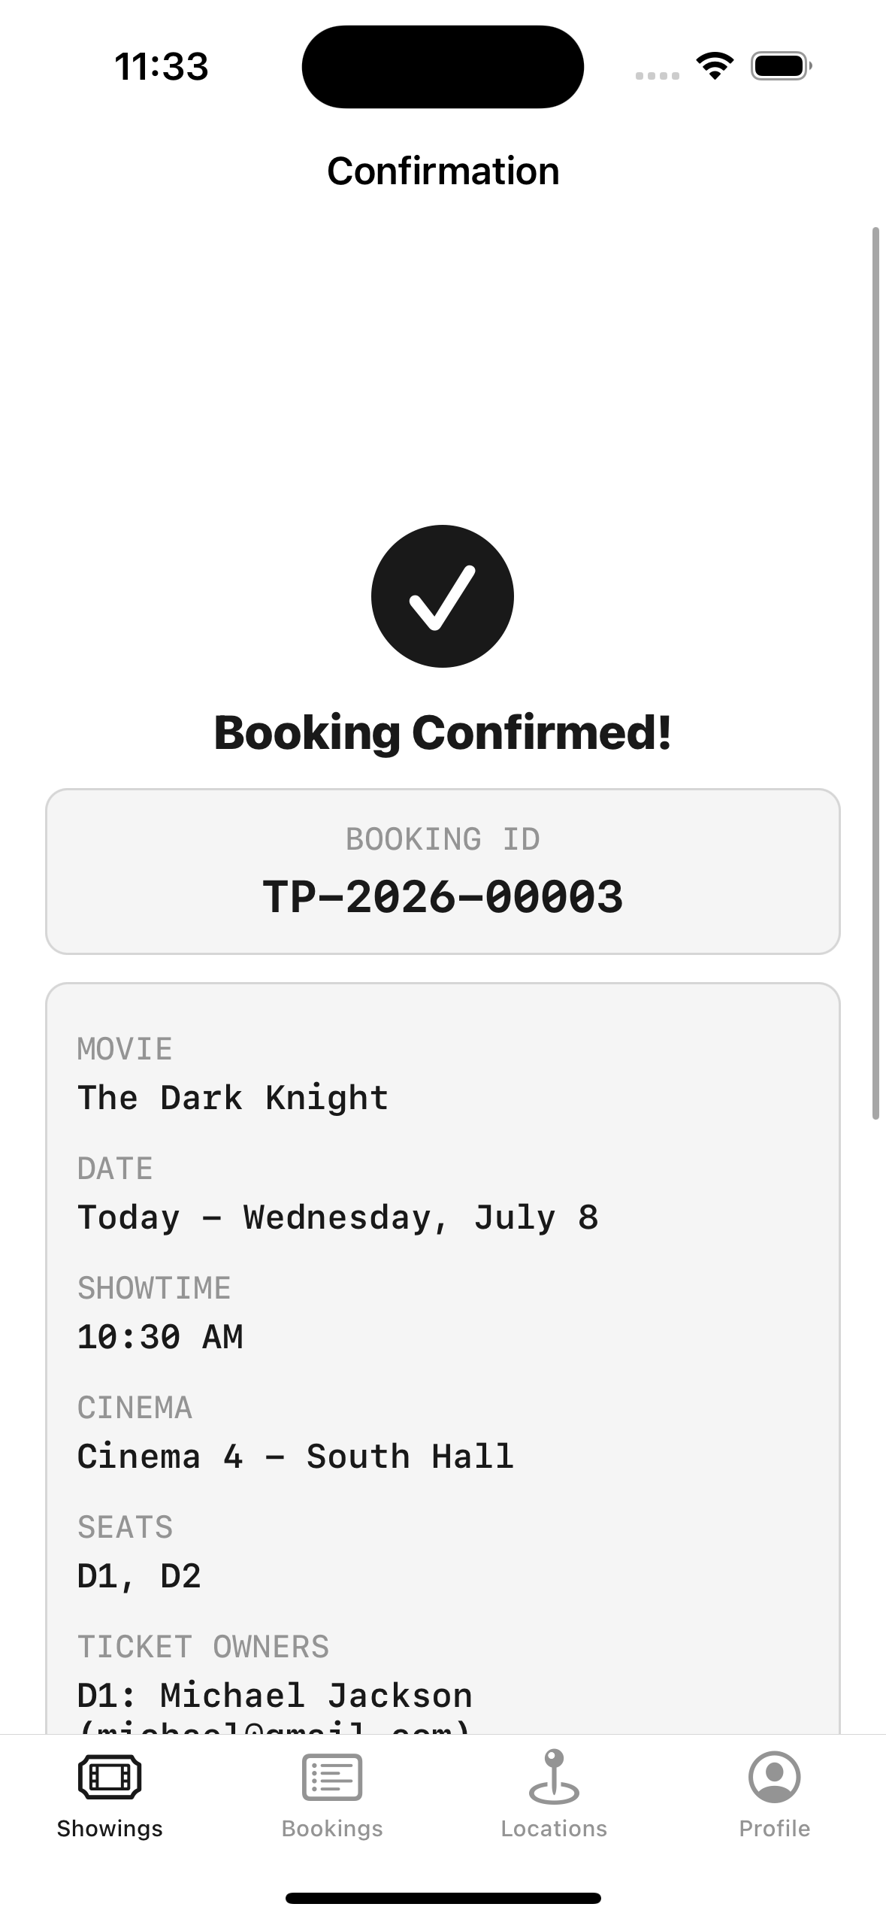
PERSISTENCE, PROVEN
Confirm a booking, then close the app completely
**Not backgrounded — closed.**
**Then reopen it**
The booking is still there, with the same ID

Slide 18
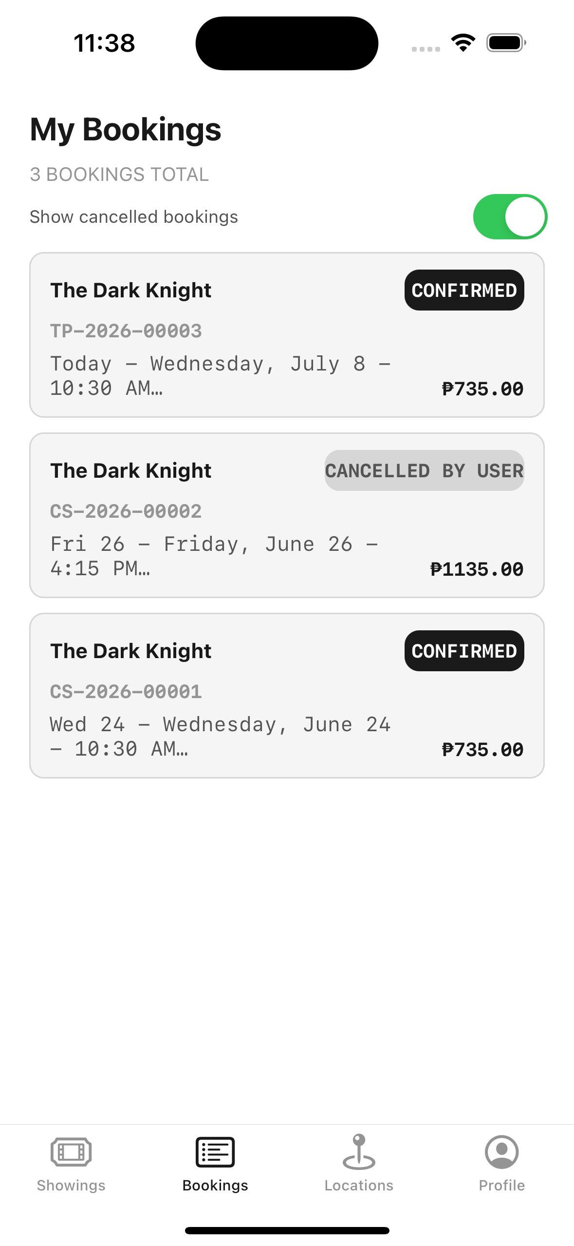
THERE IT IS
Straight back from a JSON file on disk
**Decoded back** into the same Swift types it was saved from
**No database**, no server, no third-party library

Slide 19
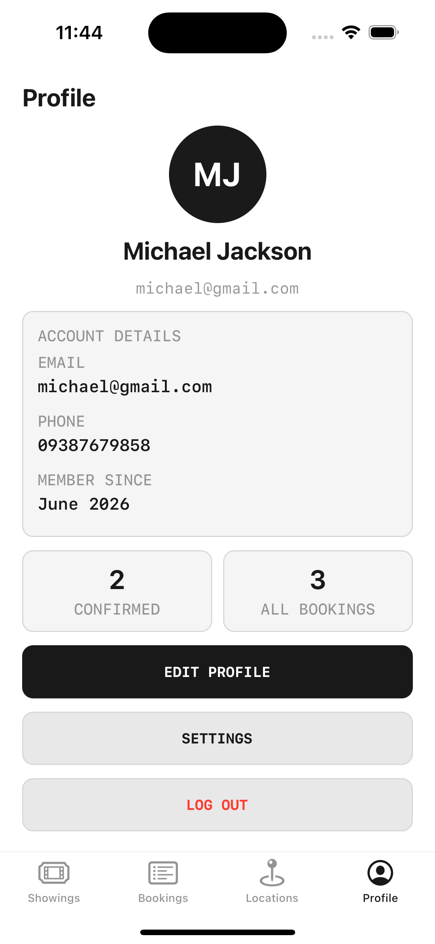
AND THE ACCOUNT
Never in the same place, never in plain text
**The profile details** are in a JSON file
**The password** is in the Keychain
Two different stores, chosen by sensitivity

Slide 20
RECAP
Data Persistence and Security
Match the mechanism to the weight and sensitivity of the data
UserDefaults for small flags — never for secrets
Codable plus FileManager persists models as JSON
UserDefaults is not encrypted; the Keychain is
Scope credentials to this device only

Slide 21
PRACTICE EXERCISE
Make something survive a relaunch
01
Persist a model as JSON with Codable and FileManager
02
Store one credential in the Keychain, this-device-only
03
Close the app fully, reopen, and prove both came back

Slide 22
Module 6 — Architecture Patterns and Dependency Injection
How to organise all of this so the app doesn't collapse under its own weight.

