Slide 1
MODULE 06
Architecture Patterns and Dependency Injection
Keeping a growing app maintainable

Slide 2
A ten-thousand-line view controller was once worn as a badge
There was a time when a very long file was taken as a sign of a skilled developer.

Slide 3
BY THE END OF THIS VIDEO YOU WILL BE ABLE TO
Objectives
Organise a project so a stranger can find things
Explain Clean Architecture's layers and the inward dependency rule
Depend on protocols instead of concrete types
Wire an app from a single composition root
Recognise when a singleton is fine and when it is a trap

Slide 4
How quickly could a stranger find the one piece they need to change?
Length isn't skill. Navigability is.

Slide 5
HOW THE REFERENCE PROJECT IS ORGANISED
Each folder has one job
Models
The data types
View
View controllers and screens
ViewModel
Logic and formatting
Domain
Protocols — the contracts
Persistence
Storage, keychain, notifications
CustomViews
Reusable components like the seat map

Slide 6
Massive View Controller
In plain MVC everything ends up in the controller — data loading, parsing, formatting, navigation. This is the failure mode the structure avoids.

Slide 7
CLEAN ARCHITECTURE
Three layers
Presentation
Views and view models
Domain
The protocols — the rules of the app
Data
Persistence, networking, the outside world

Slide 8
Dependencies point inward only
The domain layer knows nothing about UIKit, nothing about URLSession, nothing about where data comes from.

Slide 9
HOW THAT IS EXPRESSED
The app's protocols
protocol MovieFetching {
func fetchMovies() async throws -> [Movie]
}
protocol BookingManaging {
func add(_ booking: Booking)
func cancel(id: String)
func all() -> [Booking]
}

Slide 10
A PROTOCOL IS A CONTRACT
What, never how
MovieFetching says: whatever you are, you can give me movies
BookingManaging says: you can add, cancel and list bookings
Neither says where the data lives or how it gets there

Slide 11
Every view model depends on protocols — not on a concrete store
Not on a specific API client. Just the contract.

Slide 12
That is dependency injection
The consumer declares what it needs. Something else decides what it gets. It is the most valuable structural idea in this course.

Slide 13
AND THAT SOMETHING ELSE IS THE COMPOSITION ROOT
The one place concrete types are chosen
enum AppFactory {
static func makeMoviesViewModel() -> MoviesViewModel {
MoviesViewModel(fetcher: LocalMovieStore(),
bookings: FileBookingStore())
}
}
Every screen is built here. Nothing else constructs its own dependencies.

Slide 14
To swap local JSON for a real backend, you change this one file
Not a single view model changes. That is the payoff.

Slide 15
THREE INJECTION PATTERNS IN PLAY
When to use which
Singleton
One shared instance — the settings store
Protocol injection
Anything a test needs to replace
Composition root
Where the concrete choices are made

Slide 16
A WORD ON SINGLETONS
Half the bad reputation is deserved
The problem is not the single instance
The problem is reaching for it everywhere
One shared settings store is fine
Hidden dependencies you cannot see in a signature
And cannot replace in a test

Slide 17
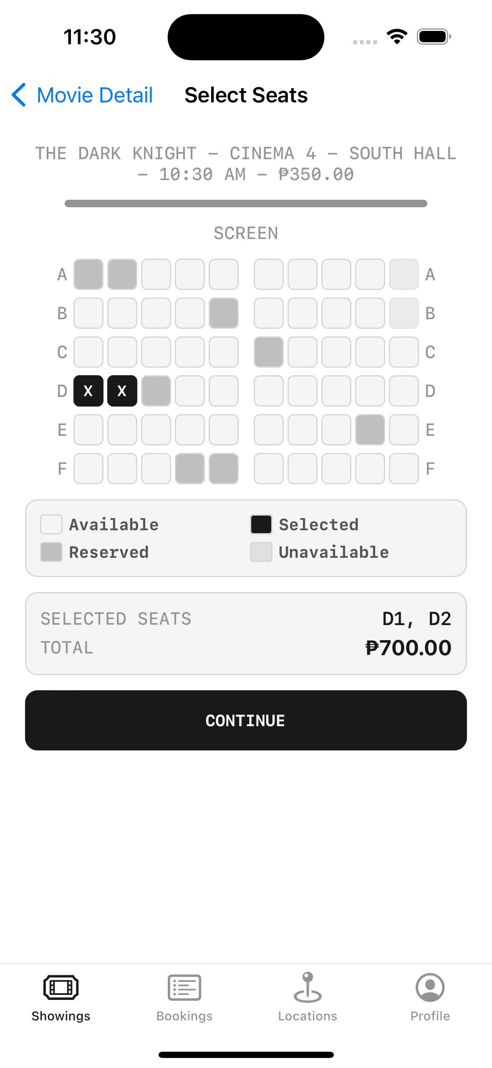
ONE MORE STRUCTURAL BENEFIT
Reusable custom views
**This seat map is not a stock UIKit control**
**Built from vertical rows of horizontal stacks**
**Written once**, used in more than one place

Slide 18
Shared formatting is the related problem
The same rating appears on the list, the detail screen and the booking. Format it in three places and they will drift apart.

Slide 19
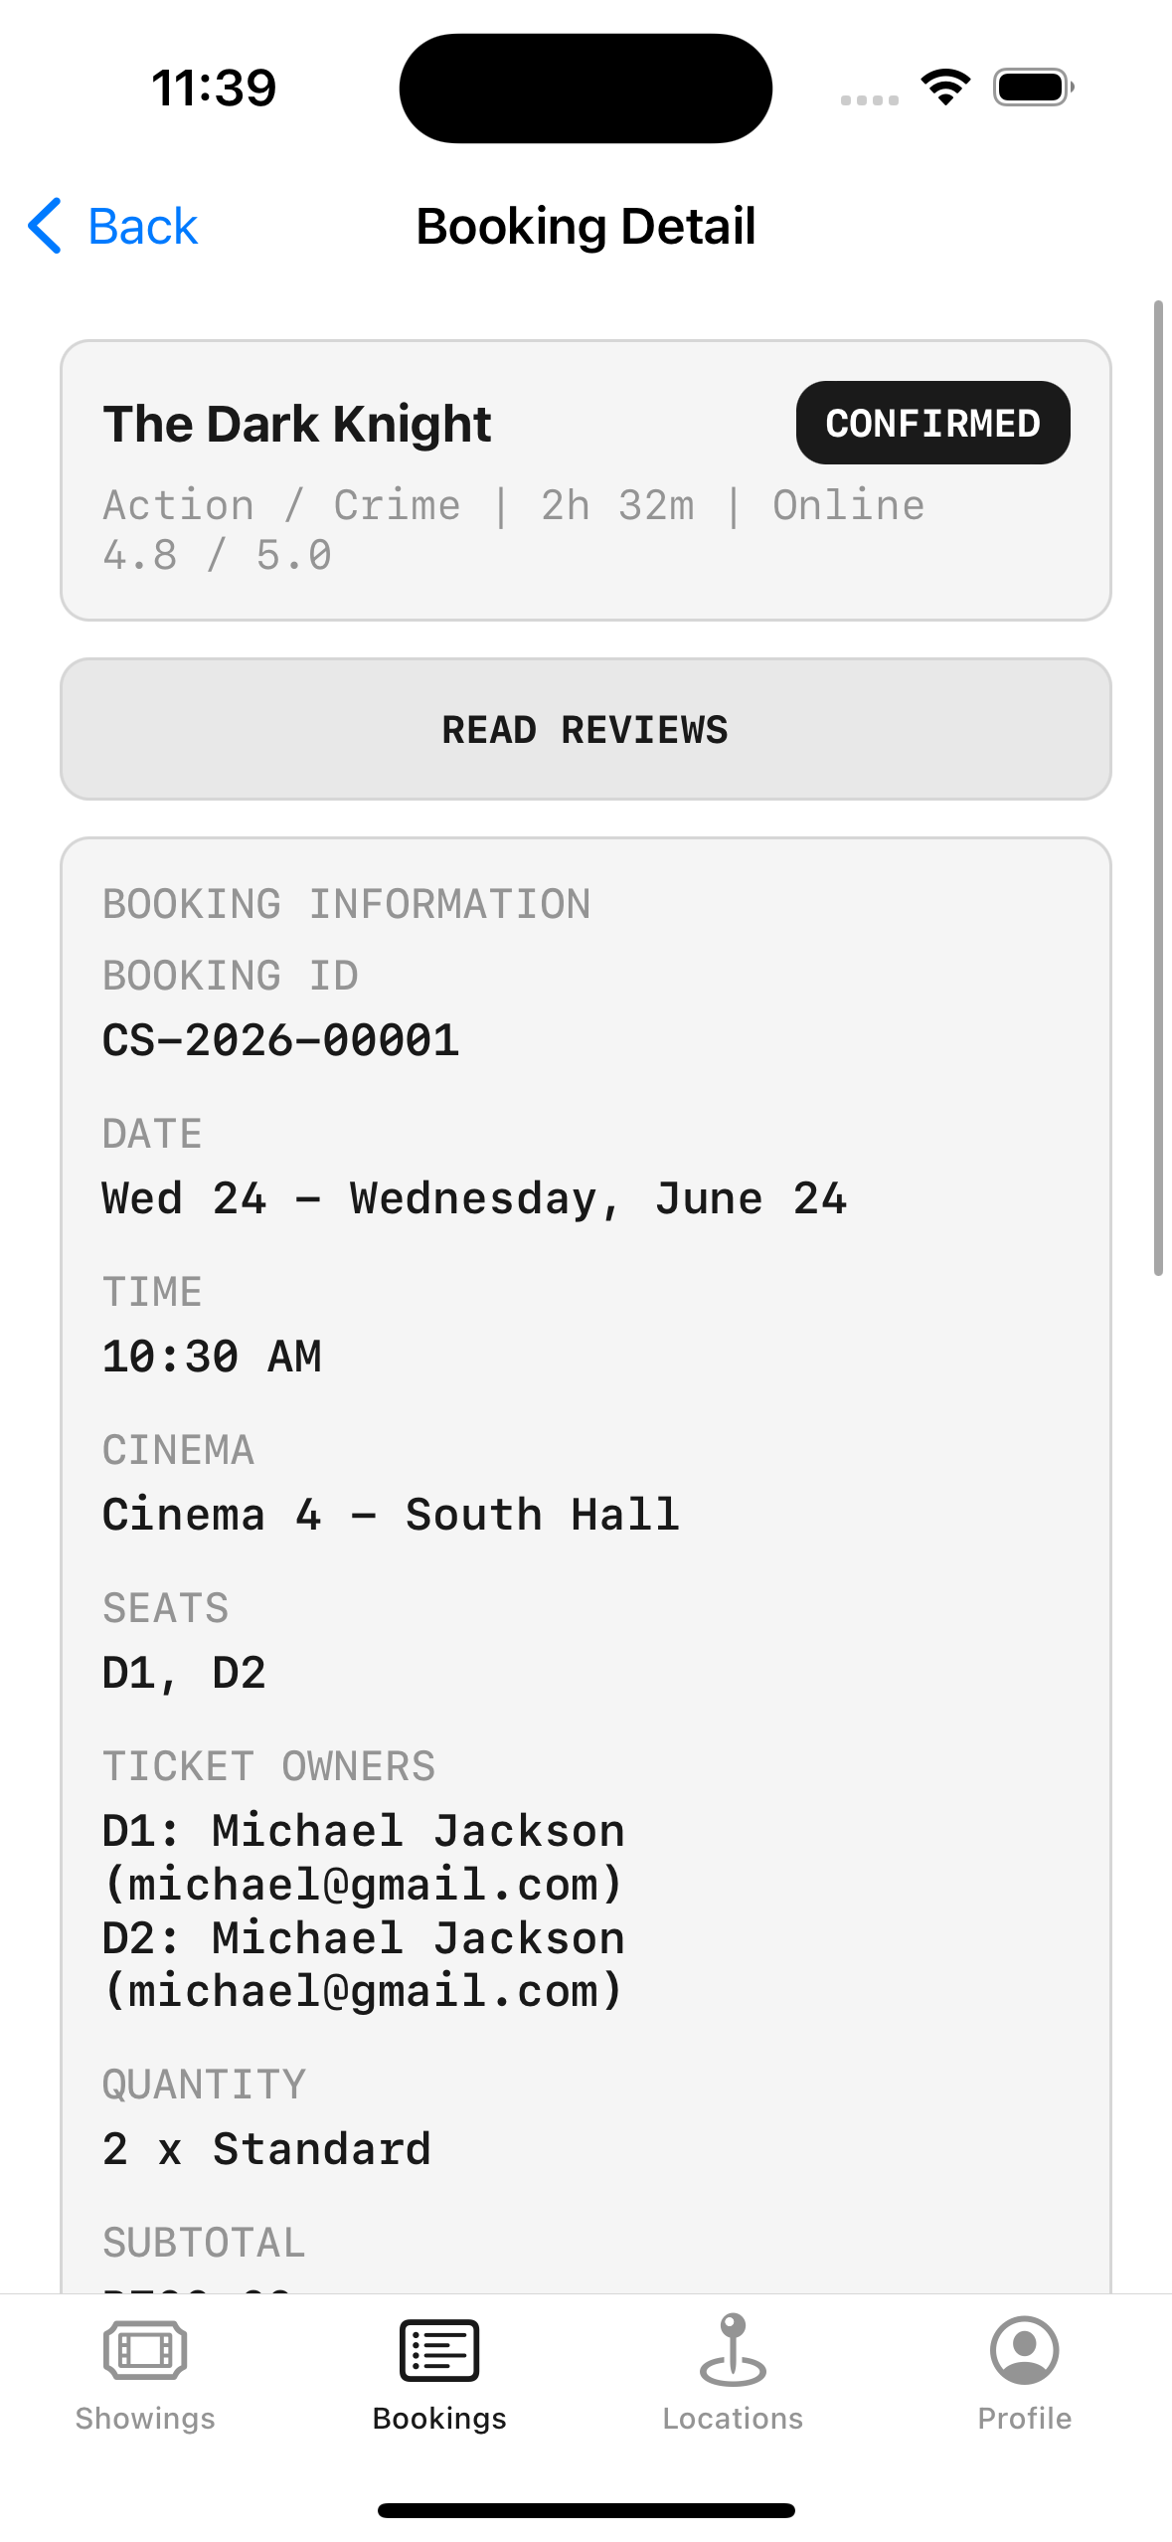
THE REUSE, IN ACTION
One component, two modes
**Interactive**, letting you pick seats
**And read-only** inside booking detail
Same component, different configuration

Slide 20
RECAP
Architecture and Dependency Injection
Navigability is the measure of quality, not brevity or length
Clean Architecture layers with dependencies pointing inward
Depend on protocols, never on concrete types
One composition root chooses every implementation
Reusable views and shared formatters stop drift

Slide 21
PRACTICE EXERCISE
Invert one dependency
01
Take a screen that builds its own data source
02
Extract a protocol for what it actually needs
03
Build it from a composition root, and swap in a fake implementation

Slide 22
Module 7 — Maps, Location, Notifications, Media and Animation
The last technical module: the device capabilities that make an app feel native.

