Slide 1
MODULE 07
Maps, Location, Notifications, Media and Animation
The device capabilities that make an app feel native

Slide 2
What makes an app feel like it belongs on a phone
Rather than like a website in a frame. It knows where it is. It can reach you when it isn't open.

Slide 3
BY THE END OF THIS VIDEO YOU WILL BE ABLE TO
Objectives
Show a map with real pins using MapKit
Request a permission correctly — in code and in Info.plist
Schedule a local notification, and know when you need a server
Pick the right photo API, and animate a change with intent

Slide 4
A DISTINCTION THAT SAVES CONFUSION
MapKit and Core Location
MapKit
Core Location
The map itself
Where the device is
What you see and interact with
GPS, permissions, updates
Pins, regions, callouts

Slide 5
A MAP NEEDS THREE THINGS
Centre, region, annotations
A coordinate to centre on
A region defining how far out you are zoomed
Annotations for your pins
Add a delegate and you can respond to taps

Slide 6
ONE DECISION
MapKit or the Google Maps SDK
Google Maps SDK
MapKit
Richer place data
Native, no API key, no dependency
Phone numbers, opening hours
Enough for showing your own locations
Needs an API key and a dependency

Slide 7
Permissions are where people lose hours
Anything touching location, camera or photos needs two things — and everybody remembers only the first.

Slide 8
BOTH ARE REQUIRED
Code and Info.plist
You request it in code
And declare it in Info.plist
locationManager
.requestWhenInUseAuthorization()
Skip it and the feature does not work
It fails silently, with no error
Everybody remembers this one

Slide 9
THE KEYS MUST BE EXACT
Info.plist usage descriptions
NSLocationWhenInUseUsageDescription
Location, while using the app
NSCameraUsageDescription
Camera
NSPhotoLibraryUsageDescription
Photo library
NSMicrophoneUsageDescription
Microphone

Slide 10
Whatever text you write is shown to the user word for word
So write a real reason — "used to show cinemas near you" — not "we need your location".

Slide 11
Two kinds of notification
And the difference is architectural, not cosmetic.

Slide 12
WHERE THEY COME FROM
Push and local
Push — APNs
Local
Sent from a server
Scheduled on the device itself
Needs a backend
No server, no account tier
Needs a paid developer account

Slide 13
THE REFERENCE APP USES LOCAL NOTIFICATIONS
The reasoning is practical
APNs needs a backend to send from
Plus a paid Apple Developer account
Local notifications cover the actual need: remind me before my booking

Slide 14
Be honest about the limitation, because it is real
A local notification can only fire on a schedule the device already knows about. Anything reactive needs a server.

Slide 15
TWO DETAILS WORTH COPYING
From this implementation
It checks a user setting first — reminders off means nothing is scheduled
Cancelling a booking cancels its pending reminder
A notification for a booking that no longer exists is a bug users remember

Slide 16
TWO PHOTO APIS, OFTEN CONFUSED
PHPicker and UIImagePickerController
PHPicker
UIImagePickerController
The modern one
Soft-deprecated since iOS 14
What you should use to pick
But PHPicker cannot take a photo
No permission prompt needed to browse
For camera capture you still need this

Slide 17
PHPicker cannot take a photo
For camera capture you still reach for the older API. Know which job each one does.

Slide 18
ANIMATION
The duration is the whole point
UIView.animate(withDuration: 0.3) {
self.seatView.alpha = 1
self.seatView.transform = .identity
}
Set the duration to zero and the change snaps — which is sometimes exactly what you want.

Slide 19
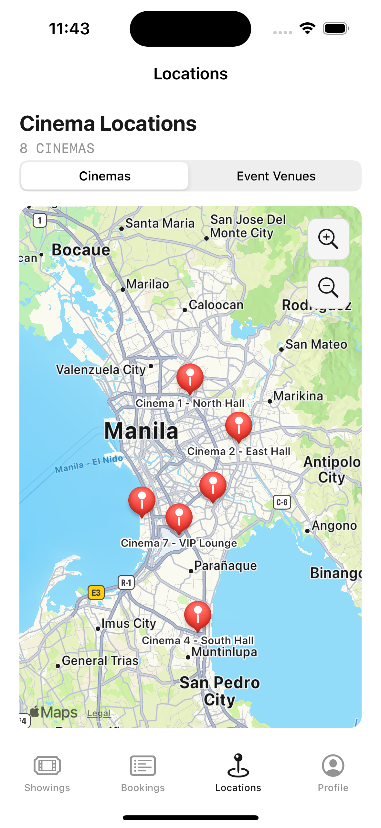
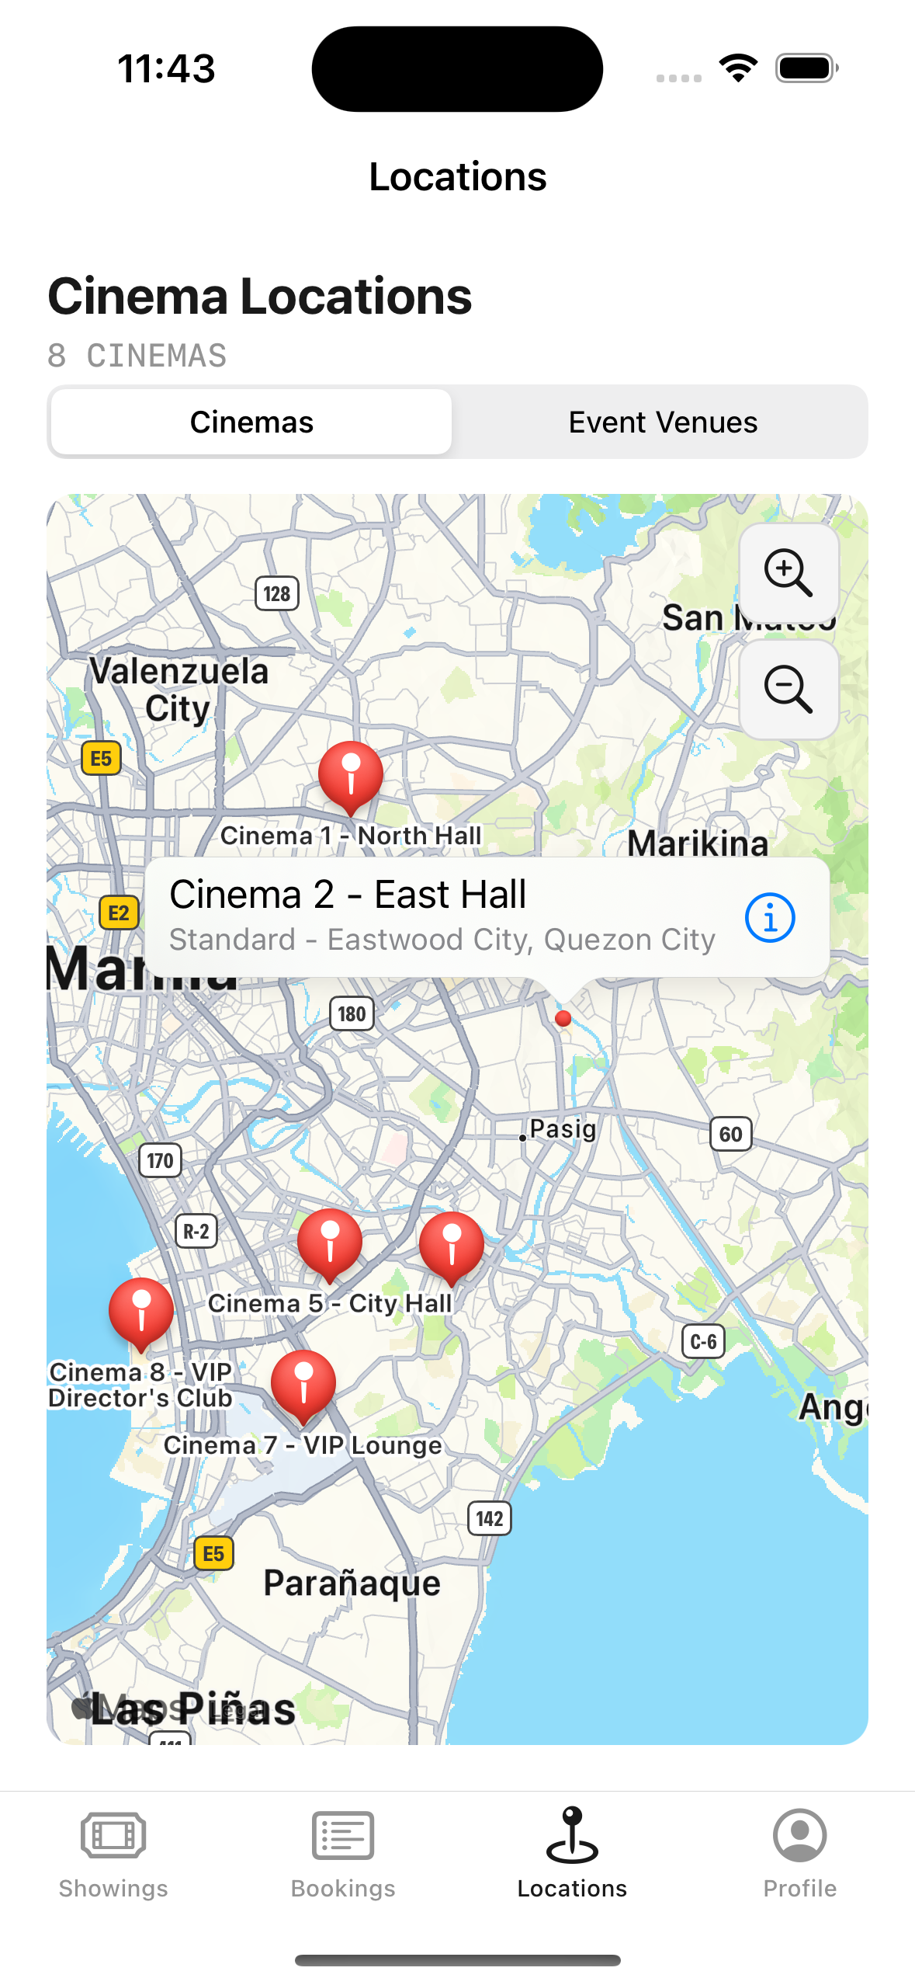
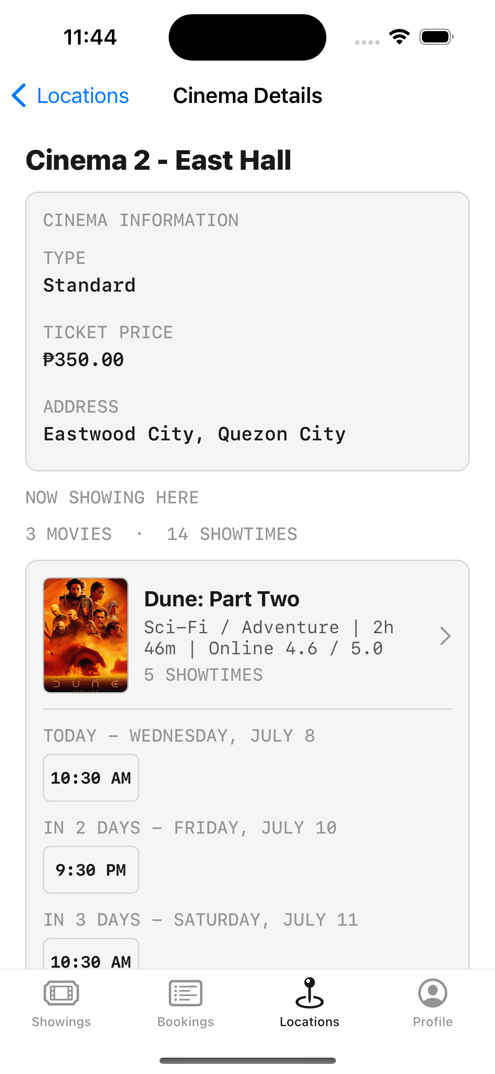
ALL TOGETHER
Real pins from real coordinates
Tapping a pin opens a callout and routes into the cinema's details and showtimes.

Slide 20
RECAP
Maps, Location, Notifications, Media, Animation
MapKit is the map; Core Location is where the device is
A permission needs both the code request and the Info.plist key
Your usage string is shown to the user word for word
Local notifications need no server; push does
PHPicker to pick, the older API to capture

Slide 21
PRACTICE EXERCISE
Make it feel native
01
Show a map with at least three real pins and a working callout
02
Request one permission properly, with an honest usage string
03
Schedule a local notification, and cancel it when its reason disappears

Slide 22
That completes the technical curriculum
Chapter 8 assembles all seven modules into one complete application.

