Slide 1
MODULE 08
Case Study — Building a Complete App
Assembling seven modules into one product

Slide 2
Seven capabilities in isolation is not one product
Assembling them is a separate skill — and it is the one interviews probe.

Slide 3
BY THE END OF THIS VIDEO YOU WILL BE ABLE TO
Objectives
Turn one sentence into a requirements list
Draw a flowchart that covers the failure branches, not just the happy path
Recognise when to cut scope deliberately
See where each module shows up in a finished product

Slide 4
It started as one sentence
A cinema ticket-booking app where you browse films, pick a schedule, choose seats, see the price and confirm a reservation.

Slide 5
THAT BECAME A REQUIREMENTS LIST
Deliberately unglamorous
Browse
Movie list · movie details · showtimes
Book
Seat selection · booking summary · confirmation
Manage
Bookings history · cancellation
Guard
Validation alerts throughout

Slide 6
One thing was missing, and an early review caught it
There was no profile screen. Adding accounts unlocked roughly a third of everything else.

Slide 7
Write requirements where somebody else can read and question them
Rather than holding them in your head. That is the strongest argument for the whole exercise.

Slide 8
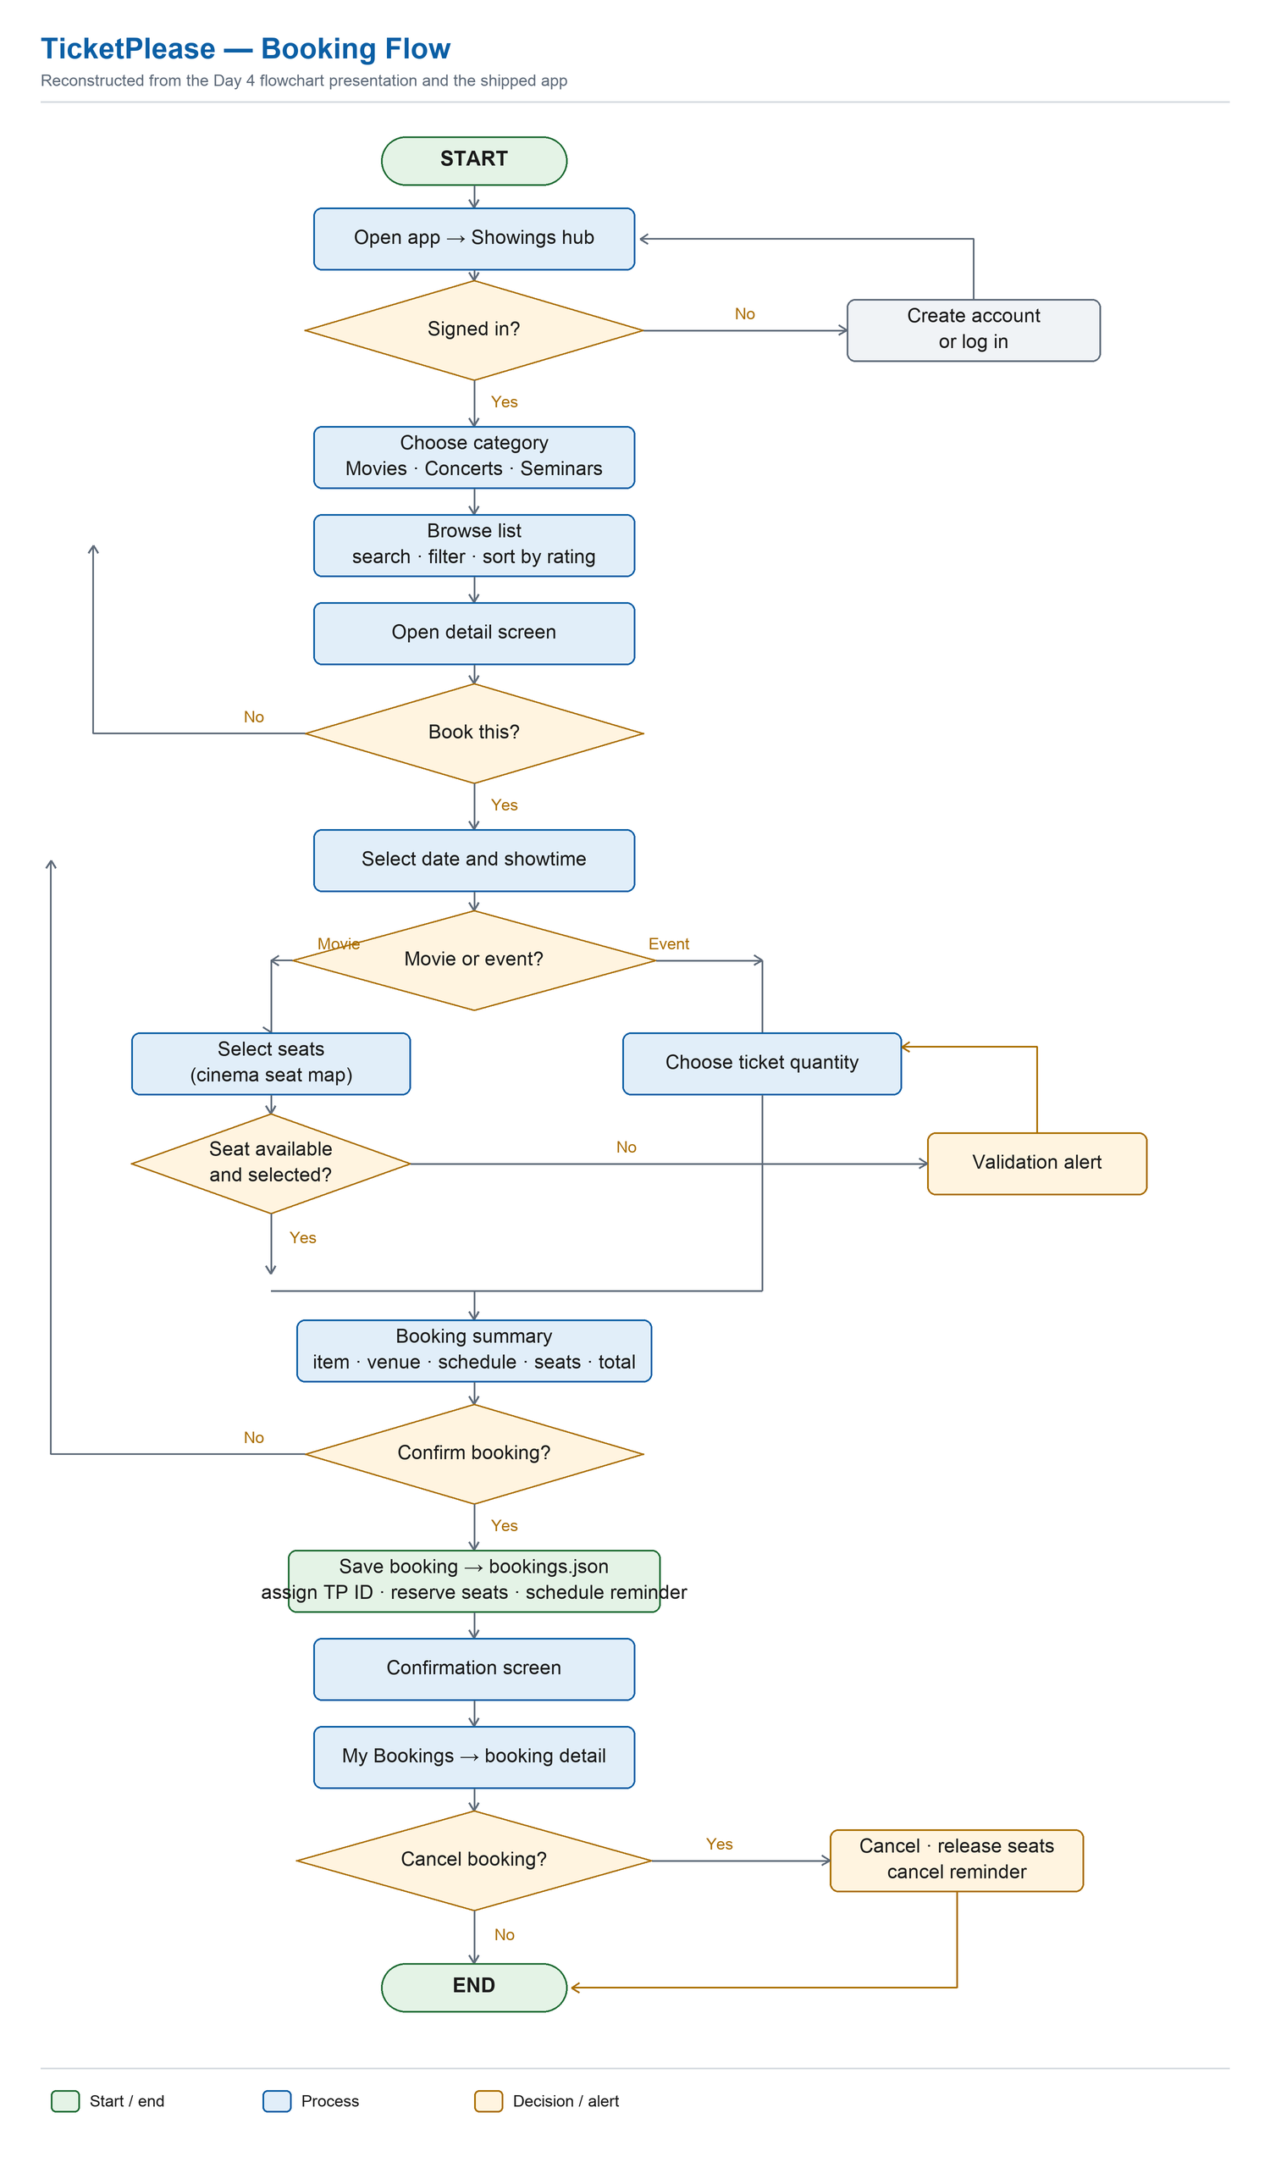
THE REQUIREMENTS BECAME THIS FLOWCHART
Rectangles are processes, diamonds are decisions

Slide 9
TRACE THE HAPPY PATH FIRST
Then look at everything else
Start, browse, select, confirm, done — that is the easy part
Not signed in routes off to account creation
No seat selected routes to a validation alert
Cancel releases the seats and cancels the pending reminder

Slide 10
Most of real app design is the handling of things going wrong
Those branches are where bugs breed. Drawing them before any code existed is why they were handled deliberately.

Slide 11
Then a wireframe — what goes where, not what it looks like
Chasing pixel-perfect visuals at that stage wastes effort on decisions that change once real content arrives.

Slide 12
TWO THINGS CHANGED BETWEEN PLAN AND BUILD
Both changes were healthy
The 'how to use' tab was cut
Payment was scoped out on purpose
It existed only to fill a fourth tab
Better to ship no payment
Settings made it redundant
Than a fake one that misleads

Slide 13
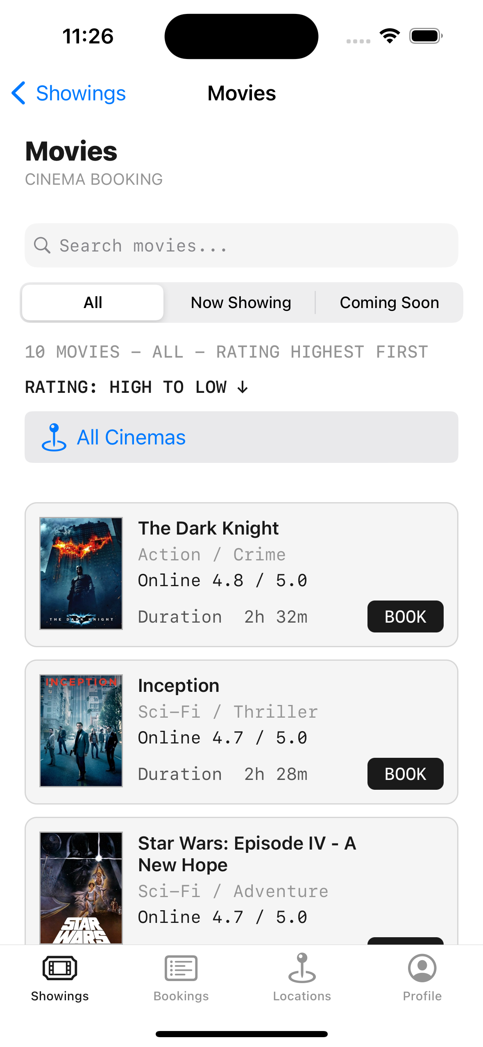
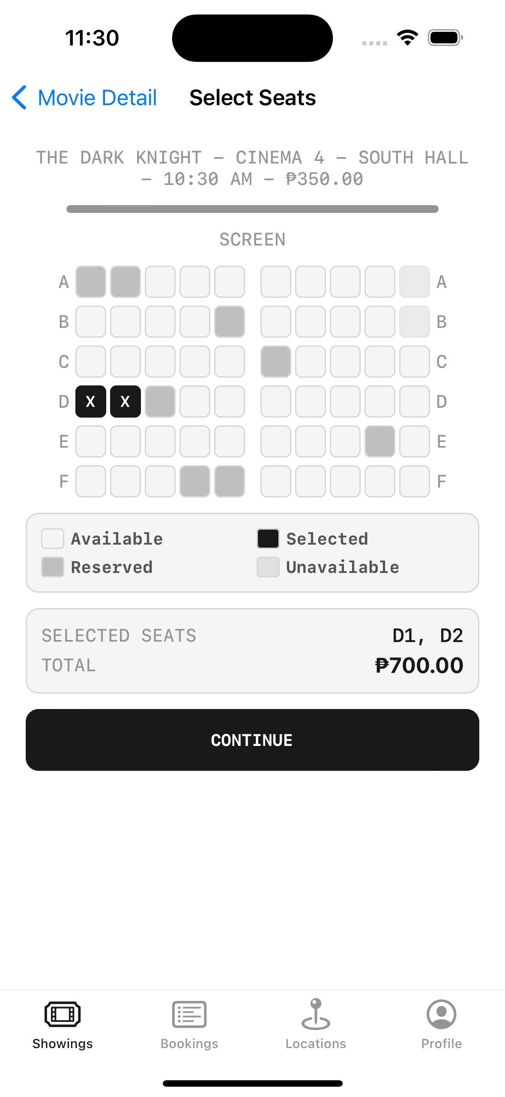
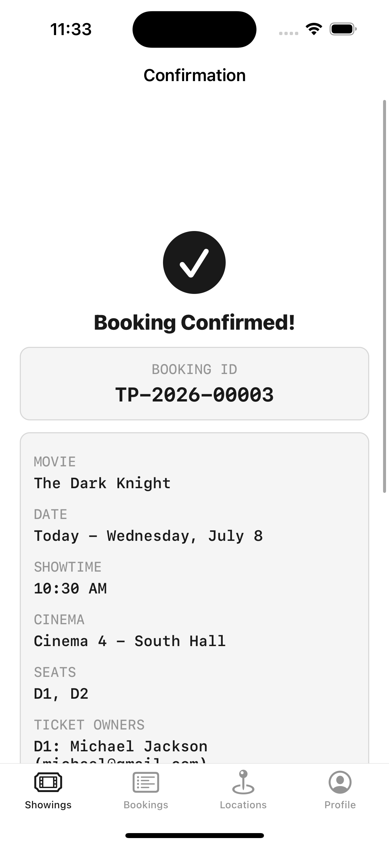
HERE IS THE RESULT
Five taps to a confirmed ticket
Browsing a film to a confirmed, locally-persisted ticket with its own booking ID.

Slide 14
EVERY STEP IS A MODULE DOING REAL WORK
Where the curriculum shows up
Module 2
The detail screen — UIKit, MVVM, table views
Modules 4 & 5
The data — networking and persistence
Module 6
The structure holding it together
Module 7
Maps, notifications, the native feel

Slide 15
ONE DESIGN DETAIL DESERVES ITS OWN MOMENT
Movies book by seat. Concerts book by quantity.
Two booking systems?
One reservation core
The obvious answer
Two different front-ends
Twice the code, twice the bugs
Exactly the reuse the architecture was built for

Slide 16
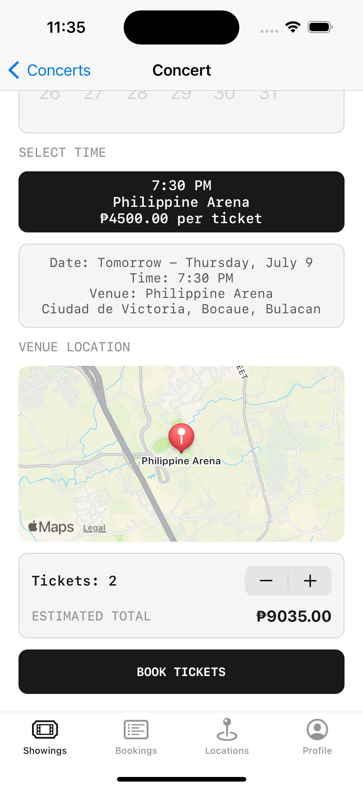
AND HERE IT IS, WORKING
The same core, two front-ends
Clean Architecture and protocol-based injection, paying off on screen.

Slide 17
RECAP
Building a Complete App
One sentence becomes a requirements list somebody else can question
The flowchart's value is its failure branches
Wireframe what goes where, not what it looks like
Cutting scope deliberately is a healthy sign, not a failure
Reuse is designed in, not discovered later

Slide 18
Chapter 9 proves it all works
And shows why the architecture from Module 6 was worth the effort.

