Slide 1
MODULE 09
Testing
Proving it works, and why architecture made it possible

Slide 2
How do you know your app works?
Not "it looked fine when I tried it" — how do you know, every time, automatically?

Slide 3
BY THE END OF THIS VIDEO YOU WILL BE ABLE TO
Objectives
Tell a unit test from a UI test, and when each earns its cost
Write a test that needs no screen at all
Replace real stores with fakes through protocols
Name tests so the suite reads as a specification

Slide 4
TWO KINDS
Unit and UI tests
Unit tests
UI tests
Never launch the app
Launch the app and drive it
Check logic directly
Tap, scroll, assert on screen
Fast — milliseconds
Slower, but they prove the whole path

Slide 5
A UNIT TEST
Read the name, predict the body
func testMovieSearchAndRatingSortAcrossCategories() {
let vm = MoviesViewModel(fetcher: FakeMovieStore())
vm.searchText = "dune"
XCTAssertEqual(vm.filteredMovies.count, 2)
vm.toggleRatingSortOrder()
XCTAssertEqual(vm.filteredMovies.first?.title, "Dune: Part Two")
}

Slide 6
WHAT IT ACTUALLY DOES
Four steps
01
Create a view model
02
Set the search text and check the filtered result
03
Flip the sort order
04
Check the order changed

Slide 7
Here is the point, and it is why Module 6 mattered
Look at what this test does not need.

Slide 8
WHAT IS ABSENT FROM THAT TEST
No screen at all
No storyboard
No view controller
No UIKit whatsoever
Only possible because the search and sort logic lives in the view model

Slide 9
Testability is a consequence of architecture, not an extra step
Had that logic stayed in the screen, this test could not exist.

Slide 10
It goes further
These are three fakes from the test file.

Slide 11
REAL VERSUS FAKE
Same contract, different weight
The real thing
The fake
Profile repository writes to disk
Keeps profiles in an array
Password store uses the Keychain
Keeps passwords in a dictionary
API client makes network calls
Returns canned data instantly

Slide 12
Each satisfies the same protocol as the real thing
So tests hand these in instead — and not one line of production code had to change.

Slide 13
THINK ABOUT THE ALTERNATIVE
Testing login without this
Writing real files to disk on every run
Storing real passwords in the real Keychain
Making real network calls — slow, flaky, and dependent on someone else's server

Slide 14
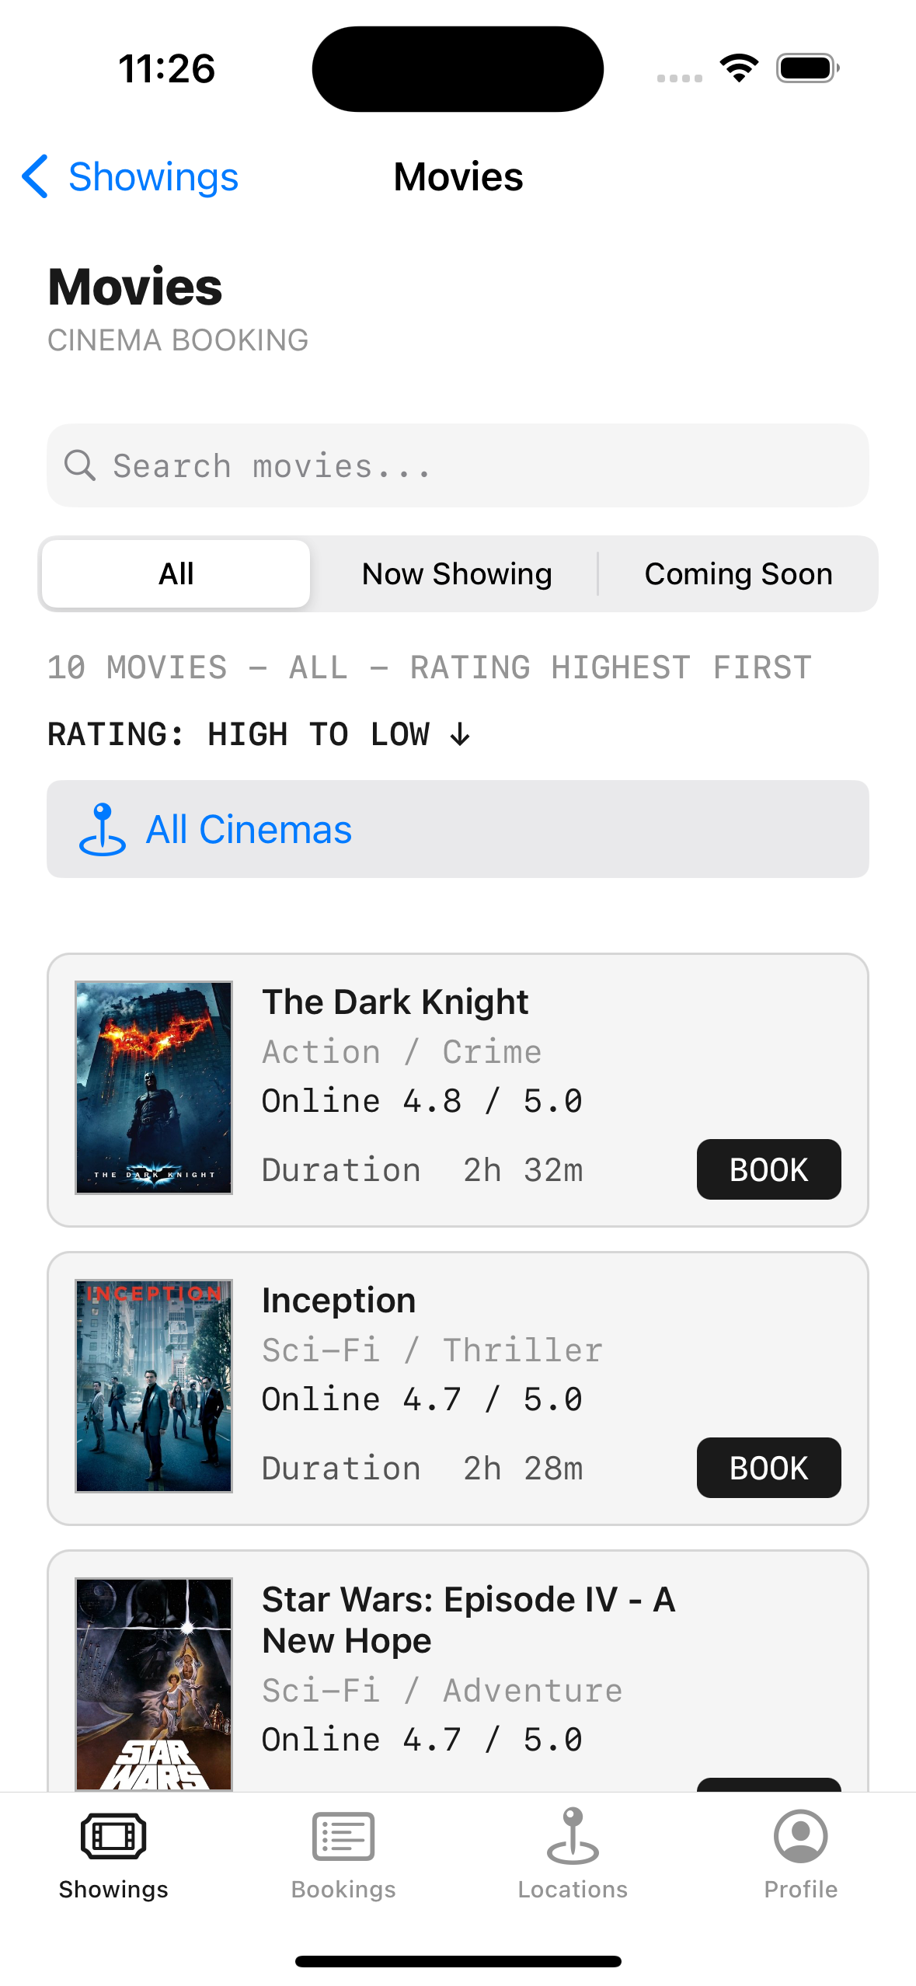
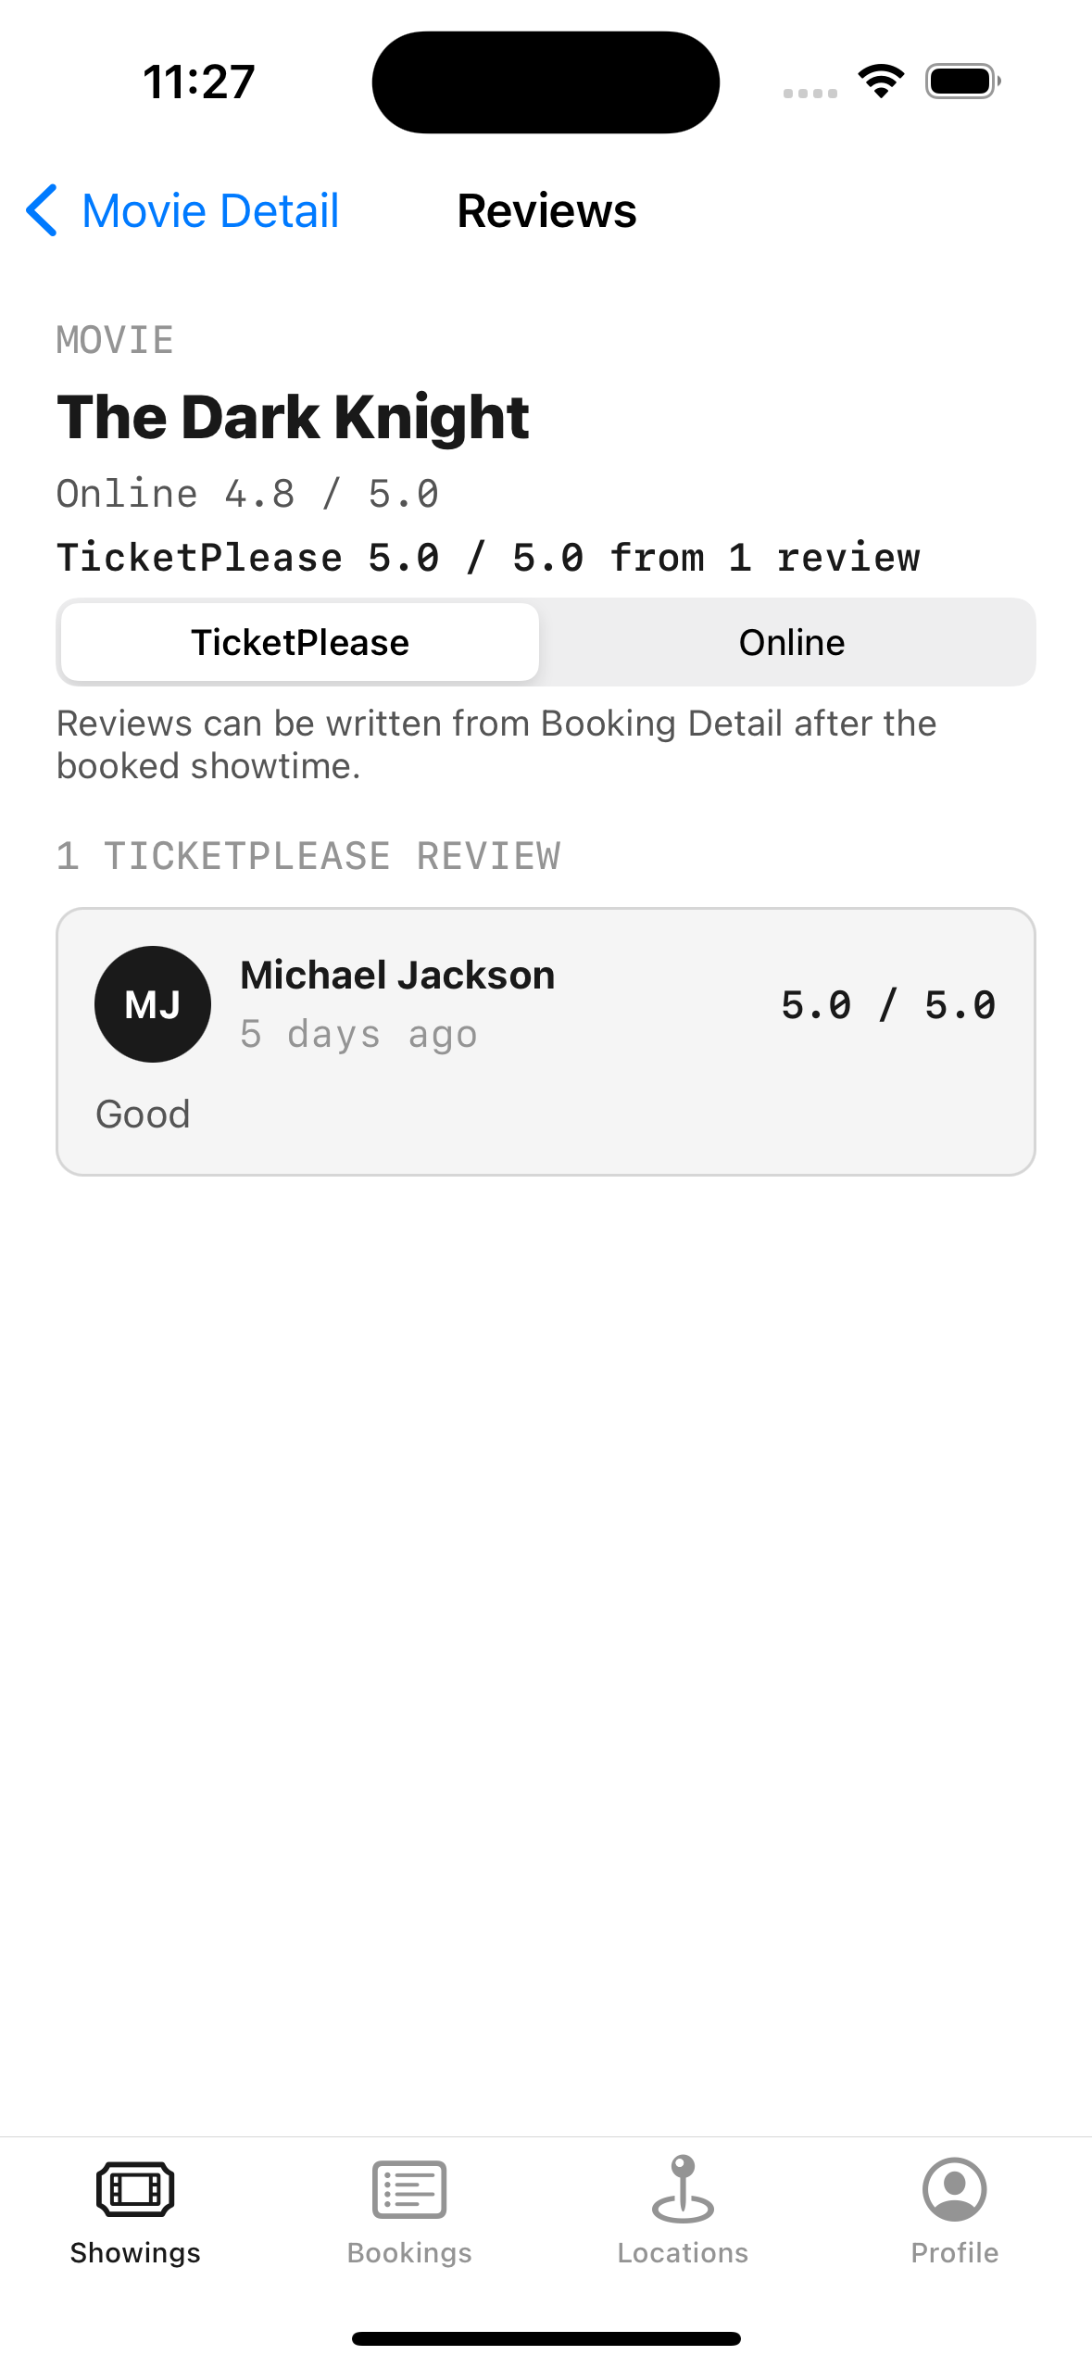
AND THIS IS A UI TEST
The app driven automatically
**Tapping a category**, opening a film
**Checking the reviews screen**, moving through the booking flow
**No hands** — the same path, every time

Slide 15
One technique worth stealing: assert a button is NOT present
Reviews can only be written from a booking, so the test proves the guard holds — absence is as testable as presence.

Slide 16
TWO PRACTICAL NOTES FOR UI TESTS
Make them survive change
Use accessibility identifiers, not visible text — copy changes, tests shouldn't break
Reset state between runs, or yesterday's data fails today's test

Slide 17
Read the test names in order and you have the specification
Ownership, cancellation, validation, the reviews guard — the behaviour of the feature, in order.

Slide 18
Unlike a document, a test name cannot go stale
Because when it stops being true, it fails.

Slide 19
RECAP
Testing
Unit tests check logic fast; UI tests prove the whole path
A testable view model needs no screen at all
Fakes satisfying the same protocol replace disk, Keychain and network
Accessibility identifiers and clean state keep tests honest
Test names are the specification that can't go stale

Slide 20
PRACTICE EXERCISE
Prove one thing automatically
01
Write a unit test for a view model with no UIKit imported
02
Replace its real store with a fake through a protocol
03
Add one UI test that asserts something is absent, not present

Slide 21
The final chapter decides whether any of this survives handover
Module 10 — Documentation Best Practices.

