Slide 1
MODULE 10
Documentation Best Practices
What makes your work survivable by somebody else

Slide 2
Six months from now, somebody opens this project
It might be a colleague. It might be you, having forgotten every decision you made.

Slide 3
BY THE END OF THIS VIDEO YOU WILL BE ABLE TO
Objectives
Keep a change list with the five fields that matter
Record AI involvement honestly, at the right depth
Write difficulties and solutions somebody can actually use
Ship documentation that cannot drift from the build

Slide 4
START WITH THE GAP
What code records, and what it doesn't
Code records
Code cannot record
What the software does
What you tried and abandoned
Precisely and completely
What broke
What you deliberately left out
Where you used an AI assistant

Slide 5
That gap is what documentation fills
It is the difference between a project that can be handed over cleanly and one that effectively cannot.

Slide 6
A FORMAT THAT WORKS
Five fields for every change
Date
With the day of the week — it anchors the change in history
What changed
Plain language a non-developer could follow
AI involvement
Whether one was used, and how deeply
Difficulties
What actually went wrong
Solutions
How each one was resolved

Slide 7
WHY THE DATE CARRIES THE DAY OF THE WEEK
It anchors the change in the project's history
What changed — plain language, no jargon
Whether AI was involved — stated, even when the answer is none
What difficulties came up — and how each was solved

Slide 8
THE LAST TWO ARE THE ONES PEOPLE DELETE
They are also the most valuable
Without difficulties
With them
It reads like marketing
It reads like engineering

Slide 9
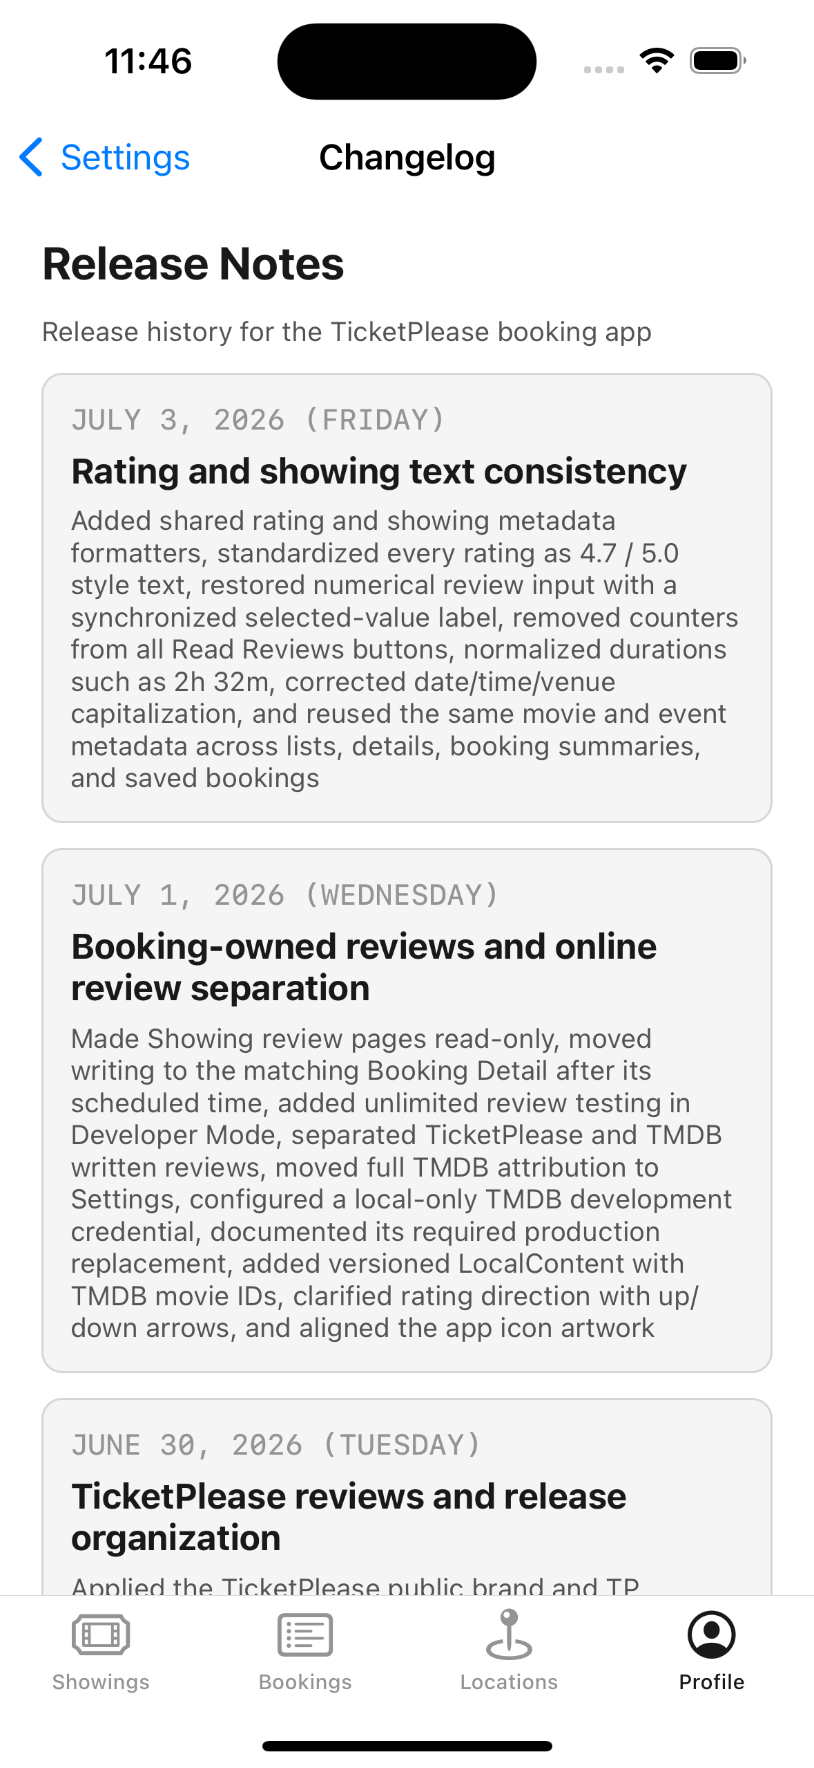
HERE'S A REAL ONE
The change list ships inside the app
**On the Settings screen**, not in a file nobody opens
**A small decision** that signals the project takes its own history seriously

Slide 10
AND IN CODE
Structured, typed data — not loose text
struct ChangelogEntry: Codable {
let date: Date
let summary: String
let aiInvolvement: AIInvolvement
let difficulties: [String]
let solutions: [String]
}
It can be displayed in the interface, and it can never drift out of sync with the build.

Slide 11
AI INVOLVEMENT
Most people get it wrong in one of two directions
Over-reporting
Saying nothing
Logging every autocomplete
Leaving a reviewer to guess
Noise nobody reads
Which they will

Slide 12
Neither avoidance nor concealment
Use AI assistants, and use them well. Then record where one helped, at what depth, and what you did to verify the result.

Slide 13
A FOUR-LEVEL SCALE IS ENOUGH
Depth of involvement
None
No assistant involved
Reference
Used like documentation
Assisted
It drafted something you then reworked
Generated
Used largely as-is — say what you checked

Slide 14
Never commit AI-produced code you can't explain
If you couldn't debug it at two in the morning without the assistant, you don't understand it yet.

Slide 15
ON DIFFICULTIES
Be specific
Helps nobody
A colleague can use this
"Had trouble with layout"
"Constraints looked correct on one device and broke on another; fixed by grouping controls into stack views and constraining the stack"

Slide 16
Record the decisions you deliberately did not take
Choosing JSON files over Core Data is a real decision. Without a note, the next person sees an absence and wonders whether you knew.

Slide 17
A CHECKLIST TO HOLD YOUR PROJECT AGAINST
Every entry
Has a real date
Says what changed in plain language
States AI involvement, even when it's none
Difficulties are honest, not sanitised
Every difficulty has a matching solution

Slide 18
AND THE REST OF IT
What else the checklist covers
Decisions you didn't take are recorded
Known limitations live somewhere findable, not implied by silence
Secrets are never in the change list
The changelog ships with the build, so it can't drift

Slide 19
RECAP
Documentation Best Practices
Code records what the software does — not why, or what failed
Five fields: date, what changed, AI involvement, difficulties, solutions
Record AI depth honestly; never ship code you can't explain
Be specific about difficulties, and record decisions not taken
Ship the changelog with the build so it cannot drift

Slide 20
PRACTICE EXERCISE
Write a real change list
01
One entry per working session, using all five fields
02
State AI involvement at one of the four levels, and what you verified
03
Include one decision you deliberately did not take

Slide 21
And that's the course
Seven modules taught you to build an iOS application. Testing proved it works. Documentation is what makes that work survivable by somebody else.

