Slide 1
Sparking Curiosity

Slide 2

But not today…. Today, I am your colleague
I will be sharing some learning from my last assignment, which involved creating an semantic layer table using Spark
Lets make it a knowledge-sharing conversation about Spark. I will throw a question, and we can debate about it. Then, I tell you my findindings.
Please please please participate: interrumpt, talk, ask, comment, challenge. Otherwise it will just be another borning presentation.
THE OBJECTIVE: to get out saying that was an interesting conversation, and hopefully that we all learn something new.

Slide 3
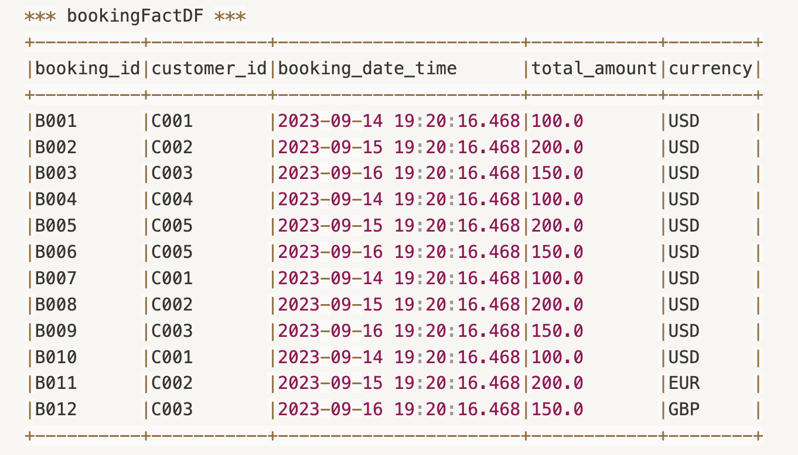
First, lets look at the data (I)
transactions
datasets.scala

Slide 4
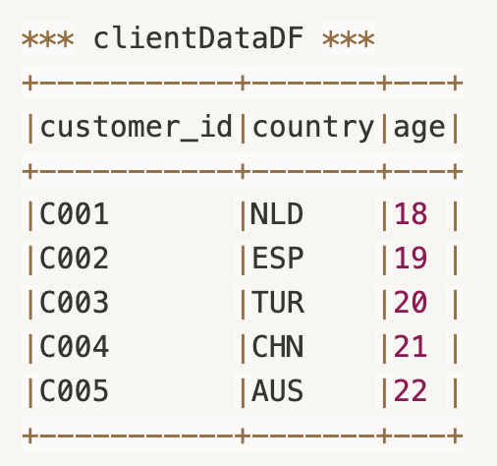
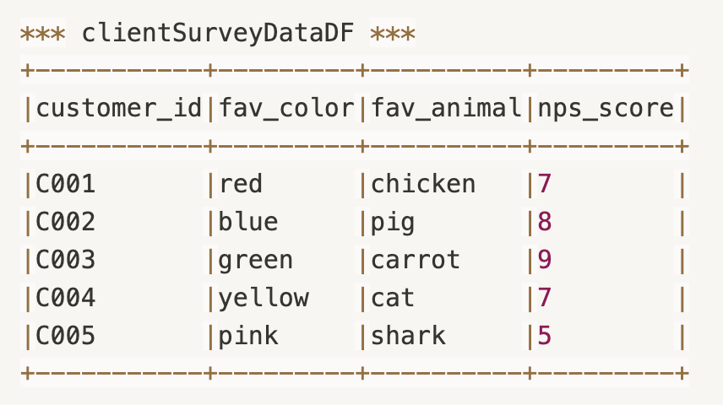
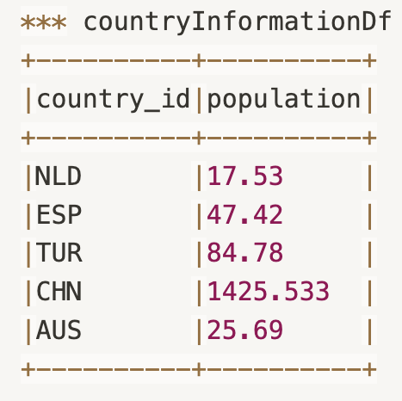
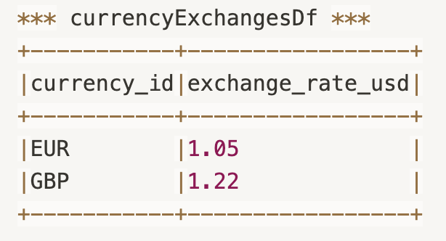
First, lets look at the data (II)
dimensions
datasets.scala

Slide 5
In Spark, Does the order of joins impact performance?

Slide 6
In other words, are these two queries similar under the hood?
SELECT * FROM bookingFactDf booking LEFT JOIN clientDataDF a ON booking.customer_id = a.customer_id LEFT JOIN currencyExchangesDf b ON booking.currency = b.currency_id LEFT JOIN clientSurveyDataDf c ON booking.customer_id = c.customer_id
SELECT * FROM bookingFactDf booking LEFT JOIN clientDataDF a ON booking.customer_id = a.customer_id LEFT JOIN clientSurveyDataDf c ON booking.customer_id = c.customer_id
LEFT JOIN currencyExchangesDf b ON booking.currency = b.currency_id

Slide 7
TIP: Look at the keys.

Slide 8
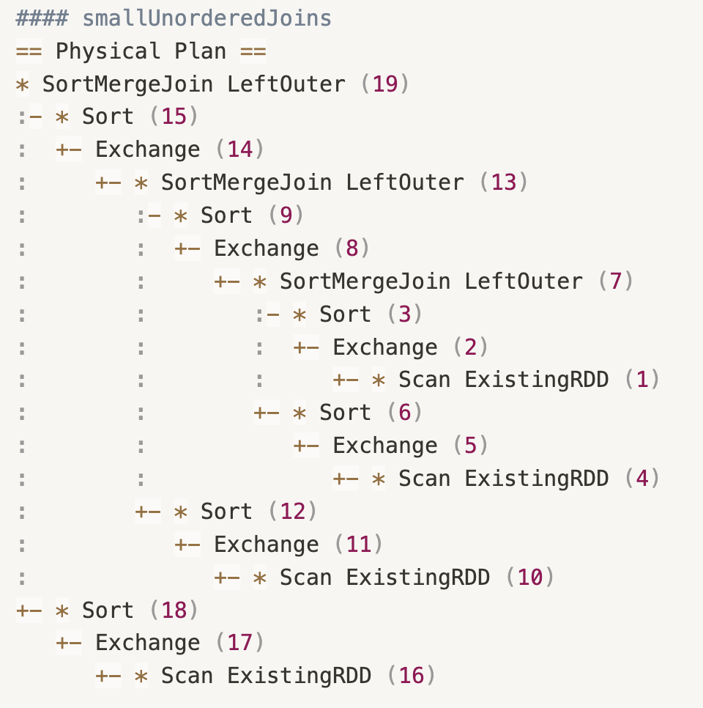
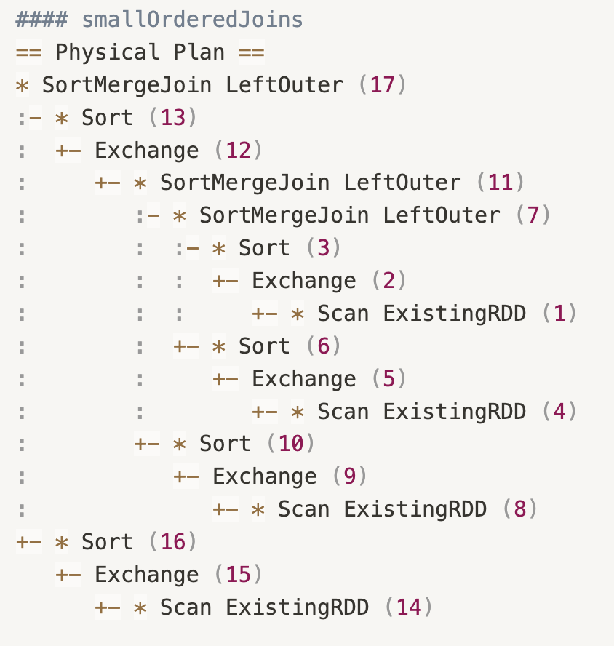
FIRST QUERY
SECOND QUERY
Exchange: 6
Sort: 6
Exchange: 5
Sort: 5
orderOfJoins.scala
Notes:
The anser is YES!

Slide 9
Can Adaptive Query Execution change this?
Is there a missing configuration parameter?

Slide 10
Does the order of a joins Borcasted tables impact pefromance?
Notes:
Yes, if you place them early, they will add their columns to the dataset, and in the following shuffle more data will need to move around.
If you add them at the end, then the only data that needs to move around is the shuffled tables
Doas it really impact pefromance? – In theory yes, in practice I don’t have the data to prove it.

Slide 11
executors
How many times the broadcasted table (purple) was shuffled / moved around?
driver
SELECT /*+ BROADCAST(b) */ * FROM bookingFactDf booking LEFT JOIN clientDataDF a ON booking.customer_id = a.customer_id LEFT JOIN currencyExchangesDf b ON booking.currency = b.currency_id LEFT JOIN clientSurveyDataDf c ON booking.customer_id = c.customer_id
Notes:
Yes, if you place them early, they will add their columns to the dataset, and in the following shuffle more data will need to move around.
If you add them at the end, then the only data that needs to move around is the shuffled tables
Doas it really impact pefromance? – In theory yes, in practice I don’t have the data to prove it.

Slide 12
executors
How many times the broadcasted table (purple) was shuffled?
driver
SELECT /*+ BROADCAST(b) */ * FROM bookingFactDf booking LEFT JOIN clientDataDF a ON booking.customer_id = a.customer_id LEFT JOIN clientSurveyDataDf c ON booking.customer_id = c.customer_id
LEFT JOIN currencyExchangesDf b ON booking.currency = b.currency_id
Notes:
Yes, if you place them early, they will add their columns to the dataset, and in the following shuffle more data will need to move around.
If you add them at the end, then the only data that needs to move around is the shuffled tables
Doas it really impact pefromance? – In theory yes, in practice I don’t have the data to prove it.

Slide 13
If you have to join the following, what strategy would be better?
A
B
SELECT * FROM bookingFactDF bookings LEFT JOIN clientDataDF client ON bookings. customer_id = client. customer_id LEFT JOIN countryInformationDf country ON client.country = country.country_id
WITH tt AS (
SELECT * FROM clientDataDF client
LEFT JOIN countryInformationDf country
ON client.country = country.country_id
)
SELECT * FROM bookingFactDF bookings
LEFT JOIN tt
ON bookings.customer_id= tt.customer_id
Assume bookingFactDF is BILLIONS of rows
clientDataDF and countryInformationDf are in the millions. Broadcast is not possible

Slide 14
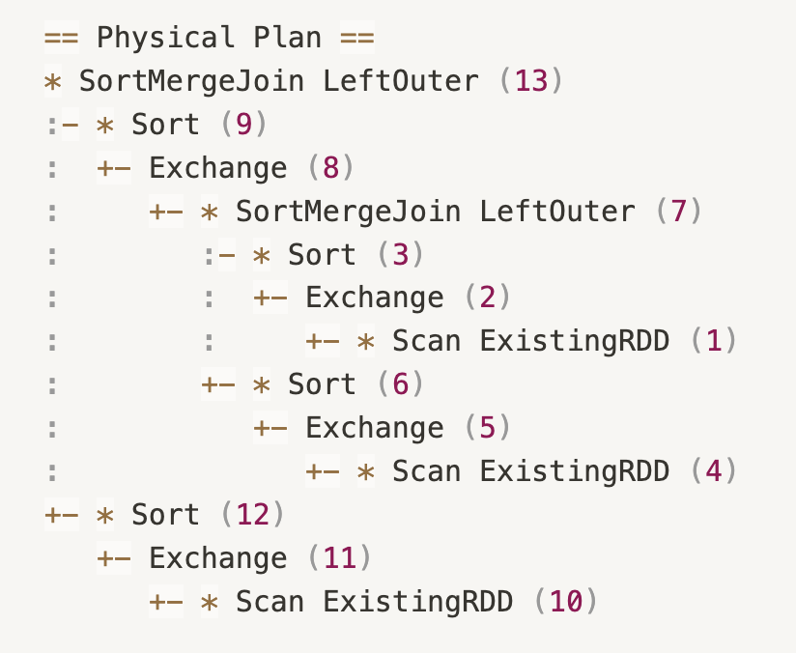
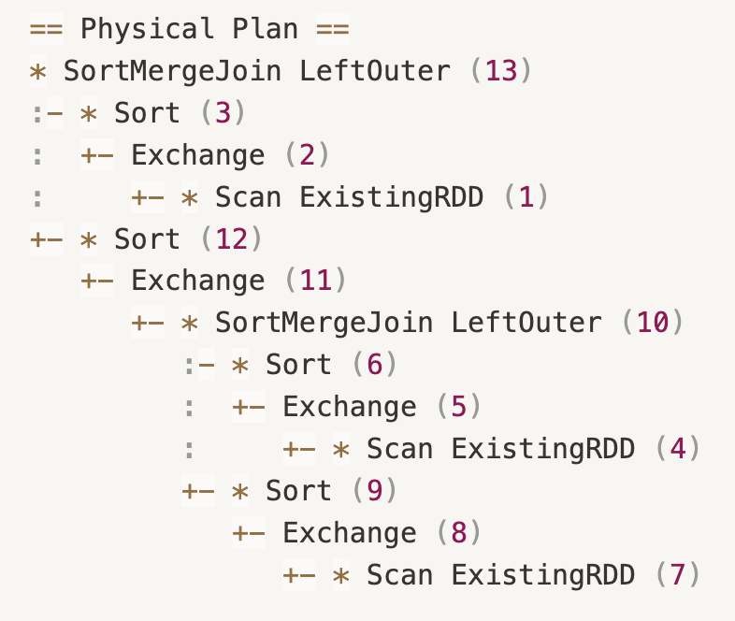
QUERY A
QUERY B
preJoins.scala
Notes:
The plans seem similar, but its not telling the full story.
I would argue that B because the large transaction table [bookingFactDF] is moved around one time, not two times.
We saw a performance improvement in doing this, unfortunately I don’t have the exact results.

Slide 15
What could be the the purpose of the following code?
SELECT * FROM bookingFactDF
LEFT JOIN currencyExchangesDf
ON
coalesce(nullif(bookingFactDF.currency,”USD”), bookingFactDF.customer_id) = currencyExchangesDf.currency_id
Notes:
Tip:
- Would looking at the data help?

Slide 16
Tip: look at the data

Slide 17
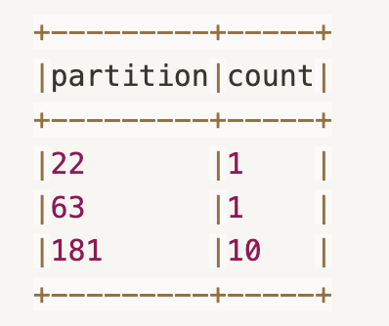
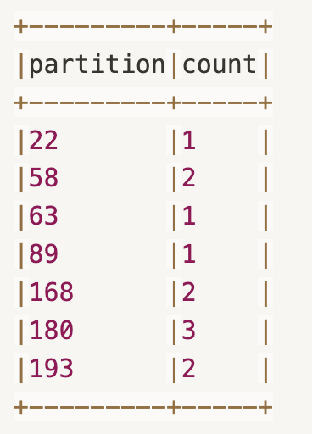
SELECT * FROM bookingFactDF LEFT JOIN currencyExchangesDf ON bookingFactDF.currency = currencyExchangesDf.currency_id
SELECT * FROM bookingFactDF
LEFT JOIN currencyExchangesDf
ON
coalesce(nullif(bookingFactDF.currency,”USD”), bookingFactDF.customer_id)
= currencyExchangesDf.currency_id
skewJoins.scala
Notes:
I would argue that B

Slide 18
Would this be better?
SELECT bf.*, null as exchange_rate_usd, null as currency_id FROM bookingFactDF bf where currency = 'USD’ UNION
(SELECT * FROM bookingFactDF LEFT JOIN currencyExchangesDf ON bookingFactDF.currency = currencyExchangesDf.currency_id WHERE currency != 'USD')
skewJoins.scala

Slide 19
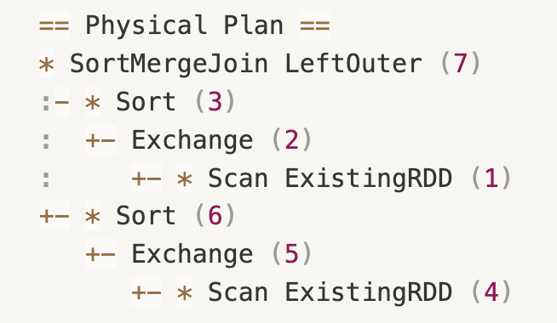
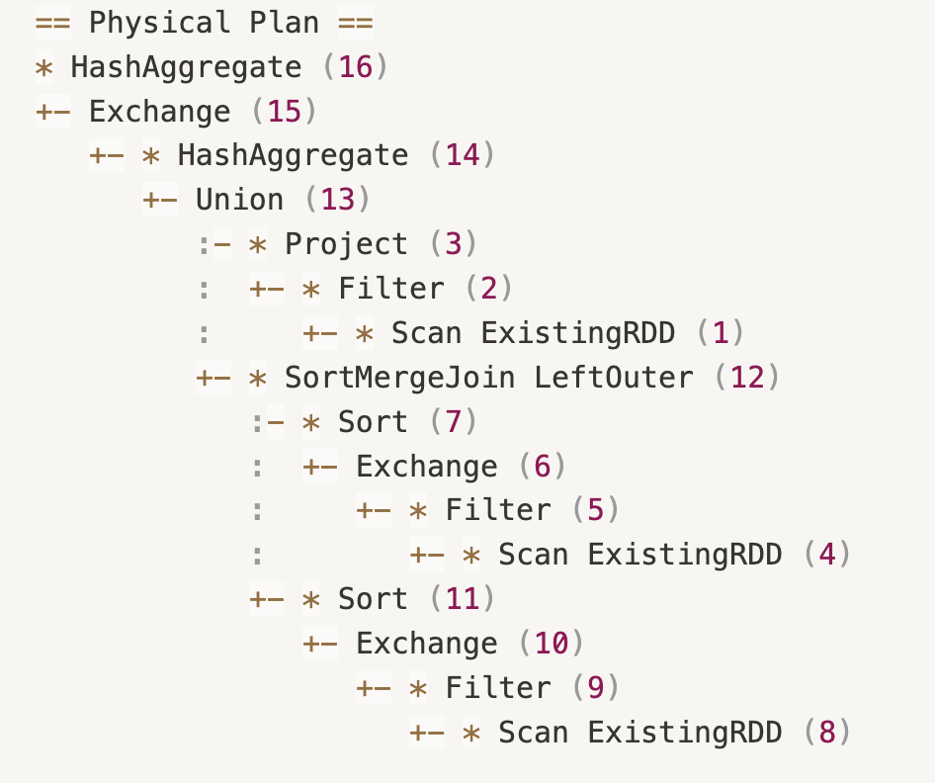
ORIGINAL QUERY
USING COMMON TABLE EXPRESSIONS
skewJoins.scala

Slide 20
How do you spot skewness without looking at the data?

Slide 21
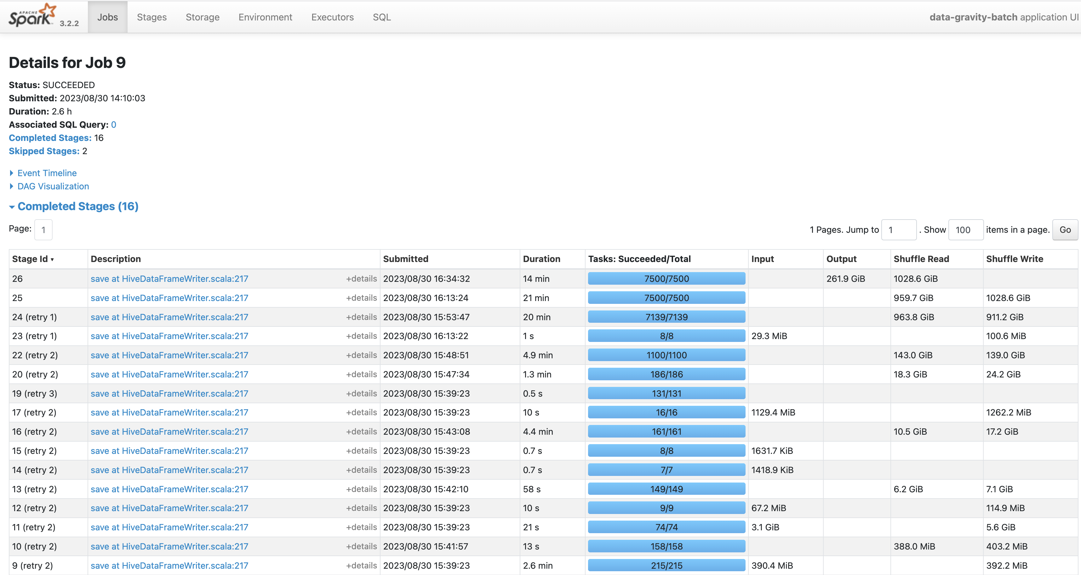
Notes:
I see retries, but to conclude that this is skew…I would not be able to tell.

Slide 22
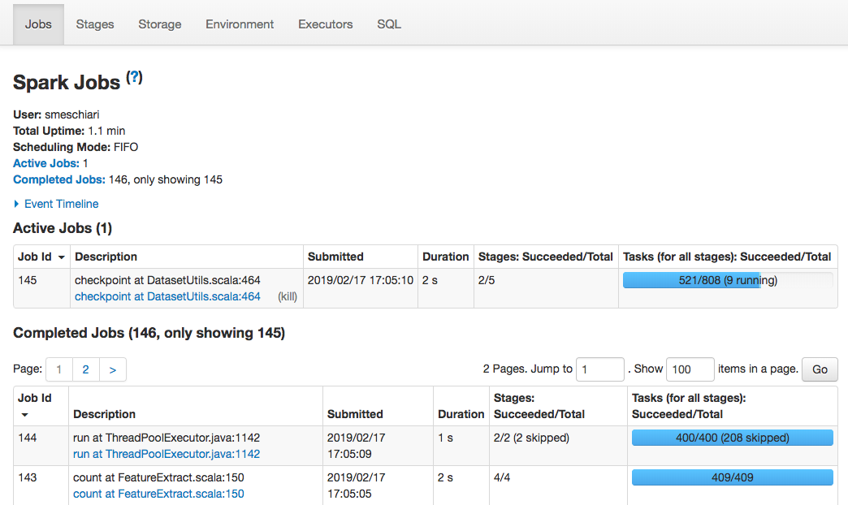

Notes:
Yes, 1 running task… this is a warning sign, could mean other things though

Slide 23
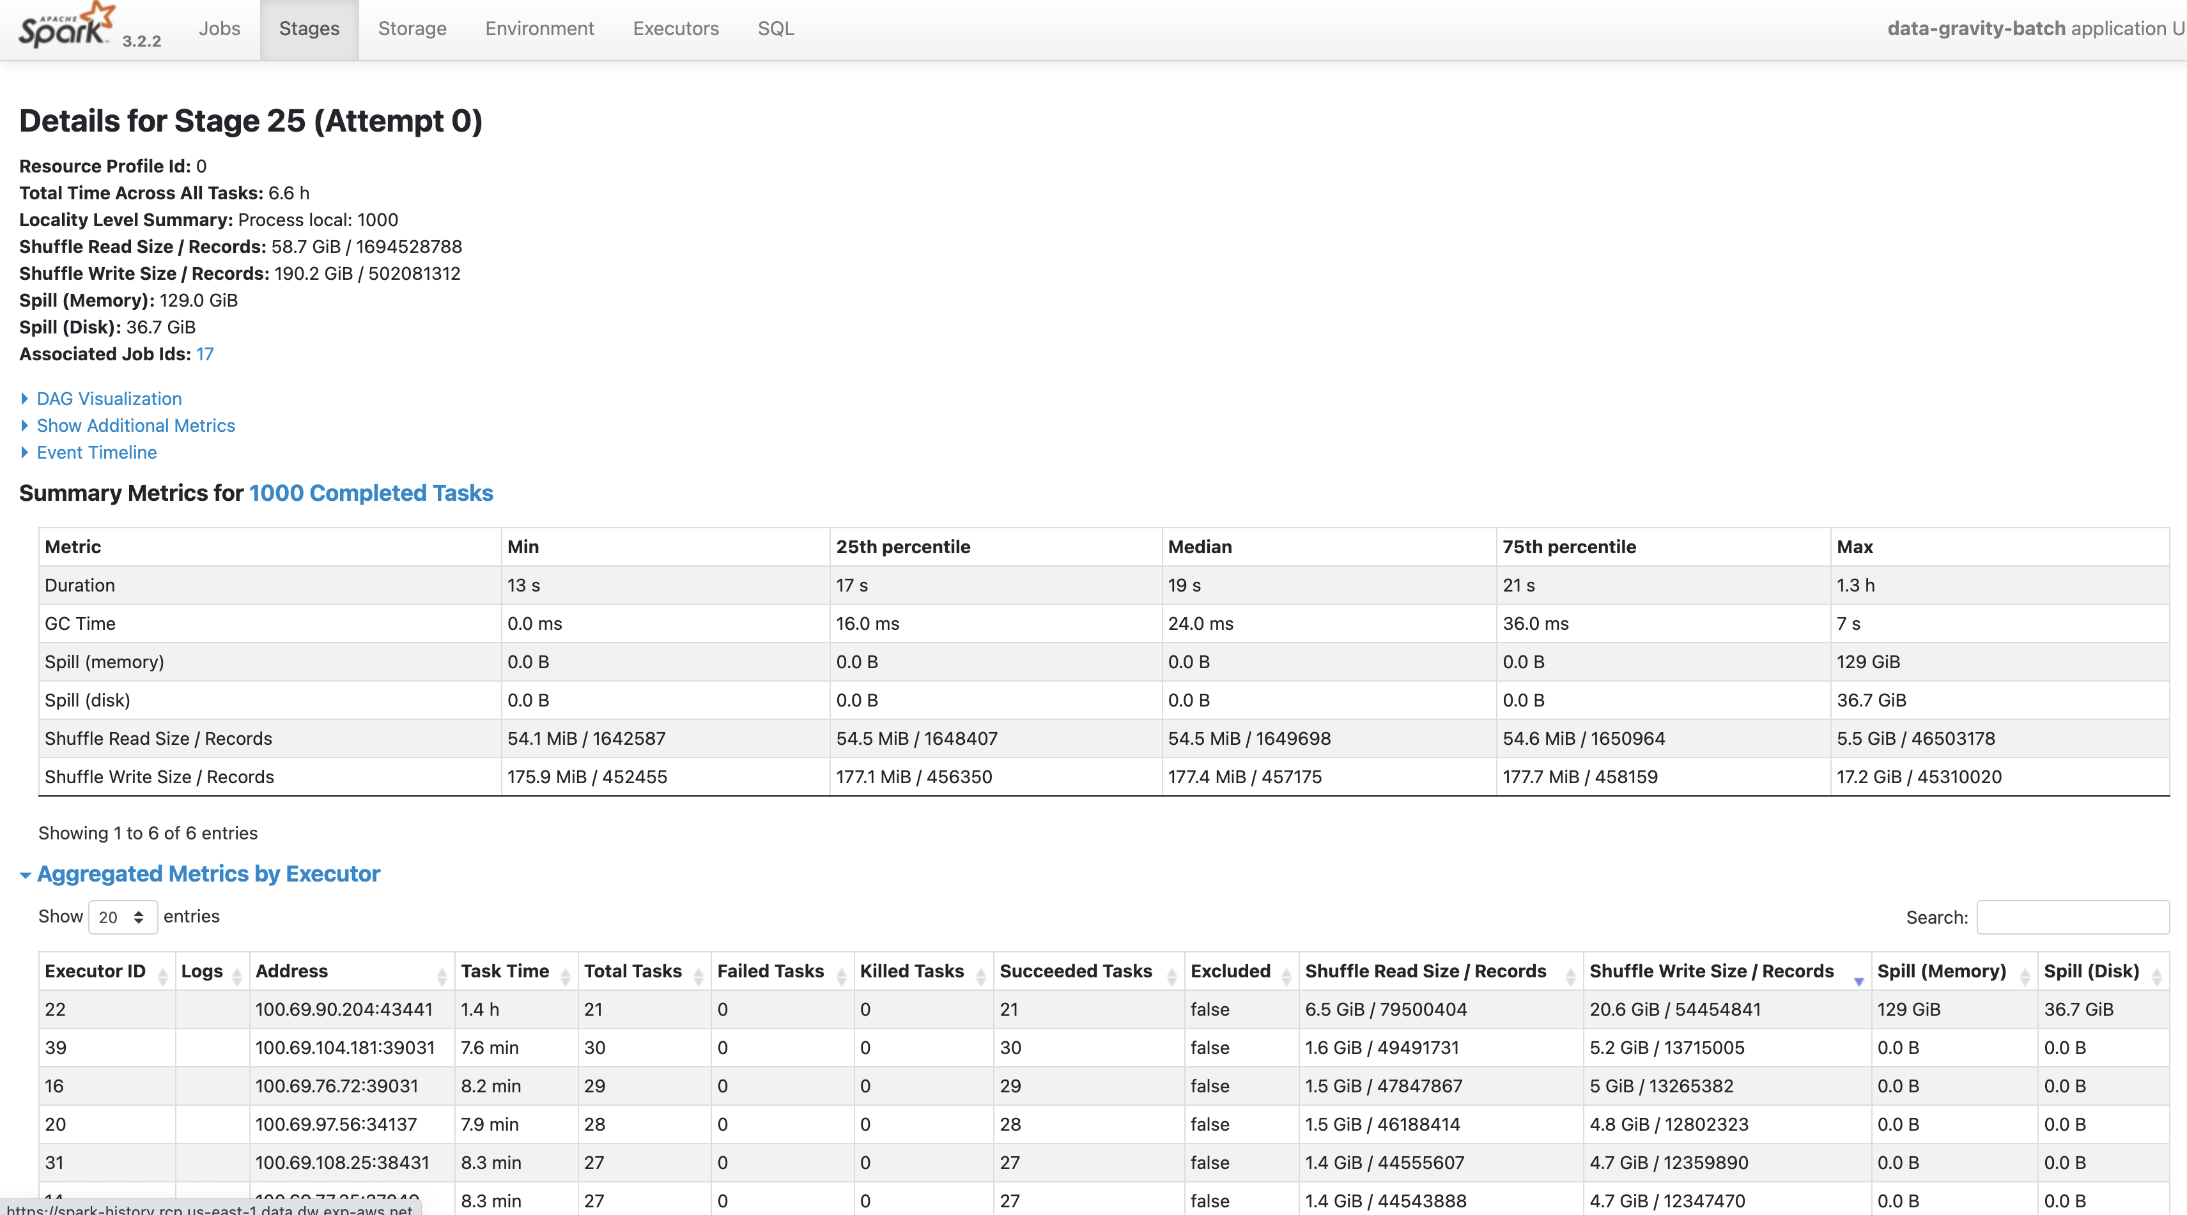
Notes:
Yes, look at that Executor ID 22 compared to 39, and look at the max… its spilling to disk

Slide 24
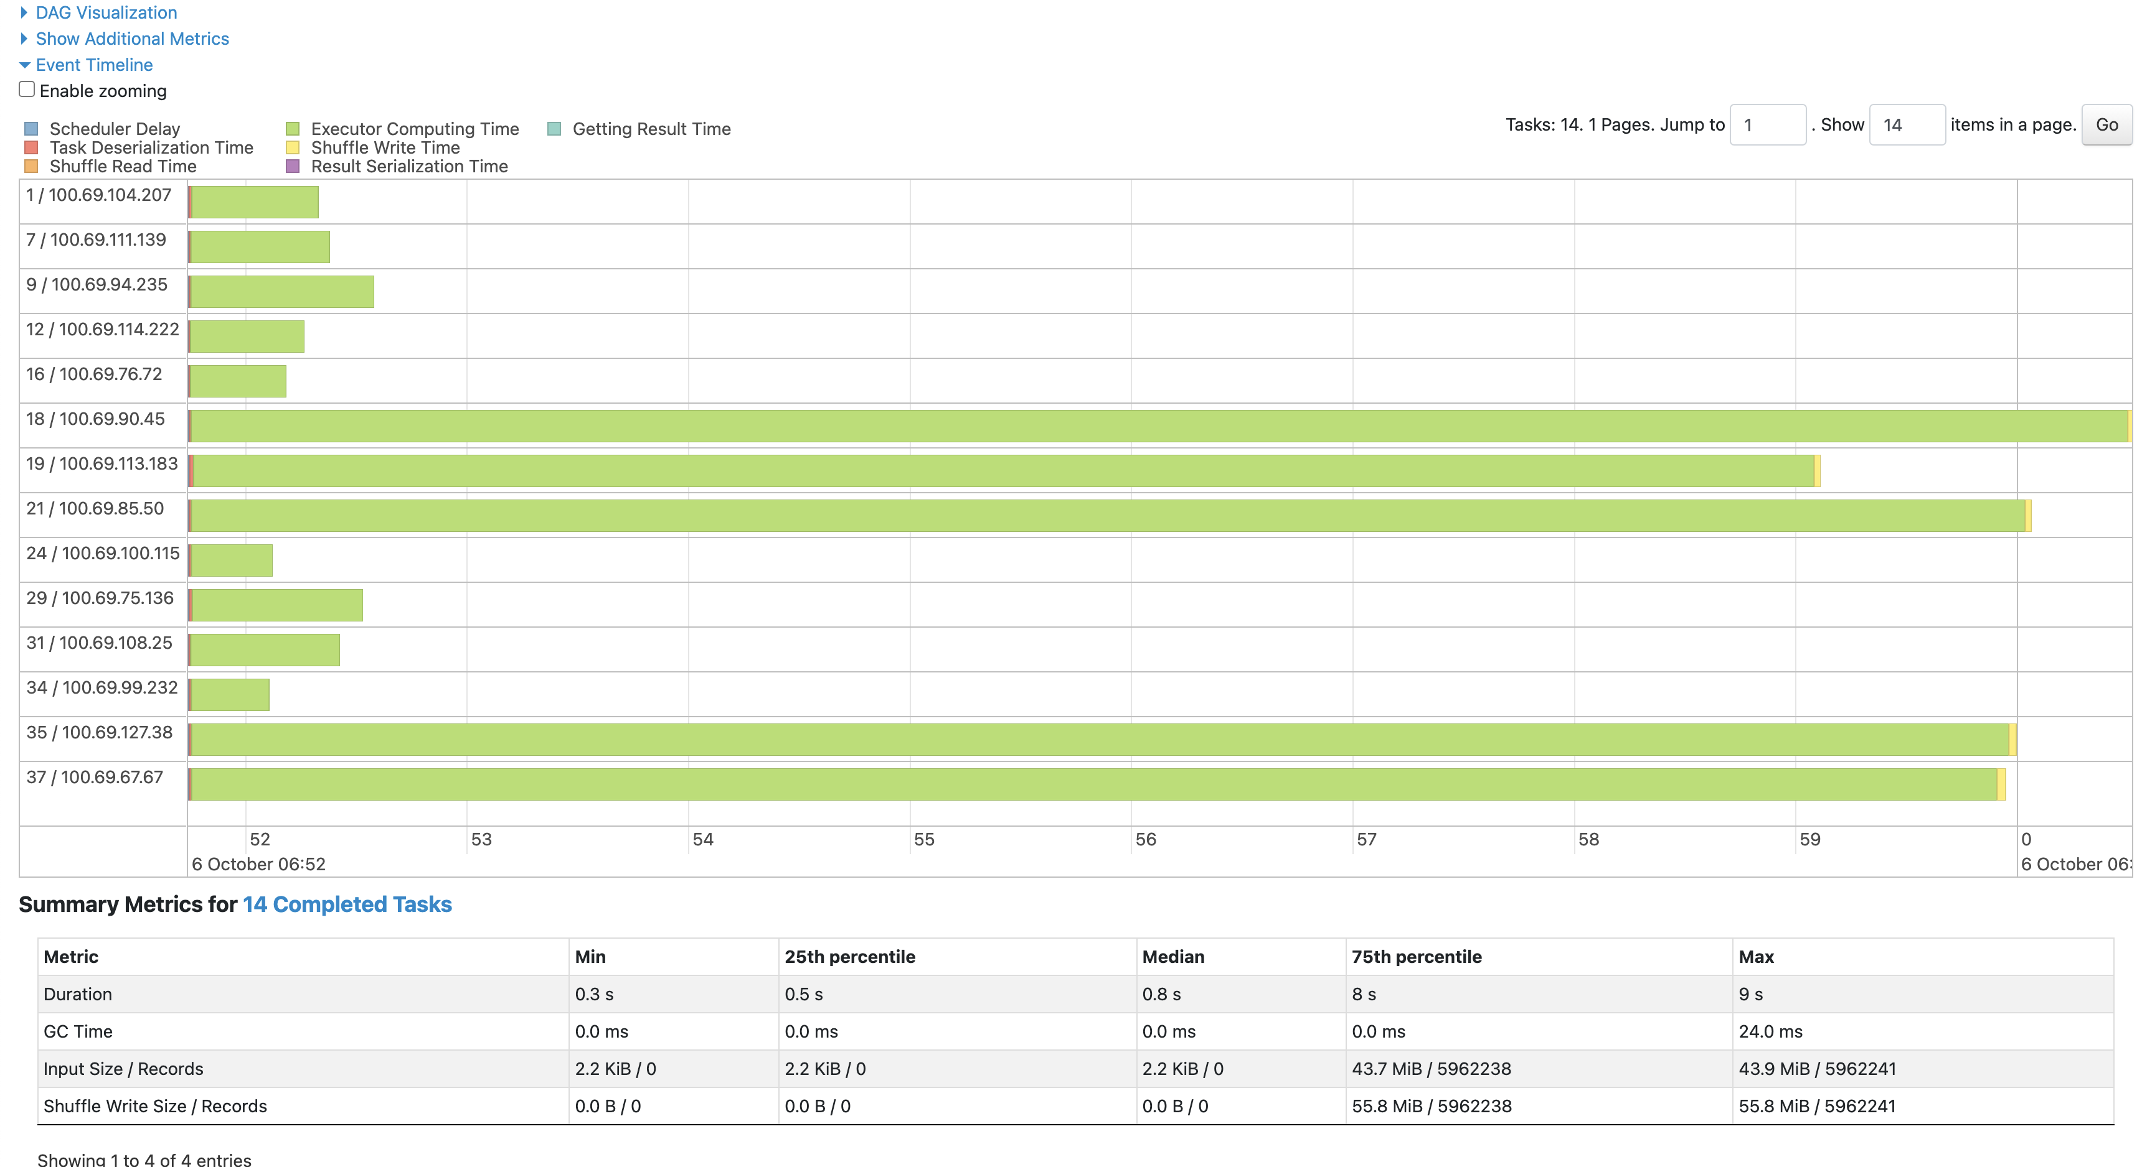
Notes:
Could be, but its such a little data, no spill to disk that I would not dedicate much time

Slide 25
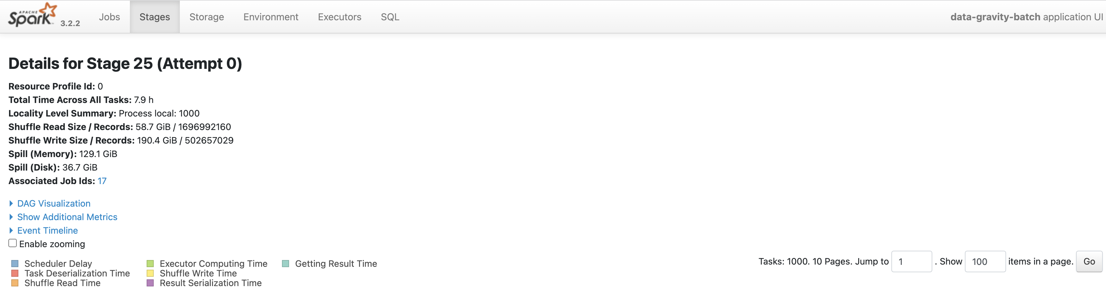
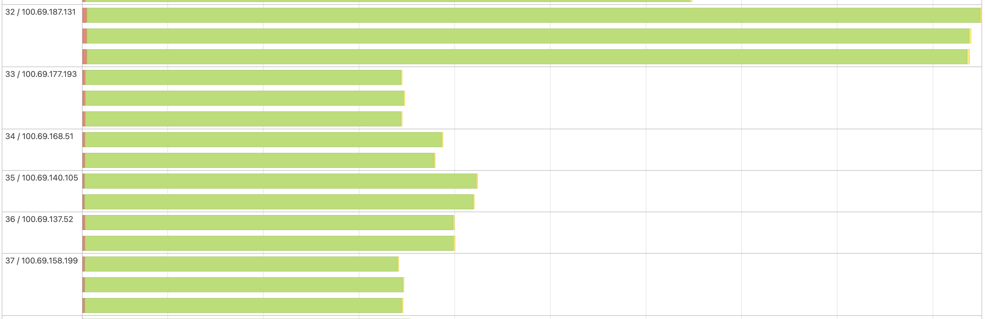
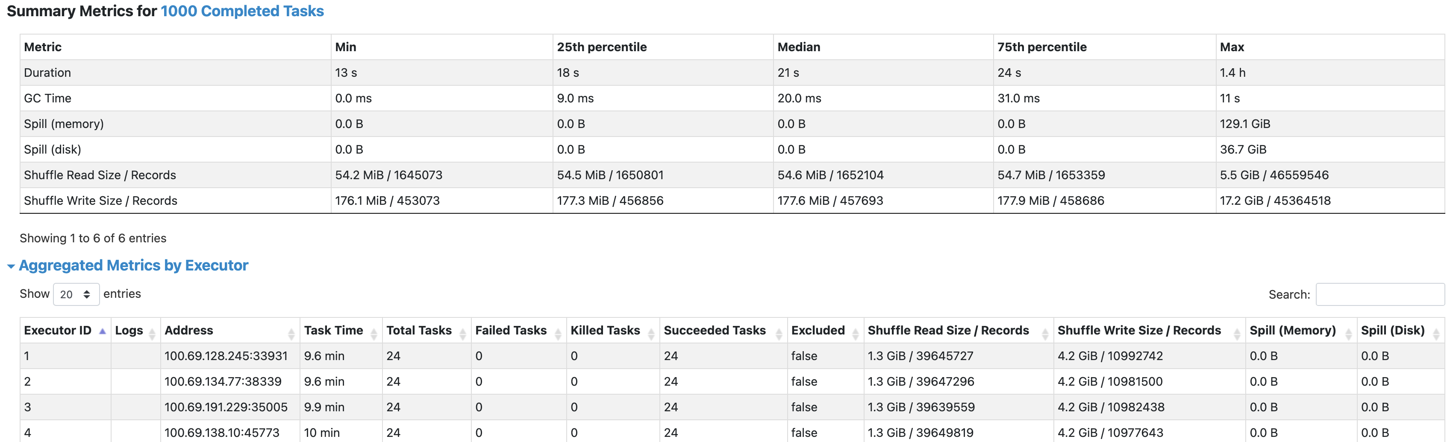
Notes:
Yes, loads of spill, one executor working more than the rest…

Slide 26
THANK YOU
Notes:
STAY IN TOUCH

