Slide 1
Information Retrieval & Text Mining
Marius Popescu
popescunmarius@gmail.com
2018 - 2019

Slide 2
Information Retrieval
7 weeks

Slide 3
Information Retrieval
Information Retrieval (IR) is finding material (usually documents) of an unstructured nature (usually text) that satisfies an information need from within large collections (usually stored on computers).
These days we frequently think first of web search, but there are many other cases:
E-mail search
Searching your laptop
Corporate knowledge bases
Legal information retrieval

Slide 4
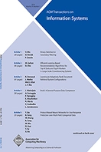
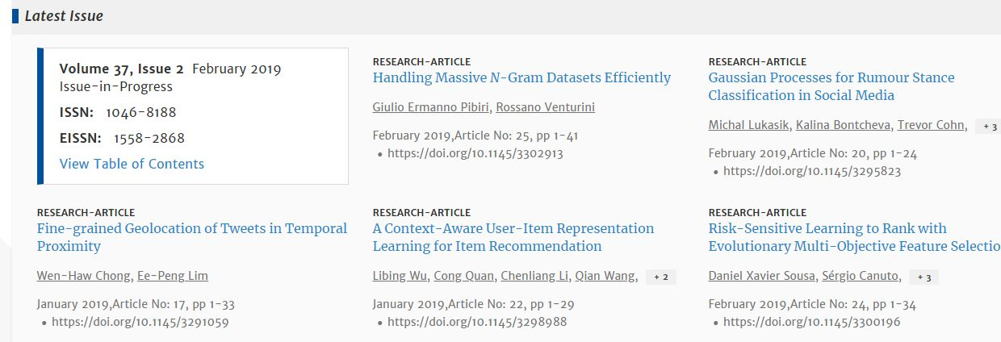
Is IR Related to AI?
ACM Transactions on Information Systems (TOIS)

Slide 5
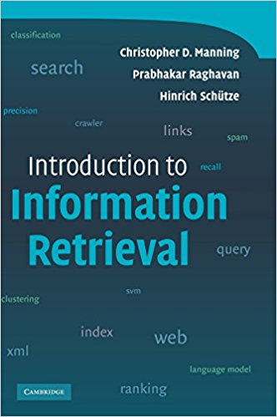
Bibliography
Textbook: https://nlp.stanford.edu/IR-book/
Slides: https://web.stanford.edu/class/cs276/

Slide 6
What We'll Cover

Slide 7

Tools
Apache Lucene: http://lucene.apache.org/
Lucene Core sub-project provides Java-based indexing and search technology, as well as spellchecking, hit highlighting and advanced analysis/tokenization capabilities (http://lucene.apache.org/core/)
PyLucene is a Python port of the Core project (http://lucene.apache.org/pylucene/)
Lucene.Net is a port of the Lucene search engine library, written in C# and targeted at .NET runtime users (http://lucenenet.apache.org/)

Slide 8
Text Mining
7 weeks

Slide 9
From Wikipedia, the free encyclopedia
Text mining, also referred to as text data mining, roughly equivalent to text analytics, is the process of deriving high-quality information from text. High-quality information is typically derived through the devising of patterns and trends through means such as statistical pattern learning. Text mining usually involves the process of structuring the input text (usually parsing, along with the addition of some derived linguistic features and the removal of others, and subsequent insertion into a database), deriving patterns within the structured data, and finally evaluation and interpretation of the output. 'High quality' in text mining usually refers to some combination of relevance, novelty, and interest.

Slide 10
Typical Text Mining Tasks
Text categorization (by topic)
Authorship analysis
Native language identification, translationese
Sentiment analysis, opinion mining
Topic modeling
Plagiarism detection

Slide 11
Tools
Machine learning
Linguistics resources

Slide 12
Administrative Details

Slide 13
Two Project Assignments
 | Release date | Due date
Project 1 | Week 3 | Week 7
Project 2 | Week 8 | Week 14
The two assignments will be graded from 0 to 10
Collaboration: All students must work individually
Any late submissions are penalized at a rate of 20% per week

Slide 14
Grading
Project 1 – 50% (you must obtain at least 5 points)
Project 2 – 50% (you must obtain at least 5 points)

