Slide 1
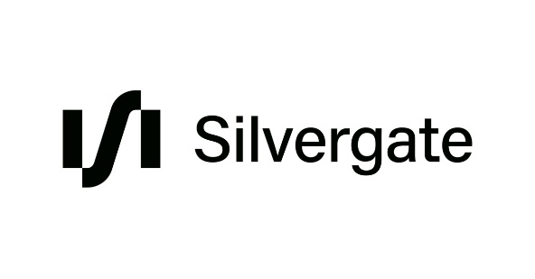



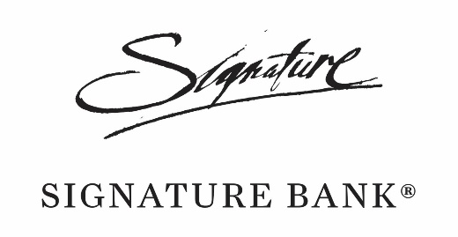
Introduction
The first quarter of this year marked a period of great financial turmoil which led to a series a banking failures in USA (most notably of Silicon Valley Bank, Signature Bank, Silvergate and First Republic) and the failure of Credit Suisse, a G-SII bank.
Some banks were absorbed by other entities (eg. Credit Suisse by UBS, First Republic by JP Morgan), others did not attract any buyers and were allowed to go under.
Although the failures were mostly idiosyncratic (a combination of poor risk management and lax supervision) there are still some useful conclusions to be extracted by the events regarding the conduct of macroprudential policy.

Slide 2
Good parts
The events were unfortunate, but still could have been much worse.
In spring everyone feared that a banking sector crisis would follow the series of failures.
All the signs were there, but it didn’t happen and banks maintained a stable evolution despite losing some investor confidence (Graph 1).
This showcases that some lessons from the Great Financial Crisis have been learned and that the current prudential and resolution mechanisms can be effective in avoiding a financial crisis.
Noteworthy that no banking groups from the EU had definitive issues following the events.

Slide 3
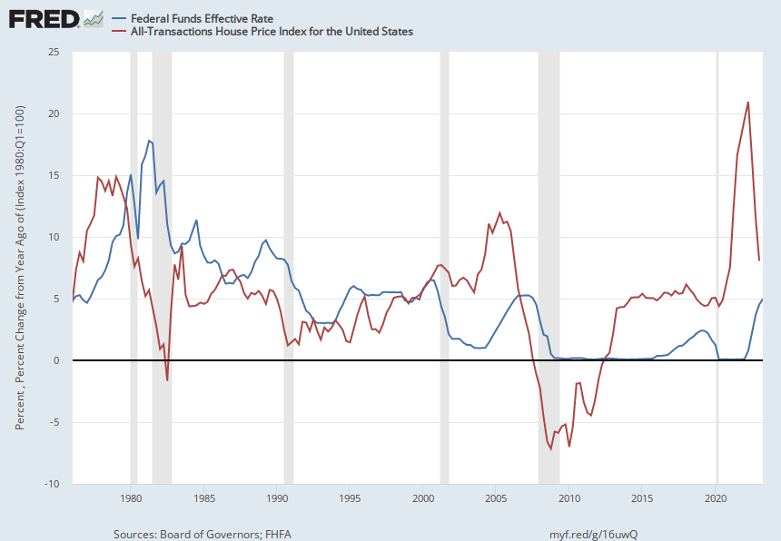
Issue 1: Transition from low interest rates to high interest rates environment
Following the Great Financial Crisis the world experienced a prolonged period of ultra-low interest rates.
There were some signs of renormalization before, but the COVID-19 pandemic cancelled them in favor of more easing times.
The rapid inflation that followed the pandemic made central banks worldwide to enter one of the most abrupt hiking cycles in history.
Banks had little time to adapt to this new environment that few analysts predicted.
Most worrisome is that interest rates hikes tend to deflate asset price growth, especially in housing (Graph 2).
The new remote working paradigm poses significant risk also to commercial real estate.
Notes:
Source: Board of Governors of the Federal Reserve System (US) Release: H.15 Selected Interest Rates Units: Percent, Not Seasonally Adjusted Frequency: Daily, 7-Day For additional historical federal funds rate data, please see Daily Federal Funds Rate from 1928-1954.The federal funds rate is the interest rate at which depository institutions trade federal funds (balances held at Federal Reserve Banks) with each other overnight. When a depository institution has surplus balances in its reserve account, it lends to other banks in need of larger balances. In simpler terms, a bank with excess cash, which is often referred to as liquidity, will lend to another bank that needs to quickly raise liquidity. (1) The rate that the borrowing institution pays to the lending institution is determined between the two banks; the weighted average rate for all of these types of negotiations is called the effective federal funds rate.(2) The effective federal funds rate is essentially determined by the market but is influenced by the Federal Reserve through open market operations to reach the federal funds rate target.(2)The Federal Open Market Committee (FOMC) meets eight times a year to determine the federal funds target rate. As previously stated, this rate influences the effective federal funds rate through open market operations or by buying and selling of government bonds (government debt).(2) More specifically, the Federal Reserve decreases liquidity by selling government bonds, thereby raising the federal funds rate because banks have less liquidity to trade with other banks. Similarly, the Federal Reserve can increase liquidity by buying government bonds, decreasing the federal funds rate because banks have excess liquidity for trade. Whether the Federal Reserve wants to buy or sell bonds depends on the state of the economy. If the FOMC believes the economy is growing too fast and inflation pressures are inconsistent with the dual mandate of the Federal Reserve, the Committee may set a higher federal funds rate target to temper economic activity. In the opposing scenario, the FOMC may set a lower federal funds rate target to spur greater economic activity. Therefore, the FOMC must observe the current state of the economy to determine the best course of monetary policy that will maximize economic growth while adhering to the dual mandate set forth by Congress. In making its monetary policy decisions, the FOMC considers a wealth of economic data, such as: trends in prices and wages, employment, consumer spending and income, business investments, and foreign exchange markets.The federal funds rate is the central interest rate in the U.S. financial market. It influences other interest rates such as the prime rate, which is the rate banks charge their customers with higher credit ratings. Additionally, the federal funds rate indirectly influences longer- term interest rates such as mortgages, loans, and savings, all of which are very important to consumer wealth and confidence.(2)References(1) Federal Reserve Bank of New York. "Federal funds." Fedpoints, August 2007.(2) Monetary Policy, Board of Governors of the Federal Reserve System. Board of Governors of the Federal Reserve System (US), Federal Funds Effective Rate [DFF], retrieved from FRED, Federal Reserve Bank of St. Louis; https://fred.stlouisfed.org/series/DFF, June 27, 2023. Source: U.S. Federal Housing Finance Agency Release: House Price Index Units: Index 1980:Q1=100, Not Seasonally Adjusted Frequency: Quarterly Estimated using sales prices and appraisal data. U.S. Federal Housing Finance Agency, All-Transactions House Price Index for the United States [USSTHPI], retrieved from FRED, Federal Reserve Bank of St. Louis; https://fred.stlouisfed.org/series/USSTHPI, June 27, 2023.

Slide 4
Issue 2: Bank’s asset side is overvalued
IFRS 9 introduced two methods of accounting for financial assets: amortised cost or fair value.
Items that bank’s intend to hold to maturity and collect cashflows appear in bookkeeping at face value (amortised cost accounting) and their devaluation do not affect the bank’s balance sheet or P&L position.
After the recent rise in interest rates, a great part of bank’s bond holdings have lost value, but for some banks this is hidden by the fact that they are accounted at amortised costs.
In case of a run on deposits, these assets might need to be sold at price value, resulting in large short term loses, which was a mechanism seen in the recent banking failures.
This is relevant especially for small banks that tend to lack sophisticated interest rate risk management.

Slide 5
Issue 3: Potential financial cycle downturn
Even though it didn’t cause a banking crisis, there are sign that the financial cycle is turning downside.
Typicall Mynski cycle turning signs

Slide 6
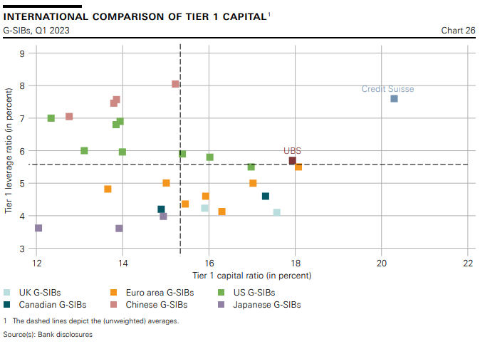
Issue 4: Prudential indicators might be missleading
One of the most intriguing aspects of the recent banking failures was the rapidity of the unfolding events.
Few people guessed before the events that the banks would fail. Some analysts even recommended buying the stocks just weeks prior to the failures.
Standard financial reporting of the banks showed no signs of trouble before the loss of confidence of the debtors and the massive deposit withdrawals
Even for the case of Credit Suisse, which has been ailing for some months prior, the capital position looked very strong just before going under (Graph 4).
This poses questions as to the validity of the current prudential indicators and their adequacy. Nevertheless, it may be true that the problem is not with the indicators, but the banks learned ability to windowdress them in order to appear normal.

Slide 7
Other issues
Client quality matters very much. It is no coincidence that the failing American banks had large crypto exposures. Also, the ties that Credit Suisse had with the defunct Archegos company are now beginning to unfold.
Bad executives went unpunished for their inappropriate management, even kept their bonuses. The US Senate is now reanalyzing the compensation rules for failing bank executives.
The executives encouraged employees to keep buying bank’s shares even though they were actually selling them behind their back, knowing for what’s coming.
The FDIC ended up bailing out large companies

Slide 8
Macroprudential policy implications
Client quality matters very much. It is no coincidence that the failing American banks had large crypto exposures. Also, the ties that Credit Suisse had with the defunct Archegos company are now beginning to unfold.
Bad executives went unpunished for their inappropriate management, even kept their bonuses. The US Senate is now reanalyzing the compensation rules for failing bank executives.
The executives encouraged employees to keep buying bank’s shares even though they were actually selling them behind their back, knowing for what’s coming.
The FDIC ended up bailing out large companies

