Slide 1

Levi9 IT Services

Slide 2


Who is Levi9
We are the new generation IT service company, strongly devoted to our people and customers.
Founded in 2005 by Bernhard van Oranje and Menno de Jong
Captive near-shore center since 2001 in Novi Sad, Serbia
European pro-active culture
Full service IT company
Software development and maintenance in .Net, Java, PHP and C++.
600+ IT professionals (.NET, Java, Testing, IT Support, Business Intelligence, Project Management)
Privately owned
We believe in our core values: transparency, pro-activeness and result driven.

Slide 3
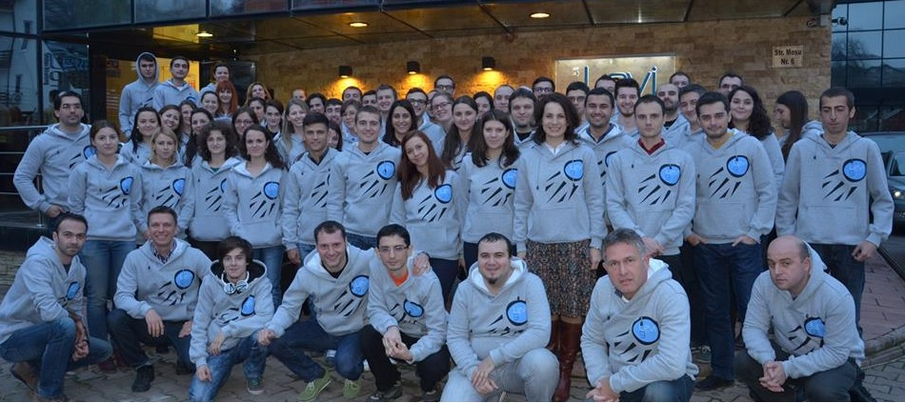
What we do?
We develop and maintain applications for Western European customers in Delivery Centers in Eastern Europe.
“We firmly believe that creating one common goal
is the basis of being successful.”

Slide 4
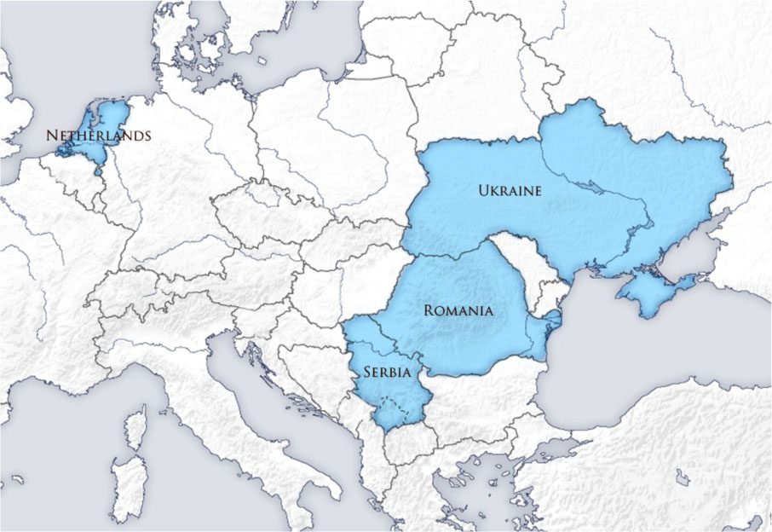
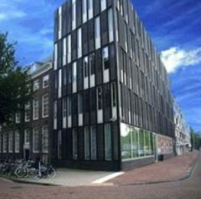
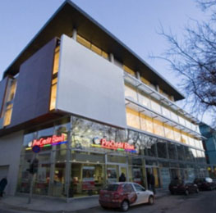
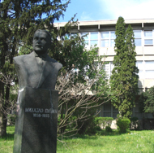
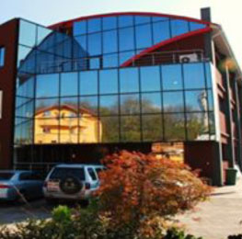
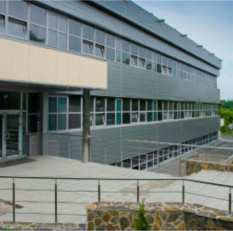
Locations
Amsterdam
Kiev
Levi9 HQ
Amsterdam – 2005
25 people
Iasi
Zrenjanin
Novi Sad
Serbia
Novi Sad – 2005
300+ people
Serbia
Zrenjanin– 2014
40+ people
Romania
Iasi – 2007
90+ people
Ukraine
Kiev – 2008
150+ people

Slide 5















Some of our Customers

Slide 6
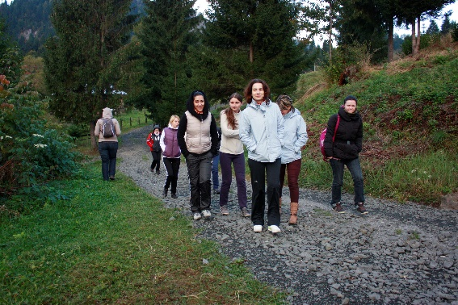
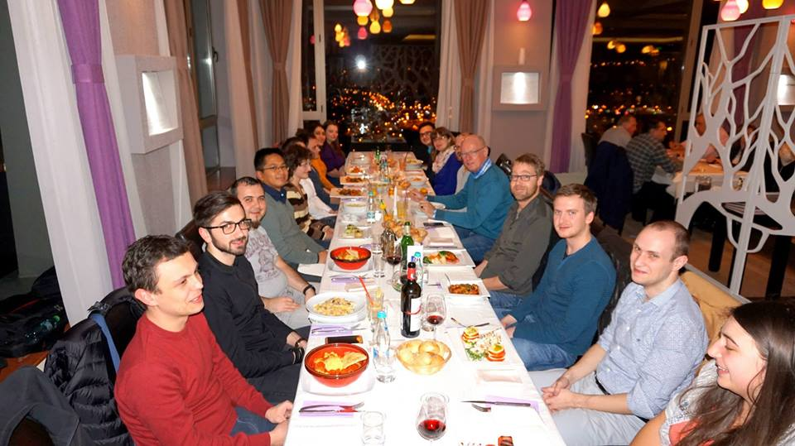

Junior Test Developer
We are expecting our future colleagues to have:
Capacity to understand the testing process in a Software Development Life Cycle
Basic knowledge on types of tests
Interest for automated tests
Good English knowledge
We can hire you if you prove your potential!

Slide 7
How to apply?
Send your CV to jobs-romania@levi9.com with the name of the targeted technology.
Our selection process takes only a few steps:
Advertise Job Vacancy
CV Review
-HR
-Technical
-Phone screening (if needed)
HR Interview
-Personality fit (“The way we are”)
-Motivation
-Spoken English
Written Tests
-Technical test
-English test
Technical Interview
-Technical experts
Offer (go/no go)
We all have to agree with the decision

Slide 8


We have One Common Goal
What about you?

