Slide 1
Levi9 IT Services
BEcome AIESEC - 2016

Slide 2

Agenda
Web Services
Types of Web Services
Richardson Maturity Model
Developing a REST application

Slide 3
Agenda
Web Services
Types of Web Services
Richardson Maturity Model
Developing a REST application

Slide 4
Web Services
What is a Web Service?
Why should I use Web Services?
What types of Web Services do you know?
Notes:
What is a Web Service?
W3C defineste un Web service ca fiind un sistem software care suporta interactiunea intre dispozitive electronice folosind un protocol de comunicare.
O definitie mai amanuntita ar fi:
Un Web service este un serviciu oferit de un dispozitiv electronic altui dispositiv electronic, comunicarea intre ele realizandu-se prin intermediul World wide web, mai exact folosind HTTP (Hypertext Transfer Protocol). Acesta a fost folosit initial pentru interactiunea dintre utilizator (om) si masina, acum utilizare lui fiind extinsa la transferul de informatii intre 2 dispozitive electronice folosind formate ca XML (eXtensile Mark-up Language) si JSON (JavaScript Object Notation). In practica Web services realizeaza o procesare de date primite ca request si pot furniza ca raspuns rezultatul procesarii sau un status al operatiei realizate si o modalitate de a obtine rezultatul procesarii.
Why should I use Web Services?
Loose coupling – slaba cuplare intre module, adica modulele nu trebuie sa aiba cunostinte directe de implementarea specifica a unui anumit modul, singura interactiune fiind modul de transmitere a informatiilor (protocolul) si modul de incapsulare a informatiilor.
Discoverability – modulele nu trebuie sa stie unde se afla fizic celelalte module, locatia pe care un modul trebuie sa o cunoasca e locatia virtuala si de acolo sa poata obtine o definitie a serviciilor oferite.
Low cost communication.
Interoperability – nu conteaza limbajul in care e scris un anumit client, sau un anumit service provider.
What types of Web Services do you know?
SOAP based Web Services
RESTful Web Services

Slide 5
Agenda
Web Services
Types of Web Services
Richardson Maturity Model
Developing a REST application

Slide 6
Types of Web Services
SOAP
REST

Slide 7
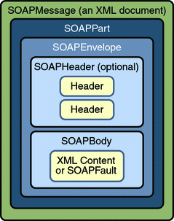
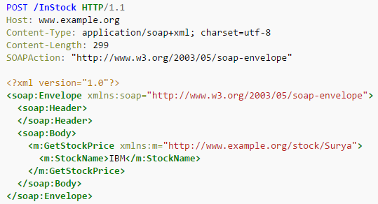
Types of Web Services – SOAP
What is SOAP?
How to describe a SOAP Web service?
Describe a SOAP message.
E.g. of SOAP Web services can be found here.
Another presentation on SOAP can be found here.
Notes:
What is SOAP?
SOAP, acronim pentru Simple Object Access Protocol, e un protocol care defineste schimbul de informatii intr-o maniera structurata folosind retelele de calculatoare. Pentru incapsularea informatiilor se foloseste formatul XML, iar transferul se realizeaza de obicei folosind protocoale ca HTTP (Hypertext Transfer Protocol) sau SMTP (Simple Mail Transfer Protocol).
How to describe a SOAP Web Service?
Through WDSL (Web Service Definition Language)
Discoverability prin UDDI (Universal Description Discovery and Integration) – nu prea e folosit
White Pages — address, contact, and known identifiers;
Yellow Pages — industrial categorizations based on standard taxonomies;
Green Pages — technical information about services exposed by the business.
Clientul are un SEI (Service Endpoint Interface – language specific) prin intermediul caruia incapsuleaza mesajul SOAP (xml) si il trimite la server.
Describer a SOAP message.
Element Description Required
Envelope Identifies the XML document as a SOAP message. Yes
Header Contains header information. No
Body Contains call, and response information. Yes
Fault Provides information about errors that occurred while processing the message. No

Slide 8
Types of Web Services – Rest
What is REST?
Another presentation on SOAP can be found here.
Notes:
REST stands for Representational State Transfer. (It is sometimes spelled "ReST".) It relies on a stateless, client-server, cacheable communications protocol -- and in virtually all cases, the HTTP protocol is used. REST is an architecture style for designing networked applications.

Slide 9
SOAP vs REST
SOAP is definitely the heavyweight choice for Web service access. It provides the following advantages when compared to REST:
Language, platform, and transport independent (REST requires use of HTTP)
Works well in distributed enterprise environments (REST assumes direct point-to-point communication)
Standardized
Provides significant pre-build extensibility in the form of the WS* standards
Built-in error handling
Automation when used with certain language products
REST is easier to use for the most part and is more flexible. It has the following advantages when compared to SOAP:
No expensive tools require to interact with the Web service
Smaller learning curve
Efficient (SOAP uses XML for all messages, REST can use smaller message formats)
Fast (no extensive processing required)
Closer to other Web technologies in design philosophy

Slide 10
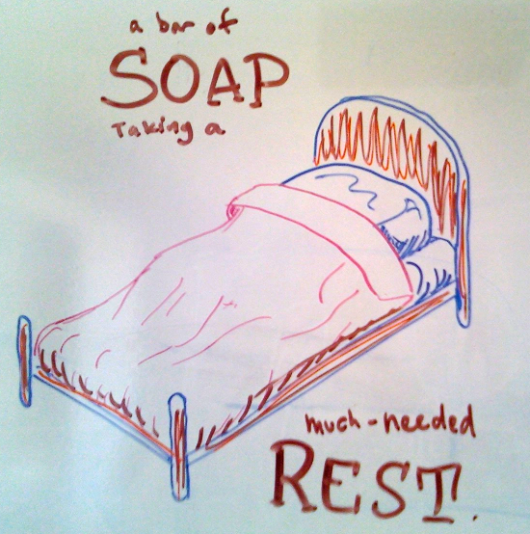
SOAP vs REST Cont’d
Some people try to say that one process is better than the other, but this statement is incorrect. Each protocol has definite advantages and equally problematic disadvantages. You need to select between SOAP and REST based on the programming language you use, the environment in which you use it, and the requirements of the application. Sometimes SOAP is a better choice and other times REST is a better choice. In order to avoid problems later, you really do need to chart the advantages and disadvantages of a particular solution in your specific situation.

Slide 11
Agenda
Web Services
Types of Web Services
Richardson Maturity Model
Developing a REST application

Slide 12
Agenda
Web Services
Types of Web Services
Richardson Maturity Model
Developing a REST application

