Slide 1

Levi9 IT Services

Slide 2

Agenda
Web Services
Types of Web Services
Richardson Maturity Model

Slide 3
Agenda
Web Services
Types of Web Services
Richardson Maturity Model

Slide 4
Web Services
What is a Web Service?
Why should I use Web Services?
What types of Web Services do you know?
Notes:
What is a Web Service?
W3C defineste un Web service ca fiind un sistem software care suporta interactiunea intre dispozitive electronice folosind un protocol de comunicare.
O definitie mai amanuntita ar fi:
Un Web service este un serviciu oferit de un dispozitiv electronic altui dispositiv electronic, comunicarea intre ele realizandu-se prin intermediul World wide web, mai exact folosind HTTP (Hypertext Transfer Protocol). Acesta a fost folosit initial pentru interactiunea dintre utilizator (om) si masina, acum utilizare lui fiind extinsa la transferul de informatii intre 2 dispozitive electronice folosind formate ca XML (eXtensile Mark-up Language) si JSON (JavaScript Object Notation). In practica Web services realizeaza o procesare de date primite ca request si pot furniza ca raspuns rezultatul procesarii sau un status al operatiei realizate si o modalitate de a obtine rezultatul procesarii.
Why should I use Web Services?
Loose coupling – slaba cuplare intre module, adica modulele nu trebuie sa aiba cunostinte directe de implementarea specifica a unui anumit modul, singura interactiune fiind modul de transmitere a informatiilor (protocolul) si modul de incapsulare a informatiilor.
Discoverability – modulele nu trebuie sa stie unde se afla fizic celelalte module, locatia pe care un modul trebuie sa o cunoasca e locatia virtuala si de acolo sa poata obtine o definitie a serviciilor oferite.
Low cost communication.
Interoperability – nu conteaza limbajul in care e scris un anumit client, sau un anumit service provider.
What types of Web Services do you know?
SOAP based Web Services
RESTful Web Services

Slide 5
Agenda
Web Services
Types of Web Services
Richardson Maturity Model

Slide 6
Types of Web Services
SOAP
REST

Slide 7
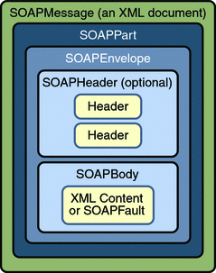
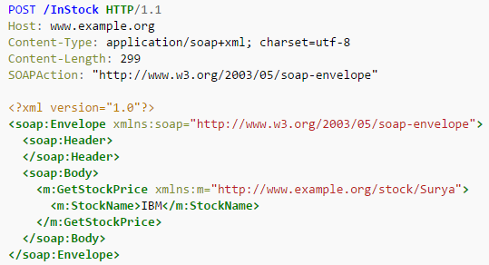
Types of Web Services – SOAP
What is SOAP?
How to describe a SOAP Web service?
Describe a SOAP message.
E.g. of SOAP Web services can be found here.
Another presentation on SOAP can be found here.
Notes:
What is SOAP?
SOAP, acronim pentru Simple Object Access Protocol, e un protocol care defineste schimbul de informatii intr-o maniera structurata folosind retelele de calculatoare. Pentru incapsularea informatiilor se foloseste formatul XML, iar transferul se realizeaza de obicei folosind protocoale ca HTTP (Hypertext Transfer Protocol) sau SMTP (Simple Mail Transfer Protocol).
How to describe a SOAP Web Service?
Through WDSL (Web Service Definition Language)
Discoverability prin UDDI (Universal Description Discovery and Integration) – nu prea e folosit
White Pages — address, contact, and known identifiers;
Yellow Pages — industrial categorizations based on standard taxonomies;
Green Pages — technical information about services exposed by the business.
Clientul implementeaza un SEI (Service Endpoint Interface – language specific) prin intermediul caruia incapsuleaza mesajul SOAP (xml) si il trimite la server.
Describer a SOAP message.
Element Description Required
Envelope Identifies the XML document as a SOAP message. Yes
Header Contains header information. No
Body Contains call, and response information. Yes
Fault Provides information about errors that occurred while processing the message. No

Slide 8
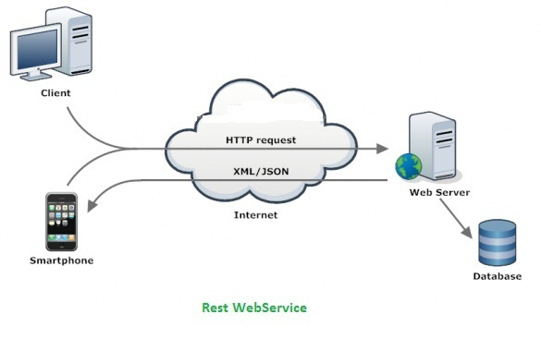
Types of Web Services – REST
What is ReST?
How REST works?
REST diagram
Another presentation on REST can be found here.
Notes:
REST stands for Representational State Transfer. (It is sometimes spelled "ReST".) It relies on a stateless, client-server, cacheable communications protocol -- and in virtually all cases, the HTTP protocol is used. REST is an architecture style for designing networked applications.
REST works over HTTP and uses the HTTP verbs (GET, POST, PUT, DELETE etc. which as you can think map on CRUD).
REST expose information as resources through URIs (uniform resource identifiers) and executes actions using HTTP verbs.
1xx Informational
Request received, continuing process.[4]
2xx Success
This class of status codes indicates the action requested by the client was received, understood, accepted, and processed successfully.[9]
200 OK
Standard response for successful HTTP requests. The actual response will depend on the request method used. In a GET request, the response will contain an entity corresponding to the requested resource. In a POST request, the response will contain an entity describing or containing the result of the action.[10]
201 Created
The request has been fulfilled, resulting in the creation of a new resource.[11]
204 No Content
The server successfully processed the request and is not returning any content.[15]
3xx Redirection
4xx Client Error
400 Bad Request
The server cannot or will not process the request due to an apparent client error (e.g., malformed request syntax, invalid request message framing, or deceptive request routing).[36]
401 Unauthorized (RFC 7235)
Similar to 403 Forbidden, but specifically for use when authentication is required and has failed or has not yet been provided. The response must include a WWW-Authenticate header field containing a challenge applicable to the requested resource. See Basic access authentication and Digest access authentication.[37] 401 semantically means "unauthenticated",[38] i.e. the user does not have the necessary credentials.
Note: Some sites issue HTTP 401 when an IP address is banned from the website (usually the website domain) and that specific address is refused permission to access a website.
403 Forbidden
The request was a valid request, but the server is refusing to respond to it. 403 error semantically means "unauthorized", i.e. the user does not have the necessary permissions for the resource.
404 Not Found
The requested resource could not be found but may be available again in the future. Subsequent requests by the client are permissible.[40]
405 Method Not Allowed
A request method is not supported for the requested resource; for example, a GET request on a form which requires data to be presented via POST, or a PUT request on a read-only resource.
415 Unsupported Media Type
The request entity has a media type which the server or resource does not support. For example, the client uploads an image as image/svg+xml, but the server requires that images use a different format.
429 Too Many Requests (RFC 6585)
The user has sent too many requests in a given amount of time. Intended for use with rate limiting schemes.[57]
5xx Server Error
500 Internal Server Error
A generic error message, given when an unexpected condition was encountered and no more specific message is suitable.[62]
501 Not Implemented
The server either does not recognize the request method, or it lacks the ability to fulfill the request. Usually this implies future availability (e.g., a new feature of a web-service API).[63]

Slide 9
SOAP vs REST
SOAP is definitely the heavyweight choice for Web service access. It provides the following advantages when compared to REST:
Language, platform, and transport independent (REST requires use of HTTP)
Works well in distributed enterprise environments (REST assumes direct point-to-point communication)
Standardized
Provides significant pre-build extensibility in the form of the WS* standards
Built-in error handling
Automation when used with certain language products
REST is easier to use for the most part and is more flexible. It has the following advantages when compared to SOAP:
No expensive tools require to interact with the Web service
Smaller learning curve
Efficient (SOAP uses XML for all messages, REST can use smaller message formats)
Fast (no extensive processing required)
Closer to other Web technologies in design philosophy

Slide 10
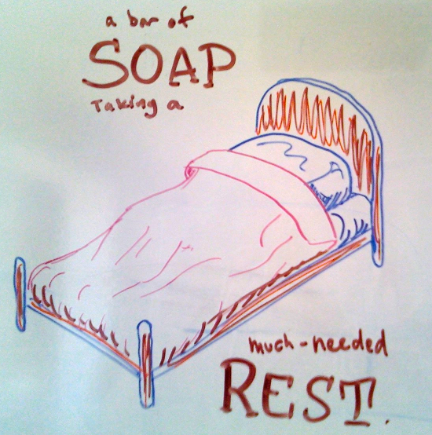
SOAP vs REST Cont’d
Some people try to say that one process is better than the other, but this statement is incorrect. Each protocol has definite advantages and equally problematic disadvantages. You need to select between SOAP and REST based on the programming language you use, the environment in which you use it, and the requirements of the application. Sometimes SOAP is a better choice and other times REST is a better choice. In order to avoid problems later, you really do need to chart the advantages and disadvantages of a particular solution in your specific situation.

Slide 11



Who uses REST

Slide 12
Agenda
Web Services
Types of Web Services
Richardson Maturity Model

Slide 13
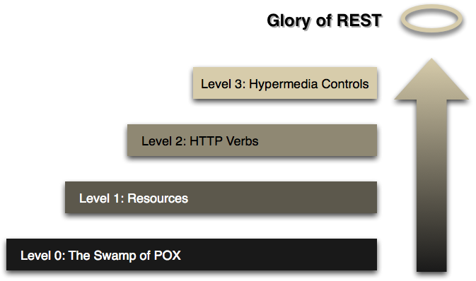
Richardson Maturity Model
A model (developed by Leonard Richardson) that breaks down the principal elements of a REST approach into three steps. These introduce resources, http verbs, and hypermedia controls.

Slide 14
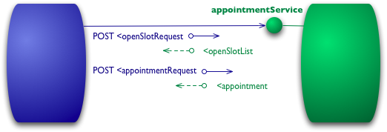
Richardson Maturity Model – Level 0
Notes:
The starting point for the model is using HTTP as a transport system for remote interactions, but without using any of the mechanisms of the web. Essentially what you are doing here is using HTTP as a tunneling mechanism for your own remote interaction mechanism, usually based on Remote Procedure Invocation.
Let's assume I want to book an appointment with my doctor. My appointment software first needs to know what open slots my doctor has on a given date, so it makes a request of the hospital appointment system to obtain that information. In a level 0 scenario, the hospital will expose a service endpoint at some URI. I then post to that endpoint a document containing the details of my request.
POST /appointmentService HTTP/1.1
[various other headers]
<openSlotRequest date = "2010-01-04" doctor = "mjones"/>
The server then will return a document giving me this information
HTTP/1.1 200 OK
[various headers]
<openSlotList>
<slot start = "1400" end = "1450">
<doctor id = "mjones"/>
</slot>
<slot start = "1600" end = "1650">
<doctor id = "mjones"/>
</slot>
</openSlotList>
I'm using XML here for the example, but the content can actually be anything: JSON, YAML, key-value pairs, or any custom format.
My next step is to book an appointment, which I can again do by posting a document to the endpoint.
POST /appointmentService HTTP/1.1
[various other headers]
<appointmentRequest>
<slot doctor = "mjones" start = "1400" end = "1450"/>
<patient id = "jsmith"/>
</appointmentRequest>
If all is well I get a response saying my appointment is booked.
HTTP/1.1 200 OK
[various headers]
<appointment>
<slot doctor = "mjones" start = "1400" end = "1450"/>
<patient id = "jsmith"/>
</appointment>
If there is a problem, say someone else got in before me, then I'll get some kind of error message in the reply body.
HTTP/1.1 200 OK
[various headers]
<appointmentRequestFailure>
<slot doctor = "mjones" start = "1400" end = "1450"/>
<patient id = "jsmith"/>
<reason>Slot not available</reason>
</appointmentRequestFailure>
So far this is a straightforward RPC style system. It's simple as it's just slinging plain old XML (POX) back and forth. If you use SOAP or XML-RPC it's basically the same mechanism, the only difference is that you wrap the XML messages in some kind of envelope.

Slide 15
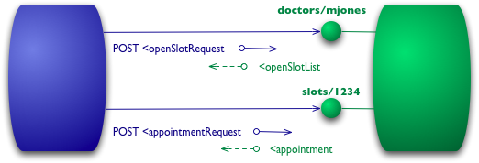
Richardson Maturity Model – Level 1
Notes:
The first step towards the Glory of Rest in the RMM is to introduce resources. So now rather than making all our requests to a singular service endpoint, we now start talking to individual resources.
So with our initial query, we might have a resource for given doctor.
POST /doctors/mjones HTTP/1.1
[various other headers]
<openSlotRequest date = "2010-01-04"/>
The reply carries the same basic information, but each slot is now a resource that can be addressed individually.
HTTP/1.1 200 OK
[various headers]
<openSlotList>
<slot id = "1234" doctor = "mjones" start = "1400" end = "1450"/>
<slot id = "5678" doctor = "mjones" start = "1600" end = "1650"/>
</openSlotList>
With specific resources booking an appointment means posting to a particular slot.
POST /slots/1234 HTTP/1.1
[various other headers]
<appointmentRequest>
<patient id = "jsmith"/>
</appointmentRequest>
If all goes well I get a similar reply to before.
HTTP/1.1 200 OK
[various headers]
<appointment>
<slot id = "1234" doctor = "mjones" start = "1400" end = "1450"/>
<patient id = "jsmith"/>
</appointment>
The difference now is that if anyone needs to do anything about the appointment, like book some tests, they first get hold of the appointment resource, which might have a URI like http://royalhope.nhs.uk/slots/1234/appointment, and post to that resource.
To an object guy like me this is like the notion of object identity. Rather than calling some function in the ether and passing arguments, we call a method on one particular object providing arguments for the other information.

Slide 16
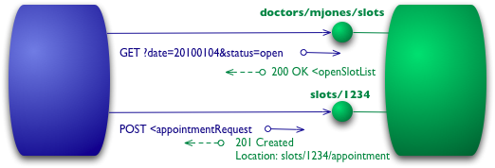
Richardson Maturity Model – Level 2
Notes:
I've used HTTP POST verbs for all my interactions here in level 0 and 1, but some people use GETs instead or in addition. At these levels it doesn't make much difference, they are both being used as tunneling mechanisms allowing you to tunnel your interactions through HTTP. Level 2 moves away from this, using the HTTP verbs as closely as possible to how they are used in HTTP itself.
For our the list of slots, this means we want to use GET.
GET /doctors/mjones/slots?date=20100104&status=open HTTP/1.1
Host: royalhope.nhs.uk
The reply is the same as it would have been with the POST
HTTP/1.1 200 OK
[various headers]
<openSlotList>
<slot id = "1234" doctor = "mjones" start = "1400" end = "1450"/>
<slot id = "5678" doctor = "mjones" start = "1600" end = "1650"/>
</openSlotList>
At Level 2, the use of GET for a request like this is crucial. HTTP defines GET as a safe operation, that is it doesn't make any significant changes to the state of anything. This allows us to invoke GETs safely any number of times in any order and get the same results each time. An important consequence of this is that it allows any participant in the routing of requests to use caching, which is a key element in making the web perform as well as it does. HTTP includes various measures to support caching, which can be used by all participants in the communication. By following the rules of HTTP we're able to take advantage of that capability.
To book an appointment we need an HTTP verb that does change state, a POST or a PUT. I'll use the same POST that I did earlier.
POST /slots/1234 HTTP/1.1
[various other headers]
<appointmentRequest>
<patient id = "jsmith"/>
</appointmentRequest>
The trade-offs between using POST and PUT here are more than I want to go into here, maybe I'll do a separate article on them some day. But I do want to point out that some people incorrectly make a correspondence between POST/PUT and create/update. The choice between them is rather different to that.
Even if I use the same post as level 1, there's another significant difference in how the remote service responds. If all goes well, the service replies with a response code of 201 to indicate that there's a new resource in the world.
HTTP/1.1 201 Created
Location: slots/1234/appointment
[various headers]
<appointment>
<slot id = "1234" doctor = "mjones" start = "1400" end = "1450"/>
<patient id = "jsmith"/>
</appointment>
The 201 response includes a location attribute with a URI that the client can use to GET the current state of that resource in the future. The response here also includes a representation of that resource to save the client an extra call right now.
There is another difference if something goes wrong, such as someone else booking the session.
HTTP/1.1 409 Conflict
[various headers]
<openSlotList>
<slot id = "5678" doctor = "mjones" start = "1600" end = "1650"/>
</openSlotList>
The important part of this response is the use of an HTTP response code to indicate something has gone wrong. In this case a 409 seems a good choice to indicate that someone else has already updated the resource in an incompatible way. Rather than using a return code of 200 but including an error response, at level 2 we explicitly use some kind of error response like this. It's up to the protocol designer to decide what codes to use, but there should be a non-2xx response if an error crops up. Level 2 introduces using HTTP verbs and HTTP response codes.
There is an inconsistency creeping in here. REST advocates talk about using all the HTTP verbs. They also justify their approach by saying that REST is attempting to learn from the practical success of the web. But the world-wide web doesn't use PUT or DELETE much in practice. There are sensible reasons for using PUT and DELETE more, but the existence proof of the web isn't one of them.
The key elements that are supported by the existence of the web are the strong separation between safe (eg GET) and non-safe operations, together with using status codes to help communicate the kinds of errors you run into.

Slide 17
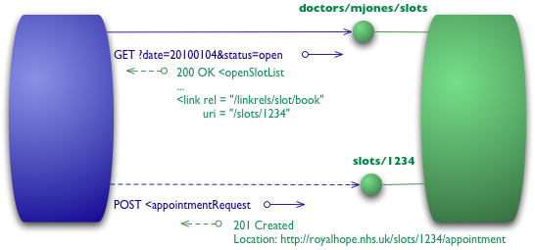
Richardson Maturity Model – Level 3
Notes:
The final level introduces something that you often hear referred to under the ugly acronym of HATEOAS (Hypertext As The Engine Of Application State). It addresses the question of how to get from a list open slots to knowing what to do to book an appointment.
We begin with the same initial GET that we sent in level 2
GET /doctors/mjones/slots?date=20100104&status=open HTTP/1.1
Host: royalhope.nhs.uk
But the response has a new element
HTTP/1.1 200 OK
[various headers]
<openSlotList>
<slot id = "1234" doctor = "mjones" start = "1400" end = "1450">
<link rel = "/linkrels/slot/book"
uri = "/slots/1234"/>
</slot>
<slot id = "5678" doctor = "mjones" start = "1600" end = "1650">
<link rel = "/linkrels/slot/book"
uri = "/slots/5678"/>
</slot>
</openSlotList>
Each slot now has a link element which contains a URI to tell us how to book an appointment.
The point of hypermedia controls is that they tell us what we can do next, and the URI of the resource we need to manipulate to do it. Rather than us having to know where to post our appointment request, the hypermedia controls in the response tell us how to do it.
The POST would again copy that of level 2
POST /slots/1234 HTTP/1.1
[various other headers]
<appointmentRequest>
<patient id = "jsmith"/>
</appointmentRequest>
And the reply contains a number of hypermedia controls for different things to do next.
HTTP/1.1 201 Created
Location: http://royalhope.nhs.uk/slots/1234/appointment
[various headers]
<appointment>
<slot id = "1234" doctor = "mjones" start = "1400" end = "1450"/>
<patient id = "jsmith"/>
<link rel = "/linkrels/appointment/cancel"
uri = "/slots/1234/appointment"/>
<link rel = "/linkrels/appointment/addTest"
uri = "/slots/1234/appointment/tests"/>
<link rel = "self"
uri = "/slots/1234/appointment"/>
<link rel = "/linkrels/appointment/changeTime"
uri = "/doctors/mjones/slots?date=20100104@status=open"/>
<link rel = "/linkrels/appointment/updateContactInfo"
uri = "/patients/jsmith/contactInfo"/>
<link rel = "/linkrels/help"
uri = "/help/appointment"/>
</appointment>
One obvious benefit of hypermedia controls is that it allows the server to change its URI scheme without breaking clients. As long as clients look up the "addTest" link URI then the server team can juggle all URIs other than the initial entry points.
A further benefit is that it helps client developers explore the protocol. The links give client developers a hint as to what may be possible next. It doesn't give all the information: both the "latest" and "cancel" controls point to the same URI - they need to figure out that one is a GET and the other a DELETE. But at least it gives them a starting point as to what to think about for more information and to look for a similar URI in the protocol documentation.
Similarly it allows the server team to advertise new capabilities by putting new links in the responses. If the client developers are keeping an eye out for unknown links these links can be a trigger for further exploration.
There's no absolute standard as to how to represent hypermedia controls. What I've done here is to use the current recommendations of the REST in Practice team, which is to follow ATOM (RFC 4287) I use a <link> element with a uri attribute for the target URI and a rel attribute for to describe the kind of relationship. A well known relationship (such as self for a reference to the element itself) is bare, any specific to that server is a fully qualified URI. ATOM states that the definition for well-known linkrels is the Registry of Link Relations . As I write these are confined to what's done by ATOM, which is generally seen as a leader in level 3 restfulness.
The Meaning of the Levels
I should stress that the RMM, while a good way to think about what the elements of REST, is not a definition of levels of REST itself. Roy Fielding has made it clear that level 3 RMM is a pre-condition of REST. Like many terms in software, REST gets lots of definitions, but since Roy Fielding coined the term, his definition should carry more weight than most.
What I find useful about this RMM is that it provides a good step by step way to understand the basic ideas behind restful thinking. As such I see it as tool to help us learn about the concepts and not something that should be used in some kind of assessment mechanism. I don't think we have enough examples yet to be really sure that the restful approach is the right way to integrate systems, I do think it's a very attractive approach and the one that I would recommend in most situations.
Talking about this with Ian Robinson, he stressed that something he found attractive about this model when Leonard Richardson first presented it was its relationship to common design techniques.
Level 1 tackles the question of handling complexity by using divide and conquer, breaking a large service endpoint down into multiple resources.
Level 2 introduces a standard set of verbs so that we handle similar situations in the same way, removing unnecessary variation.
Level 3 introduces discoverability, providing a way of making a protocol more self-documenting.
The result is a model that helps us think about the kind of HTTP service we want to provide and frame the expectations of people looking to interact with it.

Slide 18
Agenda
Web Services
Types of Web Services
Richardson Maturity Model
Notes:
Recap
Web services:
What are?
Why use them?
When to use them?
Types of Web Services
SOAP
REST
Richardson Maturity model
Level 0 – swamp of POX (use HTTP as a tunnel, specify operations through XML)
Level 1 – Introducing Resources (where is your web service functionality exposed for a given service)
Level 2 – Introducing HTTP verbs that are easily mapped over CRUD
Level 3 – HATEOAS (Hypertext As The Engine Of Application State) – self describing web service (resource)

Slide 19
ONE COMMON GOAL

