Slide 1

DBSP: Automatic Incremental View Maintenance for Rich Query Languages
Mihai Budiu, Leonid Ryzhyk – feldera.com*
Tej Chajed – University of Wisconsin-Madison*
Frank McSherry – materialize.com
Val Tannen – University of Pennsylvania
* = work done at VMware Research
Best paper award

Slide 2






Incremental Computation
Reuse “outputs” when “inputs” “change”
Perform work proportional to the size of the change
$$I$$
$$P$$
$$O$$
reuse
$$I+ΔI$$
$$P$$
$$O+ΔO$$

Slide 3
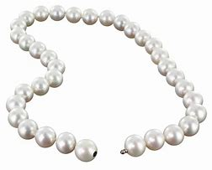
Abstract
A simple streaming language called DBSP
Four (4) operators
A definition of incremental computation in DBSP
An algorithm converting an arbitrary DBSP program to an incremental DBSP program
A recipe implementing DB queries in DBSP

Slide 4

DBSP can express
Relational (select, project, join, union, difference)
Computations on sets, multisets
Nested relations (group-by, unnest/flatmap)
Aggregation
Recursion (monotonic and non-monotonic) (graph queries)
Stratified negation
Streaming computations (joins, window aggregates)
And more… (Turing-complete)
Corollary: we get automatically incremental evaluation for all these
SQL
Datalog

Slide 5


Streams
Infinite vectors
…
$S_{A}$= streams with elements of type $A$
Assume that $A$ has $+$, $−,$and 0 (zero)
($A$ is a commutative group)
0
1
2
1
0
-1
-2
-1
time

Slide 6









Stream operators
Functions from streams to streams:$Q:S_{A}→ S_{B}$
Can have multiple inputs:
$$i_{0}$$
$$i_{1}$$
$$i_{2}$$
…
$$Q$$
$$o_{0}$$
$$o_{1}$$
$$o_{2}$$
…
…
$$T$$
…
…

Slide 7









Lifting
Convert a function $f:A→B$ into a stream operator $↑f:S_{A}→S_{B}$
$$a$$
$$b$$
$$c$$
…
$$↑f$$
$$f(a)$$
$$f(b)$$
$$f(c)$$
…

Slide 8






Chaining operators into circuits
“Dataflow graphs”
(function composition)
$$i1$$
$$A$$
$$B$$
$$C$$
o
$$i2$$
$$D$$

Slide 9










Delay ($z^{−1}$ )
Output is input stream delayed by one step
First value is 0
$$a$$
$$b$$
$$c$$
$$d$$
…
$$z^{−1}$$
$$0$$
$$a$$
$$b$$
$$c$$
…

Slide 10












Computing changes (deltas)
$$o\left[t\right]=s\left[t\right]–s\left[t−1\right]$$
$$D$$
o
o is the stream of changes of s
$$1$$
$$2$$
$$3$$
$$2$$
…
$$D$$
$$1$$
$$1$$
$$1$$
$$−1$$
…
stream of deltas

Slide 11
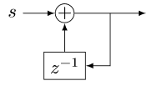










Integration
$o[0] =s[0]$
$o[t] =s[t] + o[t−1]$
$o\left[t\right]=s\left[0\right]+s\left[1\right]+ …+s[t]$
$$I$$
o
If s is a stream of changes…
… then o is the original stream
$$1$$
$$1$$
$$1$$
$$−1$$
…
$$I$$
$$1$$
$$2$$
3
$$2$$
…
stream of changes

Slide 12



$D$ and $I$ cancel out
$$⇔$$
$$⇔$$

Slide 13



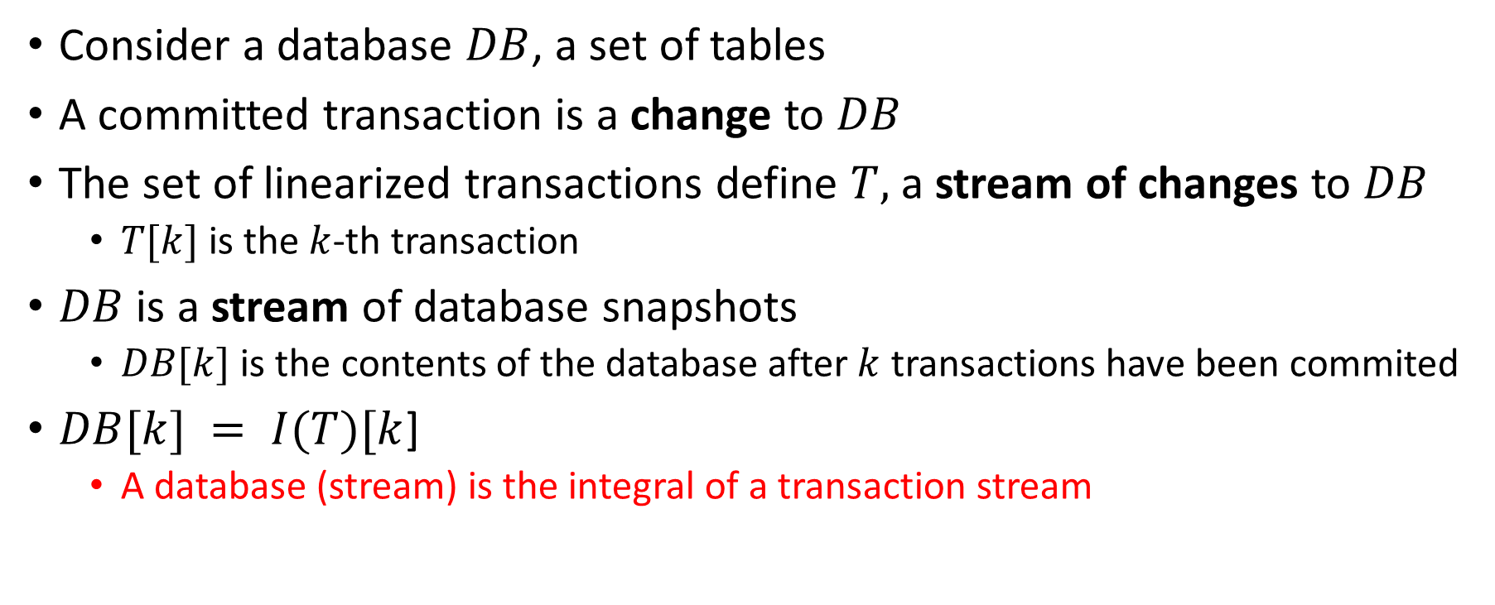






All databases are streaming databases!
Consider a database $DB$, a set of tables
A committed transaction is a change to $DB$
The set of linearized transactions define $T,$ a stream of changes to $DB$
$T[k]$is the $k$-th transaction
$DB$ is a stream of database snapshots
$DB[k]$ is the contents of the database after $k$ transactions have been commited
$DB[k] = I(T)[k$]
A database (stream) is the integral of a transaction stream
$$T_{0}$$
$$T_{1}$$
$$T_{2}$$
$$T_{3}$$
…
$$I$$
$${DB}_{0}$$
$${DB}_{1}$$
$${DB}_{2}$$
$${DB}_{3}$$
…

Slide 14












Views are lifted queries
Let $Q$ be a query defining a view $V$, e.g.:
CREATE VIEW V AS SELECT * FROM T WHERE Age >= 10
$V[k]=Q\left(DB[k]\right)$
$V$ is a stream of view snapshots:
$$V= ↑Q(DB)$$
$$↑Q$$
$$V_{0}$$
$$V_{1}$$
$$V_{2}$$
$$V_{3}$$
…
Versions of $V$
Versions of $DB$
$${DB}_{0}$$
$${DB}_{1}$$
$${DB}_{2}$$
$${DB}_{3}$$
…

Slide 15













Incrementally maintaining view $V$
This is our definition of IVM
Outputs can be small (they are deltas)
It is compositional: inputs and outputs are both changes
$${(↑Q)}^{Δ}$$
$$T_{0}$$
$$T_{1}$$
$$T_{2}$$
$$T_{3}$$
…
$$I$$
$$↑Q$$
D
$$ΔV_{0}$$
$$ΔV_{1}$$
$$ΔV_{2}$$
$$ΔV_{3}$$
…
Changes to $DB$
Changes to $V$
$$V_{0}$$
$$V_{1}$$
$$V_{2}$$
$$V_{3}$$
…
Versions of $V$
Versions of $DB$
$${DB}_{0}$$
$${DB}_{1}$$
$${DB}_{2}$$
$${DB}_{3}$$
…

Slide 16






The chain rule
$$(Q_{2}{∘Q_{1})}^{Δ}=Q_{2}^{Δ}∘Q_{1}^{Δ}$$
Proof by pictures:
We can incrementalize a complex query by incrementalizing each component independently
$$⇔$$
$$⇔$$
$$⇔$$

Slide 17
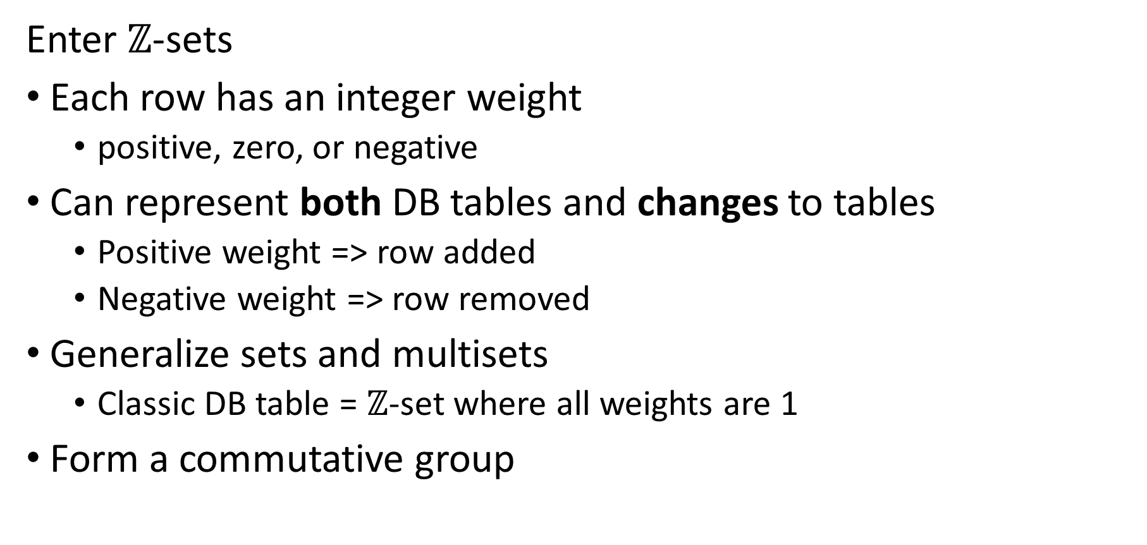
But databases are not commutative groups…
Enter $ℤ$-sets
Each row has an integer weight
positive, zero, or negative
Can represent both DB tables and changes to tables
Positive weight => row added
Negative weight => row removed
Generalize sets and multisets
Classic DB table = $ℤ$-set where all weights are 1
Form a commutative group
Name | Age | Weight
Mike | 10 | 1
John | 12 | 3
Amy | 8 | -1
Chris | 10 | 2
tuples

Slide 18
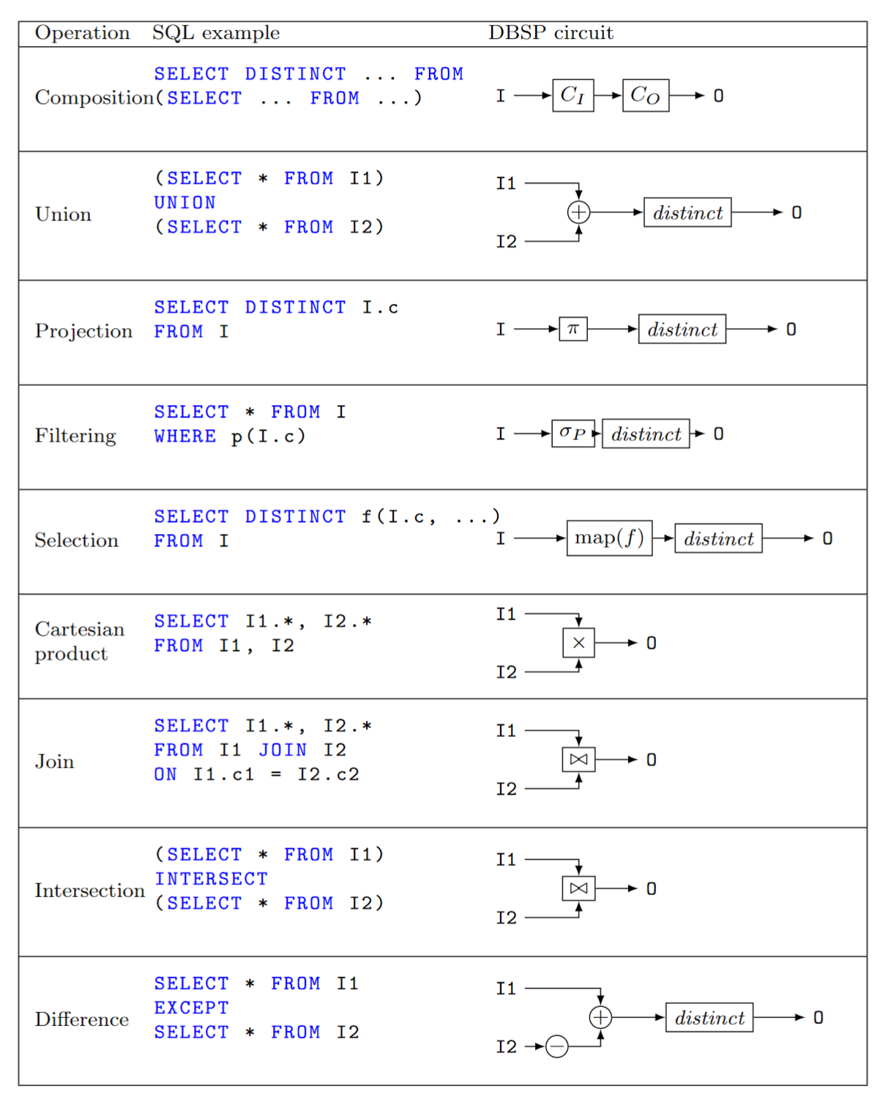

We can use $ℤ$-sets to
Implement all of SQL
Efficient incremental versions of each operator

Slide 19

Does it work?
Theory was verified using Lean theorem prover
Open-source implementations:
DBSP runtime in Rust (all DB operators and their incremental versions): https://crates.io/crates/dbsp
Full SQL compiler to DBSP (based on Apache Calcite): https://github.com/feldera/feldera/tree/main/sql-to-dbsp-compiler
We founded inc. to develop this software stack

Slide 20
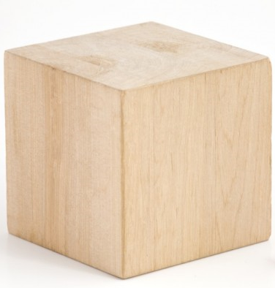
stream
DB
IVM
IVM

Slide 21
Extra slides

Slide 22





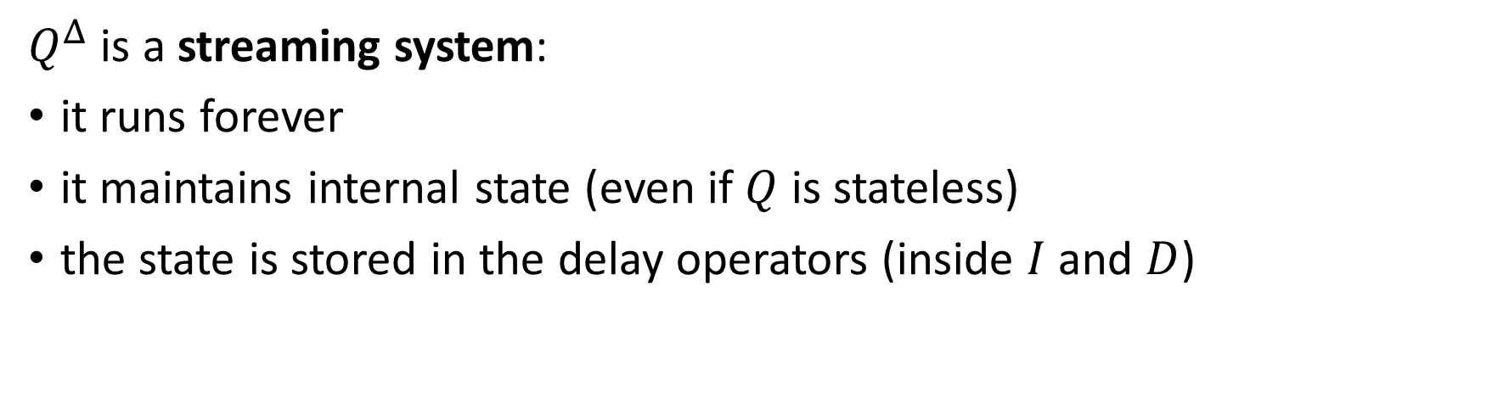




Incremental queries are streaming systems
$${Δi}_{0}$$
$${Δi}_{1}$$
$${Δi}_{2}$$
$${Δi}_{3}$$
…
$$Q^{Δ}$$
$$Δo_{0}$$
$$Δo_{1}$$
$$Δo_{2}$$
$$Δo_{3}$$
…
state
$Q^{Δ}$ is a streaming system:
it runs forever
it maintains internal state (even if $Q$ is stateless)
the state is stored in the delay operators (inside $I$ and $D$)

Slide 23




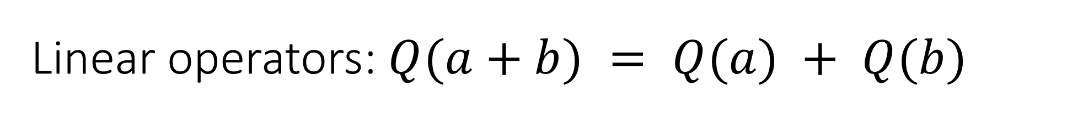




















Linear operators: $Q(a+b) = Q(a) + Q(b)$
For a linear operator $Q$ we have $Q=Q^{Δ}$
Why is this better?
Optimized:
A speedup of $O(\left|DB\right|/|T|)$
$$T_{0}$$
$$T_{1}$$
$$T_{2}$$
$$T_{3}$$
…
$$I$$
$$Q$$
D
$$ΔV_{0}$$
$$ΔV_{1}$$
$$ΔV_{2}$$
$$ΔV_{3}$$
…
$${DB}_{0}$$
$${DB}_{1}$$
$${DB}_{2}$$
$${DB}_{3}$$
…
$$T_{0}$$
$$T_{1}$$
$$T_{2}$$
$$T_{3}$$
…
$$Q$$
$$ΔV_{0}$$
$$ΔV_{1}$$
$$ΔV_{2}$$
$$ΔV_{3}$$
…

Slide 24
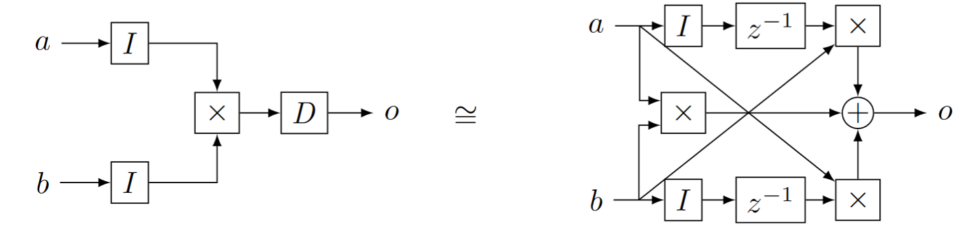


Bilinear operators
(Lifted) join
From distributivity:$Δ\left(A×B\right)=\left(A×ΔB\right)+\left(ΔA×B\right)+\left(ΔA×ΔB\right)$
Speed-up is $O(\frac{\left|A\right|}{\left|ΔA\right|}+\frac{\left|B\right|}{\left|ΔB\right|})$
$$⇔$$

