Slide 1

Scaling a Declarative Cluster Manager Architecture with Query Optimization Techniques
Kexin Rong – Georgia Tech*
Athinagoras Skiadopoulos – Stanford*
Mihai Budiu, Lalith Suresh – feldera.com*
Amy Tai – Google*
*Work done while at VMware Research

Slide 2



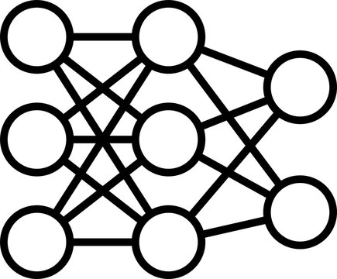




Cluster manager
Control-plane managing the execution of distributed computations
Training
Inference
Workloads
Containerize
Cluster Managers
Infrastructure
Hard to build ☹
Large ☹
Notes:
Cluster managers play a crucial role in data centers by distributing workloads among infrastructure resources. You can containerize your compute job or application, hand it off to a cluster manager, who does the hard job of assigning taking these workloads to physical or virtual resources, and making sure that the underlying infrastructure is configured according to various user specified policies.
This is obviously very difficult if we want to orchestrate highly heterogenous applications.

Slide 3


Example: Kubernetes (k8s)
Place us on the same rack!
Do NOT place us on the same rack!
Pods (jobs)
POD
2GB RAM
16GB disk
1 core
Distribute us evenly!
Kubernetes Scheduler
30 types of hard and soft constraints
Nodes (computers)
Notes:
Pods comes with various requirements: cpu and memory requirements, affinity, anti-affinity, soft requirements such as load balancing
In total, the scheduler supports around 30 different hard and soft constraints that you can configure.
The scheduler ingest all these information about the cluster, and find high quality assignments from pods to nodes such that these constraints are satisfied. What the scheduler is dealing with is an example of an multi-dimensional bin-packing problem with constriants, which is known to be an NP-hard problem.

Slide 4
The k8s cluster manager
Ad-hoc data structures to represent cluster state
Custom best-effort heuristics for decisions
Problems
Scalability: slow when constraints are complex
Decision quality: suboptimal solutions
Extensibility: very hard to add new constraints
We show how to solve these problems in an elegant way
Notes:
So how are systems like the k8s scheduler implemented?
Today, k8s scheduler solves the problem with a collection of purposely build best-effort heuristics.
This is problematic on multiple aspect.

Slide 5
Cluster manager control loop
New jobs
Fixed schema
desired
state
controller
sensing
current
state
actuation
next
state
State DB
(relational)

Slide 6


Controller implementation
C-SQL program
compiler
schema
desired
state
constraints
off-the-shelf
current
state
constraint
solver
encoder
next
state
solution
State DB
controller

Slide 7
This paper
C-SQL program
Syntax and semantics of C-SQL
DCM compiler
schema
desired
state
constraints
current
state
constraint
solver
encoder
next
state
solution
Query-optimization techniques
State DB

Slide 8

Symbolic variables in tables
foreign key
pod
node
node
Mem_overload
?var0
False
…
…
?var1
True
?var2
False
PODS table (desired state)
NODES table (current state)
Symbolic variables. Will be assigned a value by the constraint solver.
Notes:
We will explain C-SQL through some examples.
The first step is to represent the cluster state in a database. In our k8s example, you have a table for pods and a table for nodes. Pods have to be assigned to node, so you have a node column in the pods table that has a foreign key relationship with the other table.
So far, this is standard SQL. Because we want DCM to figure out which node that each pod gets assigned to, we can tag the node column as a variable column. This is essentially a new data type that we introduce in the language – each row in the variable column corresponds to a variable in a constraint solver. Because of the foreign key relationship, DCM knows that these columns can only take one of these three values.

Slide 9
Hard Constraints in C-SQL
pod
node
node
mem_overload
?var0
False
?var1
True
?var2
False
PODS table
NODES table
CREATE CONSTRAINT avoid_mem_overload AS
CHECK PODS.node IN
(SELECT node FROM NODES WHERE NODES.mem_overload = false)
FROM PODS
This part is standard SQL
Notes:
Now we have the states represented in relational tables, we can go on to specifying constraints to restrict the assignments via C-SQL.
For example, to avoid assigning pods to nodes with a memory overload, we can write a hard constraint that looks like the following.
There are two parts to this constraint queries. Let’s first look at the FROM part. This is standard SQL. The goal here is to select some rows. This is a simple example with just a table, but you can predicates and joins. Now let’s move to the constraint part, which is the CHECK clause. The constraint part specifies some conditions that should hold true for every row in the relation.

Slide 10
Queries with symbolic variables
pod
node
mem
node
available_mem
?var0
2
6
?var1
3
10
?var2
1
0
PODS table
NODES table
CREATE VIEW spare_mem_capacity AS
SELECT NODES.name, NODES.available_mem –
SUM(PODS.mem * (PODS.node = NODES.node)) AS mem_spare
FROM NODES, PODS
GROUP BY NODES.name
node
spare_mem_capacity
6 – (2*(?var0 == ) +…)
10 – (…)
0 – (…)
Results are symbolic formulas

Slide 11
Soft constraints in C-SQL
CREATE CONSTRAINT load_balance AS
MAXIMIZE MIN(mem_spare)
FROM spare_mem_capacity
node
spare_mem_capacity
6 – (2 * (?var0 == ) +…)
10 – (…)
0 – (…)
Notes:
Similarly, we can also write soft constraints which maximizes numeric expressions. Here is an example of a load balance constraint, we want to maximize the minimum spare capacity. this column is also a variable

Slide 12
C-SQL: SQL specifying constraints
C-SQL program
Standard SQL statements +
CHECK Boolean constraint statements +
MAXIMIZE numeric constraint statements
A constraint is a formula involving symbolic variables
Result of a C-SQL program when applied to a database:
One hard constraint for each CHECK
One function to maximize = sum of all MAXIMIZE constraints
Notes:
Here is a summary of C-SQL’s core syntax, it’s a variant of SQL for specifying constraint optimization problem.
Finally, a <problem> is a sequence of CREATE CONSTRAINT statements. It combines all Boolean constraints using conjunction, and combines all
optimization functions using addition.
From the definition, we can see that C-SQL programs are evaluated in two phases, relation evaluation on the database side and constraint evaluation on the constraint solver side. In fact, when we think about scalability, constraint and relation evaluations are the two main bottlenecks.

Slide 13
Where is most time spent?
Incremental View Maintenance
Feasibilty-preserving
pushdown
New jobs
Fixed schema
desired
state
constraints
sensing
current
state
constraint
solver
encoder
actuation
next
state
solution
State DB
(relational)

Slide 14
Using incremental view maintenance
C-SQL program
compiler
desired
state
sensing
current
state
Standard
Views
(no variables)
Symbolic
Views
(formulas)
constraints
IVM engine
encoder

Slide 15
IVM Performance
Less data read from DB on each request
Workload: 2019 Azure public trace
Result: p95 latency reduces from >5 seconds to 1.7ms
p95 latency
Notes:
This cluster state database bottleneck is apparent in \autoref{fig:ivmdb}, which reports the empirical cumulative distribution function (ECDF) of database latency, which includes the total time to fetch and update records from the database. Concretely, the 95th percentile (p95) database latency at $10\times$ trace speed up decreases from over 5 seconds without IVM to 1.7ms with IVM (read from intersections between latency curves and a horizontal line at $y=0.95$), which is a near $3000\times$ speed up.

Slide 16
Feasibility-preserving pushdowns
Standard
Views
(no variables)
Symbolic
Views
(formulas)
Standard
Views
(no variables)
Symbolic
Views
(formulas)
rewrite
encoder
encoder
CREATE CONSTRAINT pod_affinity AS
CHECK(NOT pods.has_pod_affinity) OR
(pods.node NOT IN (…))
FROM pods
CREATE CONSTRAINT pod_affinity AS
CHECK (pods.node NOT IN (…))
FROM pods
WHERE pods.has_pod_affinity
rewrite
Net effect: Reduces the optimization problem size
Notes:
Now relation evaluation is fast, the bottleneck moves to constraint solvers, which are known to struggle at large optimization problems.
Inspired by the predicate pushdown technique,

Slide 17
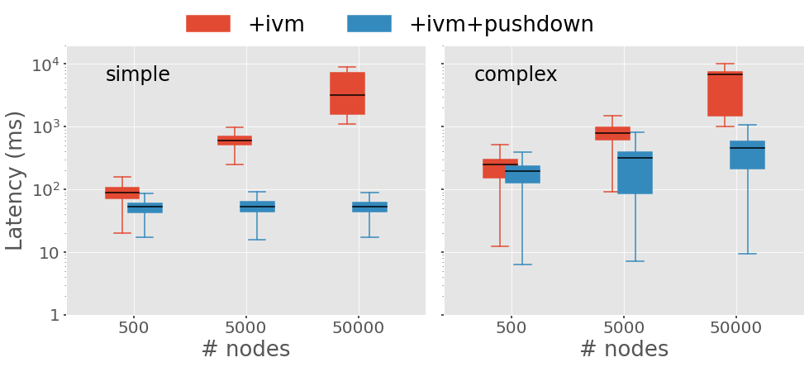
Effect of Constraint Pushdown
Result: sub-second scheduling latency for 50K node cluster size
1 sec
lower is better

Slide 18
Conclusions
Modern control systems keep state in a database
Control decisions are made by:
Optimizing some objective function(s) (e.g., avoid memory fragmentation)
Subject to feasibility constraints (e.g., each job is assigned some machine)
C-SQL can express
Feasibility constraints
Objective function(s)
C-SQL = SQL + symbolic variables
Cluster manager problems we solve:
Scalability: IVM + pushdown
Decision quality: use a generic constraint solver
Extensibility: more constraints => more C-SQL queries
These techniques are very general (not tied to cluster managers)

