Slide 1
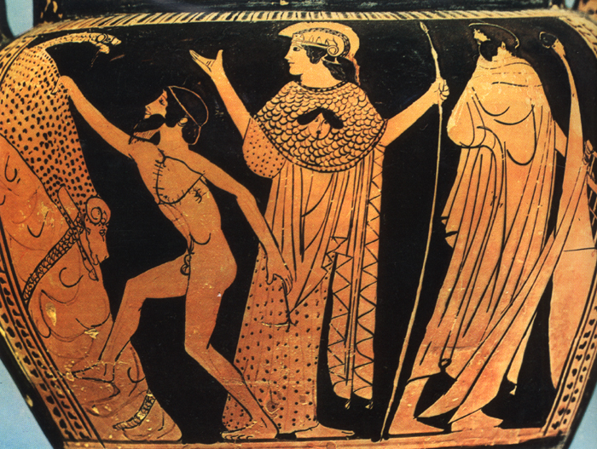
JPath: Structural Queries for JSON
November 15, 2012
Social Search Meetup
Mihai Budiu
Gordon Plotkin*
Yuan Yu
Li Zhang
MSR SVC and *University of Edinburgh

Slide 2

Why should you care?
JSON is ubiquitous on client- and server-side
JPath
is a simple and clean query language
supports efficient indexing and storage
has interesting mathematical properties
could be adapted for graph-shaped data

Slide 3
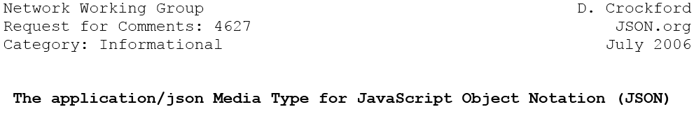
JSON
JavaScript Object Notation
IETF RFC 4627
Text data serialization format
Language-independent

Slide 4
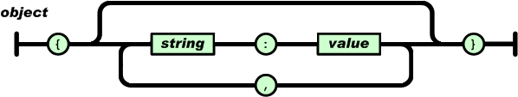
JSON Grammar
Value = primitive, array, object
Array = [ value, value, … ]
Object = { label:value, label:value, … }

Slide 5
Example
{
“location”:
[
{ “country”: “Germany”, “city”: “Berlin” },
{ “country”: “France”, “city”: “Paris” }
],
“headquarters”: “Belgium”,
“exports”:
[
{ “city”: “Moscow” },
{ “city”: “Athens” }
]
}

Slide 6

JSON Properties
Schema-less: flexible
Structured: expressive
Simple: lightweight

Slide 7
JSON Uses
JavaScript serialization / Browser AJAX var obj = eval(“(” + jsonString + “)”); var obj = jsonString.parseJSON();
Web services
Data exchange format
Big data storage
Semi-structured data storage (denormalized tables)
NoSQL databases data format

Slide 8
JSON Documents as Labeled Trees
{
“location”:
[
{ “country”: “Germany”, “city”: “Berlin” },
{ “country”: “France”, “city”: “Paris” }
],
“headquarters”: “Belgium”,
“exports”:
[
{ “city”: “Moscow” },
{ “city”: “Athens” }
]
}
root
label
location
headquarters
exports
array index
0
1
Belgium
0
1
country
city
country
city
city
city
Germany
Berlin
France
Paris
Moscow
Athens

Slide 9
Trees and Documents
Every JSON document is a tree, but
not every tree is a legal JSON document!
“location”:
[
{ “city” },
{ “city”: “Paris” }
]
location
headquarters
exports
0
1
Belgium
0
1
country
city
country
city
city
city
Germany
Berlin
France
Paris
Moscow
Athens

Slide 10
Why should you care?
JSON is ubiquitous on client- and server-side
JPath
is a simple and clean query language
supports efficient indexing and storage
has interesting mathematical properties
could be adapted for graph-shaped data

Slide 11
Query Results
+
=
query
JSON
Tree
Set of nodes

Slide 12
Jpath Syntax
query= | ε | Empty query
 | nm | Node matcher
 | / | Child
 | ? | Any
 | query & query | Set intersection
 | query | query | Set union
 | query query | Sequence
 | query* | Kleene star
 | ^query | Snap (back) operator
Recursive definition

Slide 13
Node Matchers (nm)
Arbitrary Boolean functions of node labels
Possible examples:
Expression | Matches
l => l == “price” | exactly the “price” label
“price” | exactly the “price” label
l => length(l) == 5 | all labels with length 5
l => index(l,”price”) >= 0 | all labels that contain the “price” sub-string
l => int(l)%2 == 0 | all even numeric labels
l => regexMatch(l, “[A-Za-z0-9]+”) | all alphanumeric labels
… | …

Slide 14
Query Operation
+
=
query
Start node
Result nodes

Slide 15
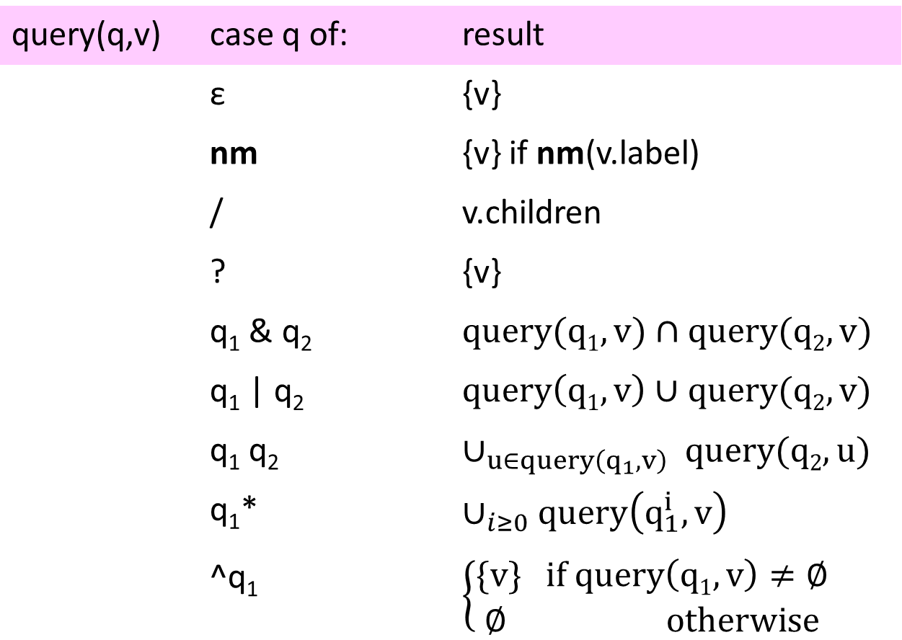
JPath Semantics
query(q,v) | case q of: | result
 | ε | {v}
 | nm | {v} if nm(v.label)
 | / | v.children
 | ? | {v}
 | q₁ & q₂ | $$query(q1,v)∩query(q2, v)$$
 | q₁ | q₂ | $$query\left(q1,v\right)∪query(q2, v)$$
 | q₁ q₂ | $$∪_{u∈query\left(q_{1},v\right) }query(q2,u)$$
 | q₁* | $$∪_{i≥0}query\left(q_{1}^{i},v\right)$$
 | ^q₁ | $$\left\{\begin{matrix}\{v\} if query\left(q1,v\right)≠∅ \\ ∅ otherwise\end{matrix}\right.$$
Complete

Slide 16
Query Examples: 1
/headquarters/Belgium
location
headquarters
exports
0
1
Belgium
0
1
country
city
country
city
city
city
Germany
Berlin
France
Paris
Moscow
Athens

Slide 17
Query Examples: 2
/?
location
headquarters
exports
0
1
Belgium
0
1
country
city
country
city
city
city
Germany
Berlin
France
Paris
Moscow
Athens

Slide 18
Query Examples: 3
(/*)/city
location
headquarters
exports
0
1
Belgium
0
1
country
city
country
city
city
city
Germany
Berlin
France
Paris
Moscow
Athens

Slide 19
Query Examples: 4
(/*)/city/?
location
headquarters
exports
0
1
Belgium
0
1
country
city
country
city
city
city
Germany
Berlin
France
Paris
Moscow
Athens

Slide 20
Query Examples: 5
/location(/*)/city/?
location
headquarters
exports
0
1
Belgium
0
1
country
city
country
city
city
city
Germany
Berlin
France
Paris
Moscow
Athens

Slide 21
Query Examples: 6
/location/?(/country/Germany | /country/France)
location
headquarters
exports
0
1
Belgium
0
1
country
city
country
city
city
city
Germany
Berlin
France
Paris
Moscow
Athens

Slide 22
Query Examples: 7
(^/headquarters/Belgium)
location
headquarters
exports
0
1
Belgium
0
1
country
city
country
city
city
city
Germany
Berlin
France
Paris
Moscow
Athens

Slide 23
Query Examples: 8
(^/headquarters/Belgium)/location/0/city/?
location
headquarters
exports
0
1
Belgium
0
1
country
city
country
city
city
city
Germany
Berlin
France
Paris
Moscow
Athens

Slide 24
Query Examples: 9
(/*)(^/country/Germany)/city/?
location
headquarters
exports
0
1
Belgium
0
1
country
city
country
city
city
city
Germany
Berlin
France
Paris
Moscow
Athens

Slide 25
Query Examples: 10
(/*)(^/country/?)/city/?
location
headquarters
exports
0
1
Belgium
0
1
country
city
country
city
city
city
Germany
Berlin
France
Paris
Moscow
Athens

Slide 26
The Cut Operator
UserQuery = q₁ ! q₂
q₁ matches
q₁/q₂ matches
Result of q₁!q₂
Result of cut is a set of trees (no longer a set of nodes)!

Slide 27
Query Examples: 11
(^/headquarters/Belgium)/location ! ?/city
Final result is:
[
{ “city”: “Berlin” },
{ “city” : “Paris” }
]
location
headquarters
exports
0
1
Belgium
0
1
country
city
country
city
city
city
Germany
Berlin
France
Paris
Moscow
Athens

Slide 28
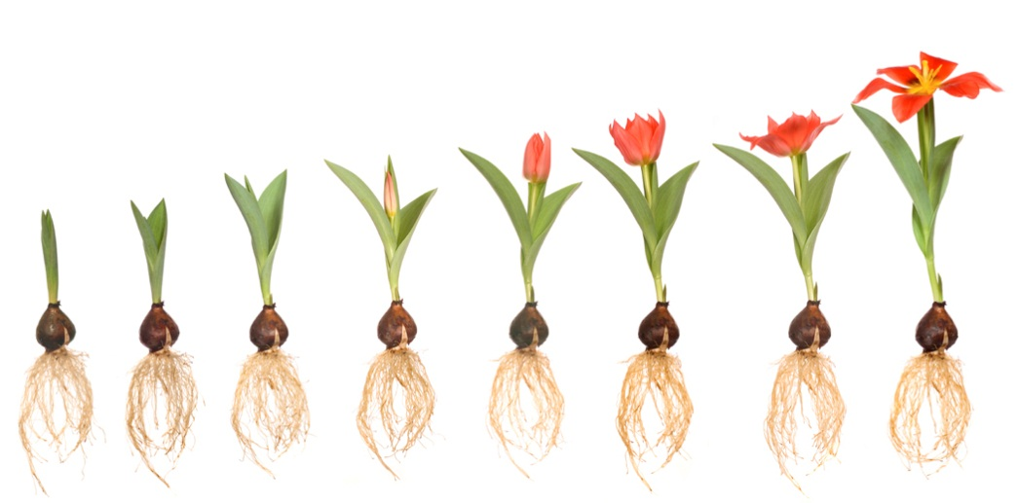
Only Monotone Operators
Query: No child has label “x”

Slide 29
Why should you care?
JSON is ubiquitous on client- and server-side
JPath
is a simple and clean query language
supports efficient indexing and storage
has interesting mathematical properties
could be adapted for graph-shaped data

Slide 30
Indexing Idea
Common structure
+
=
Still a tree!

Slide 31
Example
+
location
headquarters
exports
location
headquarters
exports
0
Italy
0
1
0
1
Belgium
0
1
country
city
city
dealers
city
country
city
country
city
city
city
Germany
Bonn
Berlin
0
Amsterdam
=
Berlin
Paris
Moscow
Athens
name
Germany
France
Hans
{1,2}
headquarters
exports
inverted index
{1,2}
location
Belgium
Italy
0
1
0
{1,2}
1
city
dealers
city
country
city
{1,2}
Moscow
Berlin
0
Athens
Amsterdam
country
city
name
Germany
Bonn
{1,2}
Berlin
France
Paris
Hans
{2}
{1}

Slide 32
Approximating Labels
headquarters
exports
location
Belgium
Italy
0
1
0
1
city
dealers
city
country
city
Moscow
Berlin
0
Athens
Amsterdam
country
city
name
Germany
Bonn
Berlin
France
Paris
Hans
headquarters
exports
Indexing policy controls collapsing
location
Belgium
Italy
0
1
*
city
dealers
city
country
city
Moscow
Berlin
0
Athens
Amsterdam
country
city
name
Germany
Bonn
Berlin
France
Paris
Hans

Slide 33
Cascaded Collapsing
headquarters
exports
location
Belgium
Italy
0
1
*
city
dealers
city
country
city
Moscow
Berlin
0
Athens
Amsterdam
country
city
name
Germany
Bonn
Berlin
France
Paris
Hans
headquarters
exports
location
Belgium
Italy
0
1
*
city
dealers
city
city
country
Moscow
Berlin
0
Athens
Amsterdam
name
Germany
France
Bonn
Berlin
Paris
Hans

Slide 34
Index Tree vs JSON Tree
location
headquarters
exports
0
Italy
0
1
country
city
city
dealers
city
Germany
Bonn
Berlin
0
Amsterdam
name
headquarters
exports
Hans
location
Belgium
Italy
Multiple labels/node
0
1
*
Inverted index
city
city
dealers
{1,2}
city
country
Moscow
Berlin
0
Athens
Amsterdam
name
Germany
France
Bonn
Berlin
Paris
Hans

Slide 35
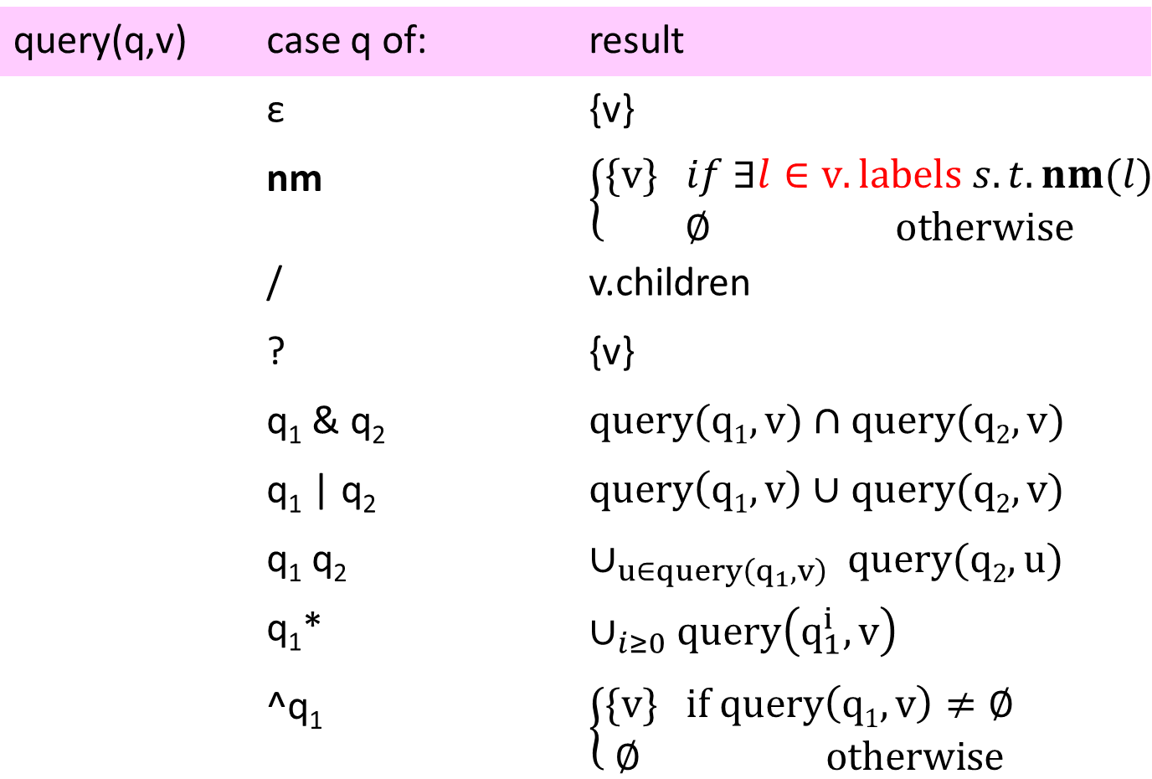
JPath Semantics on Index Trees
query(q,v) | case q of: | result
 | ε | {v}
 | nm | $$\left\{\begin{matrix}\{v\} if ∃l∈v.labels s.t. nm(l) \\ ∅ otherwise\end{matrix}\right.$$
 | / | v.children
 | ? | {v}
 | q₁ & q₂ | $$query(q1,v)∩query(q2, v)$$
 | q₁ | q₂ | $$query\left(q1,v\right)∪query(q2, v)$$
 | q₁ q₂ | $$∪_{u∈query\left(q_{1},v\right) }query(q2,u)$$
 | q₁* | $$∪_{i≥0}query\left(q_{1}^{i},v\right)$$
 | ^q₁ | $$\left\{\begin{matrix}\{v\} if query\left(q1,v\right)≠∅ \\ ∅ otherwise\end{matrix}\right.$$
The only change!

Slide 36
Using Indexes
+
+
=
index tree
+
{1,2}
query
{1}
Set of nodes
+
=
+
=
query
query
Tree 1
Tree 2

Slide 37
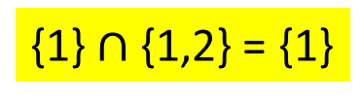
(1) Run Query on Index
(^/headquarters/Italy)/location/city/?
{1} $∩$ {1,2} = {1}
headquarters
exports
location
Belgium
Italy
0
1
*
city
dealers
city
city
country
Moscow
Berlin
0
Athens
Amsterdam
name
Germany
France
Bonn
Berlin
Paris
Hans

Slide 38
(2) Run query on Trees
(^/headquarters/Italy)/location/city/?
location
headquarters
exports
0
Italy
0
1
country
city
city
dealers
city
Germany
Bonn
Berlin
0
Amsterdam
name
headquarters
exports
Hans
location
Belgium
Italy
0
1
*
city
dealers
city
city
country
Moscow
Berlin
0
Athens
Amsterdam
name
Germany
France
Bonn
Berlin
Paris
Hans

Slide 39
Why should you care?
JSON is ubiquitous on client- and server-side
JPath
is a simple and clean query language
supports efficient indexing and storage
has interesting mathematical properties
could be adapted for graph-shaped data

Slide 40
Big JSON Data
partitioned into many chunks (aka Cosmos)
indexing/column partitioning/querying is independent for each chunk

Slide 41
Partitioning and Indexing
index tree
Distributed
stream
partitions
Preprocessing
Cross-stream references
Indexed
stream

Slide 42
Column Storage
root
/A/B/C
/C/B/C/D
/C/B/X
Cross-column references

Slide 43
Why should you care?
JSON is ubiquitous on client- and server-side
JPath
is a simple and clean query language
supports efficient indexing and storage
has interesting mathematical properties
could be adapted for graph-shaped data

Slide 44
Experiments on Bing Merged Logs
{AppNS:"FD",ClientId:"4115F05B009F4A9DB646281FD7D10BD6",ImpressionGuid:"2CC5604F3B0848609CAE4994DC640B6A",ProvClientId:true,Events:[{T:"Ev
ent.Impression",EventId:"B20A547029FB4190BB49FEF3ECFD7F86",Page:{Name:"Page.Serp",L:[{AppNS:"SERP",T:"L.Box",Region:"CoreTop",L:[{"T":"L.B
ox","K":150,"L":[{"T":"L.Url","K":"151.1"}]}]},{AppNS:"SERP",T:"L.Box",Region:"Core",L:[{"T":"L.Box","K":5000,"L":[{"T":"L.Box","Region":"
Results","L":[{"T":"L.Box","L":[{"T":"L.Box","Region":"Entity","Results":true,"L":[{"T":"L.Url","K":"5039.1"},{"T":"L.Item","K":5044,"L":[
]},{"T":"L.Url","K":"5041.1"}]},{"T":"L.Box","Region":"Entity","Results":true,"L":[{"T":"L.Url","K":"5052.1"},{"T":"L.Item","K":5057,"L":[
]},{"T":"L.Url","K":"5054.1"}]},{"T":"L.Box","Region":"Entity","Results":true,"L":[{"T":"L.Url","K":"5081.1"},{"T":"L.Box","Region":"CapMe
ta","L":[{"T":"L.Url","K":"5075.1"},{"T":"L.Url","K":"5076.1"},{"T":"L.Url","K":"5077.1"},{"T":"L.Url","K":"5078.1"}]},{"T":"L.Item","K":5
080,"L":[]},{"T":"L.Url","K":"5083.1"}]},{"T":"L.Box","Region":"Entity","Results":true,"L":[{"T":"L.Url","K":"5093.1"},{"T":"L.Item","K":5
097,"L":[]}]},{"T":"L.Box","Region":"Entity","Results":true,"L":[{"T":"L.Url","K":"5104.1"},{"T":"L.Item","K":5108,"L":[]}]},{"T":"L.Box",
"Region":"Entity","Results":true,"L":[{"T":"L.Url","K":"5116.1"},{"T":"L.Item","K":5121,"L":[]},{"T":"L.Url","K":"5118.1"}]},{"T":"L.Box",
"Region":"Entity","Results":true,"L":[{"T":"L.Url","K":"5128.1"},{"T":"L.Item","K":5132,"L":[]}]},{"T":"L.Box","Region":"Entity","Results"
:true,"L":[{"T":"L.Url","K":"5156.1"},{"T":"L.Box","Region":"CapMeta","L":[{"T":"L.Url","K":"5150.1"},{"T":"L.Url","K":"5151.1"},{"T":"L.U
rl","K":"5152.1"},{"T":"L.Url","K":"5153.1"}]},{"T":"L.Item","K":5155,"L":[]},{"T":"L.Url","K":"5158.1"}]},{"T":"L.Box","Region":"Entity",
"Results":true,"L":[{"T":"L.Url","K":"5169.1"},{"T":"L.Item","K":5174,"L":[]},{"T":"L.Url","K":"5171.1"}]},{"T":"L.Box","Region":"Entity",
"Results":true,"L":[{"T":"L.Url","K":"5181.1"},{"T":"L.Item","K":5185,"L":[]}]}]}]}]}]},{AppNS:"SERP",T:"L.Box",Region:"CoreBottom",L:[{"T
":"L.Box","Region":"Pagination","L":[{"T":"L.Url","K":"5194.1"},{"T":"L.Url","K":"5195.1"},{"T":"L.Url","K":"5196.1"},{"T":"L.Url","K":"51
97.1"},{"T":"L.Url","K":"5198.1"}]},{"T":"L.Form","K":"5191.1","L":[]}]},{AppNS:"FD",T:"L.Box",K:5,Region:"Header",L:[{T:"L.Box",K:16,Regi
on:"ScopeBar",L:[{T:"L.Url",K:"19.1"},{T:"L.Url",K:"21.1"},{T:"L.Url",K:"23.1"},{T:"L.Url",K:"25.1"},{T:"L.Url",K:"27.1"},{T:"L.Url",K:"29
.1"}]},{"T":"L.Box","Region":"NetworkLinks","L":[{"T":"L.Box","K":33,"L":[{"T":"L.Url","K":"32.1"}]},{"T":"L.Box","K":35,"L":[{"T":"L.Url"
,"K":"34.1"}]}]},{T:"L.Url",K:"12.1"},{"T":"L.Box","Region":"UserOptions","L":[{"T":"L.Url","K":"41.1"},{"T":"L.Url","K":"36.1"}]},{T:"L.F
orm",K:"6.1",L:[{T:"L.Url",K:"31.1"},{T:"L.Url",K:"9.1"}]}]},{AppNS:"FD",T:"L.Box",Region:"NavBar",L:[{"T":"L.Url","K":"2.1"}]},{AppNS:"FD
",T:"L.Box",Region:"LeftRail",L:[{"T":"L.Box","Region":"Explore","L":[{"T":"L.Box","Region":"Related","L":[{"T":"L.Box","Region":"Group","
L":[{"T":"L.Box","Region":"Entity","L":[{"AppNS":"SERP","T":"L.Url","K":"123.1"}]},{"T":"L.Box","Region":"Entity","L":[{"AppNS":"SERP","T"
:"L.Url","K":"125.1"}]},{"T":"L.Box","Region":"Entity","L":[{"AppNS":"SERP","T":"L.Url","K":"127.1"}]},{"T":"L.Box","Region":"Entity","L":
[{"AppNS":"SERP","T":"L.Url","K":"129.1"}]},{"T":"L.Box","Region":"Entity","L":[{"AppNS":"SERP","T":"L.Url","K":"131.1"}]},{"T":"L.Box","R
egion":"Entity","L":[{"AppNS":"SERP","T":"L.Url","K":"133.1"}]},{"T":"L.Box","Region":"Entity","L":[{"AppNS":"SERP","T":"L.Url","K":"135.1
"}]},{"T":"L.Box","Region":"Entity","L":[{"AppNS":"SERP","T":"L.Url","K":"137.1"}]}]}]}]}]},{AppNS:"FD",T:"L.Box",Region:"CoreTop",L:[{"T"
:"L.Box","K":43,"Region":"Promotional","L":[{"T":"L.Box","Region":"Entity","L":[{"T":"L.Url","K":"45.1"}]},{"T":"L.Box","Region":"Entity",
"L":[{"T":"L.Url","K":"47.1"}]},{"T":"L.Box","Region":"Entity","L":[{"T":"L.Url","K":"49.1"}]}]}]},{AppNS:"FD",T:"L.Box",Region:"CoreBotto
m",L:[{"T":"L.Box","K":50,"Region":"Promotional","L":[{"T":"L.Box","Region":"Entity","L":[{"T":"L.Url","K":"52.1"}]},{"T":"L.Box","Region"
:"Entity","L":[{"T":"L.Url","K":"54.1"}]}]}]},{AppNS:"FD",T:"L.Box",K:79,Region:"Footer",L:[{T:"L.Url",K:"95.1"},{T:"L.Url",K:"81.1"},{T:"
L.Url",K:"83.1"},{T:"L.Url",K:"85.1"},{T:"L.Url",K:"87.1"},{T:"L.Url",K:"89.1"},{T:"L.Url",K:"91.1"},{T:"L.Url",K:"93.1"}]}],Number:1},Req
uestInfo:{AFORM:"MSNH2",BotDogMatch:"MatchAll:MatchAll",Bytes:1275,DOB:"20100630",Entry:"Kiev.BingMain",FDPartnerEntry:"web",FDPartnerName
:"SERP",Form:"IE8SRC",IsQuery:true,Market:"de-DE",MuidSyncInitiated:true,NoRedirection:"0",PartnerCode:null,RawQuery:"mobile",Referer:null
,Url:"http://www.bing.com:80/search?q=mobile&src=IE-SearchBox&FORM=IE8SRC",UserAgent:"Mozilla/4.0 (compatible; MSIE 8.0; Windows NT 5.1; T
rident/4.0; .NET CLR 2.0.50727; .NET CLR 3.0.04506.30; .NET CLR 3.0.4506.2152; .NET CLR 3.5.30729)",Vertical:"web",Classification:{"Auth":
"NoAuth","Load":"LatencyFactor1","ReqIPType":"Other"},Cookies:{MUID:"4115F05B009F4A9DB646281FD7D10BD6",SRCHD:{"AF":"MSNH2","D":"1312765","
MS":"1322953"},SRCHUID:{GUID:"AE919F3C7688454C8E502CE5944EE649",V:"2"},SRCHUSR:{"AUTOREDIR":"0","DOB":"20100630","GEOVAR":""}},Headers:{}}
,ResponseInfo:{BlockedStatus:"None",Bytes:11981,ClickTracked:true,ClickTrackingType:"GPing Only",FDLogging:false,Format:"HTML",QueryAdultS
core:0,QueryIsAdult:0,RequestCost:1,ResultsAdultScore:2.68941e+014,SafeDisp:false,Status:200,Cookies:{"MUID":"4115F05B009F4A9DB646281FD7D1
0BD6","OrigMUID":"4115F05B009F4A9DB646281FD7D10BD6%2c2cc5604f3b0848609cae4994dc640b6a","SRCHD":{"AF":"MSNH2","D":"1312765","MS":"1358750"}
}},ServerContext:{Domain:"www.bing.com",Market:"de-DE",MarketReason:"Mix RevIP",UILang:"de-DE",UILangReason:"PreferredBAL",XForwardedFor:"
95.90.80.136, 92.123.72.118, 168.143.241.166",Experiments:{ClientIdPresent:true,FlightId:"0",Assigned:[{"Factor":"flt","Hash":975,"Level":
"0"},{"Factor":"flt2","Hash":63,"Level":"as2"},{"Factor":"flt3","Hash":408,"Level":"0"},{"Factor":"flt4","Hash":328,"Level":"0"},{"Factor"
:"ramp1","Hash":460,"Level":"0"},{"Factor":"domainvertical","Hash":412,"Level":"0"},{"Factor":"cashback","Hash":429,"Level":"0"},{"Factor"
:"release","Hash":711,"Level":"or3"}]}},UserInfo:{AcceptLanguage:"de",ClientIP:"95.90.80.136",IsMuidDobNew:false,Locale:"de-DE",LoggedInSt
ate:"Anonymous",MsIp:false,MuidDob:"2010-06-30T08:25:00.000-07:00",SafeSearch:"moderate",Loc:{"ReverseIP":{"City":"Berlin","CityCf":5,"Con
tinent":"Europe","Country":"Germany","CountryCf":8,"CountryIso":"de","Lat":52.517,"Loc":"Berlin, Berlin","Long":13.4,"PostalCode":"13178",
"Region":"Unknown","State":"Berlin","Timezone":1}}},DS:[{AppNS:"FD",T:"D.Top",K:5,Scenario:"header",Service:"config",DS:[{T:"D.Url",K:2,N:
Complex denormalized relation
Cosmos Production queries (extraction)
Multiple record types (many schemas)
Average JSON object: 40KB, 4K nodes

Slide 45
Indexing cost for 1.6GB
Total: 40K JSON objects, 16M tree nodes
Index space overhead: < 8%
Indexing time: ~.5s/MB
Index size: 5300 – 17500 nodes (function of indexing policy and data)

Slide 46
Query Cost Breakdown
Diff. indexing policies
Total time (seconds)
Query type
Simple, non-selective
Complex, selective
simple, very selective
Complex, very selective

Slide 47
Cluster Experiments
Application
large-scale analytics
Argo
Argo library
DryadLINQ (Scope, HIVE)
parallel query language
Dryad (Hadoop)
cluster-based execution
Distributed File System
terabytes/petabytes
JSON streams
data set: 1TB of JSON query logs

Slide 48
Performance
metric | Improvement
storage space | simple column store | 5x 10x
query time | shallow query deep query !* | 3-10x 1.2-1.5x 0.8x
index build | vs complex query | 10x

Slide 49
Why should you care?
JSON is ubiquitous on client- and server-side
JPath
is a simple and clean query language
supports efficient indexing and storage
has interesting mathematical properties
could be adapted for graph-shaped data

Slide 50
Indexing is Correct
Representative of v
v
query
Representative of result
query
Result of representative
Query result
tree
Index tree

Slide 51
Matrix-Based Query Representation
Query result
(inverted index)
end v
start u

Slide 52
Example Matrix
{ }
{1}
{ }
root
=
(^/headquarters/Italy)/location/city/?
headquarters
exports
location
Belgium
Italy
0
1
*
Berlin
Bonn
Paris
city
dealers
city
city
country
Moscow
Berlin
0
Athens
Amsterdam
name
Germany
France
Bonn
Berlin
Paris
Hans

Slide 53
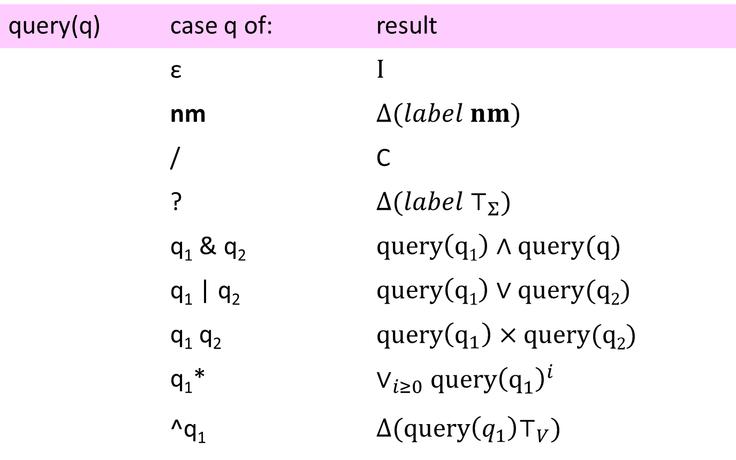
Query Execution using Matrices
query(q) | case q of: | result
 | ε | $$I$$
 | nm | $$Δ(label nm)$$
 | / | C
 | ? | $$Δ(label ⊤_{Σ})$$
 | q₁ & q₂ | $$query\left(q1\right)∧query(q)$$
 | q₁ | q₂ | $$query\left(q1\right)∨query(q2)$$
 | q₁ q₂ | $$query\left(q_{1}\right)×query(q2)$$
 | q₁* | $$∨_{i≥0}query{\left(q_{1}^{}\right)}^{i}$$
 | ^q₁ | $$Δ(query\left(q_{1}\right)⊤_{V})$$

Slide 54
Query Complexity
O(nmh+m₀nh²log n)
Tree size
Query size
Tree depth
Number of / and * operators
(counting inverted index set operations)

Slide 55
Why should you care?
JSON is ubiquitous on client- and server-side
JPath
is a simple and clean query language
supports efficient indexing and storage
has interesting mathematical properties
could be adapted for graph-shaped data

Slide 56
JPath for Graphs
John
address
friends
country
city
0
1
0
Mike
Jamie
Germany
country
address
address
friends
continent
Europe
city
country
city
Bonn
Berlin

Slide 57
Friends in Berlin
John/friends/?/(^?/address/city/Berlin)
John
address
friends
country
city
0
1
0
Mike
Jamie
Germany
country
address
address
friends
continent
Europe
city
country
city
Bonn
Berlin

Slide 58
Friends in the Same Country
(John/address/country/?) & (John/friends/?/?/address/country/?)
John
address
friends
country
city
0
1
0
Mike
Jamie
Germany
country
address
address
friends
continent
Europe
city
country
city
Bonn
Berlin

Slide 59
Friend Who Has More than 50 Friends
John/friends/?/?/friends/(l => int(l) > 50)
John
address
friends
country
city
0
1
0
Mike
Jamie
Germany
country
address
address
friends
continent
Europe
city
country
city
Bonn
Berlin

Slide 60
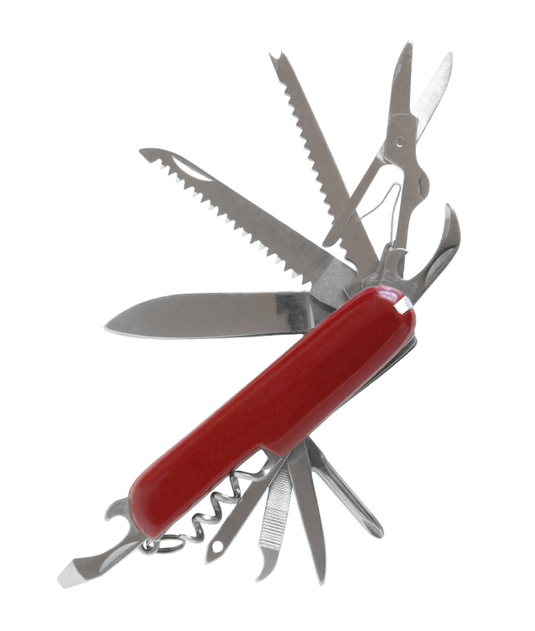
Conclusions
JSON: ubiquitous text data format
JPath: structural queries on JSON objects
Indexing techniques for JPath queries
Speeds-up selective queries
Small overhead on non-selective queries
Applicable to tree and graph-shaped data

Slide 61
Backup Slides

Slide 62
Removing Arrays
[
{ “city”: “Moscow” },
{ “city”: “Athens” }
]
{
“0”:{ “city”: “Moscow” },
“1”:{ “city”: “Athens” }
}

Slide 63
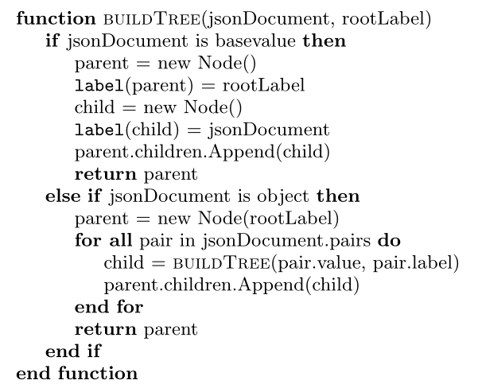
Creating a Tree

Slide 64
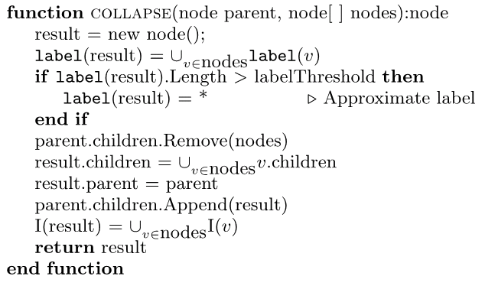
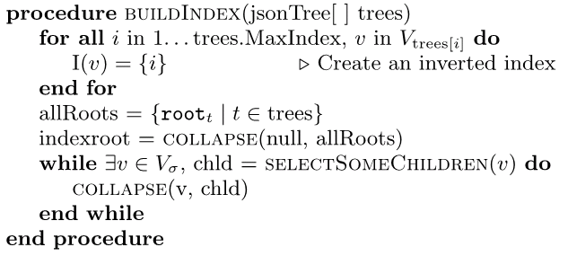
Creating an Index

Slide 65
Columns and Partitioning
JSON objects
Distributed
stream
partitions
Preprocessing
Cross-column references
Co-located partitions
Column- oriented
stream
column1
column2
column3

Slide 66
Partitioned, Indexed, Columnized
Co-located partitions
Index stream
index
Column- oriented
stream
column1
column2
column3

