Slide 1

A simple P4 demo: an L2/L3 switch in 170 LOC
netdev0.1
Ottawa, February 15, 2015
Mihai Budiu

Slide 2



Setup
Router control
Table access API
P4 program
h1
RPC
h2
P4 compiler
Tables
Data plane
P4 software switch
Mininet
Notes:
﻿cd p4factory/targets/simple_router
make behavioral
cd ../../..
﻿cd mininet-demo
sudo python 1sw_demo.py --behavioral-exe ../p4factory/targets/simple_router/behavioral-model

Slide 3

DEMO PART 1
Creating an basic ethernet+IPv4 switch from a P4 program
P4 program
Tables
P4 compiler
Data plane
P4 compiler
P4 software switch

Slide 4
Layer 3 packet forwarding
Control plane
IPv4.dst ->
nextHop.ipv4address,
outputPort,
ipv4.ttl
nextHop.ipv4address ->
ethernet.dst_addr
outputPort ->
ethernet.src_addr
Packet
Packet
Notes:
﻿mininet> h1 wireshark &
mininet> h1 ping h2 # this should fail
$ ﻿./simple_router_control --thrift-path ../p4factory/targets/simple_router/of-tests/pd_thrift < commands.txt
mininet> h1 ping h2 # this should succeed

Slide 5

Headers
header_type ethernet_t { fields { dstAddr: 48; srcAddr: 48; etherType: 16; } }
header_type ipv4_t { … }
// no options

Slide 6
Parser
﻿parser parse_ethernet { extract(ethernet); return select(latest.etherType) { 0x0800 : parse_ipv4; default: ingress; }}
…
parser parse_ipv4 { … } calculated_field ipv4.hdrChecksum { verify ipv4_checksum; update ipv4_checksum; }

Slide 7
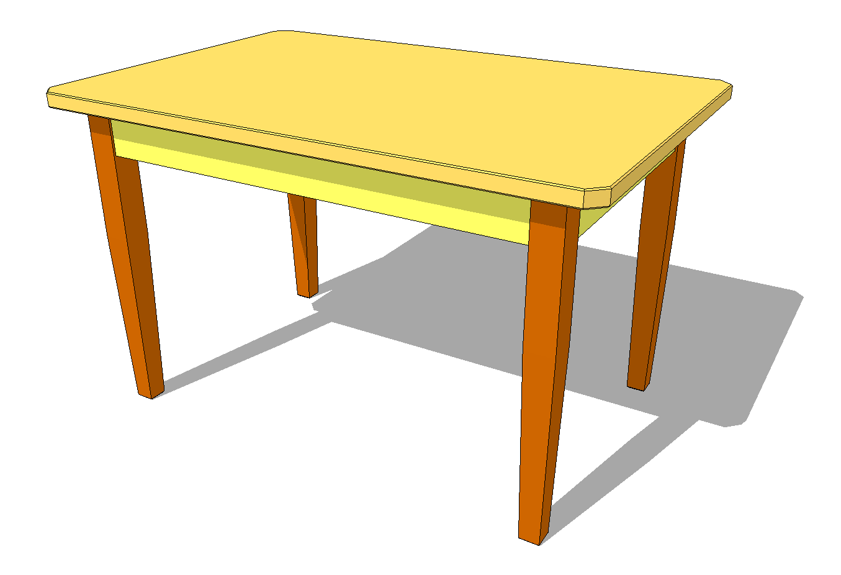
Last table
action rewrite_mac(smac) { modify_field(ethernet.srcAddr, smac); }
table send_frame { reads { std_metadata.egress_port: exact; } actions { rewrite_mac;
drop;
}
size: 256;
}
outputPort ->
ethernet.src_addr

Slide 8

Complete pipeline
control ingress { apply(ipv4_match); apply(forward); }
control egress { apply(send_frame); }

Slide 9
DEMO PART 2
Router control
Table access API
Populate switch tables to enable forwarding
RPC
Tables
Data plane
P4 software switch

Slide 10

DEMO PART 3
Counters in the datapath

Slide 11
Adding counters to table entries
counter send_frame_bytes { type : bytes; direct : send_frame; }
output_port | Action
counter
Table send_frame

Slide 12

DEMO PART 4
Divert traffic

Slide 13
Diverting traffic
Divert traffic for specific destinations to another destination
IPv4.dst ->
IPv4.dst
IPv4.dst ->
nextHop.ipv4address,
outputPort,
ipv4.ttl
nextHop.ipv4address ->
ethernet.dst_addr
outputPort ->
ethernet.src_addr
Notes:
$ ﻿./simple_router_control --thrift-path ../p4factory/targets/simple_router/of-tests/pd_thrift < divert.txt
Mininet> h1 ping h2 # this should fail, but wireshark shows packet coming back

Slide 14
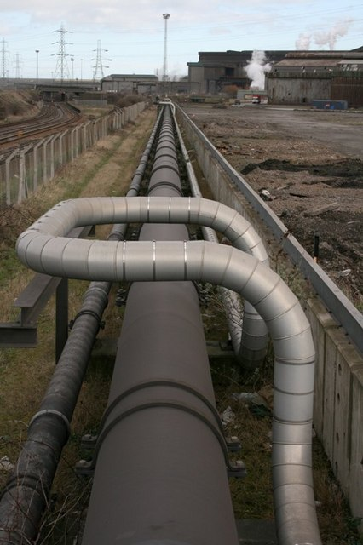
Modified pipeline
control ingress { apply(divert); apply(ipv4_match); apply(forward); }
control egress { apply(send_frame); }
Notes:
﻿./simple_router_control --thrift-path ../p4factory/targets/simple_router/of-tests/pd_thrift
SimpleRouter: get_ctr send_frame_bytes 0
<reply>
SimpleRouter: ^D

Slide 15
Diverting traffic
action replaceIp(ipdest) { modify_field(ipv4.dstAddr, ipdest); }
table divert { reads { ipv4.dstAddr: exact;} actions { replaceIp; nop; } size: 256; }

Slide 16

Availability
All this code will be available as FOSS before March 31, 2015 on http://p4.org

