Slide 1
Large-scale Machine Learning using DryadLINQ
Mihai Budiu
Microsoft Research, Silicon Valley
Ambient Intelligence: From Sensor Networks to Smart Environments and Social Media Workshop
Stanford, June 11, 2019

Slide 2
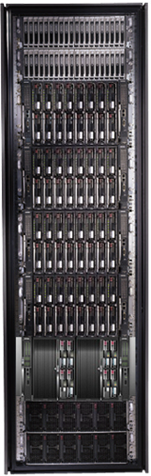
Goal of DryadLINQ
Notes:
Enable any programmer to write and run applications on small and large computer clusters.

Slide 3
Software Stack
Applications
.Net + LINQ
DryadLINQ
Dryad
Cluster storage
Cluster services
Windows Server
Windows Server
Windows Server
Windows Server

Slide 4
Dryad = Execution Layer
Job (application)
Pipeline
≈
Dryad
Unix Shell
Cluster
Machine
Notes:
In the same way as the Unix shell does not understand the pipeline running on top, but manages its execution (i.e., killing processes when one exits), Dryad does not understand the job running on top.

Slide 5
LINQ Data Model
.NET objects of type T
Collection

Slide 6
LINQ Language Summary
Input
Where (filter)
Select (map)
GroupBy
OrderBy (sort)
Aggregate (fold)
Join

Slide 7


LINQ
=> DryadLINQ
Dryad
Notes:
DryadLINQ adds a wealth of features on top of plain Dryad.

Slide 8

DryadLINQ Data Model
.Net objects
Partition
Collection

Slide 9

DryadLINQ = LINQ + Dryad
Collection<T> collection;
static bool IsLegal(Key c);
var results = from c in collection where IsLegal(c.key) select new { Hash(c.key), c.value};
Code
Dryad job
Data
collection
C#
C#
C#
C#
results
Notes:
DryadLINQ translates LINQ programs into Dryad computations:
- C# and LINQ data objects become distributed partitioned files.
- LINQ queries become distributed Dryad jobs.
- C# methods become code running on the vertices of a Dryad job.

Slide 10


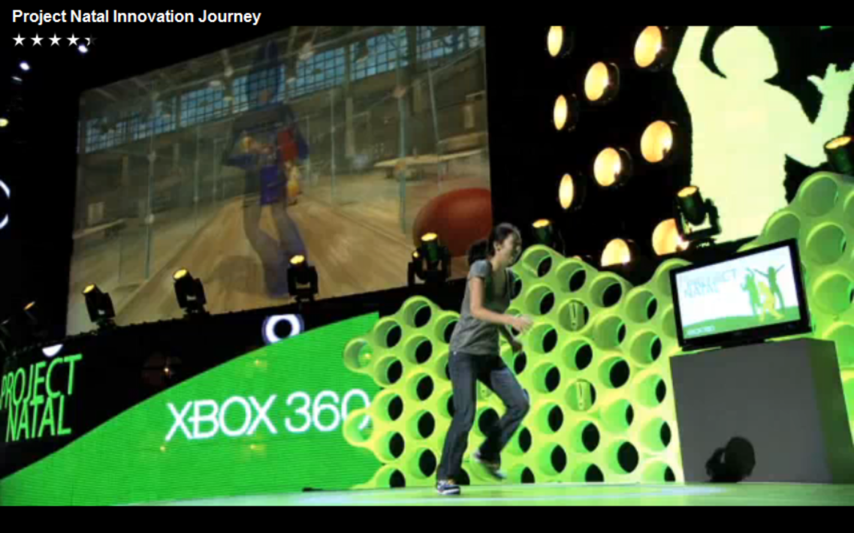
Example: Natal Training

Slide 11


Natal Problem
Recognize players from depth map
At frame rate
Low resource usage
Notes:
Image from http://r24085.ovh.net/images/Gallery/depthMap-small.jpg

Slide 12
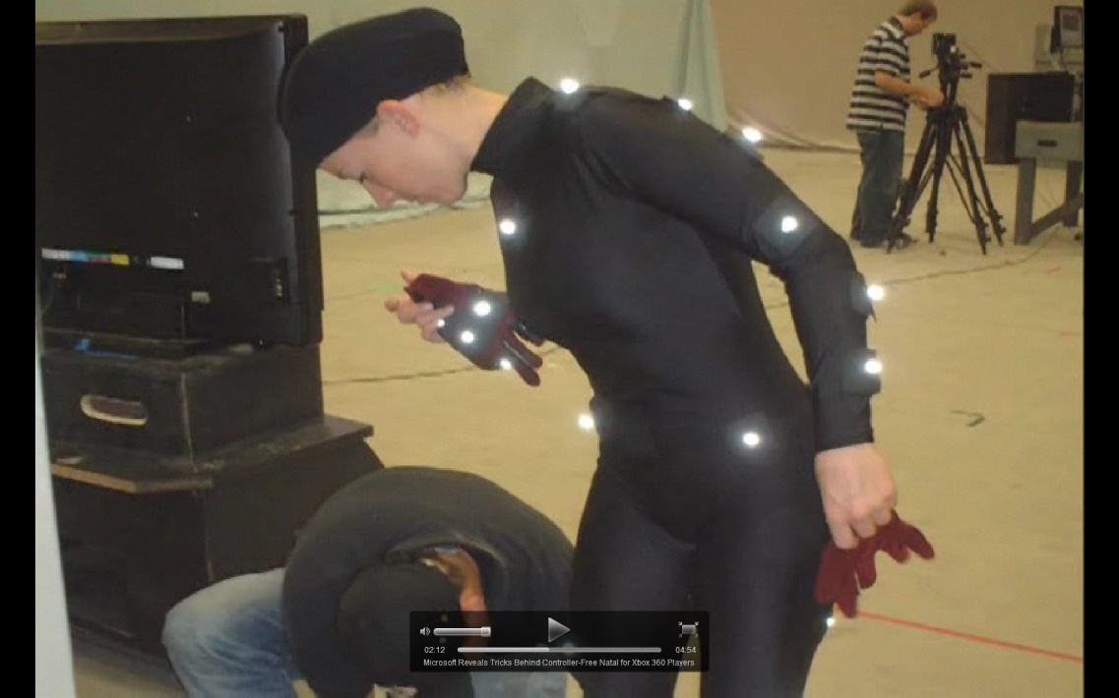


Learn from Data
Rasterize
Motion Capture
(ground truth)
Training examples
Machine learning
Classifier

Slide 13
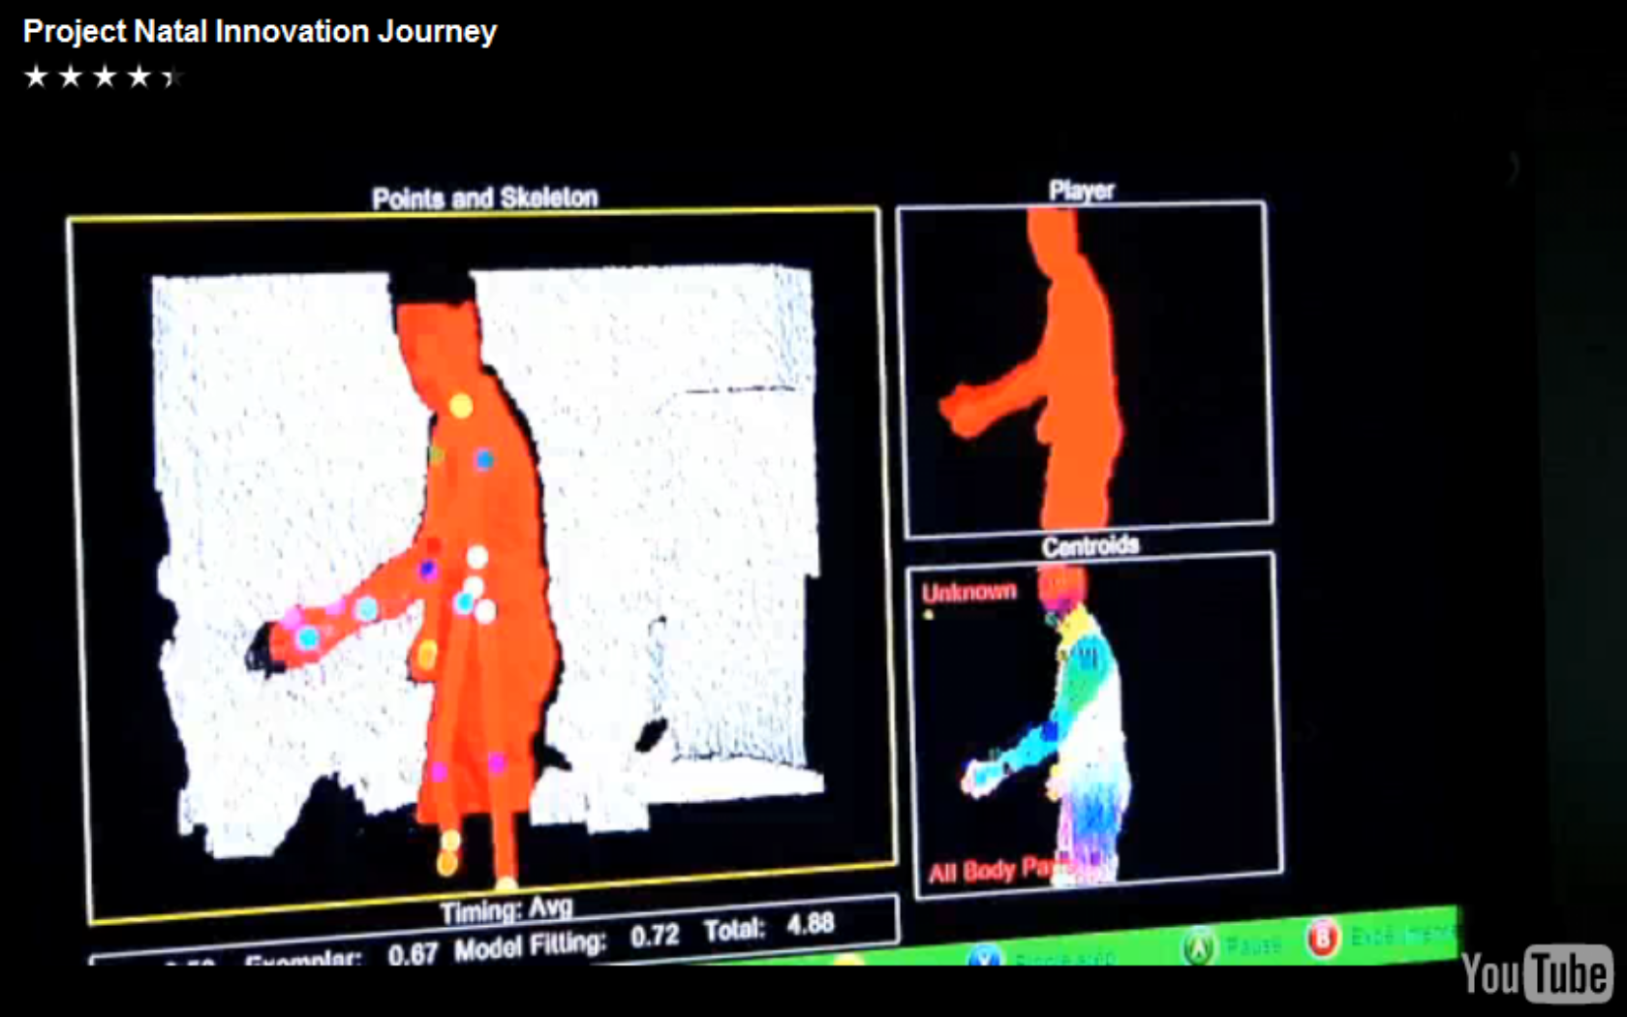
Running on Xbox

Slide 14

Cluster-based training
Classifier
Training examples
Machine learning
DryadLINQ
Dryad

Slide 15


Slide 16

You can have it!
Dryad+DryadLINQ available for download
Academic license
Commercial evaluation license
Runs on Windows HPC platform
Dryad is in binary form, DryadLINQ in source
Requires signing a 3-page licensing agreement
http://connect.microsoft.com/site/sitehome.aspx?SiteID=891

Slide 17

Conclusions
Visual Studio
LINQ
Dryad
=
17
Notes:
We believe that Dryad and DryadLINQ are a great foundation for cluster computing.

