Slide 1

Optimizing Memory Accesses for Spatial Computation
Mihai Budiu, Seth Goldstein
CGO 2003
Notes:
The Phoenix project: computing without processos, http://www.cs.cmu.edu/~phoenix
This presentation was created using TeXPoint, by George Necula, http://raw.cs.berkeley.edu/texpoint/TeXPoint.htm

Slide 2

Optimizing Memory Accesses for Spatial Computation
Program
Compiler
Notes:
Spatial computation refers to the implementation of programs completely in hardware, without using a hardware interpreter (i.e. a CPU).

Slide 3


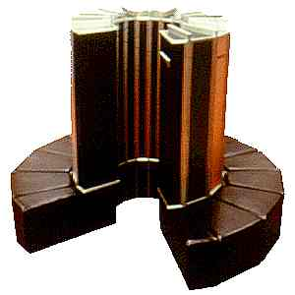
Why at CGO?
C
Predicated IR
This work
Optimized IR
Notes:
This paper is interesting for the CGO community because it focuses on the internal optimizations of the compiler, which are applicable for traditional or parallel systems as well.
Our performance results however are derived using a spatial computation platform.

Slide 4
Optimizing Memory Accesses for Spatial Computation
=*q
*p=
=*q
*p=
=a[i]
Time
=a[i]
=*p
=*p
This paper describes compiler representations and algorithms to
      increase memory access parallelism
      remove redundant memory accesses

Slide 5

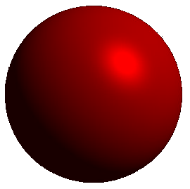
:Intermediate Representation
Traditionally
Our proposal
SSA + predication
Uniform for scalars and memory
Explicitly encode may-depend
Summarize control-flow
Executable
may-dep.
CFG
...
def-use
Notes:
The representation is self-contained and fully interpretable.
There is no need to dynamically update annotations when the program is optimized.

Slide 6
Contributions
Predicated SSA optimizations for memory
  Boolean manipulation instead of CFG dependences
  Powerful term-rewriting optimizations for memory
  Simple to implement and reason about
Expose memory parallelism in loops
  New loop pipelining techniques
  New parallelization method: loop decoupling

Slide 7
Outline
Introduction
Program representation
Redundant memory operation removal
Pipelining memory accesses in loops
Conclusions

Slide 8
Executable SSA
x
2
1
y
if (x)
y = x*2;
else
y++;
*
+
!
φ
y’
Program representation is a graph:
Nodes = operations, edges = values
Notes:
From now on I will completely elide in all slides the scalar computation representation and focus solely on the representation of memory operations.
The representation is executable: i.e. can be directly interpreted, as it completely and unambiguously describes the program semantics.

Slide 9
Predication
Pred
…=*p;
if (x)
…=*q;
else
*r = …;
(1) …=*p;
(x) …=*q;
(!x) *r = …;
Predicates encode control-flow
Hyperblock ) branch-free code
Caveat: all optimizations on hyperblock scope
Notes:
Our compiler makes extensive use of predication.
All optimizations described here are on a hyperblock scope: more than a basic block, but less than a procedure.

Slide 10
Read-write Sets
Memory
Entry
*p=…;
if (x)
…=*q;
else
*r = …;
Exit
Notes:
Each memory operation (load/store) has an associated set of locations which it may access (a conservative approximation).

Slide 11
Token Edges
Memory
Entry
*p=…;
if (x)
…=*q;
else
*r = …;
Exit
Notes:
If two memory operations may access the same location then a token edge is inserted between them.

Slide 12
Tokens ¼ SSA for Memory
Entry
Entry
*p=…;
if (x)
…=*q;
else
*r = …;
*p=…;
if (x)
…=*q;
else
*r = …;
φ
Notes:
The token edge network can be seen as a sort of Static-Single Assignment representation of memory.

Slide 13
Meaning of Token Edges
Token graph is maintained transitively reduced
*p=…
*p=…
…=*q
…=*q
Maybe dependent
No intervening
memory operation
Independent
Focus the optimizer
Linear space complexity in practice
Notes:
Although the idea of using tokens for memory dependences is not new, the contribution of this work is to show a way in which compiler optimizations can take advantage of this representation.

Slide 14
Outline
Introduction
Program Representation
Redundant memory operation removal
  Dead code elimination
  Load || load
  Store ) load
  Store ) store
  Useless token removal
  ...
Pipelining memory accesses in loops
Evaluation
Conclusions
Notes:
More optimizations, and more general versions of these optimizations, are presented in the paper.

Slide 15
Dead Code Elimination
(false)
*p=…
Notes:
This case arises quite frequently due to other optimizations.

Slide 16
¼ PRE
(p1)
...=*p
(p2)
...=*p
(p1 Ç p2)
...=*p
This corresponds in the CFG to lifting the load
to a basic block dominating the original loads
Notes:
The same optimization can be applied to loads as well.
The code is basically the same as for common-subexpression elimination in an SSA form.
(Technicality: to enable this transformation no predicate must depend on the other operation. Easily checked with a reachability computation.)

Slide 17
Forwarding Data (St ) Ld)
(p1)
*p=…
(p1)
*p=…
(p2)
(p2 Æ : p1)
…=*p
…=*p
φ
Load is executed only if store is not
Notes:
The load predicate is weakened.
The green object is a multiplexor, selecting one of its two inputs at run-time.

Slide 18
Forwarding Data (2)
(p1)
*p=…
(p1)
*p=…
(false)
…=*p
(p2)
…=*p
When p2 ) p1 the load becomes dead...
...i.e., when store dominates load in CFG
Notes:
As a particular case of the previous optimization, if whenever the load predicate is true the store predicate is as well, the load can be completely removed. It is removed by the dead-code optimization, since its predicate becomes false. This optimization can be generalized for the case of multiple stores preceding the load.

Slide 19
Store-store (1)
(p1)
*p=…
(p1 Æ : p2)
*p=…
(p2)
*p=...
(p2)
*p=...
When p1 ) p2 the first store becomes dead...
...i.e., when second store post-dominates first in CFG
Notes:
In this case the predicate of the first store is weakened, so that it is never executed when the second one will overwrite it.

Slide 20
Store-store (2)
(p1)
*p=…
(p1 Æ : p2)
*p=…
(p2)
*p=...
(p2)
*p=...
Token edge eliminated, but...
...transitive closure of tokens preserved
Notes:
Since the two predicates are now disjoint, the two stores can never occur simultaneously, so there is no need for a token edge between them.
Notice that the removal of the token edge is not trivial.

Slide 21

Key Observation
The control-dependence tests and transformations
(i.e., dominance, post-dominance)
are carried by simple predicate
Boolean manipulations.
Notes:
There is no need, for instance, to update the CFG or domination relationships when optimizations change the program.

Slide 22
Implementation Is Clean
Optimization | LOC
Useless dependence removal | 160
Immutable loads | 70
Dead-code elimination (incl. memory op) | 66
Load-after-load and store-after-store removal | 153
Redundant load and store removal | 94
Transitive reduction of token edges | 61
Loop-invariant scalar & load discovery | 74
Notes:
These optimizations require pages of pseudocode in compiler textbooks.
The explicit representation of dependences through tokens makes them trivial to implement and very fast to execute.

Slide 23
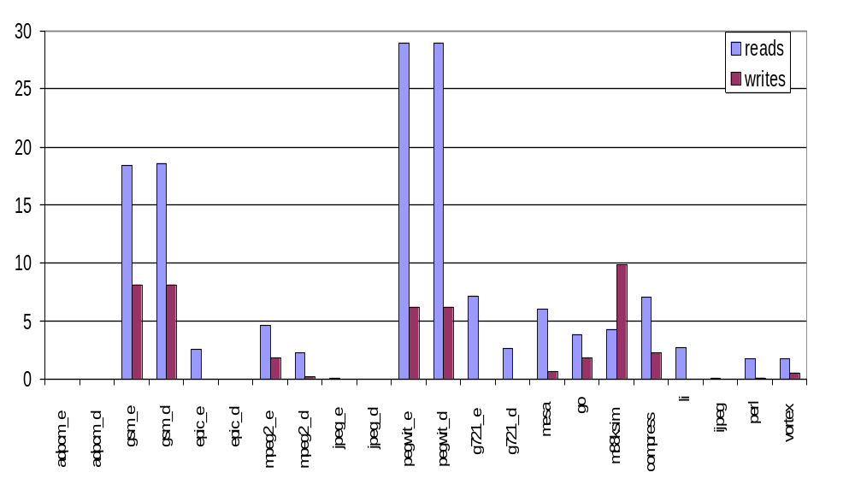
Operations Removed:
- static data -
Percent
Mediabench
SpecInt95
Notes:
This data is for a large subset of the functions (see paper for details). We currently can compile practically everything, but this is the data reported in the paper.

Slide 24
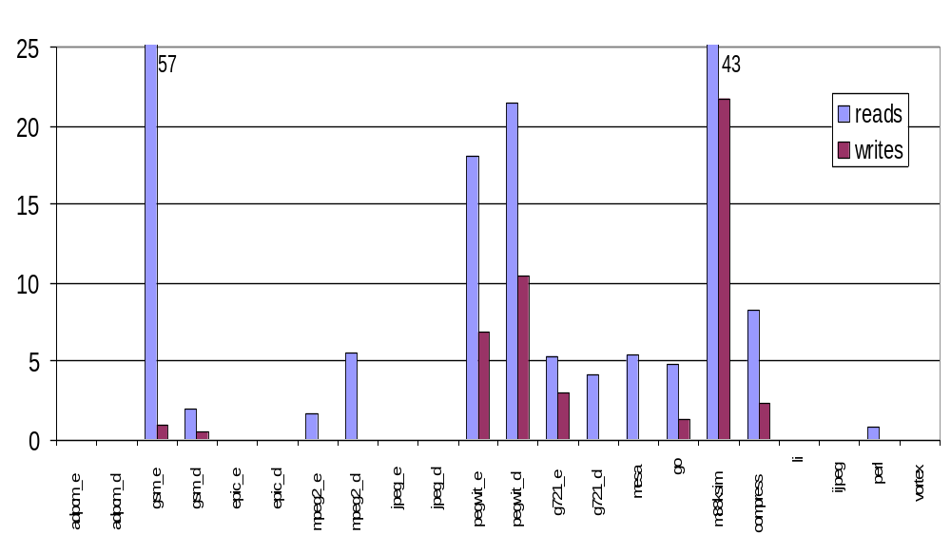
Operations Removed:
- dynamic data -
Percent
Mediabench
SpecInt95

Slide 25
Outline
Introduction
Program Representation
Redundant memory operation removal
Pipelining memory accesses in loops
Conclusions

Slide 26
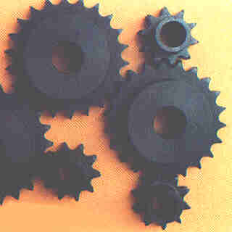

Loop Pipelining
...=*in++;
...=*in++;
*out++ =...
*out++ =...
1 loop ) 2 loops, which can slip with respect to each other
‘in’ slips ahead of ‘out’ ) pipelining of the loop body
Notes:
Second part of the paper: representation of tokens in loops to enable parallelism discovery.
We are mostly interested in loop pipelining.
If properly implemented, the ‘*in++’ loop can be several iterations ahead of the ‘*out++’ loop. The computation between them is processing multiple input data in parallel, in a pipelined fashion.

Slide 27
One Token Loop Per “Object”
a
other
extern int a[ ];
void g(int* p)
{
int i;
for (i=0; i < N; i++)
a[i] += *p;
}
a[ ]
=*a
=*p
*a=
a
other
Notes:
The implementation creates separate token loops for all major “memory objects” referred within the loop.
Note that this figure is a simplification of the actual implementation. In reality there are different nodes to send the token back up to the beginning of the loop and to send the tokens out of the loop. For pedagogical reasons this is however a good approximation.

Slide 28
Inter-iteration Dependences
All accesses prior to current iteration
a
other
=*a
=*p
*a=
All accesses after current iteration
a
other
!
Notes:
The start node ‘a’ stands for “all accesses to array a made prior to current loop iteration”.

Slide 29
Monotone Addresses
*a++=
*a++=
generator
collector
a[1] must receive token from a[0]
but these are independent!
Notes:
The generator loop generates tokens for the accesses in all iterations almost in parallel.
The collector ensures that the operations in all of the iterations have completed before enabling any operation after the loop.

Slide 30
Loop Decoupling: Motivation
a
a
for (i=0; i < N; i++) {
a[i] = ....
.... = a[i+3];
}
a[i]=
a[i]=
=a[i+3]
=a[i+3]
independent
Notes:
In the last figure the accesses to a[i] and a[i+3] are still too tightly synchronized: they must occur in lockstep.
However, this is a little too restrictive.

Slide 31
Loop Decoupling
a₃
a₀
for (i=0; i < N; i++) {
a[i] = ....
.... = a[i+3];
}
=a[i+3]
a[i]=
tk(3)
Slip control
Token generator emits 3 tokens “instantly”
It allows a₀ loop to slip at most 3 iterations ahead of a₃
Notes:
A new operator is introduced: a token generator, which dynamically controls the slip between the loops.
The slip is controlled by releasing initially a number of tokens equal with the maximum allowable slip. Further tokens are released only on completion of the dependent loop.

Slide 32
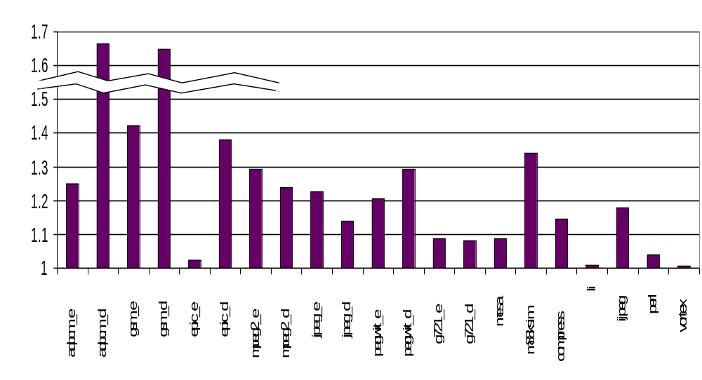
Performance Impact of
Memory Optimizations
2.12.0
Speed-up vs. no memory optimizations
Mediabench
SpecInt95
Notes:
The baseline performance is measured with all scalar optimizations enabled, but none of the described memory optimizations.

Slide 33
Conclusions
Tokens = compact representation of memory dependences
Explicit dependences enable easy & powerful optimizations
Simple predicate manipulation replaces control-flow transforms
Fine-grain dependence information enables loop pipelining
Token generators + loop decoupling = dynamic slip control

Slide 34
Backup Slides
Compilation speed
Compiler structure
Tokens in hardware
Cycle-free condition
How performance is evaluated
Sources of performance
Aren’t these optimizations well known?
Computing predicates

Slide 35
Compilation Speed
On average 3.5x slower than gcc -O3
Max 10x slower
We do intra-procedural pointer analysis,
but no scheduling or register allocation
back
Notes:
Notice that the data in the paper is wrong.

Slide 36
Compiler Structure
C/FORTRAN
Pegasus
(Predicated SSA)
Suif CC
high Suif IR
CSE
Dead-code
PRE
Induction variables
Strength reduction
Loop-invariant lift
Reassociation
Memory optimization
Constant propagation
Constant folding
Unreachable code
inlining
unrolling
call-graph
call-graph
low Suif IR
Pointer analysis
Live var. analysis
CFG construction
Unreachable code
Build hyperblocks
Ctrl dominance
Path predicates
C circuit
simulation
Verilog
back

Slide 37
Tokens in Hardware
add
token
pred
LSQ
Load
Memory
data
token
Tokens are actual operation inputs and outputs
Operation waits for token to execute
Output token released as soon as side-effect certain
back
Notes:
In hardware tokens are explicitly represented; they are not just a compiler artifact.
Tokens are part of the ISA.

Slide 38
Cycle-free Condition
(p1)
...=*p
(p1 Ç p2)
...=*p
(p2)
...=*p
Requires a reachability computation to test
Using memoization complexity is amortized constant
back
Notes:
The optimizations described cannot always be applied; this technical condition must be checked before term-rewriting.

Slide 39
How Performance Is Evaluated
C
Mem
L2
1/4M
L1
8K
LSQ
2
limited BW
(2 words/c)
Unlimited ILP
8
72
back
Notes:
This is the model used to generate the data in the “performance” slide.

Slide 40
Sources of Performance
Removal of redundant operations
More freedom in scheduling
Pipelining loops
back

Slide 41
Aren’t These Opts. Well Known?
void
f(unsigned*p, unsigned a[], int i)
{
if (p) a[i] += p;
else a[i]=1;
a[i] <<= a[i+1];
}
gcc –O3, Pentium
Sun Workshop CC –xo5, Sparc
DEC cc –O4, Alpha
MIPSpro cc –O4, SGI
SGI ORC –O4, Itanium
IBM cc –O3, AIX
Our compiler
Only ones to remove
accesses to a[i]
back

Slide 42
Computing Predicates
s
t
b
Correct for irreducible graphs
Correct even when speculatively computed
Can be eagerly computed
back
Notes:
Predicates are computed speculatively, but have a set of very nice properties.

Slide 43

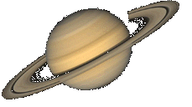
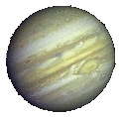





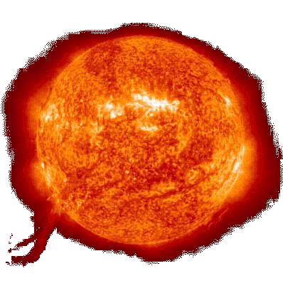
Spatial Computation
Notes:
What is spatial computation?

