Slide 1
On the Critical Path of
(Parallel) Computations
Mihai Budiu
March 30, 2005
Notes:
Planets image courtesy mostly of NASA, but from other web sites as well.

Slide 2

Outline
Three kinds of critical paths
Critical path of dataflow computations
Future work: extending the applications

Slide 3
Critical Path
Longest path between
source and sink in DAG

Slide 4
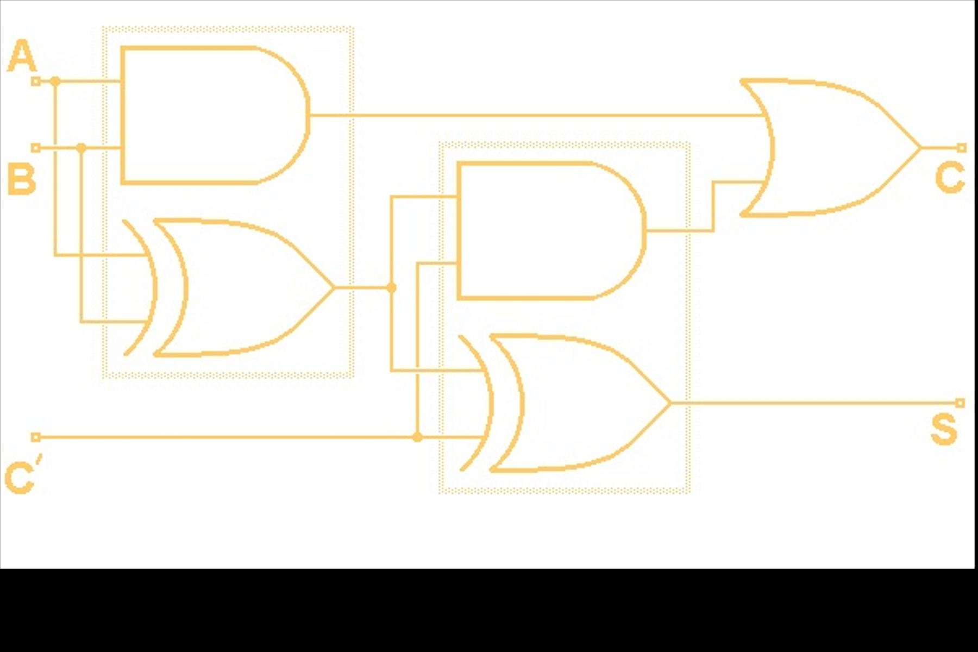
Synchronous Combinational Circuits
Longest signal propagating path
between two consecutive latches
clk > crit path
Latch
Latch
clk

Slide 5
Critical Path of a Program?
= *
dependences
dynamic
instruction
instances
= +
= +

Slide 6
Limit Studies of ILP
ILP = nodes / critical path length
Lam 92, Wall 93, Theobald 93, Rauchwerger 93, Sohi 95, Chen 90, Smith 89, Tjaden 70, Nicolau 84, Riseman 72, Kuck 72, Postiff 98, Klauser 98, Uht 03, Swanson 03
Widely variable results
Question: what is a dependence?

Slide 7
Dependences
*p = 3;
x = *q
if (a)
x = 3;
?
?
push eax
...
mov ebx, [esp]
a = b + c;
d = e + f;
?
?
single adder

Slide 8

Generic Question
push %ebp
mov %esp,%ebp
sub $0x10,%esp
push %esi
push %ebx
add $0xfffffff4,%esp
mov 0x4(%ebx),%eax
add $0x18,%eax
push %ebx
mov (%eax),%esi
call *%esi
add $0x10,%esp
lea 0xffffffe8(%ebp),%esp
pop %ebx
pop %esi
mov %ebp,%esp
pop %ebp
ret
What is the critical path of a particular program
when executed using a specified set of resources?

Slide 9
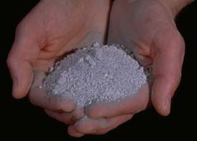
Outline
Three types of critical paths
Critical path of dataflow computations
  ASH: A Static Dataflow Model
  A critical path analysis
Future work

Slide 10
Application-Specific Hardware
C program
Compiler
Dataflow IR
HW dataflow machine
Notes:
The dataflow machine generated is very close semantically to the internal compiler representation, which makes the translation particularly efficient.
In fact, the two are so close that in the following I will blur the distinction between the representation and the resulting circuits.
By going directly from program to hardware implementation we circumvent the limitations of a fixed ISA.

Slide 11
Computation Dataflow
Program
IR
Circuits
a
7
a
x = a & 7;
...
y = x >> 2;
&
&7
2
x
>>
>>2
Operations | Nodes | Pipeline stages
Variables | Def-use edges | Channels (wires)
Pure dataflow: no program counter
Notes:
We do not have the disadvantages of the traditional dataflow machine model, because we implement the machines directly in hardware.

Slide 12
Basic Computation=
Pipeline Stage
+
latch
data
ack
valid
Notes:
The synthesized circuit are built from such constructs. The semantics of the internal representation is described in these terms.

Slide 13
Control Flow => Data Flow
data
Merge (label)
data
data
predicate
Gateway
p
Split (branch)
!
Notes:
Note: in reality the merge operator is slightly more complicated than described here, since multiple merge operators sometimes need to cooperate in order to correctly execute the program.
The merge is also called “mu”, while the gateway is also called “eta”.

Slide 14
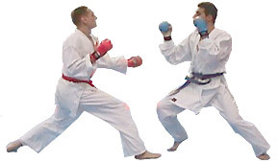
Comparison: Idealized Simulation
Compared to 4-wide out-of-order superscalar
Same operation latencies
Same memory hierarchy (LSQ, L1, L2)
not free

Slide 15
Obvious!
wrong!
ASH runs at full dataflow speed,
and has no resource limitations, so CPU cannot do any better
(if compilers equally good)

Slide 16
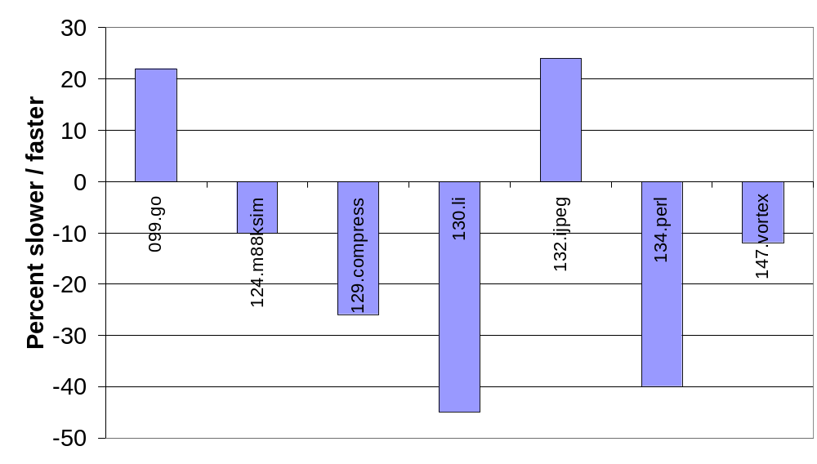
SpecInt95, ASH vs 4-way OOO

Slide 17
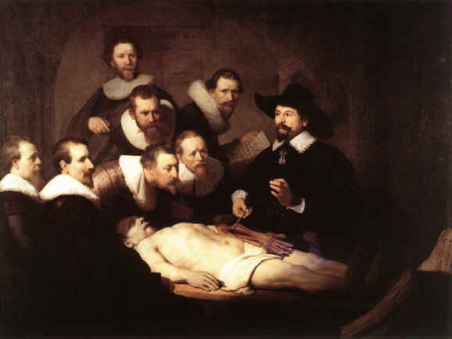
Outline
Three kinds of critical paths
Critical path of dataflow computations
  ASH
  Dissection: how and what
Future work

Slide 18

The Scalpel
CASH
Simulator
C
ASH
ASH
drawings
trace
Automatic
analysis
Dynamic Critical Path

Slide 19
Last-Arrival Events
Event enabling the
generation of a result
May be an ack
Critical path=collection
of last-arrival edges
+
data
ack
valid
Notes:
Both the internal representation and the synthesized circuit are built from such constructs.

Slide 20
Dynamic Critical Path
Some edges may repeat
Trace back along
last-arrival edges
Start from last node
O(n) space algorithm.

Slide 21
On-line Forward Algorithm
[Fields & Bodik, ISCA 01]
Inject a “token” at operation X
Propagate only last-arrival tokens
If token live at the end: X was critical
node propagating token
node discarding token
x
O(1) space (in practice).

Slide 22
On-line Sampling “Approximation” Algorithm
Chose node X randomly
Monitor for a constant number of steps (10⁵)
Use past to predict future criticality

Slide 23
Outline
Three kinds of critical paths
Critical path of dataflow computations
  ASH
  Dissection: how and what
Future work

Slide 24
The (Loop) Body
for (j = 0; X[j].r != 0xF; j++)
if (X[j].r == i)
break;
SpecINT95: 124.m88ksim, init_processor()

Slide 25
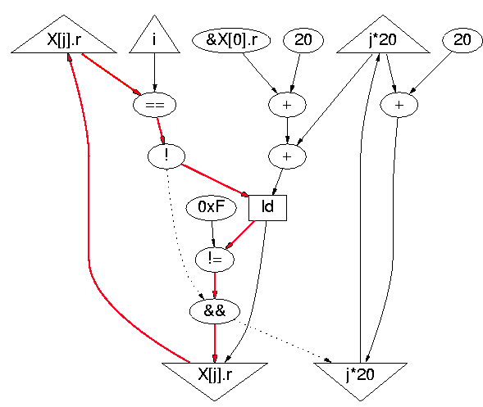
Dynamic Critical Path
definition
sizeof(X[j])
load predicate
loop predicate
for (j = 0; X[j].r != 0xF; j++)
if (X[j].r == i)
break;

Slide 26
MIPS gcc Code
LOOP:
L1: beq $v0,$a1,EXIT ; X[j].r == i
L2: addiu $v1,$v1,20 ; &X[j+1].r
L3: lw $v0,0($v1) ; X[j+1].r
L4: addiu $a0,$a0,1 ; j++
L5: bne $v0,$a3,LOOP ; X[j+1].r == 0xF
EXIT:
for (j = 0; X[j].r != 0xF; j++)
if (X[j].r == i)
break;
L1=>L2=>L3=>L5=>L1
4-instructions loop-carried dependence

Slide 27
If Branch Prediction Correct
LOOP:
L1: beq $v0,$a1,EXIT ; X[j].r == i
L2: addiu $v1,$v1,20 ; &X[j+1].r
L3: lw $v0,0($v1) ; X[j+1].r
L4: addiu $a0,$a0,1 ; j++
L5: bne $v0,$a3,LOOP ; X[j+1].r == 0xF
EXIT:
for (j = 0; X[j].r != 0xF; j++)
if (X[j].r == i)
break;
L1=>L2=>L3=>L5=>L1

Slide 28
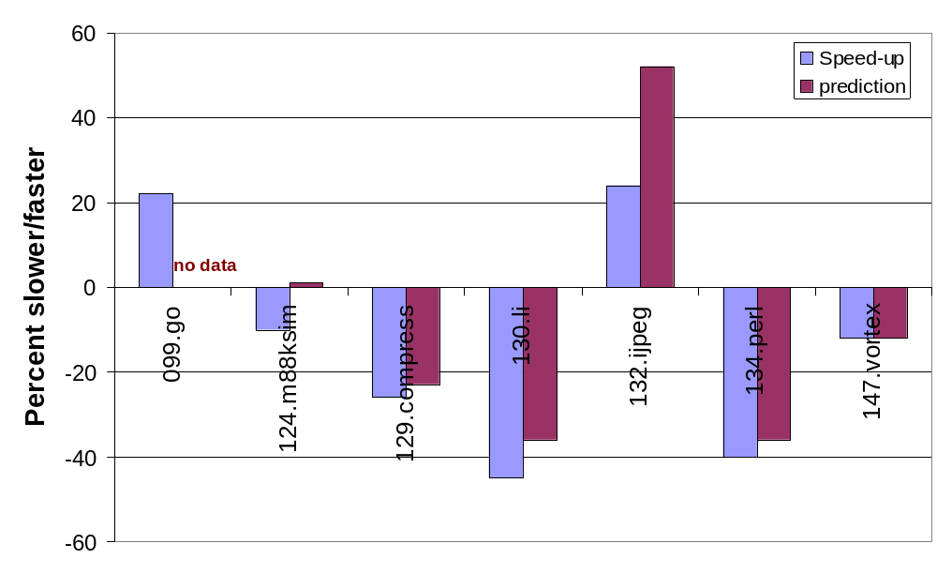
SpecInt95, perfect prediction

Slide 29
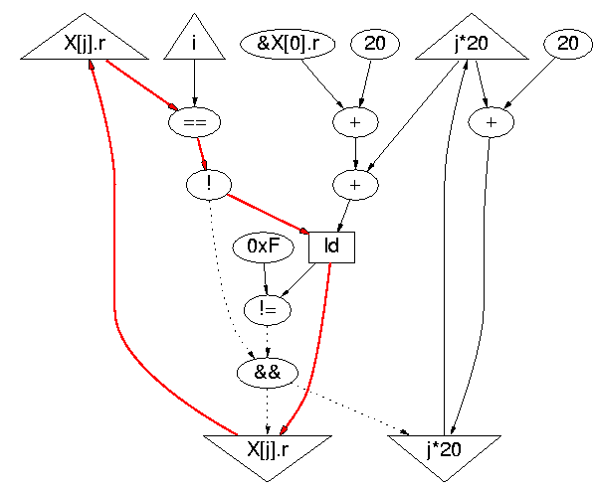

Critical Path with Prediction
Loads are not
speculative
for (j = 0; X[j].r != 0xF; j++)
if (X[j].r == i)
break;

Slide 30
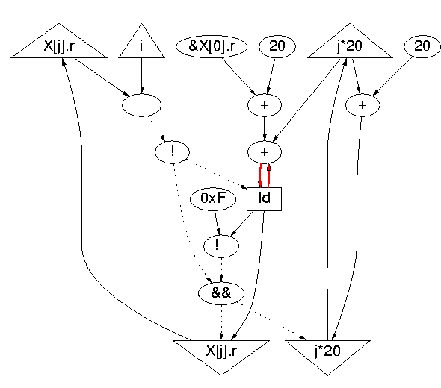
Prediction + Load Speculation
ack edge
~4 cycles!
Load not pipelined
(self-anti-dependence)
for (j = 0; X[j].r != 0xF; j++)
if (X[j].r == i)
break;

Slide 31
OOO Pipe Snapshot
LOOP:
L1: beq $v0,$a1,EXIT ; X[j].r == i
L2: addiu $v1,$v1,20 ; &X[j+1].r
L3: lw $v0,0($v1) ; X[j+1].r
L4: addiu $a0,$a0,1 ; j++
L5: bne $v0,$a3,LOOP ; X[j+1].r == 0xF
EXIT:
register
renaming
IF
DA
EX
WB
CT
L3
L3
L3
Notes:
[IF] [DA] [EX] [WB] [CT]

Slide 32

Unrolling Does Not Help
for(i = 0; i < 64; i++) {
for (j = 0; X[j].r != 0xF; j+=2) {
if (X[j].r == i)
break;
if (X[j+1].r == 0xF)
break;
if (X[j+1].r == i)
break;
}
Y[i] = X[j].q;
}
when 1 iteration
Notes:
Overhead projector image from staples.com

Slide 33
Interim Conclusion
Critical path:
powerful tool to analyze performance
Can be completely automated
Can we extend this to other parallel models of computation?

Slide 34

Outline
Three kinds of critical paths
Critical path of dataflow computations
  ASH
  Dissection
Future work

Slide 35
Lifting Criticality
1
3
2
jobs
(instructions)
resources+interfaces
(hardware)
1
critical event
3
2
3
simulation
(instantaneous resource attribution+event transitions)
critical path
(lifted)

Slide 36
Critical Path Projections
7
8
3
critical path
(lifted)
edge labels
PC
high freq

Slide 37
Plans for Summer
Implement critical path computation for a real processor described in RTL
Study properties:
  stability on projections
  stability w/ respect to μarch changes

Slide 38
Intriguing Questions
Can these insights be applied to other domains?
  job scheduling
  parallel / multithreaded computation
  distributed systems
Can compilers automatically generate code to detect critical events for a multithreaded computation?

Slide 39
Related Work
Introduction to Critical Path Analysis, book 64
Critical path analysis for the execution of parallel and distributed programs, ICDS 88
Performance of Firefly RPC, SOSP 89
Critical path analysis of TCP transactions, TN 01
Focusing Processor Policies via
Critical-Path Prediction, ISCA 01

