Slide 1

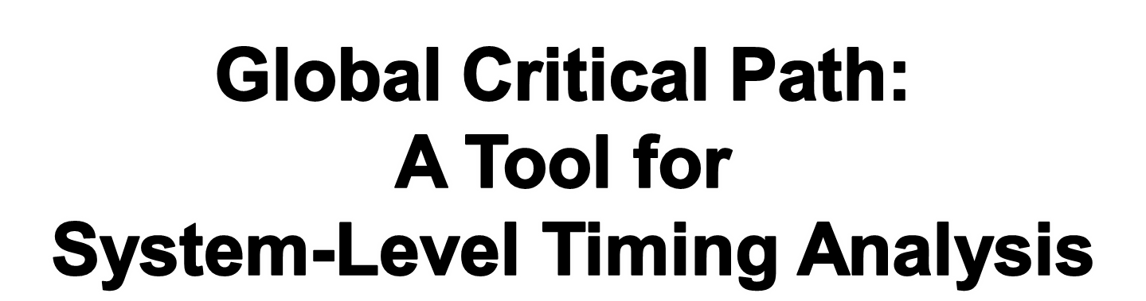
Mihai Budiu
May 23, 2007

Slide 2
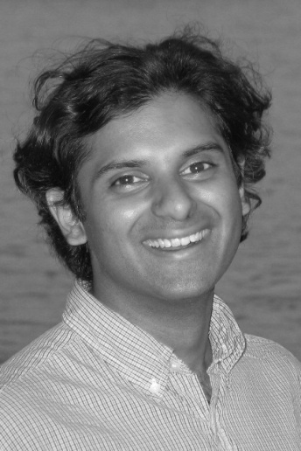
Based On
Critical Path: A Tool for System-Level Timing Analysis
Girish Venkataramani, Tiberiu Chelcea, Mihai Budiu, and Seth C. Goldstein, Design Automation Conference (DAC),
San Diego, CA, June 4-8, 2007
Girish Venkataramani: summer intern here in 2005
Now graduating from CMU
His Ph.D. thesis: A System Level Timing Analysis and
Optimization Methodology for Hardware Compilation
is based on the Global Critical Path

Slide 3
Critical Path
Longest path between
source and sink in DAG

Slide 4
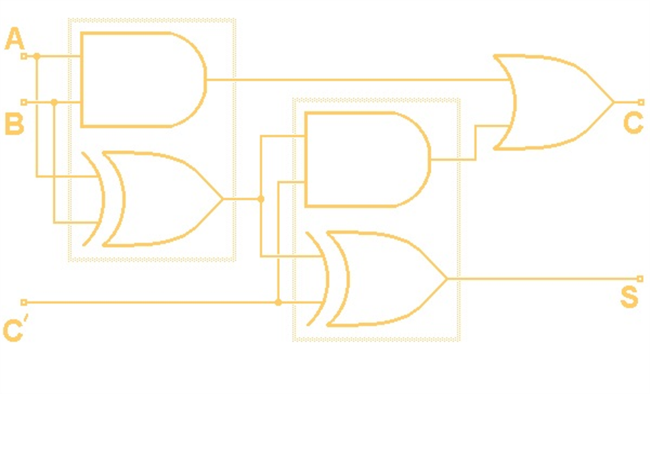
Synchronous Combinational Circuits
Longest signal propagating path
between two consecutive latches.
clk > crit path
Latch
Latch
clk

Slide 5
Events
Events = (n₁, t₁) → (n₂, t₂)
Events =
Signal Transitions on edges E
Circuit (V, E)

Slide 6
Chaining of Events
Circuit (V, E)

Slide 7
Timed Graph
Event: signal from (A, t₁) to (B, t₃)
A
A
B
B
t₀
t₁
t₂
t₃
|| (n₁,t₂) → (n₂,t₂) || = t₂ – t₁
Dynamic Critical Path = longest path in Timed Graph
Note: easy to model node computation delay too.

Slide 8
Goal: Apply to Real Circuits
In this work focused on asynchronous 4-way handshake circuits
C
Delay
H/S
+
reg
+
reg
C
Delay
H/S
req_{o}
data
+
reg
1 2 3 4
req_{i}
C
Delay
H/S
ack_{i}
ack_{o}
ack_{i}
req_{i}
data

Slide 9
Model Stages Using Behaviors
req_{o}
data
+
reg
req_{i}
C
Delay
H/S
ack_{o}
ack_{i}
Behavior | Input transitions (precondition) | Output transitions (postcondition)
Compute | req_{i0}↑, req_{i1}↑, ack₀↓ | req₀↑, ack_{i}↑
Return to zero req | ack₀↑ | req₀↓
Return to zero ack | req_{i0}↓, req_{i1}↓ | ack_{i}↓

Slide 10
Behaviors can Handle Choice
arbiter
mux
Deterministic (unique)
choice
Nondeterministic
choice
In the absence of choice and non-deterministic delays
a static analysis can determine the GCP.

Slide 11
Runtime: Locally Critical Events
req_{i0}↑
req_{i1}↑
ack₀↓
req₀↑
ack_{i}↑
timeline
Behavior | Input transitions (precondition) | Output transitions (postcondition)
Compute | req_{i0}↑, req_{i1}↑, ack₀↓ | req₀↑, ack_{i}↑
Return to zero req | ack₀↑ | req₀↓
Return to zero ack | req_{i0}↓, req_{i1}↓ | ack_{i}↓

Slide 12
GCP Computation Algorithm
3. Some transitions repeated
2. Trace back along
locally critical input event
1. Start from last node
executed
0. At run-time each node records locally critical events

Slide 13
Possible Locally Critical Paths
1
2
req_{i}↑
req_{i} ↓
req₀↑
ack_{o}↓
ack_{i}↓
3
4
req_{i} ↑
req₀↓
ack_{o}↓
ack_{o}↑
ack_{i} ↑

Slide 14
Chaining Events Backwards
1
1
req_{i}↑
req_{i}↑
req₀↑
2
req₀↑
ack_{o}↓
ack_{i}↓
ack_{o}↓
3
req₀↓
req_{i} ↓
4
ack_{o}↑
ack_{i} ↑
req_{i} ↑
ack_{o}↓

Slide 15
Theorem
PATH_{data} = [req↑]*
PATH_{sync} = [ack↑→ req↓→ ack↓]*
GCP = [PATH_{data} → PATH_{sync}]*

Slide 16
What does this mean?
PATH_{data} = [req↑]*
Good: wait for data
PATH_{sync} = [ack↑→ req↓→ ack↓]*
Maybe bad:
synchronization problem
GCP = [PATH_{data} → PATH_{sync}]*

Slide 17
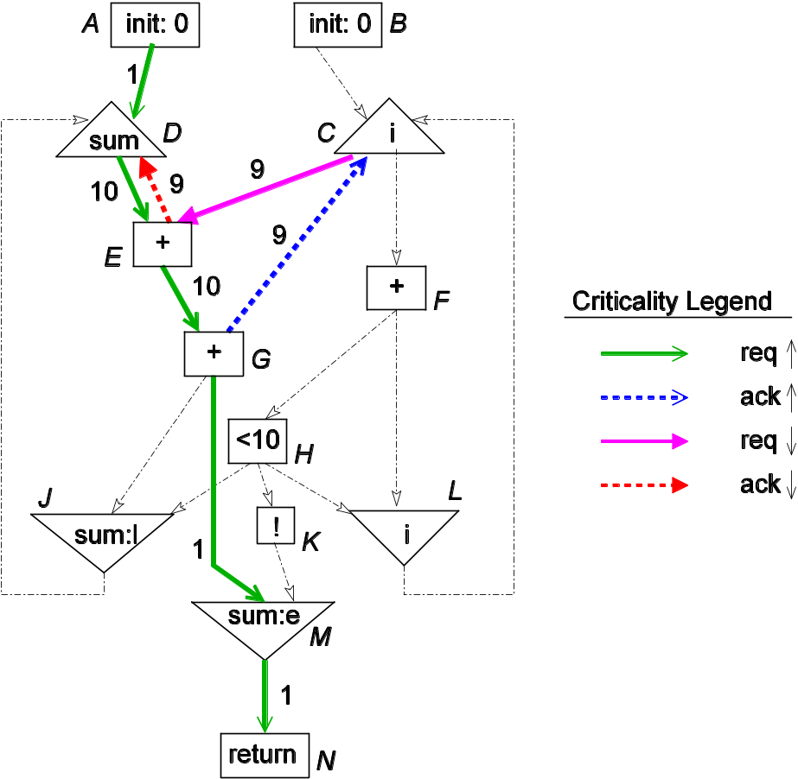
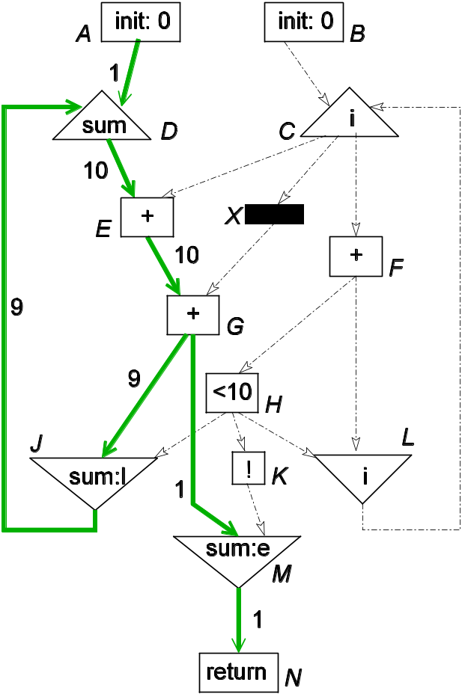
An Example
req_{AD}↑→ [req_{DE}↑→req_{EG}↑→ack_{GC}↑→req_{CE}↓→ack_{ED}↓]⁹
→req_{DE}↑→req_{EG}↑ →req_{GM}↑ →req_{MN}↑
req_{AD}↑→
[req_{DE}↑→req_{EG}↑→ack_{GJ}↑→req_{JA}↑]⁹
→req_{DE}↑→req_{EG}↑ →req_{GM}↑ →req_{MN}↑

Slide 18

Critical Path Toolflow
C
GCP
Feedback path
CASH
core
Verilog
back-end
P/R
model
GCP
extraction
Synopsys,
Cadence P/R
PLI calls
Execution
trace
ModelSim
asynchronous
circuit
layout
Input data
Notes:
CASH generates Verilog, which is then synthesized using commercial tools in a 180nm technology. The results are evaluated using Verilog-level simulation.
We only model the computation and memory access network; we do not model the memory itself, the cost of the rest of the computation, and the overhead of starting/stopping computation.
We do not include the cost of memory in this comparison.

Slide 19
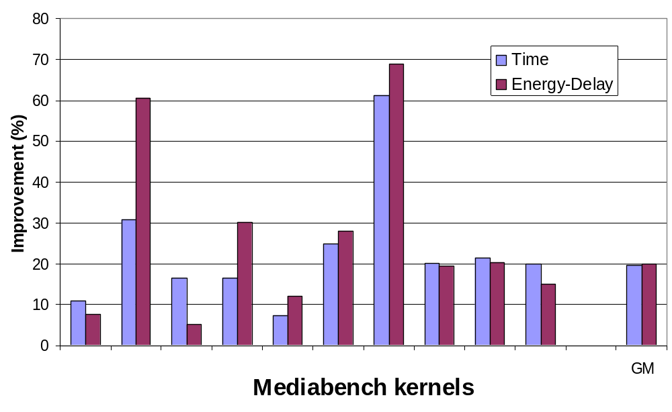
Effectiveness

Slide 20
Conclusions: Global Critical Path
t₀
t₁
t₂
t₃
Is defined as a path on the timed graph.
Tracks dependences.
Can be computed by automatic tools.
Summarizes concurrent computation bottlenecks.
Can be incorporated in a feedback loop.
to drive optimizations and de-optimizations.
Is a profiling (input-dependent) concept.

