Slide 1
Differential Datalog (DDlog)
Leonid Ryzhyk, Mihai Budiu
VMware Research
September 11, 2019
Stanford DAWN Retreat

Slide 2

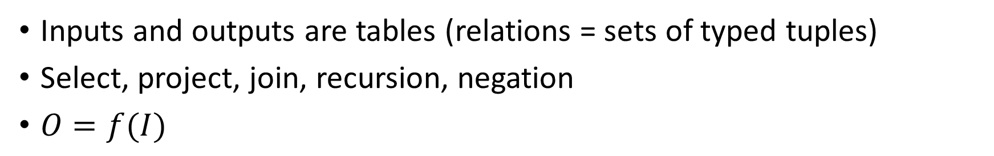
Datalog
Datalog
$$f$$
Input tables
Output tables
Inputs and outputs are tables (relations = sets of typed tuples)
Select, project, join, recursion, negation
$O=f(I)$

Slide 3



Differential Datalog
Datalog
$$Δf$$
Input tables
Output tables

Slide 4
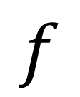
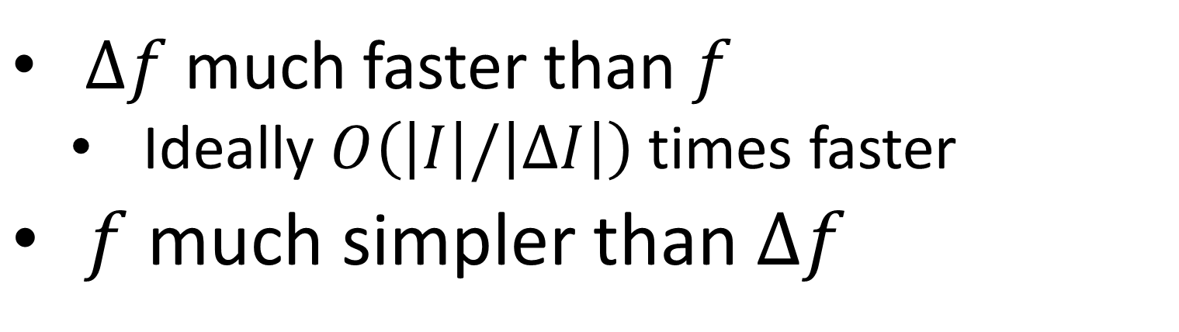
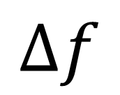
DDlog
DDLog compiler
$$f$$
$$Δf$$
$Δf$ much faster than $f$
Ideally $O\left(\left|I\right|/\left|ΔI\right|\right)$ times faster
$f$ much simpler than $Δf$

Slide 5









DDlog programs are streaming systems
Stream of input changes
Datalog
Stream of output changes
$${ΔI}_{3}$$
$${ΔI}_{2}$$
$${ΔI}_{1}$$
$${ΔI}_{0}$$
$${ΔO}_{3}$$
$${ΔO}_{2}$$
$${ΔO}_{1}$$
$${ΔO}_{0}$$
…
…
$$Δf$$
transactions

Slide 6
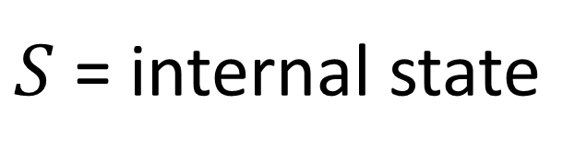

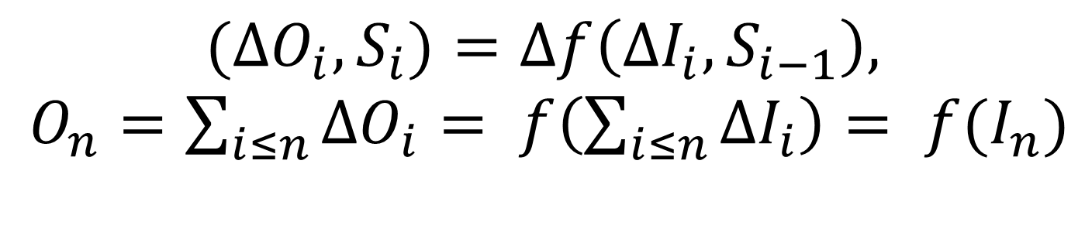
Correctness
$${(ΔO}_{i}, S_{i})=Δf\left({ΔI}_{i}, S_{i−1}\right),$$ $O_{n}=\sum_{i≤n}{{ΔO}_{i}}= f\left(\sum_{i≤n}{{ΔI}_{i}}\right)= {f(I}_{n})$
s.t.
Datalog
$${ΔI}_{3}$$
$${ΔI}_{2}$$
$${ΔI}_{1}$$
$${ΔI}_{0}$$
$${ΔO}_{3}$$
$${ΔO}_{2}$$
$${ΔO}_{1}$$
$${ΔO}_{0}$$
…
…
$$Δf$$
$S$ = internal state

Slide 7

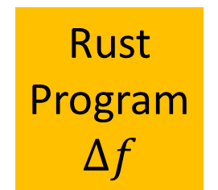
DDlog System architecture
Input changes
DDLog
program
DDLog compiler
Rust
Program
$$Δf$$
Rust compiler
Native executable
$$f$$
Haskell
Output changes
Differential dataflow
library

Slide 8




Who cares?
Databases: incremental view update
Compilers(Incremental) program analysis
Killer app: distributed systems control
VMware builds lots of these
E.g. OVN: Open Virtual Network Controller => 6,000 lines of DDlog
…

Slide 9

Why?
Management policies
Controller
Faster
Algorithm is ~ O(|state|/|$Δ$|) faster
Milliseconds instead of minutes
Less bandwidth
Much simpler code
Factors of 10-100x possible
Controller state
System state
View update
Managed entity
Configuration

Slide 10
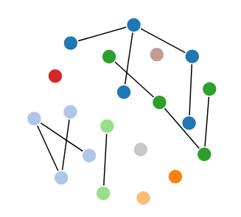
Connected components in DDlog
typedef Node = bit<16>
input relation Edge(source: Node, dest: Node)
// Symmetric edges
relation SimEdge(source: Node, dest: Node)
SimEdge(n, m) :- Edge(n, m).
SimEdge(n, m) :- Edge(m, n).
relation Reach(from: Node, to: Node)
Reach(n, m) :- SimEdge(n, _), var m = n.
Reach(n, m) :- SimEdge(n, m).
Reach(n, m) :- SimEdge(n, x), Reach(x, m).
// Canonical representative of a connected component: node with smallest value
output relation Canonical(node: Node, repr: Node)
Canonical(n, r) :- Reach(n, m), var r = Aggregate( (n), group_min(m) ).
The non-incremental algorithm is much simpler than the incremental one.
Try to write the incremental one by hand!

Slide 11
Demo
Graph
edges &
components
Graph
edges &
components
Graph
edges
Random graph
changes
Connected components
Web server
Web browser
serialize
deserialize
Java
Rust
Java
JavaScript+d3
compiler
ddlog

Slide 12
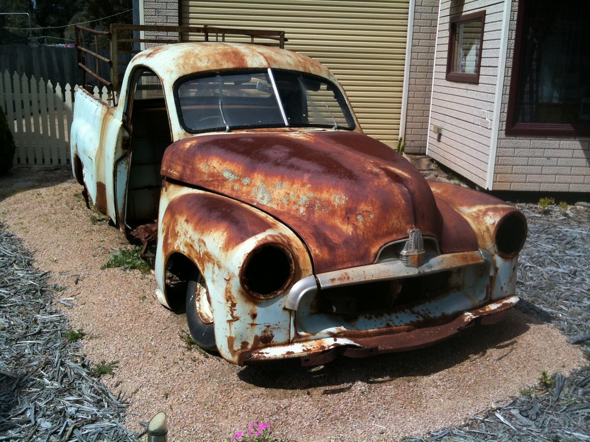
Not your grandfather’s Datalog
Strongly typed: bigint, strings, structs, union types, generic types
Powerful expression language
Arithmetic
Type-based safe matching
Javascript-like string interpolation
Module system
Native code execution
Vectors, Sets, Maps
Functions, iterators, aggregation
Profiling, logging, replay
Interoperation with Rust, C/C++, Java

Slide 13
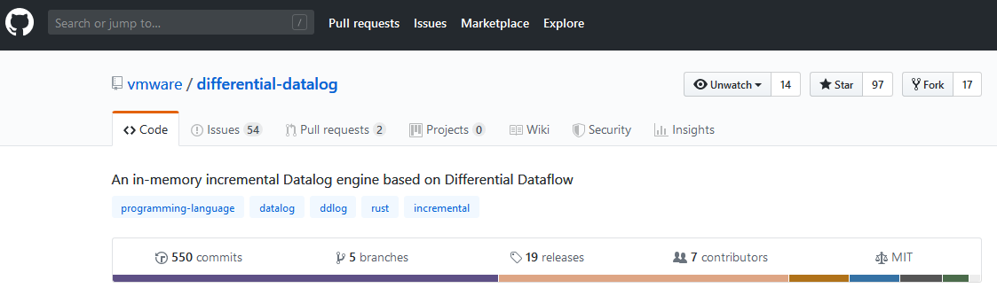
Kick the tires!

Slide 14
Backup slides

Slide 15
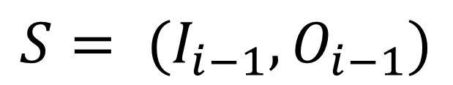
Strawman solution
$${ΔO}_{i}=f\left({I_{i−1}+ΔI}_{i}\right)− O_{i−1}$$
Datalog
$${ΔI}_{3}$$
$${ΔI}_{2}$$
$${ΔI}_{1}$$
$${ΔI}_{0}$$
$${ΔO}_{3}$$
$${ΔO}_{2}$$
$${ΔO}_{1}$$
$${ΔO}_{0}$$
…
…
$$Δf$$
$$S= {(I_{i−1},O}_{i−1})$$

