Slide 1
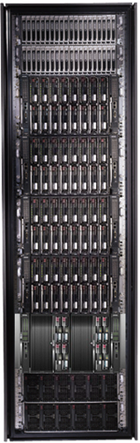
Cluster Computing with DryadLINQ
Mihai Budiu
Microsoft Research, Silicon Valley
Cloud computing: Infrastructure, Services, and Applications
UC Berkeley, March 4 2009

Slide 2
Goal
Notes:
Enable any programmer to write and run applications on small and large computer clusters.

Slide 3
Design Space
Grid
Internet
Data-
parallel
Search
Dryad
Shared
memory
Private
data
center
Transaction
HPC
Latency
Throughput
Notes:
Dryad is optimized for: throughput, data-parallel computation, in a private data-center.

Slide 4
Data-Parallel Computation
Application
SQL
Sawzall
≈SQL
LINQ, SQL
Parallel Databases
Sawzall
Pig, Hive
DryadLINQ Scope
Language
Map-Reduce
Hadoop
Dryad
Execution
GFS BigTable
HDFS
S3
Cosmos
Azure SQL Server
Storage

Slide 5

Software Stack
Applications
Log parsing
Machine Learning
Data mining
SQL
C#
Graphs
legacy code
SSIS
PSQL
Scope
.Net
Distributed Data Structures
SQL server
Distributed Shell
DryadLINQ
C++
queueing
Dryad
Distributed FS (Cosmos)
Azure XStore
SQL Server
NTFS
Cluster Services
Azure XCompute
Windows HPC
Windows Server
Windows Server
Windows Server
Windows Server

Slide 6
Outline
Introduction
Dryad
DryadLINQ
Conclusions

Slide 7

Dryad
Continuously deployed since 2006
Running on >> 10⁴ machines
Sifting through > 10Pb data daily
Runs on clusters > 3000 machines
Handles jobs with > 10⁵ processes each
Platform for rich software ecosystem
Used by >> 100 developers
Written at Microsoft Research, Silicon Valley

Slide 8
Dryad = Execution Layer
Job (application)
Pipeline
≈
Dryad
Shell
Cluster
Machine
Notes:
In the same way as the Unix shell does not understand the pipeline running on top, but manages its execution (i.e., killing processes when one exits), Dryad does not understand the job running on top.

Slide 9

2-D Piping
Unix Pipes: 1-D
grep | sed | sort | awk | perl
Dryad: 2-D
grep¹⁰⁰⁰ | sed⁵⁰⁰ | sort¹⁰⁰⁰ | awk⁵⁰⁰ | perl⁵⁰
Notes:
Dryad is a generalization of the Unix piping mechanism: instead of uni-dimensional (chain) pipelines, it provides two-dimensional pipelines. The unit is still a process connected by a point-to-point channel, but the processes are replicated.

Slide 10
Virtualized 2-D Pipelines
Notes:
This is a possible schedule of a Dryad job using 2 machines.

Slide 11


Virtualized 2-D Pipelines

Slide 12

Virtualized 2-D Pipelines

Slide 13
Virtualized 2-D Pipelines

Slide 14
Virtualized 2-D Pipelines
2D DAG
multi-machine
virtualized
Notes:
The Unix pipeline is generalized 3-ways:
2D instead of 1D
spans multiple machines
resources are virtualized: you can run the same large job on many or few machines

Slide 15
Dryad Job Structure
Channels
Input files
Stage
Output files
grep
sort
awk
sed
perl
grep
sort
sed
awk
grep
sort
Vertices (processes)
Notes:
This is the basic Dryad terminology.

Slide 16
Channels
Finite streams of items
distributed filesystem files (persistent)
SMB/NTFS files (temporary)
TCP pipes (inter-machine)
memory FIFOs (intra-machine)
X
Items
M
Notes:
Channels are very abstract, enabling a variety of transport mechanisms.
The performance and fault-tolerance of these machanisms vary widely.

Slide 17
Dryad System Architecture
data plane
Files, TCP, FIFO, Network
job schedule
V
V
V
NS
PD
PD
PD
control plane
Job manager
cluster
Notes:
The brain of a Dryad job is a centralized Job Manager, which maintains a complete state of the job.
The JM controls the processes running on a cluster, but never exchanges data with them.
(The data plane is completely separated from the control plane.)

Slide 18



Fault Tolerance
Notes:
Vertex failures and channel failures are handled differently.

Slide 19
Policy Managers
R
R
R
R
Stage R
Connection R-X
X
X
X
X
Stage X
X Manager
R manager
R-X Manager
Job
Manager

Slide 20
Dynamic Graph Rewriting
X[0]
X[1]
X[3]
X[2]
X’[2]
Slow vertex
Duplicate vertex
Completed vertices
Duplication Policy = f(running times, data volumes)
Notes:
The handling of apparently very slow computation by duplication of vertices is handled by a stage manager.

Slide 21
Cluster network topology
top-level switch
top-of-rack switch
rack

Slide 22
Dynamic Aggregation
S
S
S
S
S
S
T
static
S
S
S
S
S
S
# 1
# 2
# 1
# 3
# 3
# 2
rack #
A
A
A
# 1
# 2
# 3
dynamic
T
Notes:
Aggregating data with associative operators can be done in a bandwidth-preserving fashion in the intermediate aggregations are placed close to the source data.

Slide 23

Policy vs. Mechanism
Application-level
Most complex in C++ code
Invoked with upcalls
Need good default implementations
DryadLINQ provides a comprehensive set
Built-in
Scheduling
Graph rewriting
Fault tolerance
Statistics and reporting

Slide 24
Outline
Introduction
Dryad
DryadLINQ
Conclusions

Slide 25

LINQ
=> DryadLINQ
Dryad
Notes:
DryadLINQ adds a wealth of features on top of plain Dryad.

Slide 26
LINQ = .Net+ Queries
Collection<T> collection;
bool IsLegal(Key);
string Hash(Key);
var results = from c in collection where IsLegal(c.key) select new { Hash(c.key), c.value};
Notes:
Language Integrated Query is an extension of .Net which allows one to write declarative computations on collections (green part).

Slide 27

Collections and Iterators
class Collection<T> : IEnumerable<T>;
public interface IEnumerable<T> {
IEnumerator<T> GetEnumerator();
}
public interface IEnumerator <T> {
T Current { get; }
bool MoveNext();
void Reset();
}

Slide 28

DryadLINQ Data Model
.Net objects
Partition
Collection

Slide 29

DryadLINQ = LINQ + Dryad
Collection<T> collection;
bool IsLegal(Key k);
string Hash(Key);
var results = from c in collection where IsLegal(c.key) select new { Hash(c.key), c.value};
Vertex code
Query plan
(Dryad job)
Data
collection
C#
C#
C#
C#
results
Notes:
DryadLINQ translates LINQ programs into Dryad computations:
- C# and LINQ data objects become distributed partitioned files.
- LINQ queries become distributed Dryad jobs.
- C# methods become code running on the vertices of a Dryad job.

Slide 30
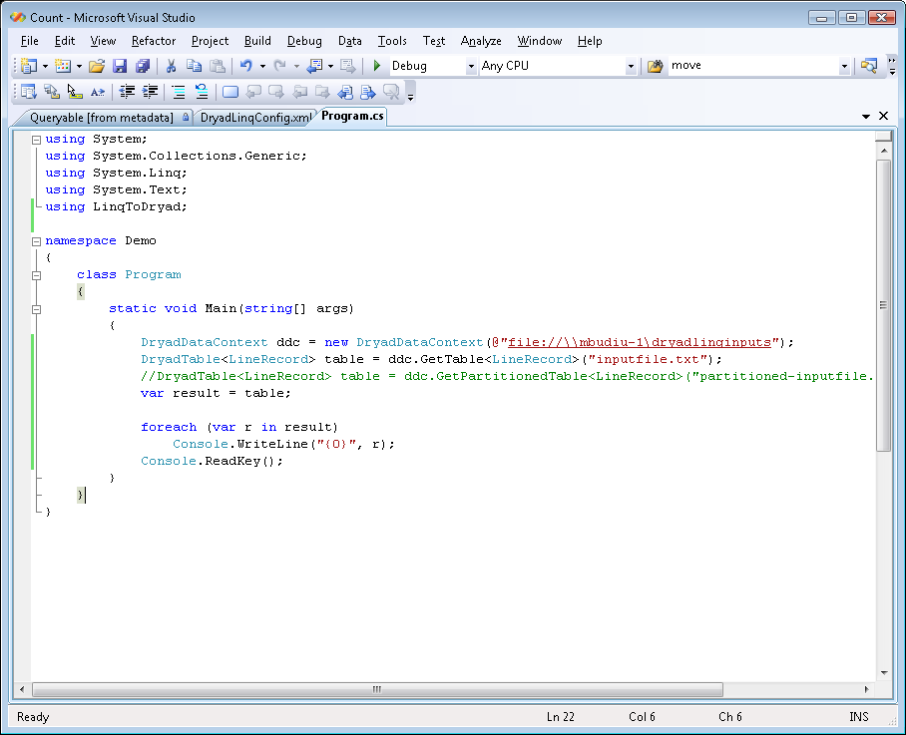
Demo

Slide 31
Example: Histogram
public static IQueryable<Pair> Histogram(
IQueryable<LineRecord> input, int k)
{
var words = input.SelectMany(x => x.line.Split(' '));
var groups = words.GroupBy(x => x);
var counts = groups.Select(x => new Pair(x.Key, x.Count()));
var ordered = counts.OrderByDescending(x => x.count);
var top = ordered.Take(k);
return top;
}
“A line of words of wisdom”
[“A”, “line”, “of”, “words”, “of”, “wisdom”]
[[“A”], [“line”], [“of”, “of”], [“words”], [“wisdom”]]
[ {“A”, 1}, {“line”, 1}, {“of”, 2}, {“words”, 1}, {“wisdom”, 1}]
[{“of”, 2}, {“A”, 1}, {“line”, 1}, {“words”, 1}, {“wisdom”, 1}]
[{“of”, 2}, {“A”, 1}, {“line”, 1}]

Slide 32
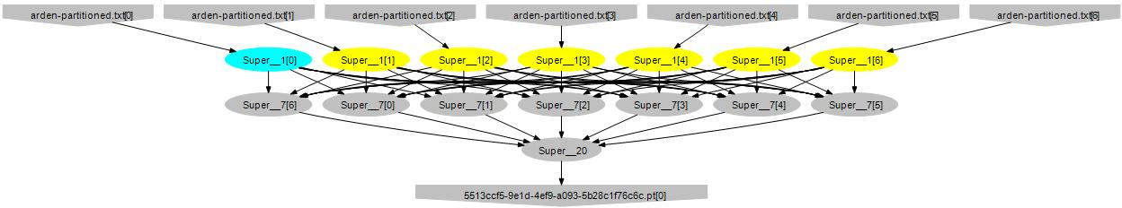
Histogram Plan
SelectMany
Sort
GroupBy+Select
HashDistribute
MergeSort
GroupBy
Select
Sort
Take
MergeSort
Take

Slide 33
Map-Reduce in DryadLINQ
public static IQueryable<S> MapReduce<T,M,K,S>(
this IQueryable<T> input,
Expression<Func<T, IEnumerable<M>>> mapper,
Expression<Func<M,K>> keySelector,
Expression<Func<IGrouping<K,M>,S>> reducer)
{
var map = input.SelectMany(mapper);
var group = map.GroupBy(keySelector);
var result = group.Select(reducer);
return result;
}

Slide 34
Map-Reduce Plan
M
M
M
M
M
M
M
map
Q
Q
Q
Q
Q
Q
Q
sort
G₁
G₁
G₁
G₁
G₁
G₁
G₁
groupby
map
M
R
R
R
R
R
R
R
reduce
D
D
D
D
D
D
D
distribute
G
R
MS
MS
MS
MS
MS
mergesort
groupby
X
G₂
G₂
G₂
G₂
G₂
partial aggregation
R
R
R
R
R
reduce
X
X
X
MS
MS
mergesort
static
dynamic
dynamic
G₂
G₂
groupby
reduce
S
S
S
S
S
S
R
R
reduce
A
A
A
X
X
consumer
T

Slide 35
Distributed Sorting Plan
DS
DS
DS
DS
DS
H
H
H
O
D
D
D
D
D
static
dynamic
dynamic
M
M
M
M
M
S
S
S
S
S

Slide 36
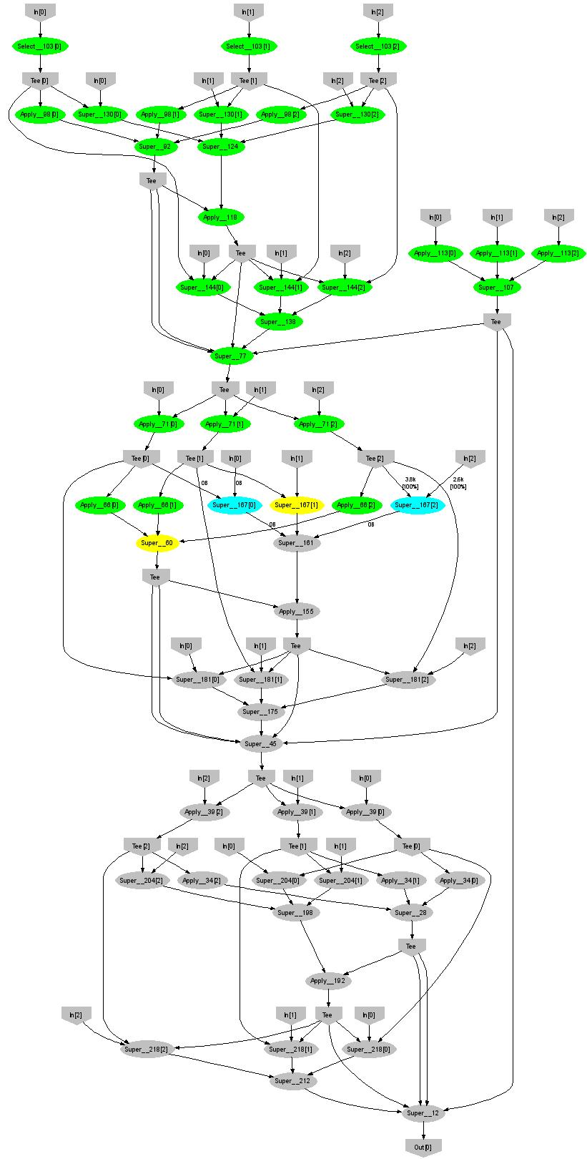
Expectation Maximization
160 lines
3 iterations shown
Notes:
More complicated, even iterative algorithms, can be implemented.

Slide 37
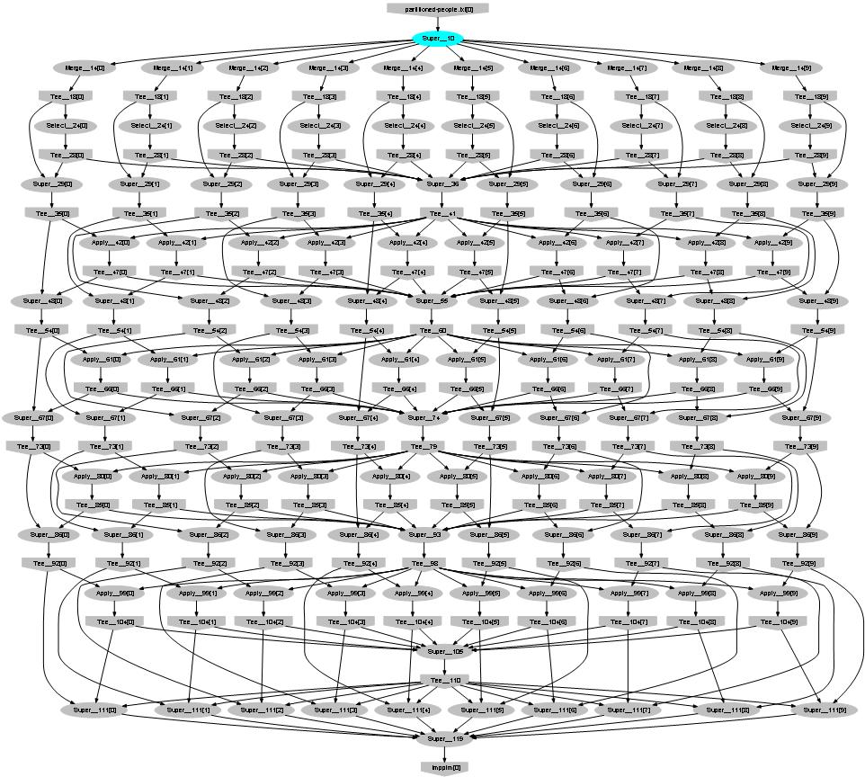
Probabilistic Index Maps
Images
features

Slide 38

Language Summary
Where
Select
GroupBy
OrderBy
Aggregate
Join
Apply
Materialize

Slide 39
LINQ System Architecture
Local machine
Execution engine
LINQ-to-obj
PLINQ
LINQ-to-SQL
LINQ-to-WS
DryadLINQ
Flickr
Oracle
LINQ-to-XML
Your own
.Net program
(C#, VB, F#, etc)
LINQ Provider
Query
Objects

Slide 40
The DryadLINQ Provider
Client machine
.Net
DryadLINQ
Data center
Distributed query plan
Query Expr
Invoke
Query
Vertex code
Con- text
Input Tables
ToCollection
Dryad JM
Dryad Execution
.Net Objects
Output DryadTable
Results
foreach
(11)
Output Tables

Slide 41
Combining Query Providers
Local machine
Execution engines
.Net program
(C#, VB, F#, etc)
LINQ Provider
PLINQ
Query
LINQ Provider
SQL Server
LINQ Provider
DryadLINQ
Objects
LINQ Provider
LINQ-to-obj

Slide 42
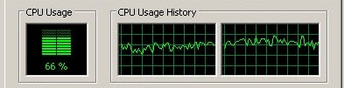


Using PLINQ
Query
DryadLINQ
Local query
PLINQ
Notes:
At the bottom DryadLINQ uses LINQ to run the computation in parallel on multiple cores.

Slide 43

Using LINQ to SQL Server
Query
DryadLINQ
Query
Query
Query
LINQ to SQL
LINQ to SQL
Query
Query

Slide 44
Using LINQ-to-objects
Local machine
LINQ to obj
debug
Query
production
DryadLINQ
Cluster

Slide 45
Outline
Introduction
Dryad
DryadLINQ
Conclusions

Slide 46

Lessons Learned (1)
What worked well?
Complete separation of storage / execution / language
Using LINQ +.Net (language integration)
Strong typing for data
Allowing flexible and powerful policies
Centralized job manager: no replication, no consensus, no checkpointing
Porting (HPC, Cosmos, Azure, SQL Server)
Technology transfer (done at the right time)

Slide 47

Lessons Learned (2)
What worked less well
Error handling and propagation
Distributed (randomized) resource allocation
TCP pipe channels
Hierarchical dataflow graphs (each vertex = small graph)
Forking the source tree

Slide 48
Lessons Learned (3)
Tricks of the trade
Asynchronous operations hide latency
Management through distributed state machines
Logging state transitions for debugging
Complete separation of data and control
Leases clean-up after themselves
Understand scaling factors
O(machines) < O(vertices) < O(edges)
Don’t fix a broken API, re-design it
Compression trades-off bandwidth for CPU
Managed code increases productivity by 10x10

Slide 49
Ongoing Dryad/DryadLINQ Research
Performance modeling
Scheduling and resource allocation
Profiling and performance debugging
Incremental computation
Hardware acceleration
High-level programming abstractions
Many domain-specific applications

Slide 50
Sample applications written using DryadLINQ | Class
Distributed linear algebra | Numerical
Accelerated Page-Rank computation | Web graph
Privacy-preserving query language | Data mining
Expectation maximization for a mixture of Gaussians | Clustering
K-means | Clustering
Linear regression | Statistics
Probabilistic Index Maps | Image processing
Principal component analysis | Data mining
Probabilistic Latent Semantic Indexing | Data mining
Performance analysis and visualization | Debugging
Road network shortest-path preprocessing | Graph
Botnet detection | Data mining
Epitome computation | Image processing
Neural network training | Statistics
Parallel machine learning framework infer.net | Machine learning
Distributed query caching | Optimization
Image indexing | Image processing
Web indexing structure | Web graph

Slide 51

Conclusions
Visual Studio
LINQ
Dryad
=
51
Notes:
We believe that Dryad and DryadLINQ are a great foundation for cluster computing.

Slide 52
“What’s the point if I can’t have it?”
Glad you asked
We’re offering Dryad+DryadLINQ to academic partners
Dryad is in binary form, DryadLINQ in source
Requires signing a 3-page licensing agreement

Slide 53

Backup Slides

Slide 54
DryadLINQ
Declarative programming
Integration with Visual Studio
Integration with .Net
Type safety
Automatic serialization
Job graph optimizations
static
dynamic
Conciseness
Notes:
DryadLINQ adds a wealth of features on top of plain Dryad.

Slide 55
What does DryadLINQ do?
public struct Data { …
public static int Compare(Data left, Data right);
}
Data g = new Data();
var result = table.Where(s => Data.Compare(s, g) < 0);
public static void Read(this DryadBinaryReader reader, out Data obj);
public static int Write(this DryadBinaryWriter writer, Data obj);
public class DryadFactoryType__0 : LinqToDryad.DryadFactory<Data>
Data serialization
Data factory
DryadVertexEnv denv = new DryadVertexEnv(args);
var dwriter__2 = denv.MakeWriter(FactoryType__0);
var dreader__3 = denv.MakeReader(FactoryType__0);
var source__4 = DryadLinqVertex.Where(dreader__3,
s => (Data.Compare(s, ((Data)DryadLinqObjectStore.Get(0))) < ((System.Int32)(0))), false);
dwriter__2.WriteItemSequence(source__4);
Channel writer
Channel reader
LINQ code
Context serialization

Slide 56
Range-Distribution Manager
S
S
S
[0-100)
S
S
S
Hist
[0-30),[30-100)
T
static
D
D
D
T
T
[0-?)
[0-30)
[?-100)
[30-100)
dynamic
56
Notes:
Using a connection manager one can load-balance the data distribution at run-time, based on data statistics obtained from sampling the data stream. In this case the number of destination vertices and the ranges for each vertex are decided dynamically.

Slide 57

Staging
1. Build
2. Send .exe
7. Serialize vertices
vertex code
5. Generate graph
JM code
Cluster services
6. Initialize vertices
3. Start JM
8. Monitor
Vertex execution
4. Query cluster resources
Notes:
Computation Staging

Slide 58
Bibliography
Dryad: Distributed Data-Parallel Programs from Sequential Building Blocks
Michael Isard, Mihai Budiu, Yuan Yu, Andrew Birrell, and Dennis Fetterly
European Conference on Computer Systems (EuroSys), Lisbon, Portugal, March 21-23, 2007
DryadLINQ: A System for General-Purpose Distributed Data-Parallel Computing Using a High-Level Language
Yuan Yu, Michael Isard, Dennis Fetterly, Mihai Budiu, Úlfar Erlingsson, Pradeep Kumar Gunda, and Jon Currey Symposium on Operating System Design and Implementation (OSDI), San Diego, CA, December 8-10, 2008
SCOPE: Easy and Efficient Parallel Processing of Massive Data Sets Ronnie Chaiken, Bob Jenkins, Per-Åke Larson, Bill Ramsey, Darren Shakib, Simon Weaver, and Jingren Zhou
Very Large Databases Conference (VLDB), Auckland, New Zealand, August 23-28 2008
Hunting for problems with Artemis Gabriela F. Creţu-Ciocârlie, Mihai Budiu, and Moises Goldszmidt USENIX Workshop on the Analysis of System Logs (WASL), San Diego, CA, December 7, 2008

Slide 59

Data Partitioning
DATA
RAM
DATA
Notes:
A common scenario: too much data to process. Instead of trying to be clever, just use more machines and a brute-force algorithm.

Slide 60
Linear Algebra & Machine Learning in DryadLINQ
Data analysis
Machine learning
Large Vector
DryadLINQ
Dryad
Notes:
I will now focus on a library for machine-learning algorithms we have built on top of DryadLINQ.

Slide 61
Operations on Large Vectors: Map 1
T
f
U
f preserves partitioning
T
f
U
Notes:
One can apply an arbitrary C# side-effect free function f to all objects in a vector.

Slide 62
Map 2 (Pairwise)
T
f
U
V
T
U
f
V
Notes:
Or one can do it to a pair of vectors.

Slide 63
Map 3 (Vector-Scalar)
T
f
U
V
T
U
f
V
63
Notes:
Or one can use a vector and a scalar, replicating the scalar for each element of the vector.

Slide 64
Reduce (Fold)
f
U
U
U
U
f
f
f
U
U
U
f
U
Notes:
Finally, one can fold a vector to a scalar.

Slide 65
Linear Algebra
T
T
,
U
,
V
=
Notes:
Having vectors of vectors or matrices builds to a nice linear algebra library.

Slide 66
Linear Regression
Data
Find
S.t.
Notes:
We will show how to compute linear regression parameters.

Slide 67
Analytic Solution
X[0]
X[1]
X[2]
Y[0]
Y[1]
Y[2]
Map
X×X^{T}
X×X^{T}
X×X^{T}
Y×X^{T}
Y×X^{T}
Y×X^{T}
Reduce
Σ
Σ
[ ]⁻¹
*
A
Notes:
This expression uses a query plan composed of 2 (pairwise) maps and 2 reduces.

Slide 68
Linear Regression Code
Vectors x = input(0), y = input(1);
Matrices xx = x.Map(x, (a,b) => a.OuterProd(b));
OneMatrix xxs = xx.Sum();
Matrices yx = y.Map(x, (a,b) => a.OuterProd(b));
OneMatrix yxs = yx.Sum();
OneMatrix xxinv = xxs.Map(a => a.Inverse());
OneMatrix A = yxs.Map(xxinv, (a, b) => a.Mult(b));
Notes:
The complete source code for linear regression has 6 lines of code.

