Slide 1
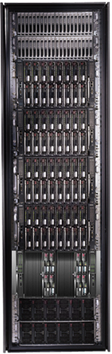
Cluster Computing with DryadLINQ
Mihai Budiu, MSR-SVC
PARC, May 8 2008

Slide 2







Aknowledgments
MSR SVC and ISRC SVC
Michael Isard, Yuan Yu, Andrew Birrell, Dennis Fetterly
Ulfar Erlingsson, Pradeep Kumar Gunda, Jon Currey

Slide 3
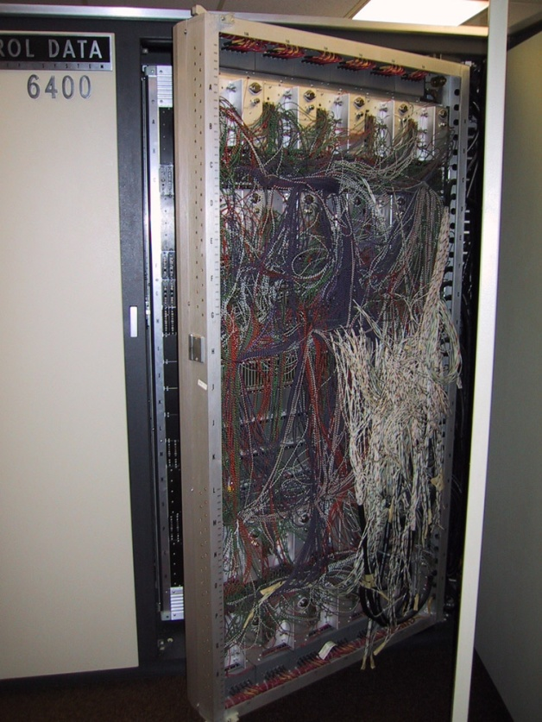
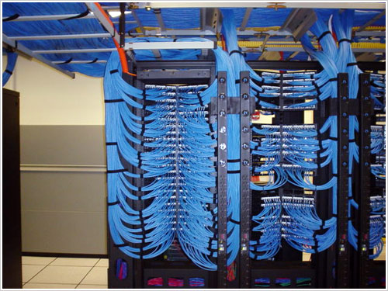
Computer Evolution
?
1961
2008
2040

Slide 4
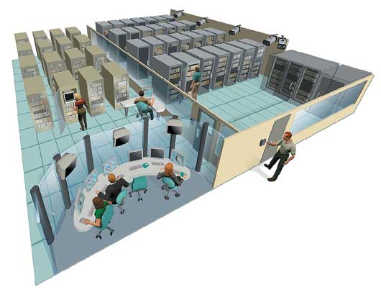
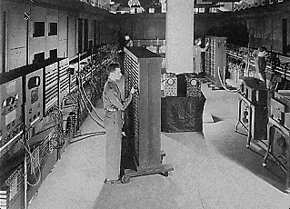
Computer Evolution
?
ENIAC 1943 30 tons
200kW
Datacenter 2008 500,000 ft²
40MW
2040

Slide 5

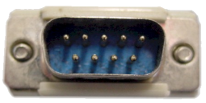
2040

Slide 6
Layers
Applications
Programming Languages and APIs
Resource Management
Scheduling
Distributed Execution
Operating System
Caching and Synchronization
Storage
Identity & Security
Networking

Slide 7









Pieces of the Global Computer

Slide 8
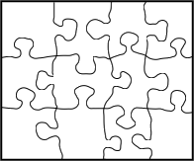

This Work

Slide 9
The Rest of This Talk
Machine Learning
Large Vectors
DryadLINQ
Dryad
Distributed Filesystem
CIFS/NTFS
Cluster Services
Windows Server
Windows Server
Windows Server
Windows Server

Slide 10


TeraSort
How fast can you sort 10¹⁰ 100-byte records (1Tb)?
Sequential scan/disk = 4.6 hours
Current record: 435 seconds (7.2 min) cluster of 40 Itanium2, 2520 SAN disks
Code: 3300 lines of C
Our result: 349 seconds (5.8 min) cluster of 240 AMD64 (quad) machines, 920 disks
Code: 17 lines of LINQ

Slide 11
Outline
Introduction
Dryad
DryadLINQ
Building on DryadLINQ

Slide 12
Outline
Introduction
Dryad
deployed since 2006
many thousands of machines
analyzes many petabytes of data/day
DryadLINQ
Building on DryadLINQ

Slide 13
Goal
Notes:
Enable any programmer to write and run applications on small and large computer clusters.

Slide 14
Design Space
Grid
Internet
Data-
parallel
Search
Dryad
Shared
memory
Private
data
center
Transaction
HPC
Latency
Throughput
Notes:
Dryad is optimized for: throughput, data-parallel computation, in a private data-center.

Slide 15

Data Partitioning
DATA
RAM
DATA
Notes:
A common scenario: too much data to process. Instead of trying to be clever, just use more machines and a brute-force algorithm.

Slide 16

2-D Piping
Unix Pipes: 1-D
grep | sed | sort | awk | perl
Dryad: 2-D
grep¹⁰⁰⁰ | sed⁵⁰⁰ | sort¹⁰⁰⁰ | awk⁵⁰⁰ | perl⁵⁰
Notes:
Dryad is a generalization of the Unix piping mechanism: instead of uni-dimensional (chain) pipelines, it provides two-dimensional pipelines. The unit is still a process connected by a point-to-point channel, but the processes are replicated.

Slide 17
Dryad = Execution Layer
Job (application)
Pipeline
≈
Dryad
Shell
Cluster
Machine
Notes:
In the same way as the Unix shell does not understand the pipeline running on top, but manages its execution (i.e., killing processes when one exits), Dryad does not understand the job running on top.

Slide 18
Virtualized 2-D Pipelines
Notes:
This is a possible schedule of a Dryad job using 2 machines.

Slide 19


Virtualized 2-D Pipelines

Slide 20

Virtualized 2-D Pipelines

Slide 21
Virtualized 2-D Pipelines

Slide 22
Virtualized 2-D Pipelines
2D DAG
multi-machine
virtualized
Notes:
The Unix pipeline is generalized 3-ways:
2D instead of 1D
spans multiple machines
resources are virtualized: you can run the same large job on many or few machines

Slide 23
Dryad Job Structure
Channels
Input files
Stage
Output files
grep
sort
awk
sed
perl
grep
sort
sed
awk
grep
sort
Vertices (processes)
Notes:
This is the basic Dryad terminology.

Slide 24
Channels
Finite Streams of items
distributed filesystem files (persistent)
SMB/NTFS files (temporary)
TCP pipes (inter-machine)
memory FIFOs (intra-machine)
X
Items
M
Notes:
Channels are very abstract, enabling a variety of transport mechanisms.
The performance and fault-tolerance of these machanisms vary widely.

Slide 25
Architecture
data plane
Files, TCP, FIFO, Network
job schedule
V
V
V
NS
PD
PD
PD
control plane
Job manager
cluster
Notes:
The brain of a Dryad job is a centralized Job Manager, which maintains a complete state of the job.
The JM controls the processes running on a cluster, but never exchanges data with them.
(The data plane is completely separated from the control plane.)

Slide 26



Fault Tolerance
Notes:
Vertex failures and channel failures are handled differently.

Slide 27
Dynamic Graph Rewriting
X[0]
X[1]
X[3]
X[2]
X’[2]
Slow vertex
Duplicate vertex
Completed vertices
Duplication Policy = f(running times, data volumes)
Notes:
The handling of apparently very slow computation by duplication of vertices is handled by a stage manager.

Slide 28
Dynamic Aggregation
S
S
S
S
S
S
T
static
S
S
S
S
S
S
# 1
# 2
# 1
# 3
# 3
# 2
rack #
A
A
A
# 1
# 2
# 3
dynamic
T
Notes:
Aggregating data with associative operators can be done in a bandwidth-preserving fashion in the intermediate aggregations are placed close to the source data.

Slide 29
Data-Parallel Computation
Parallel Databases
Map-Reduce
Application
Dryad
Execution
GFS BigTable
Storage

Slide 30
Outline
Introduction
Dryad
DryadLINQ
Building on Dryad

Slide 31

DryadLINQ
Dryad
Notes:
DryadLINQ adds a wealth of features on top of plain Dryad.

Slide 32
LINQ
Collection<T> collection;
bool IsLegal(Key);
string Hash(Key);
var results = from c in collection where IsLegal(c.key) select new { Hash(c.key), c.value};
Notes:
Language Integrated Query is an extension of C# which allows one to write declarative computations on collections (green part).

Slide 33

DryadLINQ = LINQ + Dryad
Collection<T> collection;
bool IsLegal(Key k);
string Hash(Key);
var results = from c in collection where IsLegal(c.key) select new { Hash(c.key), c.value};
Vertex code
Query plan
(Dryad job)
Data
collection
C#
C#
C#
C#
results
Notes:
DryadLINQ translates LINQ programs into Dryad computations:
- C# and LINQ data objects become distributed partitioned files.
- LINQ queries become distributed Dryad jobs.
- C# methods become code running on the vertices of a Dryad job.

Slide 34

Data Model
C# objects
Partition
Collection

Slide 35
Query Providers
Client machine
C#
DryadLINQ
Data center
Distributed query plan
Query Expr
Invoke
Query
ToDryadTable
Input Tables
JM
Dryad Execution
C# Objects
Output DryadTable
Results
foreach
(11)
Output Tables

Slide 36
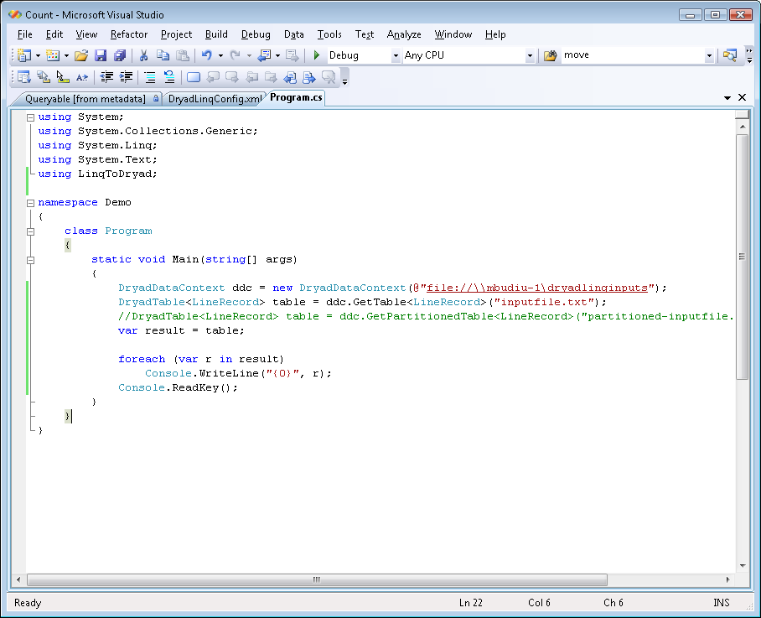
Demo

Slide 37
Example: Histogram
public static IQueryable<Pair> Histogram(
IQueryable<LineRecord> input, int k)
{
var words = input.SelectMany(x => x.line.Split(' '));
var groups = words.GroupBy(x => x);
var counts = groups.Select(x => new Pair(x.Key, x.Count()));
var ordered = counts.OrderByDescending(x => x.count);
var top = ordered.Take(k);
return top;
}
“A line of words of wisdom”
[“A”, “line”, “of”, “words”, “of”, “wisdom”]
[[“A”], [“line”], [“of”, “of”], [“words”], [“wisdom”]]
[ {“A”, 1}, {“line”, 1}, {“of”, 2}, {“words”, 1}, {“wisdom”, 1}]
[{“of”, 2}, {“A”, 1}, {“line”, 1}, {“words”, 1}, {“wisdom”, 1}]
[{“of”, 2}, {“A”, 1}, {“line”, 1}]

Slide 38
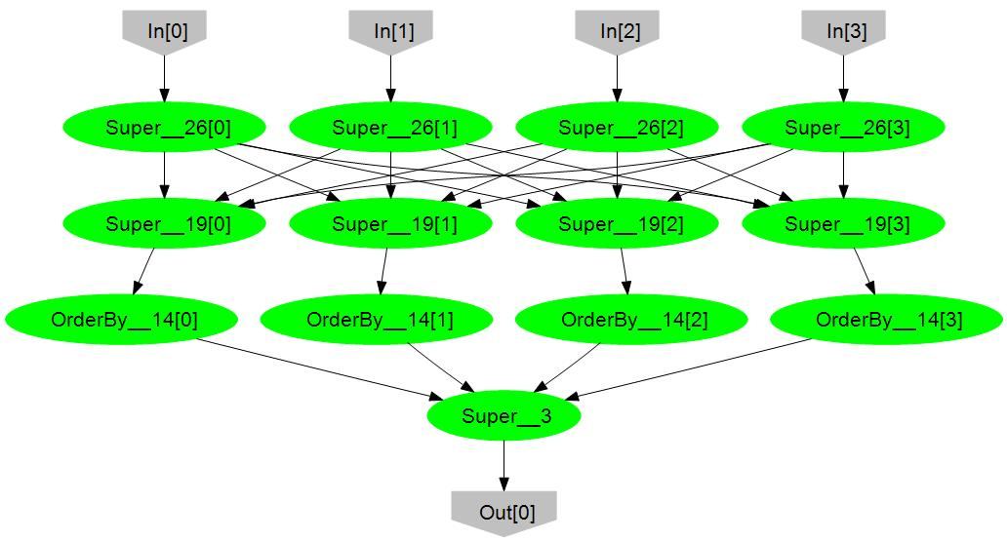
Histogram Plan
SelectMany
HashDistribute
Merge
GroupBy
Select
OrderByDescending Take
MergeSort
Take

Slide 39
Map-Reduce in DryadLINQ
public static IQueryable<S> MapReduce<T,M,K,S>(
this IQueryable<T> input,
Expression<Func<T, IEnumerable<M>>> mapper,
Expression<Func<M,K>> keySelector,
Expression<Func<IGrouping<K,M>,S>> reducer)
{
var map = input.SelectMany(mapper);
var group = map.GroupBy(keySelector);
var result = group.Select(reducer);
return result;
}

Slide 40
Map-Reduce Plan
M
M
M
M
M
M
M
map
Q
Q
Q
Q
Q
Q
Q
sort
M
G₁
G₁
G₁
G₁
G₁
G₁
G₁
groupby
map
D
R
R
R
R
R
R
R
reduce
D
D
D
D
D
D
D
distribute
G
R
(1)
(2)
(3)
MS
MS
mergesort
MS
MS
MS
groupby
X
G₂
G₂
G₂
G₂
G₂
partial aggregation
R
R
R
R
R
reduce
X
X
X
MS
MS
mergesort
G₂
G₂
groupby
reduce
S
S
S
S
S
S
R
R
reduce
A
A
A
X
X
consumer
T

Slide 41
Distributed Sorting in DryadLINQ
public static IQueryable<TSource>
DSort<TSource, TKey>(this IQueryable<TSource> source,
Expression<Func<TSource, TKey>> keySelector,
int pcount)
{
var samples = source.Apply(x => Sampling(x));
var keys = samples.Apply(x => ComputeKeys(x, pcount));
var parts = source.RangePartition(keySelector, keys);
return parts.OrderBy(keySelector);
}

Slide 42
Distributed Sorting Plan
DS
DS
DS
DS
DS
H
H
H
O
D
D
D
D
D
(1)
(2)
(3)
M
M
M
M
M
S
S
S
S
S

Slide 43
Outline
Introduction
Dryad
DryadLINQ
Building on DryadLINQ

Slide 44
Machine Learning in DryadLINQ
Data analysis
Machine learning
Large Vector
DryadLINQ
Dryad
Notes:
I will now focus on a library for machine-learning algorithms we have built on top of DryadLINQ.

Slide 45
Operations on Large Vectors: Map 1
T
f
U
f preserves partitioning
T
f
U
Notes:
One can apply an arbitrary C# side-effect free function f to all objects in a vector.

Slide 46
Map 2 (Pairwise)
T
f
U
V
T
U
f
V
Notes:
Or one can do it to a pair of vectors.

Slide 47
Map 3 (Vector-Scalar)
T
f
U
V
T
U
f
V
47
Notes:
Or one can use a vector and a scalar, replicating the scalar for each element of the vector.

Slide 48
Reduce (Fold)
f
U
U
U
U
f
f
f
U
U
U
f
U
Notes:
Finally, one can fold a vector to a scalar.

Slide 49
Linear Algebra
T
T
,
U
,
V
=
Notes:
Having vectors of vectors or matrices builds to a nice linear algebra library.

Slide 50
Linear Regression
Data
Find
S.t.
Notes:
We will show how to compute linear regression parameters.

Slide 51
Analytic Solution
X[0]
X[1]
X[2]
Y[0]
Y[1]
Y[2]
Map
X×X^{T}
X×X^{T}
X×X^{T}
Y×X^{T}
Y×X^{T}
Y×X^{T}
Reduce
Σ
Σ
[ ]⁻¹
*
A
Notes:
This expression uses a query plan composed of 2 (pairwise) maps and 2 reduces.

Slide 52
Linear Regression Code
Vectors x = input(0), y = input(1);
Matrices xx = x.Map(x, (a,b) => a.OuterProd(b));
OneMatrix xxs = xx.Sum();
Matrices yx = y.Map(x, (a,b) => a.OuterProd(b));
OneMatrix yxs = yx.Sum();
OneMatrix xxinv = xxs.Map(a => a.Inverse());
OneMatrix A = yxs.Map(xxinv, (a, b) => a.Mult(b));
Notes:
The complete source code for linear regression has 6 lines of code.

Slide 53
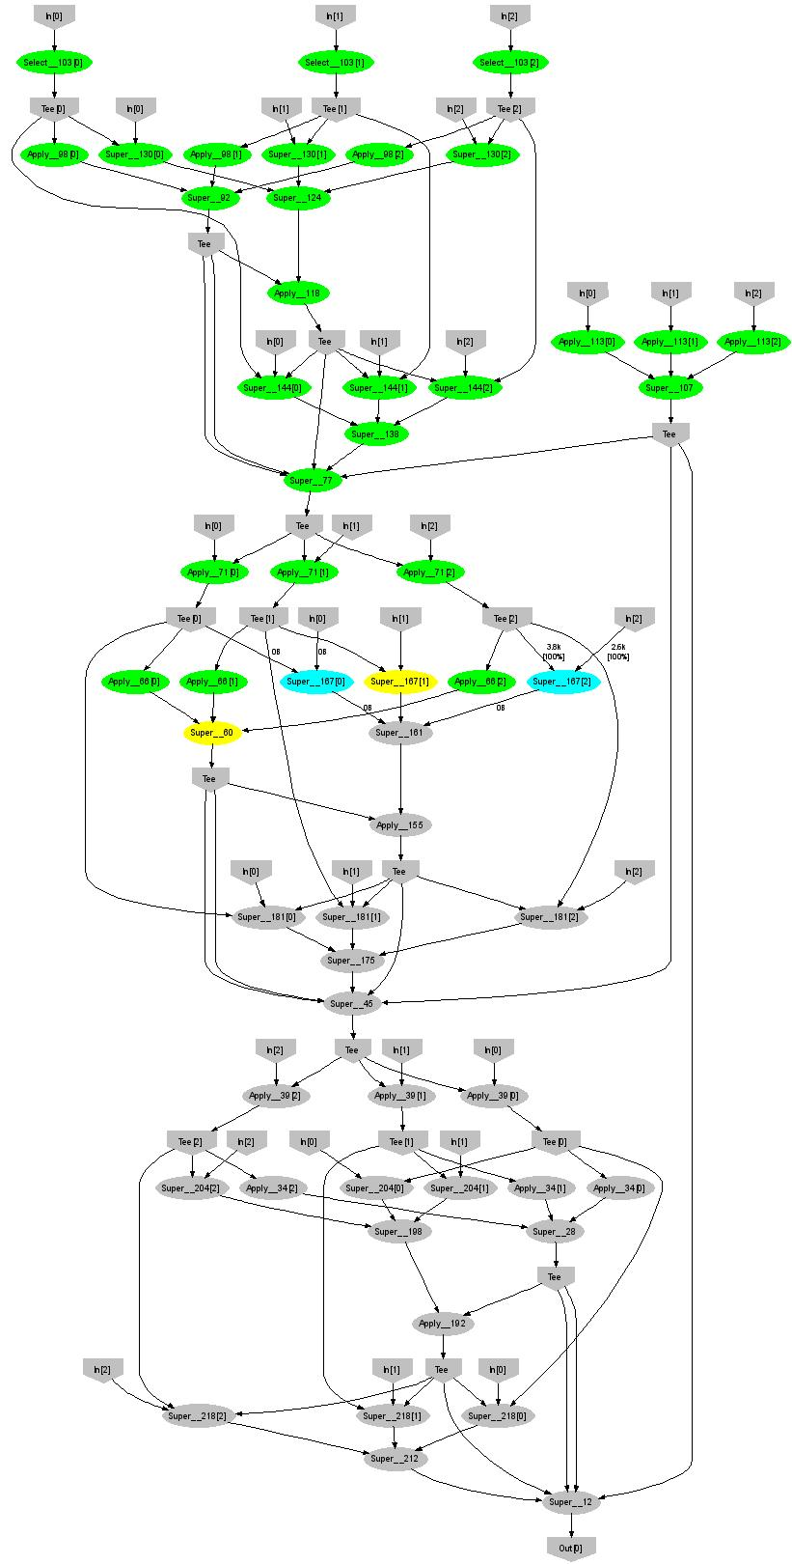
Expectation Maximization (Gaussians)
160 lines
3 iterations shown
Notes:
More complicated, even iterative algorithms, can be implemented.

Slide 54
Conclusions
Dryad = distributed execution environment
Application-independent (semantics oblivious)
Supports rich software ecosystem
Relational algebra, Map-reduce, LINQ
DryadLINQ = Compiles LINQ to Dryad
C# objects and declarative programming
.Net and Visual Studio for parallel programming
Notes:
We believe that Dryad and DryadLINQ are a great foundation for cluster computing.

Slide 55

Backup Slides

Slide 56
Software Stack
Machine Learning
sed, awk, grep, etc.
C#
legacy code
SSIS
PSQL
Perl
C++
Scope
C#
Vectors
SQL server
Job queueing, monitoring
Distributed Shell
DryadLINQ
C++
Dryad
Distributed Filesystem
CIFS/NTFS
Cluster Services
Windows Server
Windows Server
Windows Server
Windows Server
Notes:
There is a rich software ecosystem built around dryad.
In this talk I will focus on a few of the layers developed at Microsoft Research SVC.

Slide 57
Very Large Vector Library
PartitionedVector<T>
T
T
T
Scalar<T>
T
Notes:
The main datastructure is a vector of type <T>, whose elements are partitioned among many machines. The partitioning is hidden from the user. The API of vectors has only 4 operations.

Slide 58
DryadLINQ
Declarative programming
Integration with Visual Studio
Integration with .Net
Type safety
Automatic serialization
Job graph optimizations
static
dynamic
Conciseness
Notes:
DryadLINQ adds a wealth of features on top of plain Dryad.

Slide 59
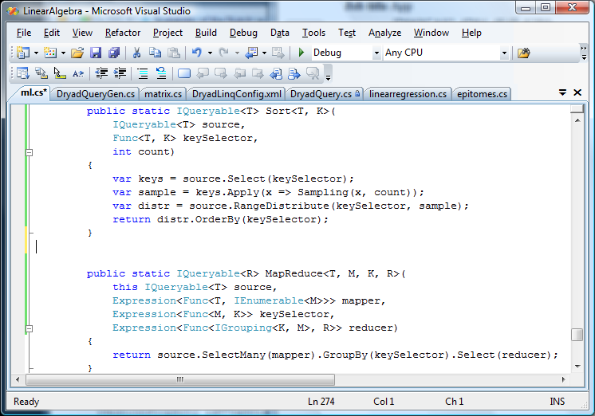
Sort & Map-Reduce in DryadLINQ
Notes:
This is how one can implement distributed sorting and map-reduce in DryadLINQ.

Slide 60
Dryad Map-Reduce
Many similarities
Execution layer
Job = arbitrary DAG
Plug-in policies
Program=graph gen.
Complex ( features)
New (< 2 years)
Still growing
Internal
Exe + app. model
Map+sort+reduce
Few policies
Program=map+reduce
Simple
Mature (> 4 years)
Widely deployed
Hadoop
Notes:
This is a comparison between Microsoft Dryad and Google’s Map-Reduce.

Slide 61

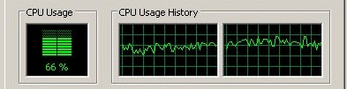

PLINQ
public static IEnumerable<TSource>
DryadSort<TSource, TKey>(IEnumerable<TSource> source,
Func<TSource, TKey> keySelector,
IComparer<TKey> comparer,
bool isDescending)
{
return source.AsParallel().OrderBy(keySelector, comparer);
}
Notes:
At the bottom DryadLINQ uses LINQ to run the computation in parallel on multiple cores.

Slide 62
Query histogram computation
Input: log file (n partitions)
Extract queries from log partitions
Re-partition by hash of query (k buckets)
Compute histogram within each bucket
Notes:
A large scale example.

Slide 63
Naïve histogram topology
P parse lines
D hash distribute
S quicksort
C count occurrences
MS merge sort
Each
Q
is
:
k
C
C
Each
R
k
R
R
S
k
S
is
:
n
D
C
Q
Q
n
P
MS
Notes:
An initial plan.

Slide 64
Efficient histogram topology
P parse lines
D hash distribute
S quicksort
C count occurrences
MS merge sort
M non-deterministic merge
k
Each
Q'
is
:
Each
T
R
k
R
C
Each
is
:
R
T
S
is
:
D
P
C
C
Q'
n
M
MS
MS
Notes:
A better, dynamically-managed plan.

Slide 65
Final histogram refinement
450
33.4 GB
1,800 computers
43,171 vertices
11,072 processes
11.5 minutes
R
450
R
118 GB
T
217
T
154 GB
Q'
10,405
Q'
99,713
10.2
TB
Notes:
Some performance numbers.

Slide 66
Data Distribution (Group By)
Source
Source
Source
m
m x n
Dest
Dest
Dest
n
Notes:
Redistributing data is an important step for load balancing or when changing keys.

Slide 67
Range-Distribution Manager
S
S
S
[0-100)
S
S
S
Hist
[0-30),[30-100)
T
static
D
D
D
T
T
[0-?)
[0-30)
[?-100)
[30-100)
dynamic
67
Notes:
Using a connection manager one can load-balance the data distribution at run-time, based on data statistics obtained from sampling the data stream. In this case the number of destination vertices and the ranges for each vertex are decided dynamically.

Slide 68
Goal: Declarative Programming
X
X
X
X
S
S
S
T
T
T
T
static
dynamic
Notes:
We evolve towards a programming model in which resources are always allocated dynamically, based on demand.

Slide 69

Staging
1. Build
2. Send .exe
7. Serialize vertices
vertex code
5. Generate graph
JM code
Cluster services
6. Initialize vertices
3. Start JM
8. Monitor
Vertex execution
4. Query cluster resources
Notes:
Computation Staging

Slide 70
SkyServer Query 18
select distinct P.ObjID
into results
from photoPrimary U,
neighbors N,
photoPrimary L
where U.ObjID = N.ObjID
and L.ObjID = N.NeighborObjID
and P.ObjID < L.ObjID
and abs((U.u-U.g)-(L.u-L.g))<0.05
and abs((U.g-U.r)-(L.g-L.r))<0.05
and abs((U.r-U.i)-(L.r-L.i))<0.05
and abs((U.i-U.z)-(L.i-L.z))<0.05
H
Y
n
Y
L
L
S
4n
S
M
4n
M
D
n
D
X
n
X
U
N
U
N
Notes:
This is a SQL query manually translated to Dryad C++ code.

Slide 71

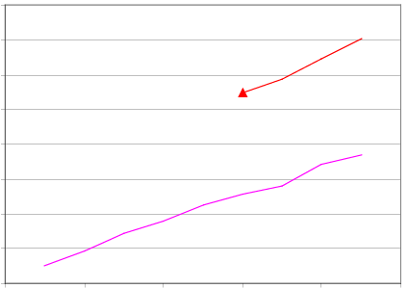
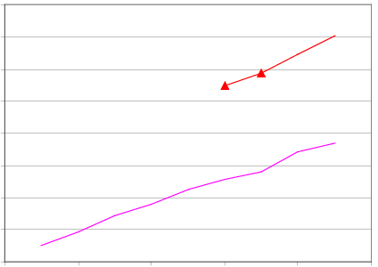
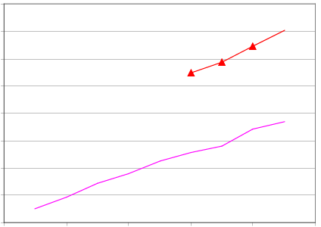
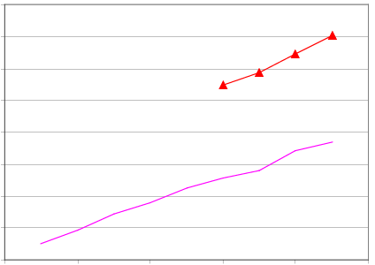
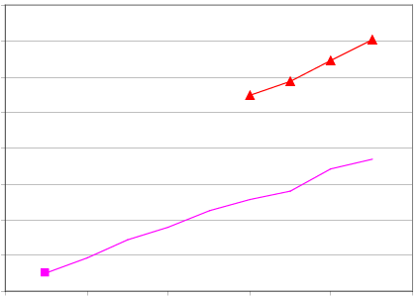
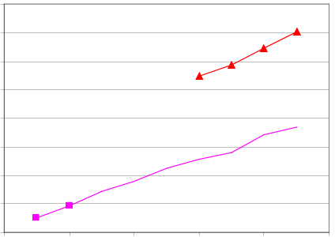
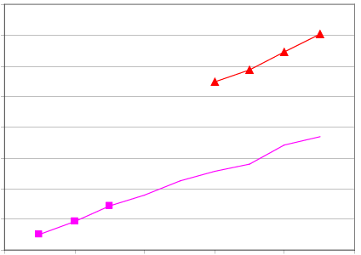
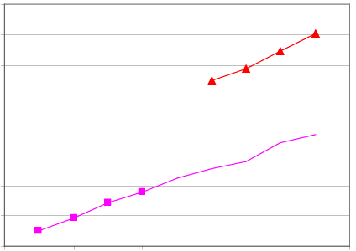
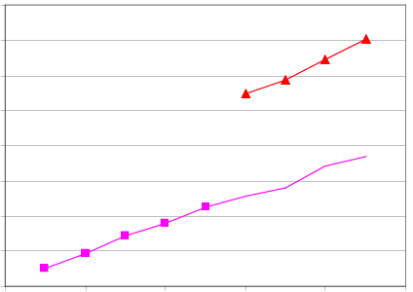
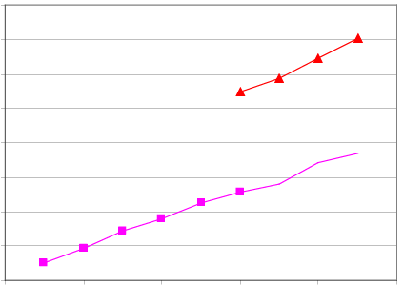
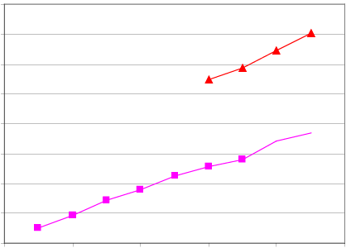
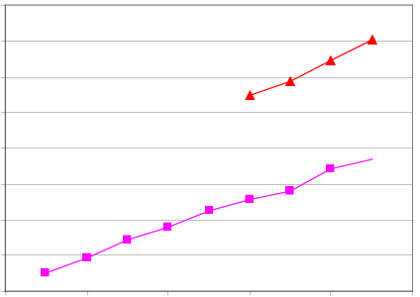
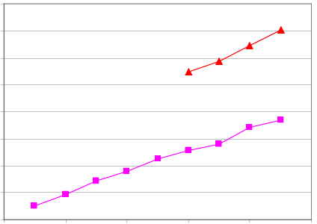
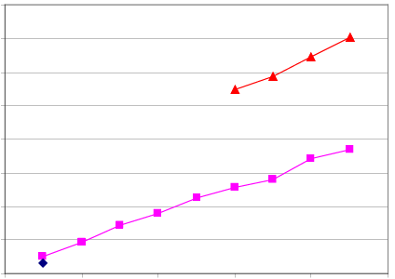



SkyServer Q18 Performance
16.0
Dryad In-Memory
14.0
Dryad Two-pass
12.0
SQLServer 2005
10.0
Speed-up (times)
8.0
6.0
4.0
2.0
0.0
0
2
4
6
8
10
Number of Computers
Notes:
This is the performance of the query running on a small cluster. The y axis show “how many times the computation is faster compared with SQL Server 2005”. Once the whole dataset of the computation fits in the collective memory of the cluster (6+ machines), the computation can be sped-up dramatically by changing the channel transport mechanism (a one-line code change).

