Slide 1
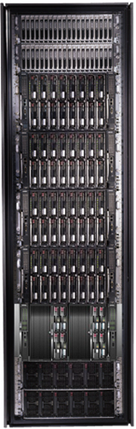
Cluster Computing with Dryad
Mihai Budiu, MSR-SVC
LiveLabs, March 2008

Slide 2
Goal
Notes:
Enable any programmer to write and run applications on small and large computer clusters.

Slide 3





The Dryad Project
http://research.microsoft.com/research/sv/dryad
Dryad: Distributed Data-Parallel Programs from Sequential Building Blocks Michael Isard, Mihai Budiu, Yuan Yu, Andrew Birrell, and Dennis Fetterly
European Conference on Computer Systems (EuroSys), Lisbon, Portugal, March 21-23, 2007
Notes:
The first published Dryad paper.

Slide 4
Outline
Dryad Design
Implementation
Policies as Plug-ins
Building on Dryad

Slide 5
Design Space
Grid
Internet
Data-
parallel
Search
Dryad
Shared
memory
Private
data
center
Transaction
HPC
Latency
Throughput
Notes:
Dryad is optimized for: throughput, data-parallel computation, in a private data-center.

Slide 6

Data Partitioning
DATA
RAM
DATA
Notes:
A common scenario: too much data to process. Instead of trying to be clever, just use more machines and a brute-force algorithm.

Slide 7

2-D Piping
Unix Pipes: 1-D
grep | sed | sort | awk | perl
Dryad: 2-D
grep¹⁰⁰⁰ | sed⁵⁰⁰ | sort¹⁰⁰⁰ | awk⁵⁰⁰ | perl⁵⁰
Notes:
Dryad is a generalization of the Unix piping mechanism: instead of uni-dimensional (chain) pipelines, it provides two-dimensional pipelines. The unit is still a process connected by a point-to-point channel, but the processes are replicated.

Slide 8
Dryad = Execution Layer
Job (Application)
Pipeline
≈
Dryad
Shell
Cluster
Machine
Notes:
In the same way as the Unix shell does not understand the pipeline running on top, but manages its execution (i.e., killing processes when one exits), Dryad does not understand the job running on top.

Slide 9
Outline
Dryad Design
Implementation
Policies as Plug-ins
Building on Dryad

Slide 10
Virtualized 2-D Pipelines
Notes:
This is a possible schedule of a Dryad job using 2 machines.

Slide 11


Virtualized 2-D Pipelines

Slide 12

Virtualized 2-D Pipelines

Slide 13
Virtualized 2-D Pipelines

Slide 14
Virtualized 2-D Pipelines
2D DAG
multi-machine
virtualized
Notes:
The Unix pipeline is generalized 3-ways:
2D instead of 1D
spans multiple machines
resources are virtualized: you can run the same large job on many or few machines

Slide 15
Dryad Job Structure
grep¹⁰⁰⁰ | sed⁵⁰⁰ | sort¹⁰⁰⁰ | awk⁵⁰⁰ | perl⁵⁰
Channels
Input files
Stage
Output files
grep
sort
awk
sed
perl
grep
sort
sed
awk
grep
sort
Vertices (processes)
Notes:
This is the basic Dryad terminology.

Slide 16
Channels
Finite Streams of items
distributed filesystem files (persistent)
SMB/NTFS files (temporary)
TCP pipes (inter-machine)
memory FIFOs (intra-machine)
X
Items
M
Notes:
Channels are very abstract, enabling a variety of transport mechanisms.
The performance and fault-tolerance of these machanisms vary widely.

Slide 17
Architecture
data plane
Files, TCP, FIFO, Network
job schedule
V
V
V
NS
PD
PD
PD
control plane
Job manager
cluster
Notes:
The brain of a Dryad job is a centralized Job Manager, which maintains a complete state of the job.
The JM controls the processes running on a cluster, but never exchanges data with them.
(The data plane is completely separated from the control plane.)

Slide 18

Staging
1. Build
2. Send .exe
7. Serialize vertices
vertex code
5. Generate graph
JM code
Cluster services
6. Initialize vertices
3. Start JM
8. Monitor
Vertex execution
4. Query cluster resources
Notes:
Computation Staging

Slide 19



Fault Tolerance
Notes:
Vertex failures and channel failures are handled differently.

Slide 20
Outline
Dryad Design
Implementation
Policies and Resource Management
Building on Dryad

Slide 21
Policy Managers
R
R
R
R
Stage R
Connection R-X
X
X
X
X
Stage X
X Manager
R manager
R-X Manager
Job
Manager
Notes:
Each stage has a “stage manager”.
Each inter-stage set of edges has a “connection manager”.
The managers get upcalls for all important events in the corresponding vertices, and can make policy decisions.
The user can change the managers.
The managers can even rewrite the graph at run-time.

Slide 22
Duplicate Execution Manager
X[0]
X[1]
X[3]
X[2]
X’[2]
Slow vertex
Duplicate vertex
Completed vertices
Duplication Policy = f(running times, data volumes)
Notes:
The handling of apparently very slow computation by duplication of vertices is handled by a stage manager.

Slide 23
Aggregation Manager
S
S
S
S
S
S
T
static
S
S
S
S
S
S
# 1
# 2
# 1
# 3
# 3
# 2
rack #
A
A
A
# 1
# 2
# 3
dynamic
T
Notes:
Aggregating data with associative operators can be done in a bandwidth-preserving fashion in the intermediate aggregations are placed close to the source data.

Slide 24
Data Distribution (Group By)
Source
Source
Source
m
m x n
Dest
Dest
Dest
n
Notes:
Redistributing data is an important step for load balancing or when changing keys.

Slide 25
Range-Distribution Manager
S
S
S
[0-100)
S
S
S
Hist
[0-30),[30-100)
T
static
D
D
D
T
T
[0-?)
[0-30)
[?-100)
[30-100)
dynamic
25
Notes:
Using a connection manager one can load-balance the data distribution at run-time, based on data statistics obtained from sampling the data stream. In this case the number of destination vertices and the ranges for each vertex are decided dynamically.

Slide 26
Goal: Declarative Programming
X
X
X
X
S
S
S
T
T
T
T
static
dynamic
Notes:
We evolve towards a programming model in which resources are always allocated dynamically, based on demand.

Slide 27
Outline
Dryad Design
Implementation
Policies as Plug-ins
Building on Dryad

Slide 28
Software Stack
Machine Learning
sed, awk, grep, etc.
C#
legacy code
SSIS
PSQL
Perl
C++
Queries
C#
Vectors
SQL server
Job queueing, monitoring
Distributed Shell
DryadLINQ
C++
Dryad
Distributed Filesystem
CIFS/NTFS
Cluster Services
Windows Server
Windows Server
Windows Server
Windows Server
Notes:
There is a rich software ecosystem built around dryad.
In this talk I will focus on a few of the layers developed at Microsoft Research SVC.

Slide 29
SkyServer Query 18
select distinct P.ObjID
into results
from photoPrimary U,
neighbors N,
photoPrimary L
where U.ObjID = N.ObjID
and L.ObjID = N.NeighborObjID
and P.ObjID < L.ObjID
and abs((U.u-U.g)-(L.u-L.g))<0.05
and abs((U.g-U.r)-(L.g-L.r))<0.05
and abs((U.r-U.i)-(L.r-L.i))<0.05
and abs((U.i-U.z)-(L.i-L.z))<0.05
H
Y
n
Y
L
L
S
4n
S
M
4n
M
D
n
D
X
n
X
U
N
U
N
Notes:
This is a SQL query manually translated to Dryad C++ code.

Slide 30
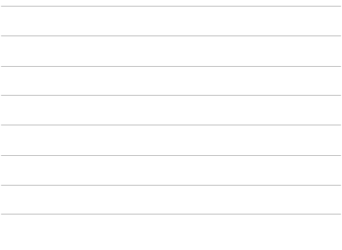
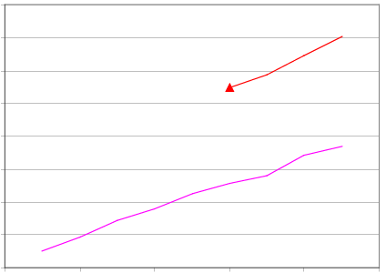
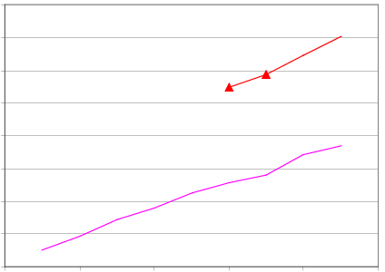
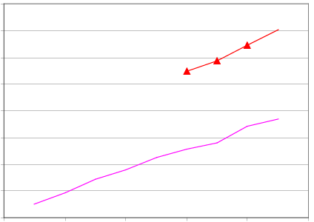
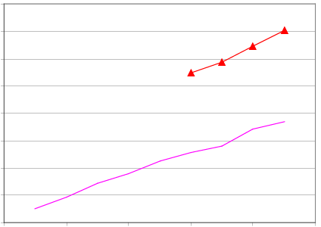
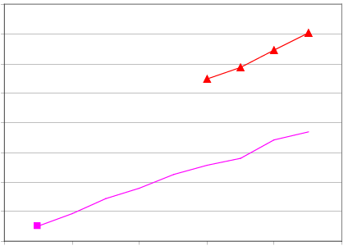
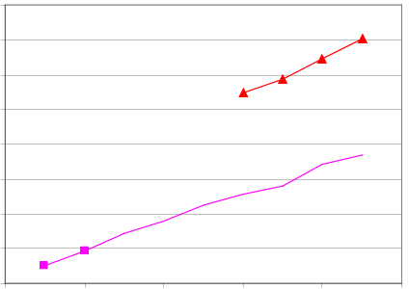
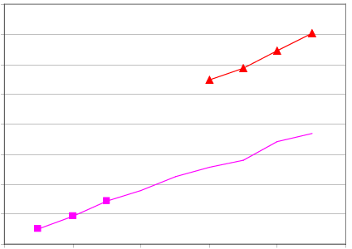
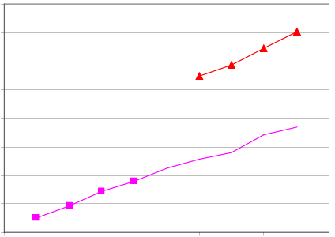
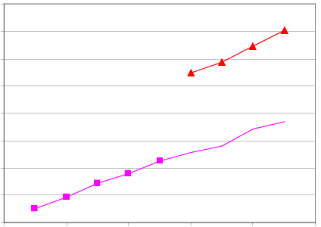
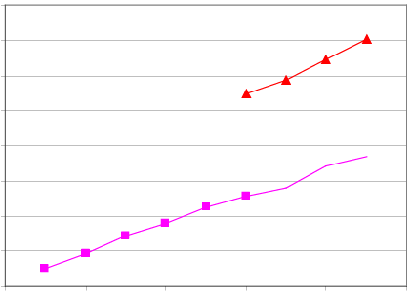
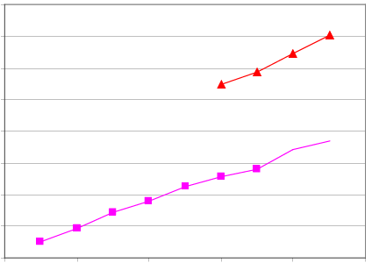
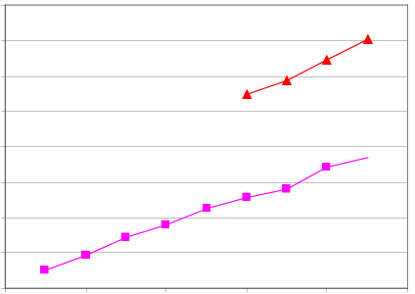
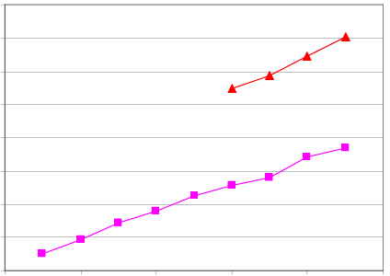
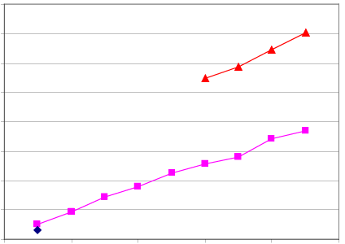



SkyServer Q18 Performance
16.0
Dryad In-Memory
14.0
Dryad Two-pass
12.0
SQLServer 2005
10.0
Speed-up (times)
8.0
6.0
4.0
2.0
0.0
0
2
4
6
8
10
Number of Computers
Notes:
This is the performance of the query running on a small cluster. The y axis show “how many times the computation is faster compared with SQL Server 2005”. Once the whole dataset of the computation fits in the collective memory of the cluster (6+ machines), the computation can be sped-up dramatically by changing the channel transport mechanism (a one-line code change).

Slide 31

DryadLINQ
Declarative programming
Integration with Visual Studio
Integration with .Net
Type safety
Automatic serialization
Job graph optimizations
static
dynamic
Conciseness
Notes:
DryadLINQ adds a wealth of features on top of plain Dryad.

Slide 32
LINQ
Collection<T> collection;
bool IsLegal(Key);
string Hash(Key);
var results = from c in collection where IsLegal(c.key) select new { Hash(c.key), c.value};
Notes:
Language Integrated Query is an extension of C# which allows one to write declarative computations on collections (green part).

Slide 33

DryadLINQ = LINQ + Dryad
Collection<T> collection;
bool IsLegal(Key k);
string Hash(Key);
var results = from c in collection where IsLegal(c.key) select new { Hash(c.key), c.value};
Vertex code
Query plan
(Dryad job)
Data
collection
C#
C#
C#
C#
results
Notes:
DryadLINQ translates LINQ programs into Dryad computations:
- C# and LINQ data objects become distributed partitioned files.
- LINQ queries become distributed Dryad jobs.
- C# methods become code running on the vertices of a Dryad job.

Slide 34
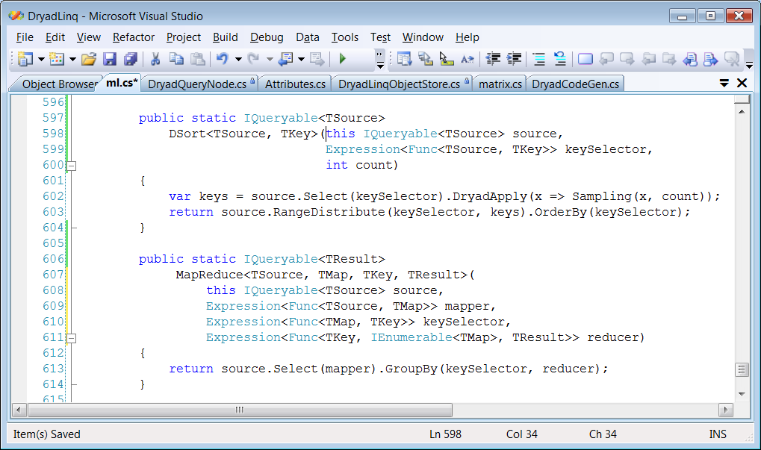
Sort & Map-Reduce in DryadLINQ
S
S
S
[0-100)
Sampl
[0-30),[30-100)
D
D
D
Sort
Sort
[0-30)
[30-100)
Notes:
This is how one can implement distributed sorting and map-reduce in DryadLINQ.

Slide 35

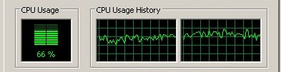

PLINQ
public static IEnumerable<TSource>
DryadSort<TSource, TKey>(IEnumerable<TSource> source,
Func<TSource, TKey> keySelector,
IComparer<TKey> comparer,
bool isDescending)
{
return source.AsParallel().OrderBy(keySelector, comparer);
}
Notes:
At the bottom DryadLINQ uses LINQ to run the computation in parallel on multiple cores.

Slide 36
Machine Learning in DryadLINQ
Data analysis
Machine learning
Large Vector
DryadLINQ
Dryad
Notes:
I will now focus on a library for machine-learning algorithms we have built on top of DryadLINQ.

Slide 37
Very Large Vector Library
PartitionedVector<T>
T
T
T
Scalar<T>
T
Notes:
The main datastructure is a vector of type <T>, whose elements are partitioned among many machines. The partitioning is hidden from the user. The API of vectors has only 4 operations.

Slide 38
Operations on Large Vectors: Map 1
T
f
U
f preserves partitioning
T
f
U
Notes:
One can apply an arbitrary C# side-effect free function f to all objects in a vector.

Slide 39
Map 2 (Pairwise)
T
f
U
V
T
U
f
V
Notes:
Or one can do it to a pair of vectors.

Slide 40
Map 3 (Vector-Scalar)
T
f
U
V
T
U
f
V
40
Notes:
Or one can use a vector and a scalar, replicating the scalar for each element of the vector.

Slide 41
Reduce (Fold)
f
U
U
U
U
f
f
f
U
U
U
f
U
Notes:
Finally, one can fold a vector to a scalar.

Slide 42
Linear Algebra
T
T
,
U
,
V
=
Notes:
Having vectors of vectors or matrices builds to a nice linear algebra library.

Slide 43
Linear Regression
Data
Find
S.t.
Notes:
We will show how to compute linear regression parameters.

Slide 44
Analytic Solution
X[0]
X[1]
X[2]
Y[0]
Y[1]
Y[2]
Map
X×X^{T}
X×X^{T}
X×X^{T}
Y×X^{T}
Y×X^{T}
Y×X^{T}
Reduce
Σ
Σ
[ ]⁻¹
*
A
Notes:
This expression uses a query plan composed of 2 (pairwise) maps and 2 reduces.

Slide 45
Linear Regression Code
Vectors x = input(0), y = input(1);
Matrices xx = x.PairwiseOuterProduct(x);
OneMatrix xxs = xx.Sum();
Matrices yx = y.PairwiseOuterProduct(x);
OneMatrix yxs = yx.Sum();
OneMatrix xxinv = xxs.Map(a => a.Inverse());
OneMatrix A = yxs.Map( xxinv, (a, b) => a.Multiply(b));
Notes:
The complete source code for linear regression has 6 lines of code.

Slide 46
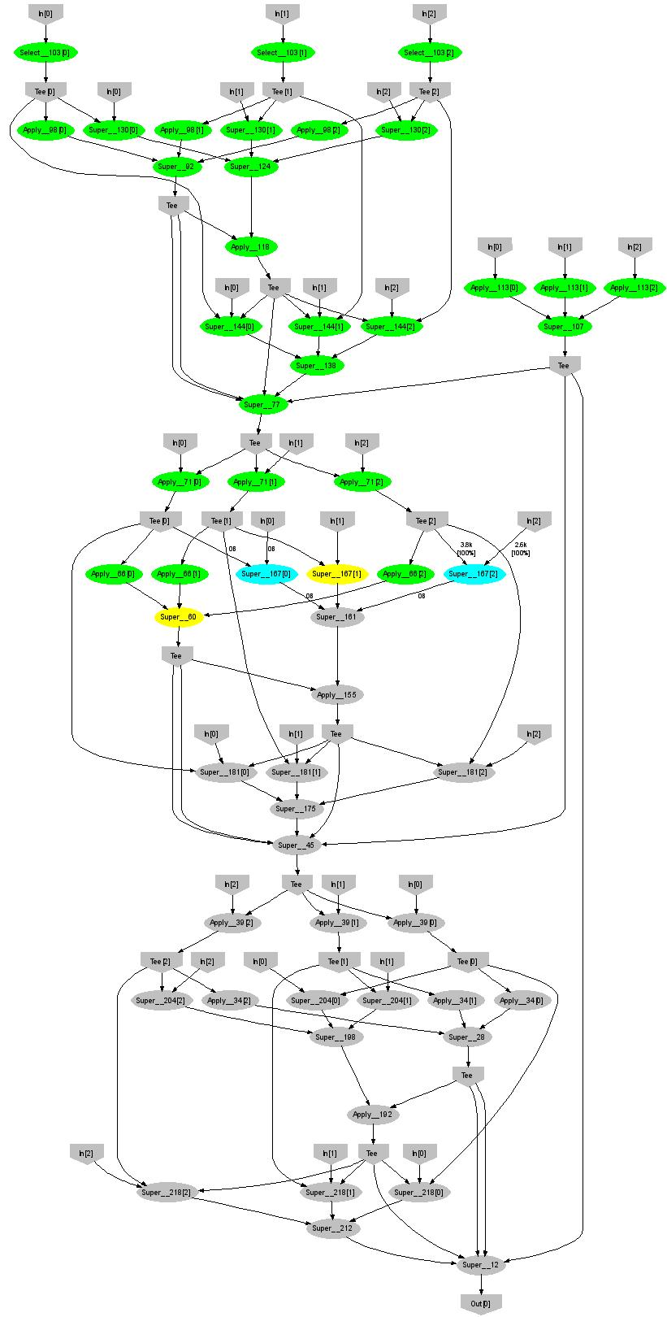
Expectation Maximization (Gaussians)
160 lines
3 iterations shown
Notes:
More complicated, even iterative algorithms, can be implemented.

Slide 47
Conclusions
Dryad = distributed execution environment
Application-independent (semantics oblivious)
Supports rich software ecosystem
Relational algebra
Map-reduce
LINQ
Etc.
DryadLINQ = A Dryad provider for LINQ
This is only the beginning!
START
Notes:
We believe that Dryad and DryadLINQ are a great foundation for cluster computing.

Slide 48
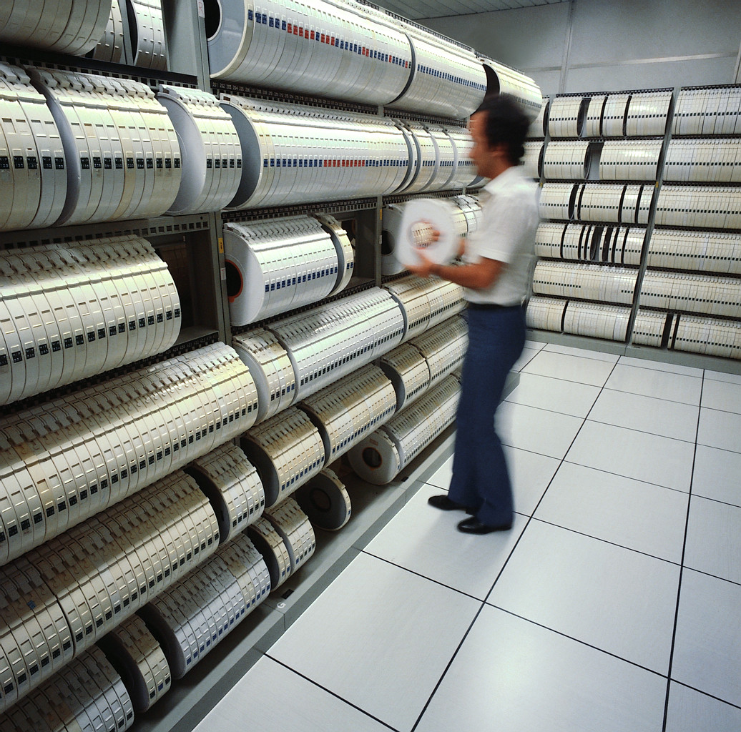
Backup Slides

Slide 49
Dryad Map-Reduce
Many similarities
Execution layer
Job = arbitrary DAG
Plug-in policies
Program=graph gen.
Complex ( features)
New (< 2 years)
Still growing
Internal
Exe + app. model
Map+sort+reduce
Few policies
Program=map+reduce
Simple
Mature (> 4 years)
Widely deployed
Hadoop
Notes:
This is a comparison between Microsoft Dryad and Google’s Map-Reduce.

Slide 50
Small Cluster Support
Merge
Merge
Merge
Merge
Merge
Sort
Sort
Sort
Sort
Sort
Fast channels
Grouping vertices
Notes:
One can group multiple vertices to run in a single process, and one can use special transport mechanisms to optimize computations for small clusters.

Slide 51
SkyServer DB query
H
Took SQL plan
Manually coded in Dryad
Manually partitioned data
[distinct]
[merge outputs]
(u.color,n.neighborobjid)
[re-partition by n.neighborobjid]
[order by n.neighborobjid]
Y
n
Y
select
u.color,n.neighborobjid
from u join n
where
u.objid = n.objid
U
U
select
u.objid
from u join <temp>
where
u.objid = <temp>.neighborobjid and
|u.color - <temp>.color| < d
S
4n
S
u: objid, color
n: objid, neighborobjid
[partition by objid]
M
4n
M
D
n
D
X
n
X
U
N
U
N
Notes:
This is an explanation of the SkyServer Query plan.

Slide 52
Optimization
H
Y
U
Y
n
Y
S
S
S
S
U
U
M
4n
S
S
M
M
4n
M
M
M
D
n
D
D
X
n
X
X
U
N
U
N
U
N
Notes:
Red channels are FIFOs.

Slide 53
Optimization
H
Y
U
Y
n
Y
S
S
S
S
U
U
M
4n
S
S
M
M
4n
M
M
M
D
n
D
D
X
n
X
X
U
N
U
N
U
N
Notes:
Blue channels are TCP pipes.

Slide 54
Query histogram computation
Input: log file (n partitions)
Extract queries from log partitions
Re-partition by hash of query (k buckets)
Compute histogram within each bucket
Notes:
A large scale example.

Slide 55
Naïve histogram topology
P parse lines
D hash distribute
S quicksort
C count occurrences
MS merge sort
Each
Q
is
:
k
C
C
Each
R
k
R
R
S
k
S
is
:
n
D
C
Q
Q
n
P
MS
Notes:
An initial plan.

Slide 56
Efficient histogram topology
P parse lines
D hash distribute
S quicksort
C count occurrences
MS merge sort
M non-deterministic merge
k
Each
Q'
is
:
Each
T
R
k
R
C
Each
is
:
R
T
S
is
:
D
P
C
C
Q'
n
M
MS
MS
Notes:
A better, dynamically-managed plan.

Slide 57
Final histogram refinement
450
33.4 GB
1,800 computers
43,171 vertices
11,072 processes
11.5 minutes
R
450
R
118 GB
T
217
T
154 GB
Q'
10,405
Q'
99,713
10.2
TB
Notes:
Some performance numbers.

