Slide 1
BitValue: Detecting and Exploiting Narrow Bitwidth Computations
Mihai Budiu
Carnegie Mellon University
mihaib@cs.cmu.edu
joint work with Majd Sakr, Kip Walker and Seth Copen Goldstein

Slide 2
Word Size Evolution
Year | CPU | Word size
1971 | 4004 | 4
1972 | 8008 | 8
1978 | 8086 | 16
1985 | 80386 | 32
2000 | Itanium | 64
Size increase recently driven by address space constraints
Claim: data often does not use the whole word width
We present a technique for static width inference

Slide 3
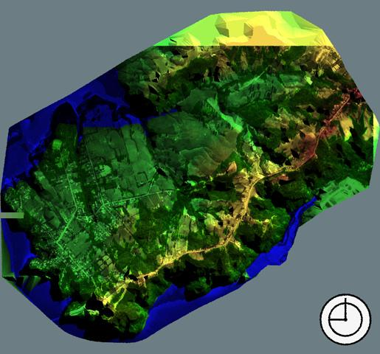
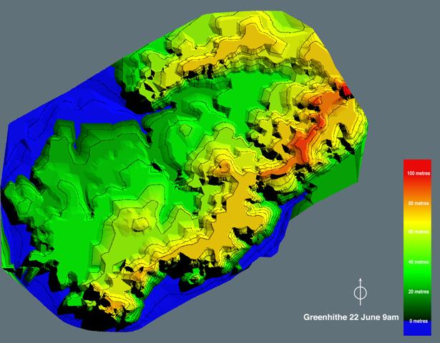
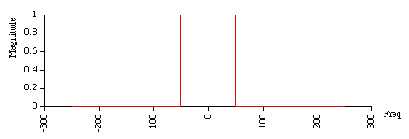
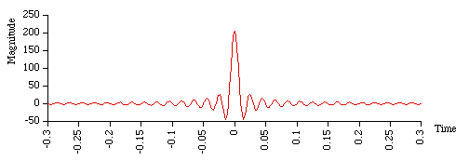
Motivation: Applications
Media processing
Digital Signal Processing
FFT

Slide 4

Motivation: Applications (2)
Cumulative frequency
Operations on <16 bits
bits
Source: Brooks & Martonosi, HPCA ‘99

Slide 5
Motivation: Hardware
“MMX”
CPU support for narrow widths
Reconfigurable hardware
+
+
+
+
+
b
a
(a & 0xf) | (b & 0x18)

Slide 6
Motivation: Languages
No programming language support
No compiler support
int a;
long b;
int a;
a = (a >> 16) & 0xf0;

Slide 7
Outline
Motivation
The width inference algorithm
Implementations
Results
Conclusions

Slide 8
The Width Inference Algorithm
Data-flow at the bit level
Infer values for each bit of an integer
Forward and backward propagation
  Forward discover constant bits
  Backward discover don’t care bits
We use iterative DF analysis
Low time and space complexity

Slide 9
Benefits of Bit Value Inference
You don’t have to implement:
  don’t care bits
  constant bits
Use hardware more efficiently
⇒ increased performance

Slide 10
The Lattices
xx
x
0x
Pointwise
0
1
00
01
10
0u
u
uu
The bit lattice
The bitstring lattice L

Slide 11
Forward (Constant) Propagation
u00uu
u001u
+
u0uuu

Slide 12
Backward (Don’t Care) Propagation
xuu
xuu
xuu
In
+
xux
Out
xux

Slide 13
Transfer Functions
Given
We show how to build
Forward(f) : L^{k} -> L
#
f : int^{k} -> int
#
Backward(f, in) : L x L^{k-1} -> L
#

Slide 14
Sample Forward Transfer Function
Worst
Best Best
01 + 00 00 + 00
01 + 10 00 + 10
Worst
01 + x0
00 + x0
0u + x0
Worst
Best Best
01 00
11 10
Worst
x1
x0
xu
We resort to conservative approximations

Slide 15
Induction Variable Analysis
We complement the data-flow with induction variable analysis
We determine the range for the linear loop induction variables
j’s range is 0-10, 4 bits:
uuuu is an upper bound for its value
for (i=0; i < 5; i++)
j = 2*i;

Slide 16
Implementation for C
Suif compiler passes
Intraprocedural, no pointer analysis
1100 lines/second on PIII/600
“Validated” algorithm through code instrumentation
We only deal with scalars

Slide 17
Implementation for Reconfigurable Hardware
Part of a standalone compiler/CAD tool for DIL, a hardware description language
DIL allows widths to be unspecified
Width inference is used to bound precision and reduce hardware
Produce smaller and faster hardware

Slide 18
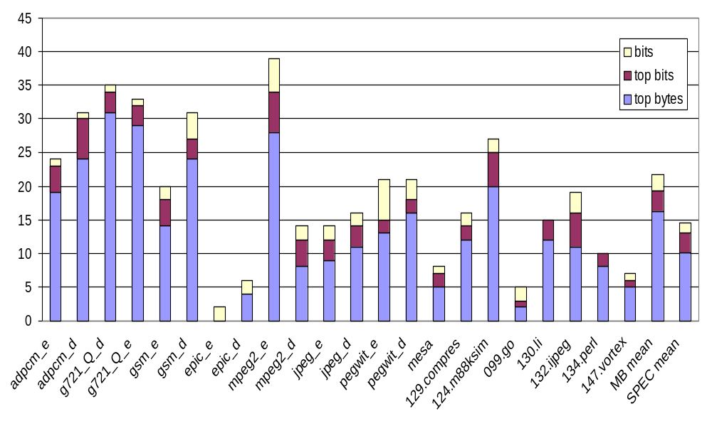
“Useless” Data (Dynamic)
Mediabench
SPECint 95
mean
Percent

Slide 19
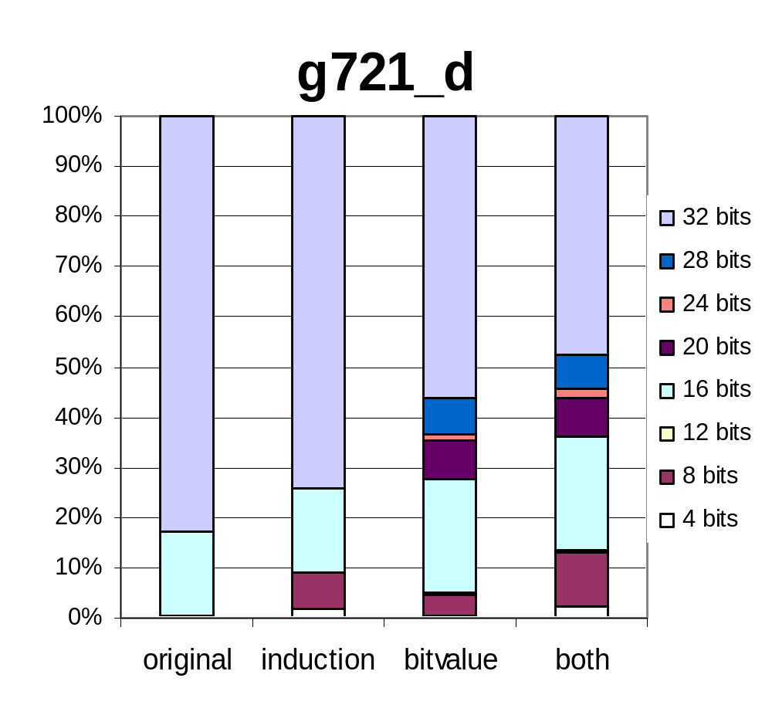
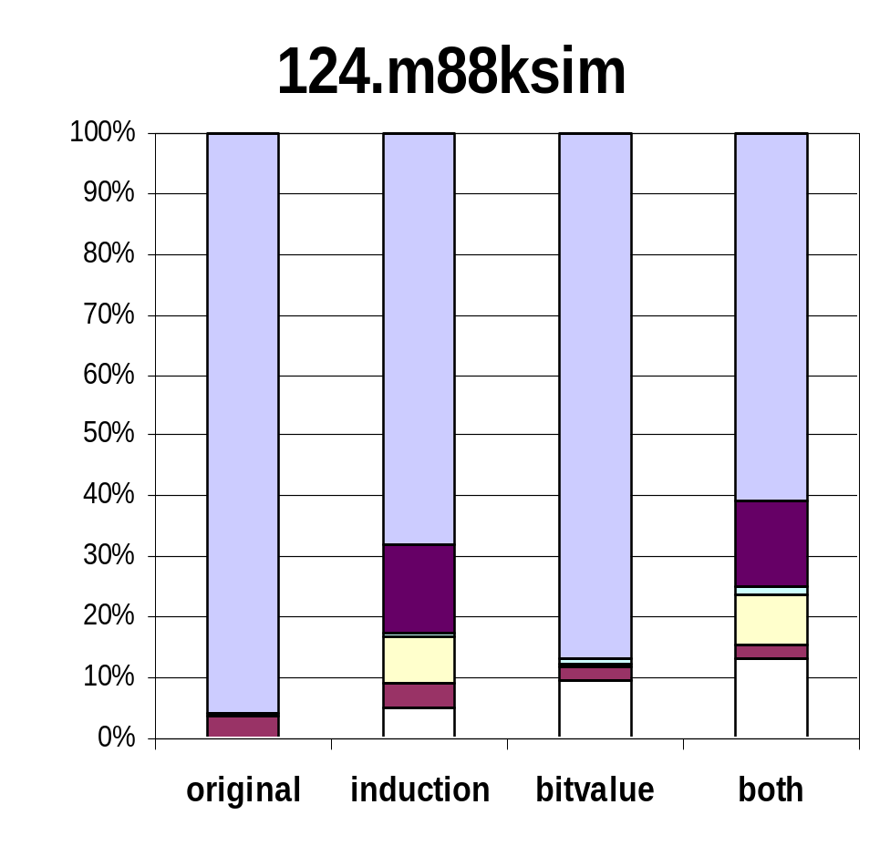
Size Histograms (Dynamic)

Slide 20
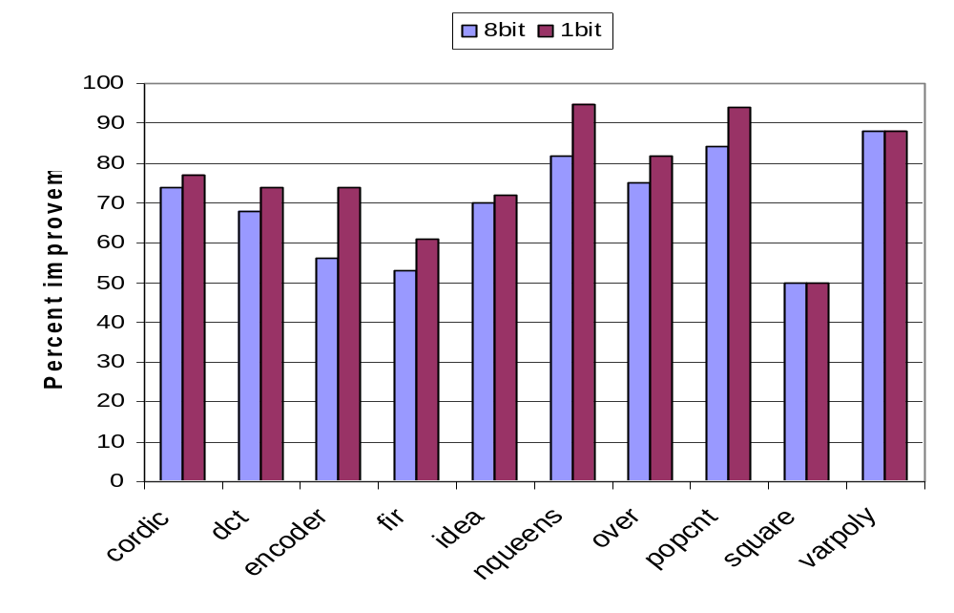
Circuit Reduction for
Reconfigurable Hardware

Slide 21
Conclusions (1)
Wide data values often inappropriate
Reducing width can lead to performance increase
It is worth to explore architectures which can better exploit useless bits

Slide 22
Conclusions (2)
Static bit-value analysis is very powerful
Efficient data-flow algorithm for bit-value inference
Can pass to compiler width hints using masks

Slide 23
Backup slides

Slide 24
Sources of Width Reduction
Array index calculations
Loop induction variables
Masking and shifting

