Slide 1
Peer-to-peer
Hardware-Software Interfaces for Reconfigurable Fabrics
Mihai Budiu
Mahim Mishra
Ashwin Bharambe
Seth Copen Goldstein
Carnegie Mellon University

Slide 2
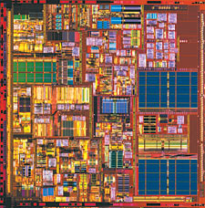
Resources Galore
Logic
Cache
Reconfigurable
Hardware
2002
2007

Slide 3
Why RH:
Computational Bandwidth
Fixed
“Unbounded”
CPU
RH

Slide 4
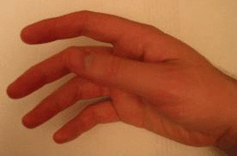

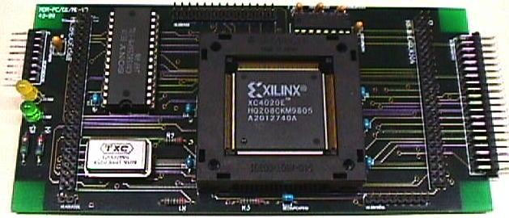
Using RH Today
Application
Partition
C Program
OS support
HDL
Compiler
CAD
communication

Slide 5
Computer System Tomorrow
Tight coupling
CPU
RH
low-ILP computation
+ OS
+ VM
high-ILP
computation
Memory
Notes:
CPUs are very convenient; they will probably be around forever, but they will not evolve as fast as in the past.
We can envision delegating to them “fringe” jobs, while we run the core computation on the ASH fabrics.

Slide 6
This Work
HLL Program
Partitioning
cc
CAD
CPU
RH
Memory
We suggest a high-level mechanism (not a policy).
Notes:
CPUs are very convenient; they will probably be around forever, but they will not evolve as fast as in the past.
We can envision delegating to them “fringe” jobs, while we run the core computation on the ASH fabrics.

Slide 7
Outline
Motivation
Interfacing RH & CPU
Opportunities
Conclusions

Slide 8
Premises
RH is large
  can implement large program fragments
RH can access memory
  does not require CPU support to access data
  coherent memory view with CPU
RH seen through clean abstraction
  interface portability

Slide 9
Unit of Partitioning: Procedure
Program call-graph:
hot spot
high ILP
recursive
leaves
library

Slide 10
Production-Quality Software
int foo(….)
{
highly parallel computation;
….
if (!r) {
fprintf(stderr, “Unexpected input”);
return E_BADIN;
}
….
}

Slide 11
Peering
Program
a( ) {
b( );
}
b( ) {
c( );
}
c( ) {
d( )
}
d( ) { }
CPU
RH
a
b
c
d

Slide 12
“RPC”
Stubs
marshalling,
control transfer
CPU
RH
a
b’
b
c’
c
d’
d
software
procedure
call
hardware
dependent

Slide 13
Stubs
Program
a( ) {
r = b(b_args);
}
b(b_args) {
}
a( ) {
r = b’(b_args);
}
b’(b_args) {
}
RH
send_rh(b_args);
invoke_rh(b);
r = receive_rh( );
return r;
b
CPU

Slide 14
Required Stubs
1 stub to call each RH procedure
1 stub for each procedure called by RH
CPU
RH

Slide 15
Compiling
Program
policy
Partitioning
Procedures
for RH
Procedures
for CPU
Stubs
HLL to HDL
Linker
Synthesis
Executable
Configuration
automatic

Slide 16
Outline
Motivation
Interfacing RH & CPU
Opportunities
Conclusions

Slide 17
Evaluation
How much can be mapped to RH?
SpecInt95 & Mediabench
Partition strictly on procedure boundaries
Limit RH to 10⁶ bit-operations

Slide 18
Coverage
Running
Time
On RH
Method1
Method2
N
N
a( ) {
b( );
}
b( ) {
c( );
}
c( ) {}
40%
N
Y
35%
25%
Y
Y
Total
100%
40%
75%

Slide 19
Coverage
Running
Time
On RH
Method1
Method2
a( ) {
b( );
}
b( ) {
c( );
}
c( ) {}
40%
N
Y
35%
N
N
25%
Y
Y
Total
100%
25%
65%

Slide 20
Policies
leaves on RH
RH X CPU
arbitrary

Slide 21
RH Stack Models
Locals
in registers
f(x) {
return x+1;
}
f() {
int local;
g(&local);
}
Locals
statically allocated
Dynamic
stack
f(x) {
f(x+1);
}

Slide 22
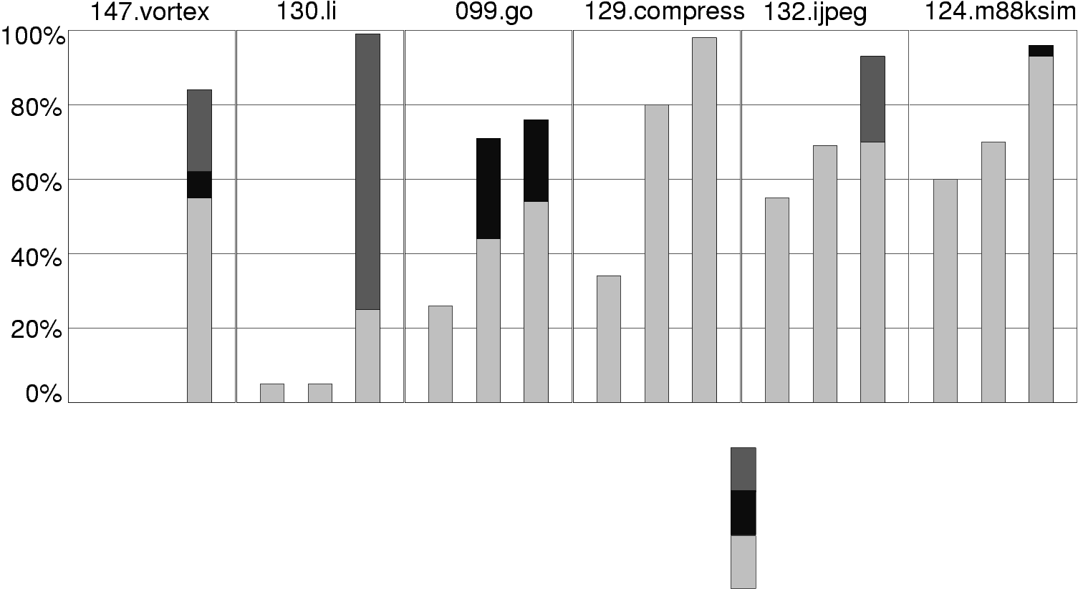
Potential RH Coverage: SpecINT95
% Running time
dynamic stack
static stack frames
no stack
leaves
CPU->RH
CPU->RH->CPU

Slide 23
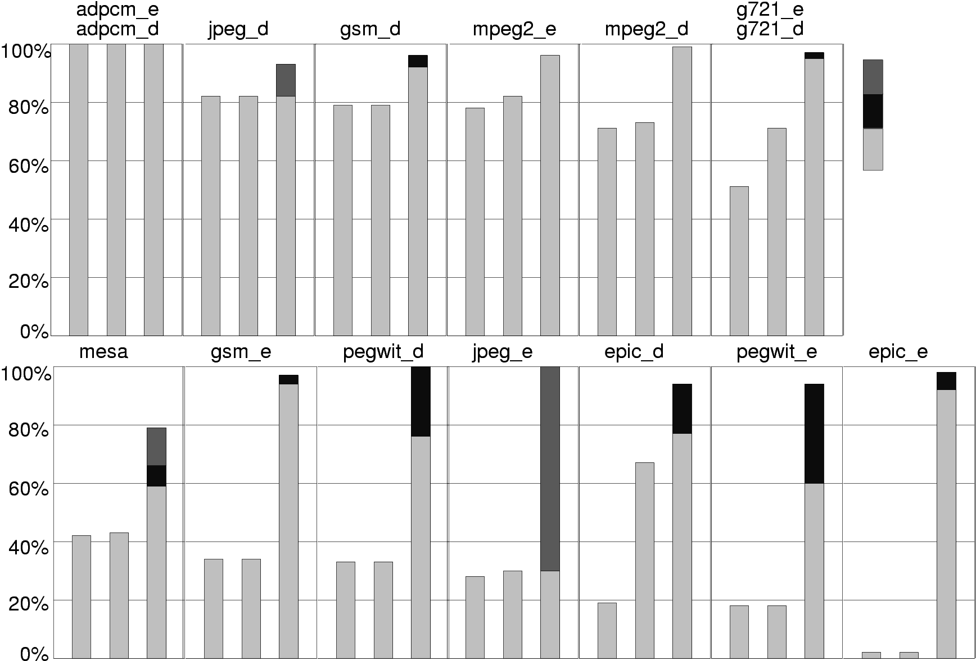
Potential RH Coverage: Mediabench
dynamic stack
static stack frames
no stack
leaves
CPU->RH
CPU->RH->CPU

Slide 24
Conclusions
RH and CPU as peers
RH/CPU interface: (remote) procedure call
RPC used for control transfer (not data)
Stubs make RH/CPU interface transparent
Stubs are automatically generated
Peering gives partitioner freedom

Slide 25
The End

Slide 27
Dispatcher Stubs
a( ) {
r = b(b_args);
}
b(b_args) {
if (x) c( );
return r;
}
c( ) {
}
b’(b_args) {
send_rh(b_args);
invoke_rh(b);
while (1) {
com = get_rh_command( );
if (! com) break;
(*com)( );
}
r = receive_rh( );
return r;
}
c’s stub
Independent of b
Program

Slide 28
C’s Stub
a( ) {
r = b(b_args);
}
b(b_args) {
if (x) c( );
return r;
}
c( ) {
}
c’( ) {
receive_rh(c_args);
r = c(c_args);
send_rh(r);
invoke_rh(return_to_rh);
}
Program
back

Slide 29
Attempt 1
Program
Manual partitioning
Interface: ad hoc
Ex: OneChip, NAPA, PAM
Advantage: huge speed-ups
Problem: very hard work
RH

Slide 30
Attempt 2
Select small computations
Interface: RH = functional unit
Ex: PRISC, Chimaera
Advantage: easy to automate
Problem: low speed-up
>>
+
*
>>
+
Program

Slide 31
Attempt 3
Select loop body
Deeply pipelined implementation
No memory access
Interface: I/O or
Functional Unit or Coprocessor
Ex: PipeRench
Advantage: very high speed-up
Problems: cannot be automated
  loop-carried dependences few opportunities
while (b) {
b[ j+5];
}
Program

Slide 32
Attempt 4
Select whole loop
Pipelined implementation
Autonomous memory access
Interface: coprocessor
Ex: GARP
Advantage: many opportunities
Problems:
  complicated algorithm
  requires exceptional loop exits
while (b) {
if (error)
printf(“err”);
a[x] = y;
}
Program

