Slide 1

Nerpa: full-stack SDN
Mihai Budiu
Ben Pfaff, Debnil Sur, Leonid Ryzhyk
VMware
FlexNet Workshop
Houston, August 25-26, 2022

Slide 2
Vision
Program
Management plane
Control plane
Data planes
Data planes
Data planes

Slide 3
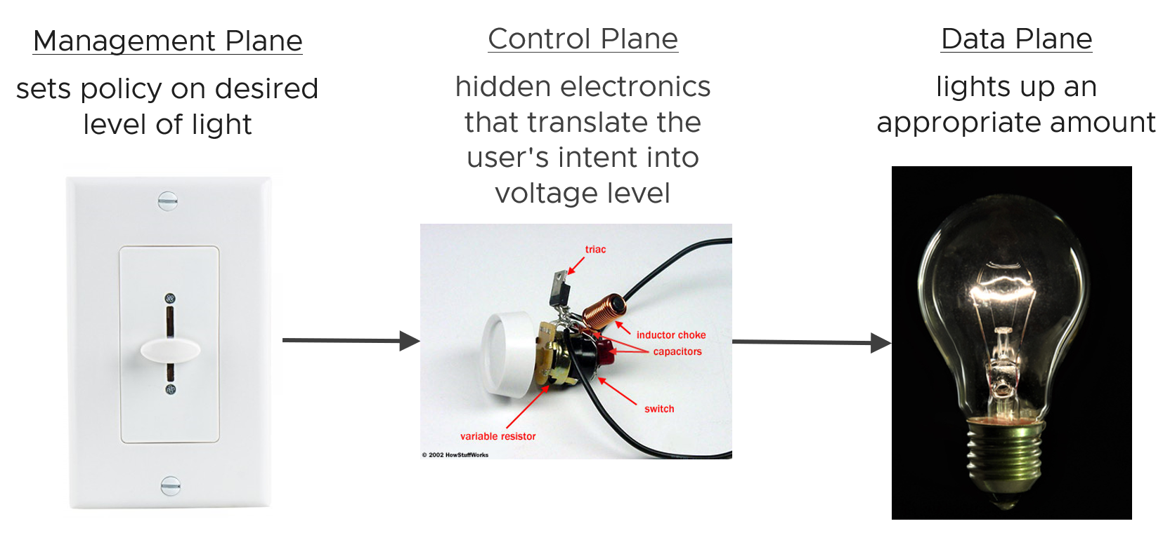

The three planes for a lightbulb

Slide 4
Our approach
DB schema
DDlog program
P4 program
Type checked
OVSDB
Management plane
Differential Datalog
Control plane
Data planes
Data planes
P4
Data planes

Slide 5
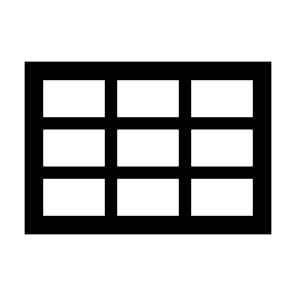
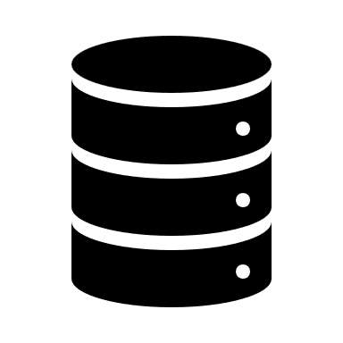
Management plane
Represent and persist network state as database relations
E.g., tables of switches, links, hosts, policies, etc.
Use DB APIs to read/write the network state
Desired state
DB API
Changes
control plane
Changes
Realized state

Slide 6
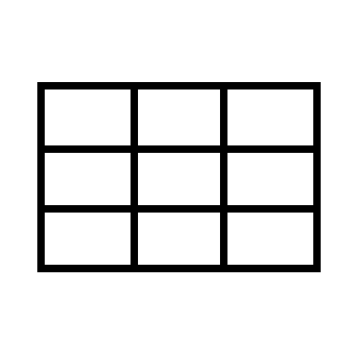
Control-plane
Express network state as database views
Queries compute views as functions of the realized and desired state
Maintains the contents of the views automatically and incrementally
queries
Desired state
views
routing
Changes
Changes
data planes
mgmt plane
vlan
Changes
Changes
Changes
Realized state

Slide 7
Data planes
VMs
views
OvS
views
Dispatch
Changes
Changes
Changes
Changes
Changes
switches
control plane
Changes
switch
Changes
Changes
Monitoring

Slide 8
Programming the system
Written by programmers
OVSDB schema
DDlog program
P4 program
Compiler
input relations
output relations
Compiler
Compiler
Rust
OVSDB
Control plane
P4
Rust wrapper
Rust wrapper
P4 Runtime

Slide 9
Incremental computation
Query
Input tables
Output tables

Slide 10


Differential Datalog
Incremental query
Input tables
Output tables

Slide 11
Open-source components
Nerpa: https://github.com/vmware/nerpa
Includes a prototype P4 to OpenFlow compiler
Differential Datalog: https://github.com/vmware/differential-datalog
OVN (open virtual network controller): https://www.ovn.org
DBSP: streaming incremental query engine: https://github.com/vmware/database-stream-processor

Slide 12

Conclusion
Treat the network as a single heterogeneous distributed system
Program the whole network stack, not disjoint parts
Automate as much as possible
Typecheck the whole stack
Data exchange
Incremental computation
Everything is a “change”

Slide 13
Simplified example: Routing in DDlog
Topology
input relation Switch(
id: uuid_t)
input relation Link(
from_switch: uuid_t,
to_switch: uuid_t,
port: port_t
Routing
input relation Route(
subnet : ip_subnet_t,
gw_switch: uuid_t,
distance : int)
output relation ShortestRoute(
subnet : ip_subnet_t,
gw_switch: uuid_t)
ShortestRoute(subnet,switch) :- Route(subnet,sw,d),
var switch = Aggregate((subnet), arg_min(sw, d)).
Topology x Routing
output relation NextHop(
subnet: ip_subnet_t,
switch: uuid_t,
port : port_t)
NextHop(subnet,switch,PHY_PORT) :- ShortestRoute(subnet,switch).
NextHop(subnet,switch,port) :- ShortestRoute(subnet,gateway), Link(switch, gateway, port).
Notes:
13

