Slide 1
Fast Compilation for Reconfigurable Hardware
Mihai Budiu and Seth Copen Goldstein
Carnegie Mellon University
Computer Science Department
Joint work with
Srihari Cadambi, Herman Schmit, Matt Moe,
Robert Taylor, Ronald Laufer

Slide 2
Goal
To program reconfigurable devices using the standard software development processes:
  Compile C or Java
  Do it quickly
Java
Partitioner
Data-flow Intermediate Language
DIL
This talk
Configuration
Reconfigurable HW
CPU

Slide 3
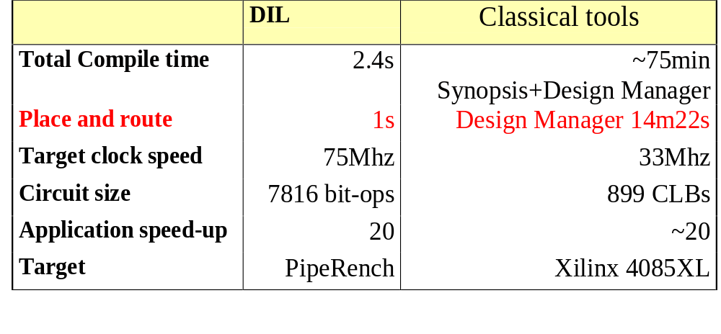
Compiler Performance on 1D DCT
(8 inputs 8 bit each)
Compilation: ~700x faster

Slide 4
The Place and Route Problem
~
&
~
&
<<
>>
Interconnection
operators
<<
>>
.
Interconnection
network
.
<<
[1,2]
<<
[1,2]
+
+
Processing elements

Slide 5

Our Target:
Medium grain processing elements (4 bits)
Pipelined architecture
Virtualized hardware
Local interconnection network
Wide pipelined bus

Slide 6
The Place and Route Problem
~
&
~
&
<<
>>
Interconnection
operators
<<
>>
Stripe
.
Interconnection
network
.
<<
[1,2]
<<
[1,2]
+
+
Processing elements

Slide 7
Why Place and Route Is Hard
Hard constraints:
  Stripe width
  Pipelined bus width
Word-based circuit
  interconnection network switches words
  fixed PE size
Scarce input ports for the interconnection network

Slide 8
How We Simplify Place and Route
Computation-oriented programs (restricted language, with unidirectional data flow)
Hardware resources virtualized
Relatively rich interconnection network
High granularity placement (I.e. one 32-bit adder instead of 100 gates)
There is a wide pipelined bus available
Timing is very predictable

Slide 9
The Key Idea
Global analysis and transformations guarantee placeability using lazy noops (conservatively)
Deterministic, greedy place & route
(no backtracking)
All passes linear time in the size of the circuit

Slide 10
Guaranteeing Placement
&
~
>>
Simple
permutation
~
&
<<
noop
<<
>>
Complex
permutation
.
Simple
permutation
.
noop
[1,2]
<<
[1,2]
Simple
permutation
+
<<
+
The inserted noops are sufficient but not necessary

Slide 11
Placement of a Non-lazy Noop
~
&
noop
~
&
noop
noop
+
+

Slide 12
Lazy Noops Are Not Placed
~
&
noop
~
&
+
noop
+

Slide 13
Place and Route Overview
Analysis:
  Noops have been inserted to guarantee that the graph is routable.
Place & Route:
  will determine which lazy noops are instantiated
Next: actual Place and Route

Slide 14
Step1: Analyze Routability
Already placed
~
&
&
noop
~
+
+
+
+
+
+
+
noop
Q: can we place the + given the
placement of its ancestors?
+

Slide 15
Step 2: If a Node Is Unroutable
~
&
~
&
noop
noop
noop
noop
+
+
Solution: promote a lazy noop

Slide 16
Step 3: Choosing a Noop
~
&
~
&
noop
noop
Closest noop
which is routable.
noop
noop
+
+

Slide 17
Other Details
Operators are decomposed in pieces for:
  timing constraints
  size constraints
When placing optimize for
  register pressure when accessing the bus
  constraints placed on future nodes
Long critical paths are sliced with pipeline registers

Slide 18
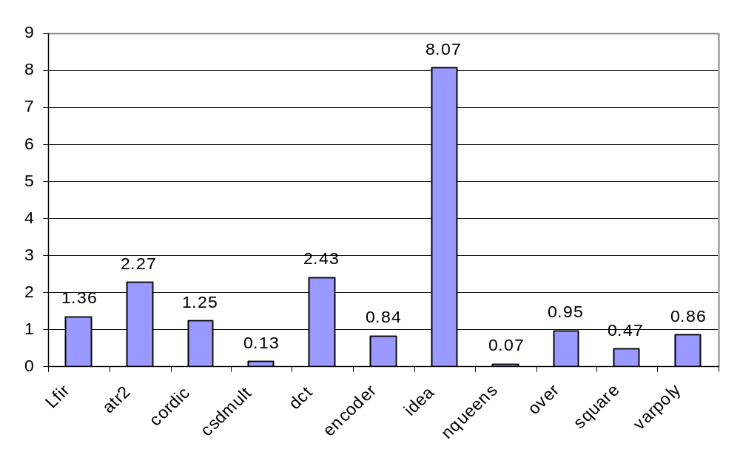
Compilation Times (Seconds on PII/400)

Slide 19
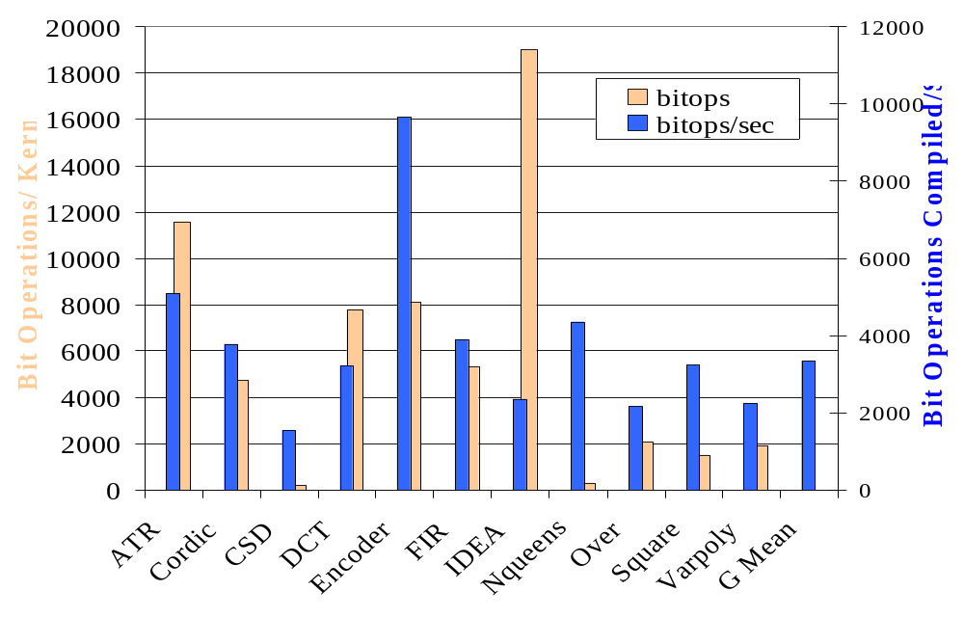
Compilation Speed (PII/400)

Slide 20
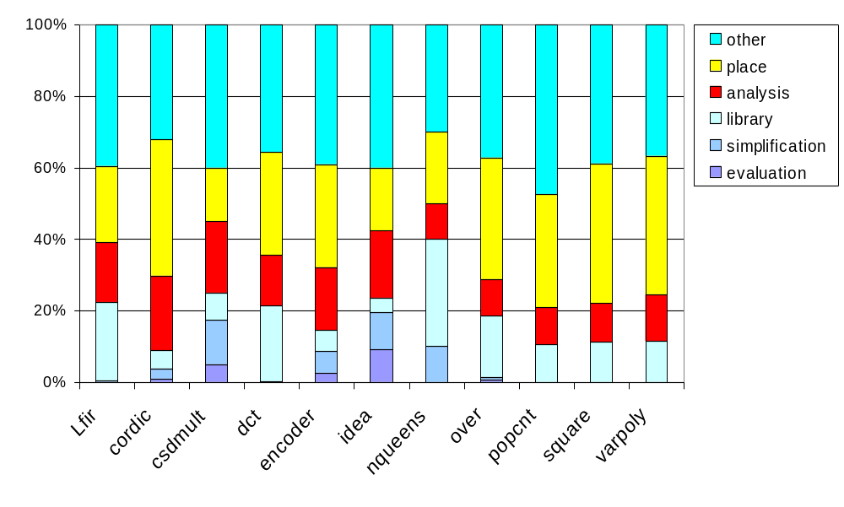
Compilation Times Breakdown
Place and route

Slide 21
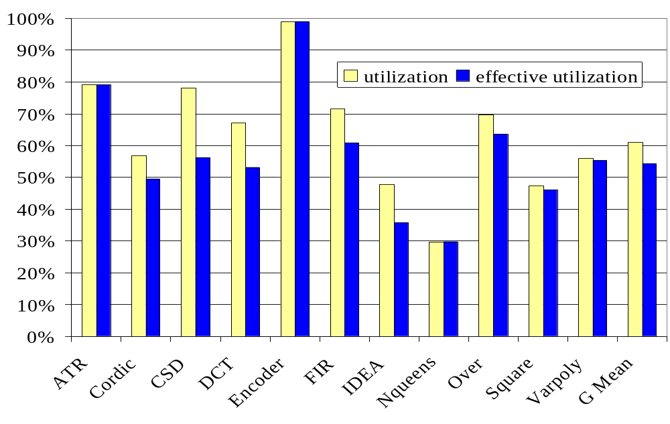
Placed Circuit Utilization

Slide 22
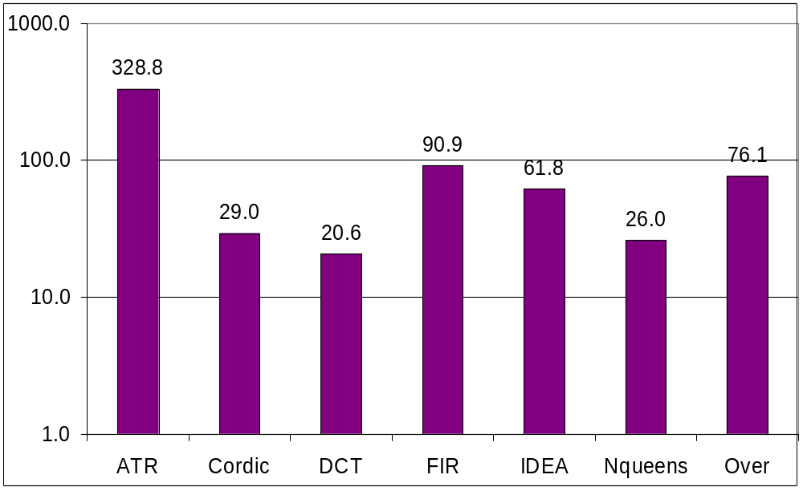
Simulated Speed-up vs. UltraSparc @ 300Mhz

Slide 23
Conclusions
Fast compilation from HLL achievable
(seconds not tens of minutes.)
High-quality output achievable
(60% density)
Linear-time Place and Route feasible using the technique of lazy noops

Slide 24
Future Work
Time-multiplexing the bus
Porting to commercial FPGAs
Front-end from C/Java to DIL

Slide 25
How We Simplify Place and Route
Computation-oriented programs (restricted language, with unidirectional data flow)
Hardware resources virtualized
Relatively rich interconnection network
High granularity placement (I.e. one 32-bit adder instead of 100 gates)
There is a wide pipelined bus available
Timing is very predictable

Slide 26
Our Target Applications
Pipelineable applications
  Stream processing (e.g. DSP, encryption)
  Multimedia processing
  Vector processing
  Limited data dependencies
v9
Input
data
v8
v7
v6
v5
HW
v4
v3
v2
v1
Output
data
Computational power stems from massive parallelism

Slide 27
Mapping Circuits to PipeRench
a
b
c
a
b
c
+
a
b
c
-
+
+
-
-
a
b
c
+
-

Slide 28
Timing and Size Guarantees
24
24
8
8
+
8
8
24
24
+
+
8
8
8
24
8
+
8
24

Slide 29
Optimize for Register Pressure
~
&
&
~
noop
+
+
+
+
+
+
+
Cost: 1 2 1 -- -- 0
noop
Best
position
+

Slide 30
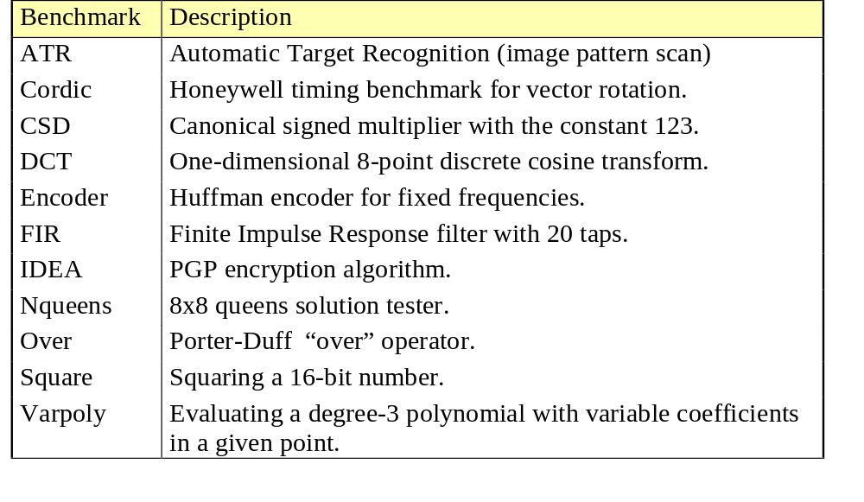
Kernels

